Slide 1
The Ottoman Empire and Europe, 1453-1922 Mediterranean Trade and the Changing Balance of Economic Power, Seventeenth and Eighteenth Centuries
James E. Baldwin Department of History
University of Warwick

Slide 2
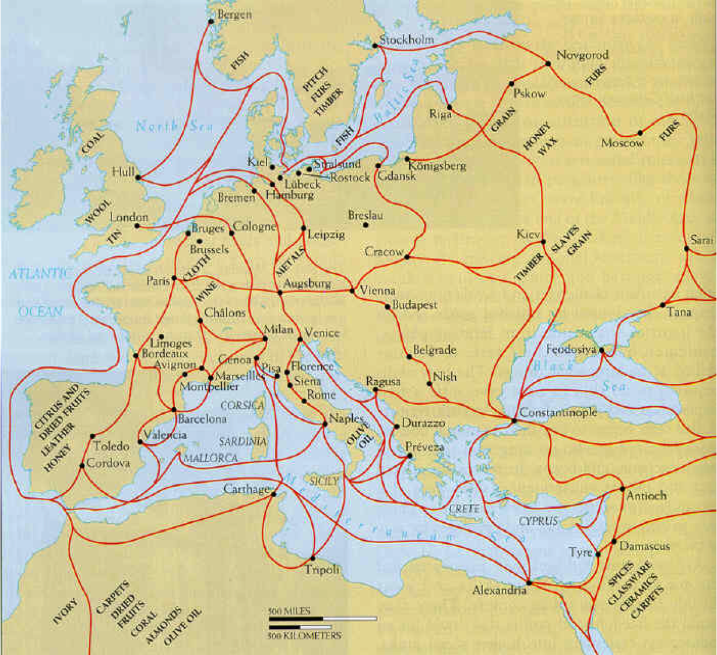

Slide 3
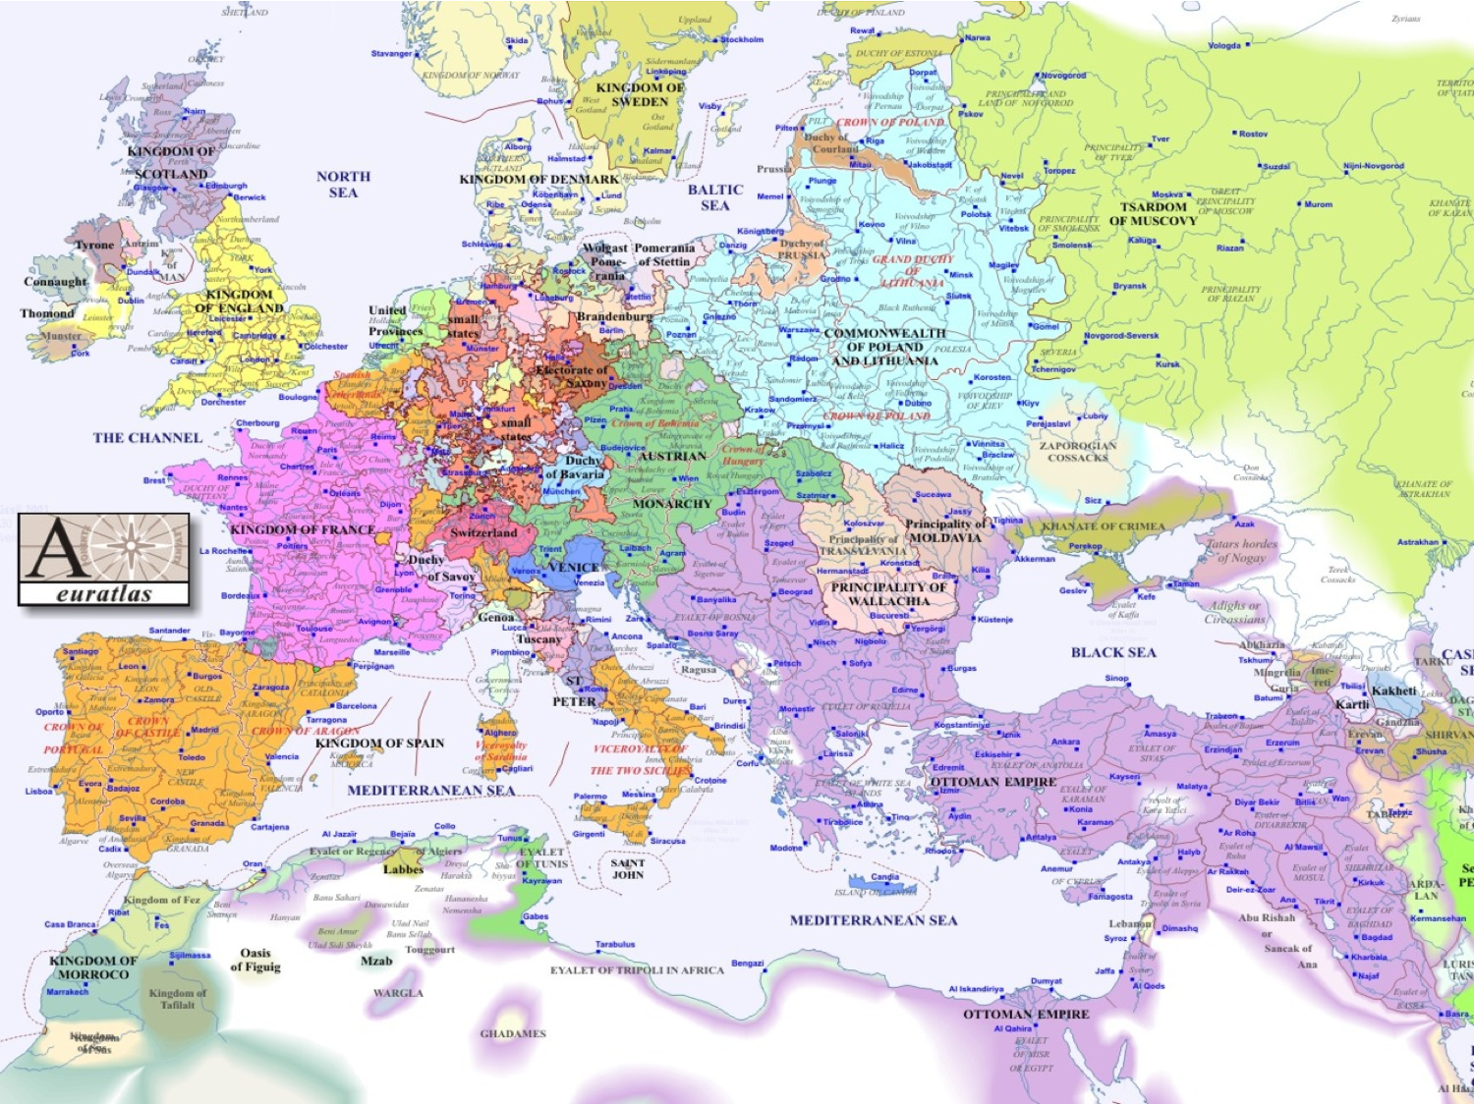

Slide 4
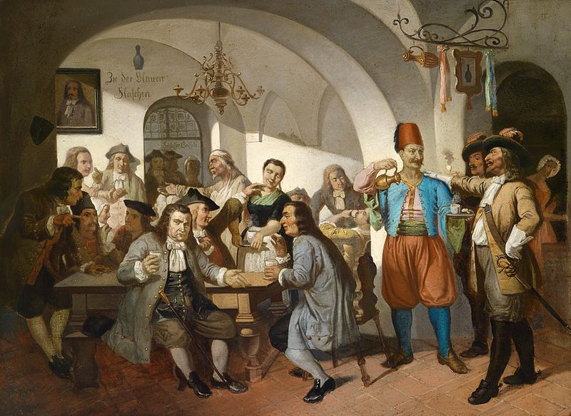

Slide 5
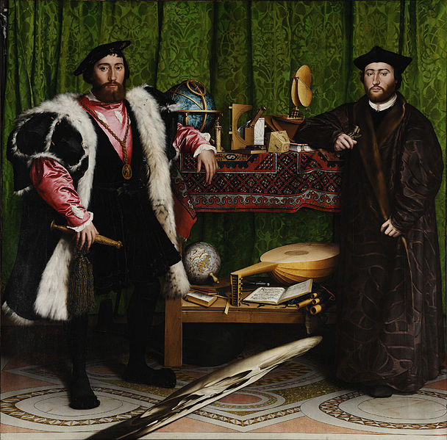

Slide 6


Slide 7
Ottoman-European trade in the sixteenth century
Ottoman exports to Europe:
spices, pepper, coffee, dried fruits, cotton, silk, carpets.
European exports to Ottoman Empire:
paper, tin, cloth.
Western Europe has a negative balance of trade with the Ottoman empire.

Slide 8


Slide 9


Slide 10
Institutional innovation
The Partnership
dissolved upon withdrawal or death of any partner.
incentivizes small, short-term ventures to limit risk.
The Joint-Stock Company
shares can be sold and inherited, so company remains intact when a partner withdraws or dies.
facilitates larger enterprises with indefinite time horizons.

Slide 11
The Levant Company
English joint-stock company formed to trade in the Ottoman Empire.
Formed in 1581, lasted until 1825.
Initially involved 53 merchants; a century later had 200.
Size and longevity allowed it to secure better prices, employ representatives to negotiate better terms, pay for armed protection from pirates and bandits.

Slide 12
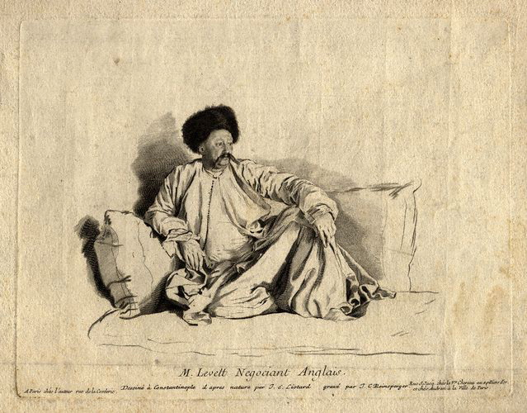

Slide 13
Mercantilism
Government should seek a positive balance of trade.
Grant monopolies to trading companies such as the Levant Company.
Impose tariffs to protect domestic industry from imports.
Encourage exports.

Slide 14
Ottoman economic policy
Preserve tax revenues, even if that meant privileging imports over domestic production.
Secure provisions for Constantinople, which often meant prohibiting exports.
Encouraging imports and discouraging exports was the opposite of the mercantilist approach.

Slide 15
The Capitulations
Legal agreements setting out terms on which Europeans could trade in the Ottoman Empire.
Granted to France, England and the Dutch Republic during the sixteenth and seventeenth centuries.
Intended to encourage trade by improving standards of justice and providing certainty on taxes.
As Ottoman Empire weakened during the eighteenth century, exploited by Europeans to gain immunity from Ottoman taxes and courts.

