Slide 1
The Ottoman Empire and Europe, 1453-1922
Ottoman – European Economic Relations in the Nineteenth Century
James E. Baldwin
Department of History
University of Warwick

Slide 2
The eighteenth century
By late 18th century, west Europeans dominate Mediterranean trade
The effect on the Ottoman economy was limited; most trade was internal or with countries to the empire’s east
The nineteenth century saw massive divergence of economic fortunes between Europe and Asia

Slide 3
Effect of the Industrial Revolution
Global price deflation: 50% fall between 1820 and 1913
This made traditional, non-mechanized manufacturing in the Ottoman Empire uncompetitive
Example of Syrian cloth industry: number of looms falls by 37% in Aleppo and 65% in Damascus between mid 18th century and 1820s; then by a further 80% in both cities between 1820s and 1840s

Slide 4
Effect of Industrial Revolution
Industrialization of western Europe entailed the de-industrialization of Ottoman Empire
Labor redeployed into agriculture, in particular cash crops needed by industrializing western Europe, i.e. cotton
The Ottoman Empire became a peripheral economy in the global capitalist system: supplying raw materials, importing manufactured products

Slide 5


Slide 6
Economic and political weakness
1838 Anglo-Turkish Commercial Convention, and other agreements, prevented Ottomans from raising tariffs
Abolition of Janissaries in 1826 meant abolition of their monopolies on various trades
Ottomans agreed to further liberal, free trade policies because they relied on British support against threats from Russia and Egypt’s Mehmed Ali

Slide 7
Economic and social change
Ottoman economy grew during 19th century; but much more slowly than western Europe, hence the divergence
Nevertheless, many trading cities became much richer: Constantinople, Salonica, Smyrna, Aleppo, Beirut, Cairo, Alexandria
Prosperity unevenly spread: Ottoman Christians increasingly able to receive capitulatory privileges by obtaining European nationality
Economic empowerment of Ottoman Christians caused resentment, and lay behind sectarian violence in Syria in the 1850s and 60s

Slide 8
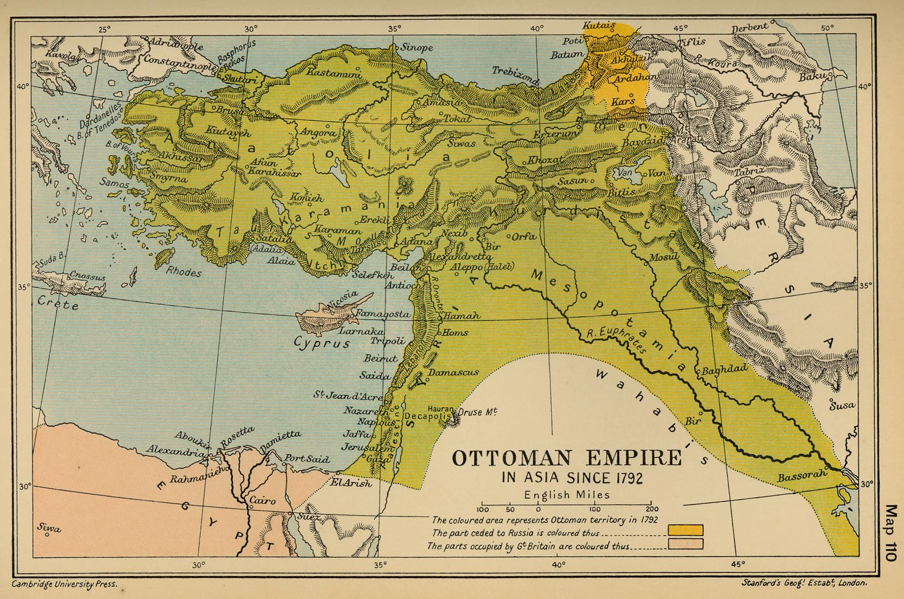

Slide 9
Ottoman borrowing
First bond sold to international investors in 1854 in London to finance Crimean War; later borrowing also largely financed military spending
Bond had a real interest rate of 7.9%; later bonds would have interest rates of up to 12.3%
This was high, but lower than rates obtainable within the empire, due to more advanced financial markets in London
External debt quickly spiraled: by 1875 debt repayment consumed more than half of revenue
Empire declared bankruptcy in 1876

Slide 10
Ottoman Public Debt Administration
Formed in 1881 after negotiations with creditors
Staffed by representatives of creditor nations, the PDA took control of particular revenue sources to ensure prioritization of debt repayment
Imposed austerity on the empire, and entailed foreign intrusion in empire’s internal affairs.

Slide 11
The Egyptian case
Egypt a province of the Ottoman Empire, but has autonomous administration under the khedives descended from Mehmed Ali
Egypt contracts first foreign loan in Paris in 1859
Egyptian borrowing mainly finances investment in infrastructure: railways, bridges, telegraphs, Suez Canal, expansion of cotton and sugar cultivation
Revenues do not increase as quickly as expected, and Egypt also declares bankruptcy in 1876

Slide 12
Consequences of Egypt’s bankruptcy
Caisse de la Dette, with European directors, receives revenues for debt repayment
Commission de la Dette Publique takes over collection of certain revenues
A Briton and a Frenchman appointed Minister of Finance and Minister of Public Works
Nationalist movement led by army officer Ahmad ‘Urabi opposes khedive Tawfiq and foreign interference; violence breaks out in 1882
Britain invades Egypt to restore Tawfiq’s government; occupation lasts until 1954

Slide 13
