Slide 1
The Ottoman Empire and Europe, 1453-1922
Migration and the Cosmopolitan Cities of the Levant
James E. Baldwin
Department of History
University of Warwick

Slide 2
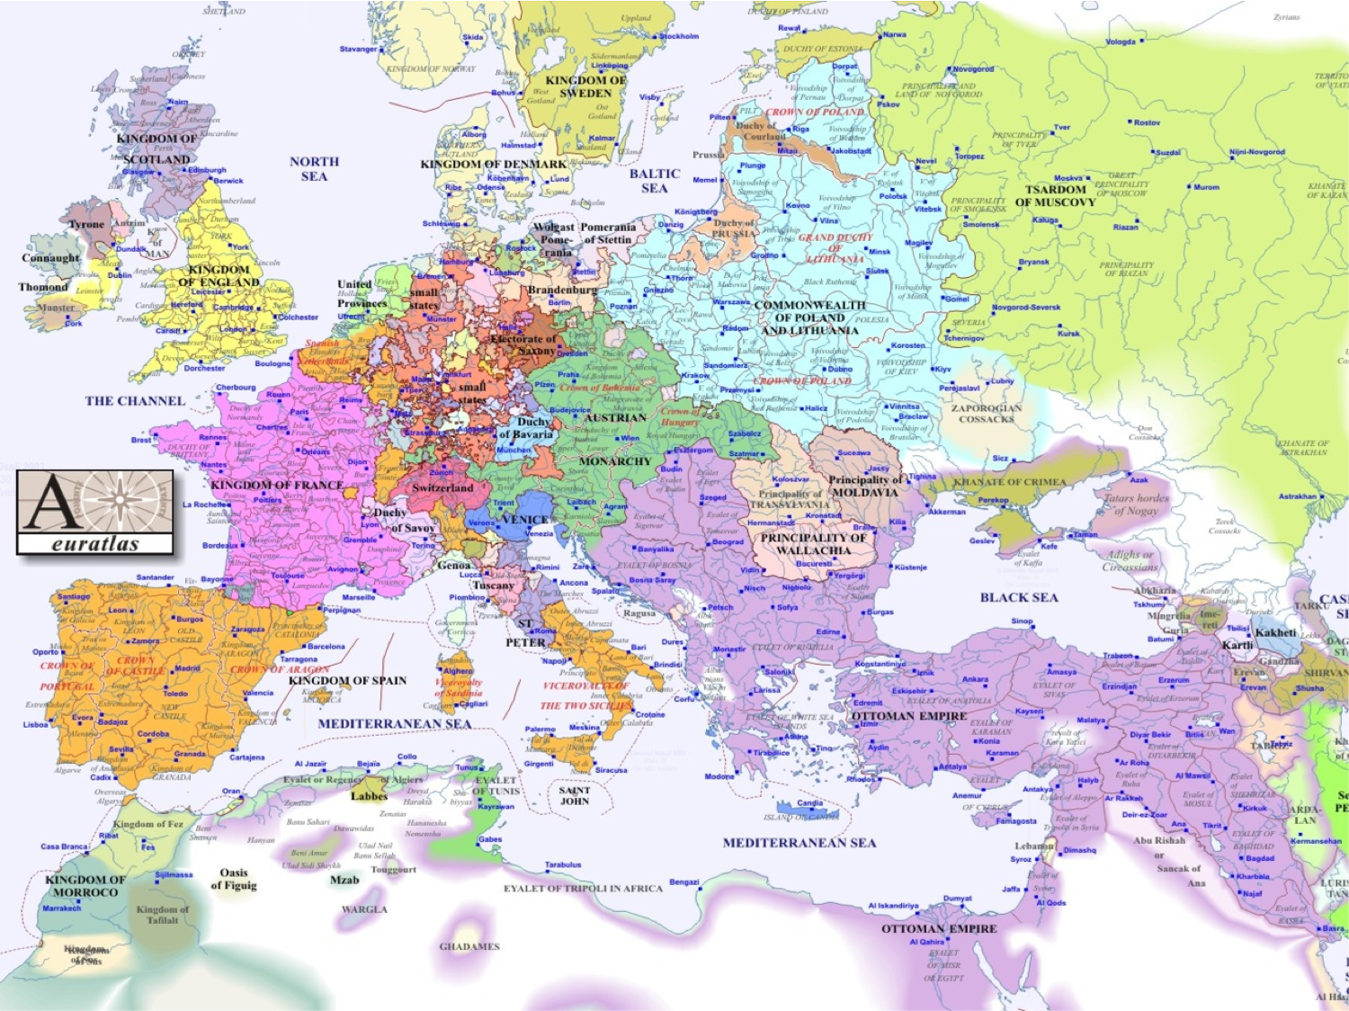

Slide 4
Beneficiaries of the 19th-century boom
Mediterranean port cities experienced rapid growth due to the growth of Ottoman-European commerce
Cities including Salonica, Smyrna, Alexandria, Beirut and others saw population growth, immigration from elsewhere in the empire and from Europe, and infrastructural development

Slide 5
Salonica
A diverse city for a long time prior to the 19th century – Greeks, Bulgarians, Turks and a centre of Sephardic Jewish life in the empire
Principal port of the Balkans, exporting local goods such as cotton and tobacco
Rapid growth of European community, from 100 in 1768 to 10,000 at end of 19th century
The Cercle de Salonique, an emblem of elite inter-communal sociability
Greek-Turkish population exchange saw Muslims leave in 1920s
Most Salonican Jews were murdered in the Holocaust

Slide 6
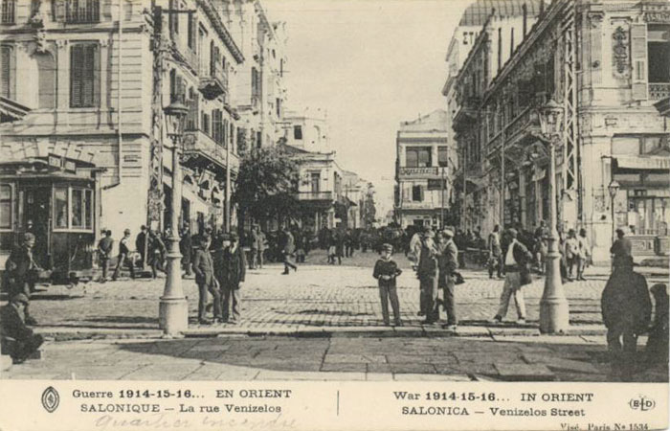

Slide 7
Smyrna / Izmir
Principal port for Ottoman-European trade since the 17th century
Exported Anatolian agricultural products, imported European textiles
At end of 19th century, two largest groups were Turks and Greeks, with substantial communities of Armenians, Jews and foreign nationals
Inter-communal violence rare in Smyrna during the 19th century
Turkish War of Independence saw massacres and forced expulsion of local Greeks and Armenians; Greek quarter burned down; remaining Greeks expelled in the population exchange

Slide 8
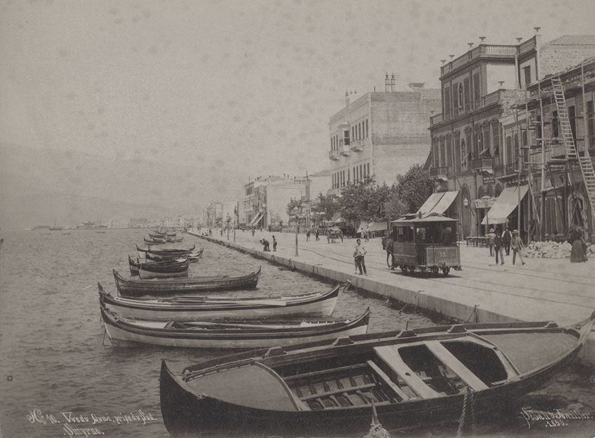

Slide 9
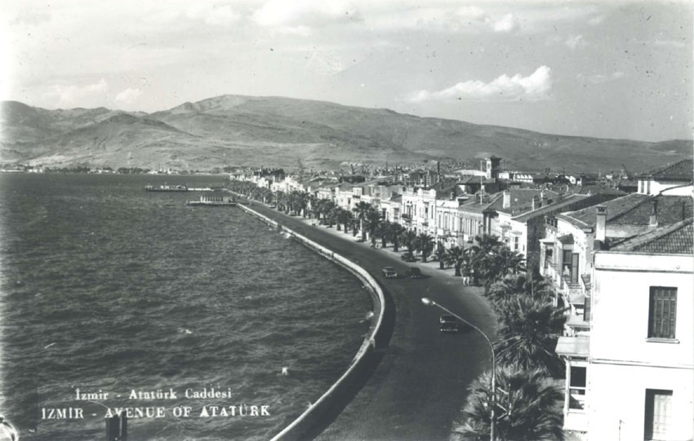

Slide 10
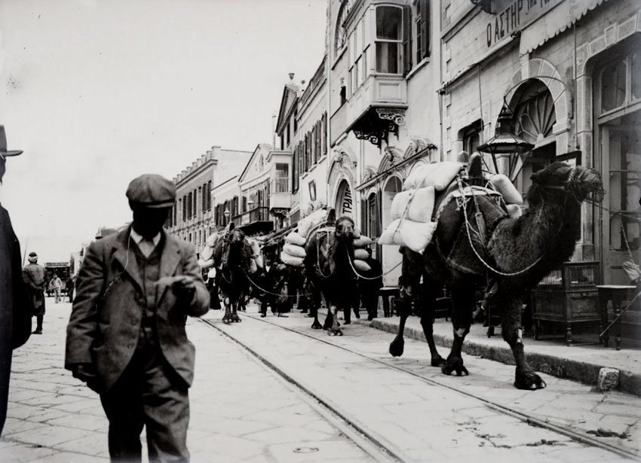

Slide 11
Alexandria
Ancient city fallen into obscurity by 1800
Revitalized by Mahmudiyya canal to the Nile
Substantial foreign and Ottoman migration to Alexandria during 19th century – Greeks, Sephardi Jews, Italians, French, British
Occupied by Britain after 1882
Municipal Council enforced dominance of multicultural merchant elite
Most foreign and minority communities left after Nasser’s nationalization program of the 1950s

Slide 12
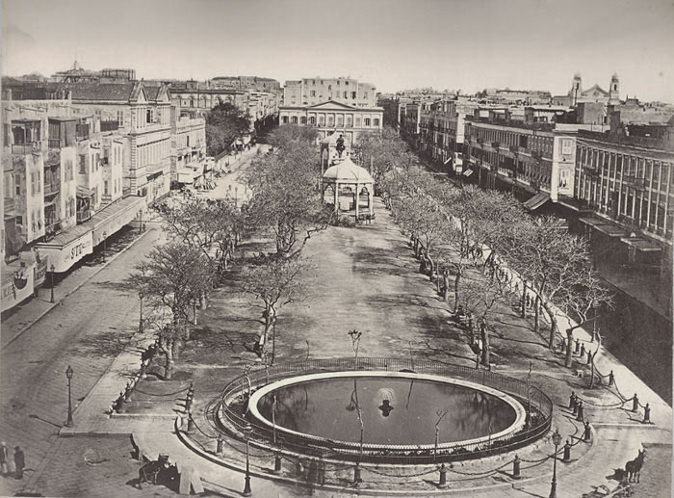

Slide 13
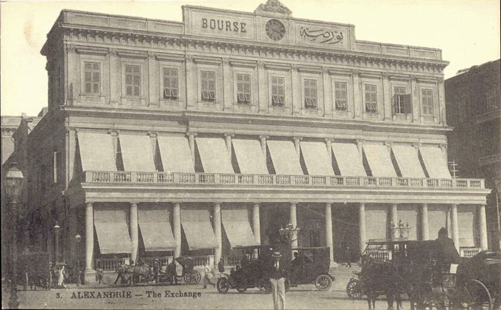

Slide 14
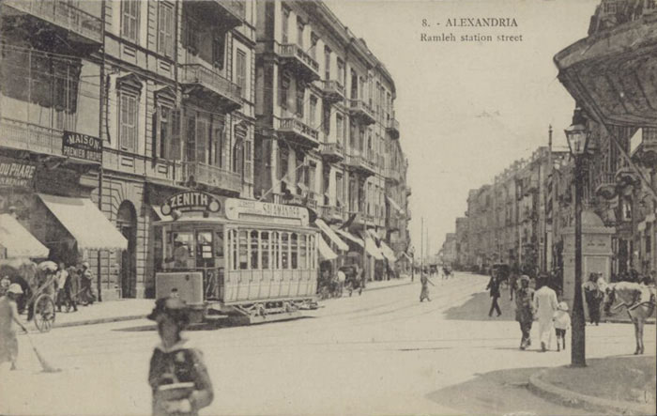

Slide 15
Cosmopolitan Culture
Multi-lingual: Greek, Turkish, Arabic, Armenian, Maltese, Italian. French increasingly becomes the lingua franca of the elite.
Publishing: newspapers flourish, in French and local languages
Education: European-style schools educate an increasing number of the elite of all faiths. Ottoman educational reformers begin to imitate them.
Port cities conduits for the Europeanization of Ottoman elite culture.

Slide 16
Social relations
Residential segregation: foreigners and the wealthy concentrated in new districts with better housing and facilities
Vast inequality of wealth leading to resentment
Beratlis: local Christians and Jews receiving privileges of foreign nationals
Political tensions related to nationalism
Inequality and Europeanization caused tension within as well as between communities.

