Slide 1
The Ottoman Empire and Europe, 1453-1922 Nationalism in the Ottoman Balkans
James E. Baldwin
Department of History
University of Warwick

Slide 2
What is nationalism?
The nation-state
A sovereign state with a relatively homogenous citizenry
Common language, symbols, institutions, history
Often, but not always, a common religion/denomination
The nation-state is the standard form of state organization today
Nationalism is a recent phenomenon – emerging in the early modern period, becoming ubiquitous in the 19th and 20th centuries

Slide 3
The Ottoman Empire
Cosmopolitan, multi-ethnic, multi-lingual, multi-confessional
Ethnic/linguistic identity secondary to religion, status and locality
Multi-lingualism and translation the norm
Other similar early modern empires: Habsburg monarchy, Russia, Persia, Mughal India, China

Slide 4
Why nationalism?
Nationalists assume the nation to be a primordial, essential quality
Benedict Anderson, Imagined Communities
Anderson’s theory: nationalism the product of capitalist print culture and the resulting homogenization of language
Print capitalism standardized dominant languages and squeezed out minority languages
Print media increased people’s awareness of other similar people in different regions
State policies enforced national identity by favoring the dominant language

Slide 5
Nationalism and the Orthodox Church
Orthodox Church also a cosmopolitan, multi-ethnic institution
Greek the language of liturgy and church government
Orthodox Christians spoke Greek, Serbian, Bulgarian, Romanian, Albanian, Arabic
Upper echelons of clergy were either native Greeks or Hellenized
Slavic nationalists resented Greek domination of church
Greek nationalists quarreled with the Church’s conception of Greek identity

Slide 6
The Greek revolt
In early 19th century, Greek nationalist a fringe movement associated with intellectuals and exiles
Philiki Etairia (Friendly Society) – a secret society promoting Greek separatism
Launched invasion in 1820 led by General Ypsilantis, a Phanariot in Russian service
Invasion failed, but provoked uprising among Greeks in the Peloponnese
Uprising supported by Philhellenes in western Europe; some joined as volunteers, including the poet Byron
European powers intervene militarily and diplomatically; independence of small Greek state conceded

Slide 7
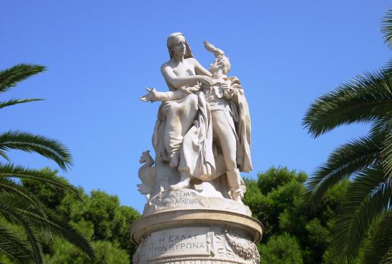

Slide 8
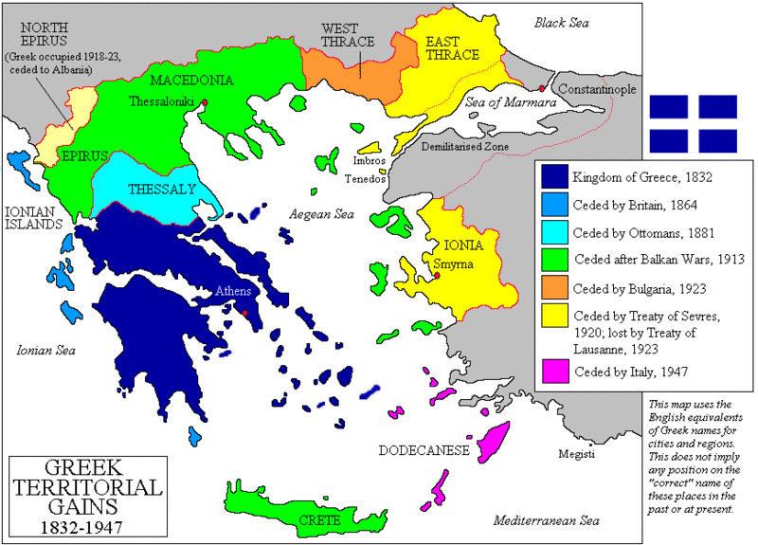

Slide 9
Bulgarian National Awakening
Initially a cultural movement focused on education: schools and “reading rooms”
Directed primarily against Hellenization
Sought independent Bulgarian church; secured in 1870 with Ottoman Sultan’s backing, but not recognized by Patriarch
April Uprising of 1876: a small uprising brutally suppressed by Ottoman irregulars, including massacres in Plovdiv region
Suppression increases sympathy for nationalist cause among Bulgarians and European powers
Russia attempts to impose large independent Bulgarian state in 1878 Treaty of San Stefano
Britain and Austria fear Russian influence in Balkans and water down the proposal in the Treaty of Berlin; result is smaller autonomous Bulgarian principality with vassal status, and restrictions on Ottoman activity in Eastern Rumelia provinces

Slide 10
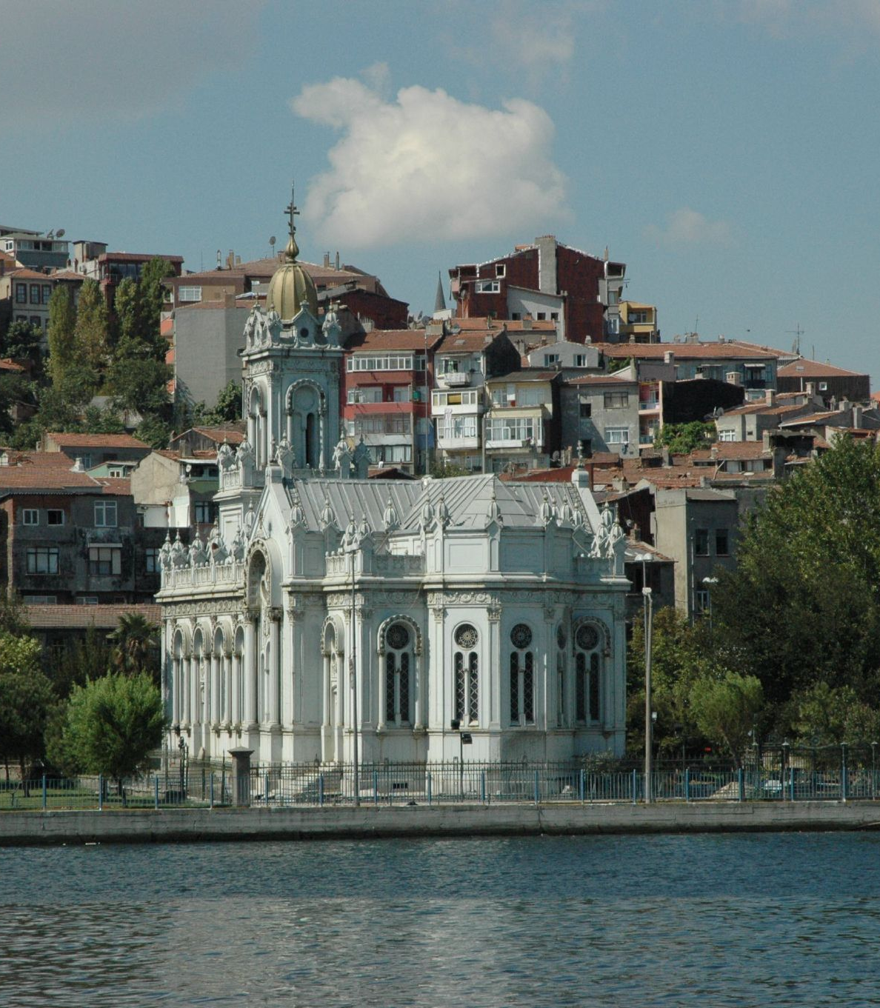
Church of St. Stephen of
the Bulgars, Istanbul

Slide 11
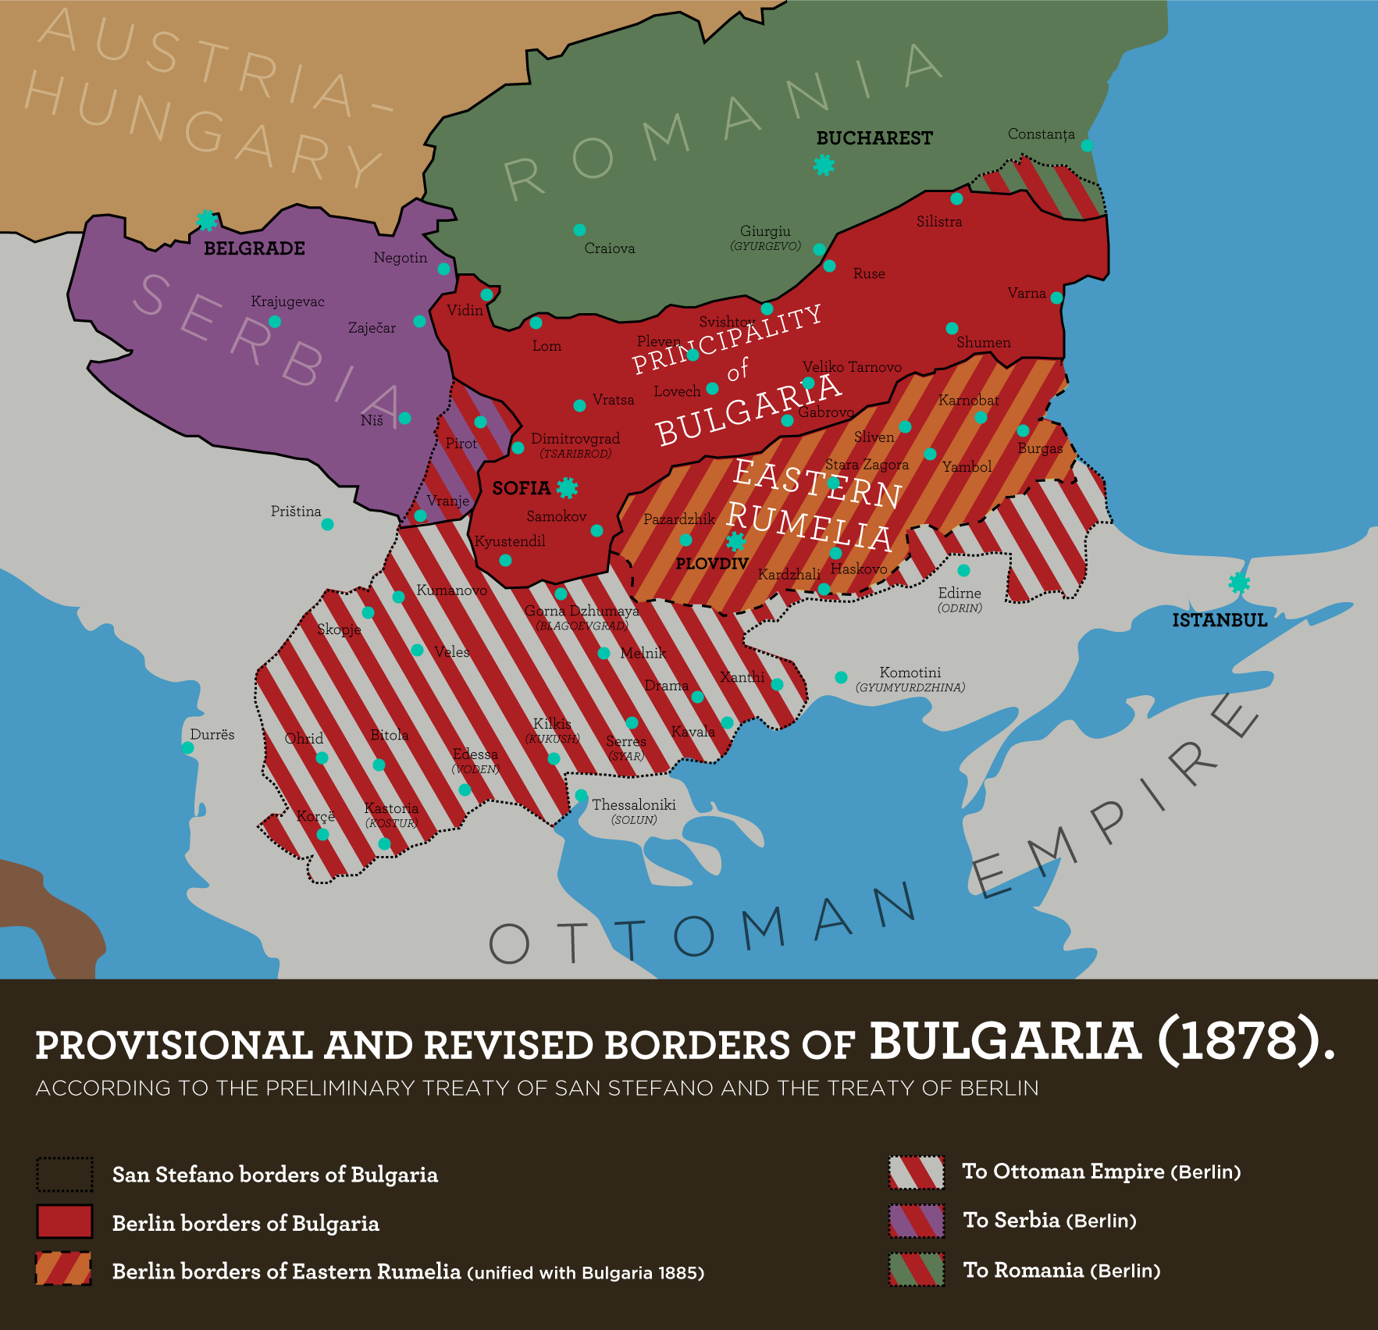

Slide 12
