Slide 1
The Ottoman Empire and Europe, 1453-1922
Loyalism among Ottoman
Non-Muslims
James E. Baldwin
Department of History
University of Warwick

Slide 2
Ottomanism: a positive response to nationalism
An attempt to redefine Ottoman subjecthood to appeal to Muslims, Christians and Jews of all ethnicities.
Ottomanism (Osmanlılık): a national identity that would encompass all inhabitants of the empire as Ottomans.
Note the contrast with the former, narrow meaning of Ottoman / Osmanlı.

Slide 3
Attributes of Ottoman identity
Loyalty to the Sultan and the empire.
Turkish as the unifying, though not the only, language.
Diversity and tolerance as key characteristics.
Accompanied by institutional reforms of the Tanzimat: integrated education with secular curriculum, non-Muslims in the armed forces.
Ottoman Nationality Law of 1869 defined Ottoman citizenship, and did not connect it with religion.

Slide 4
Privileged non-Muslims in the old regime
Many non-Muslims had a vested interest in the old regime.
Although most top positions reserved for Muslims, the old regime included numerous niches in which particular non-Muslim groups could achieve wealth and power.
Two examples: Phanariots and Jewish bankers.

Slide 5
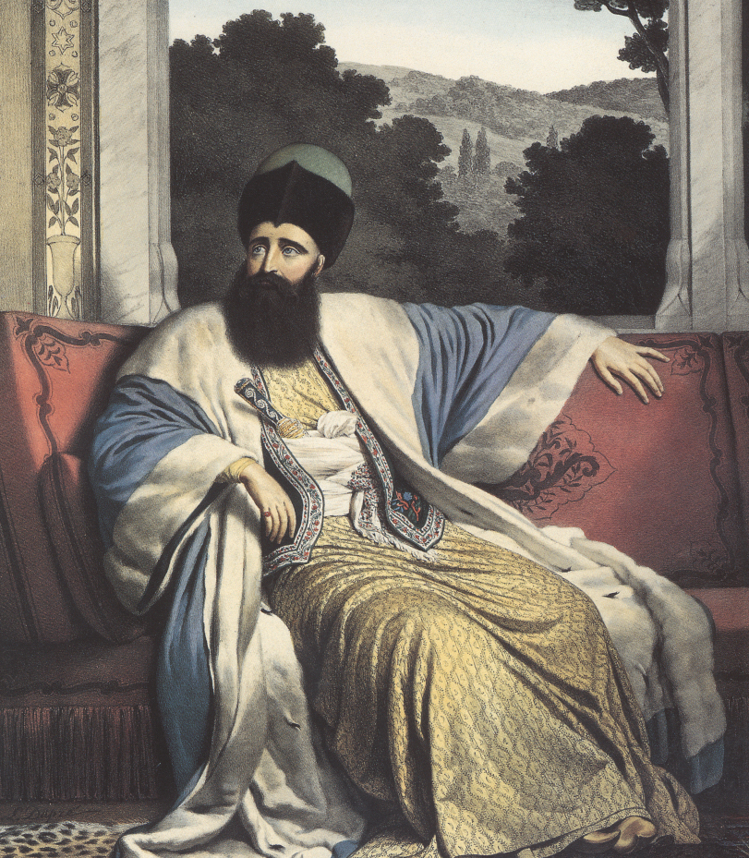
Mikhail Soutsos

Slide 6
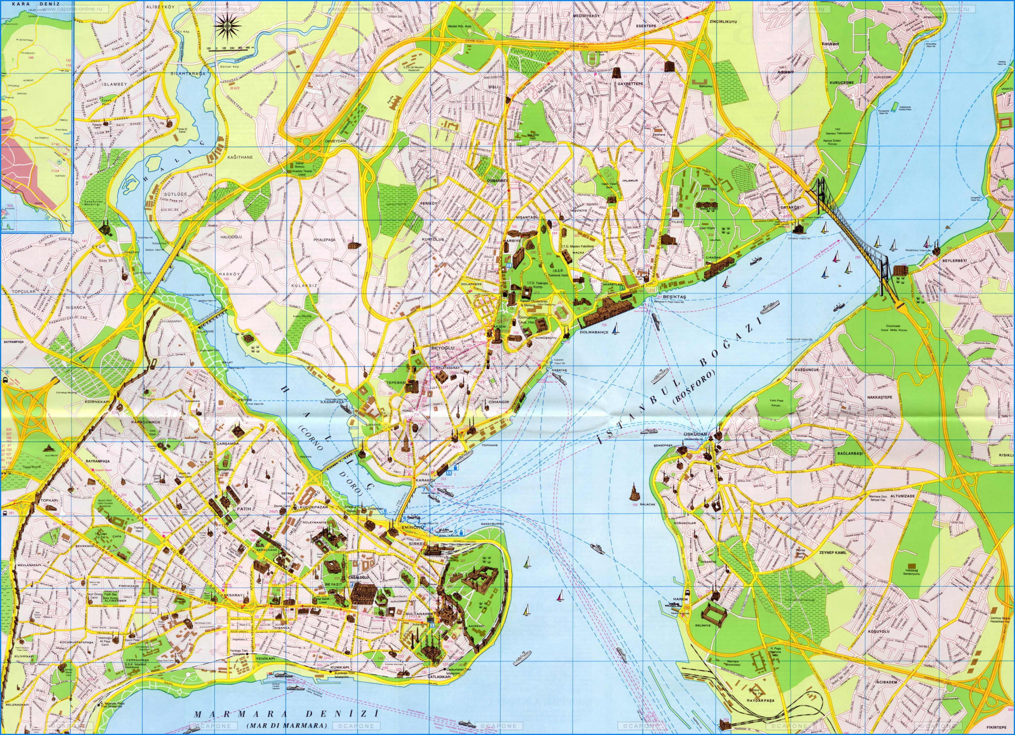

Slide 7
The Phanariots
Elite of Greeks and Hellenized Romanians and Albanians, residing in Phanar district of Constantinople (Fener).
Rise to prominence in diplomatic service in 18th century.
Serve as princes of Wallachia and Moldavia, north of the Danube, and as governors of Greek islands.

Slide 8
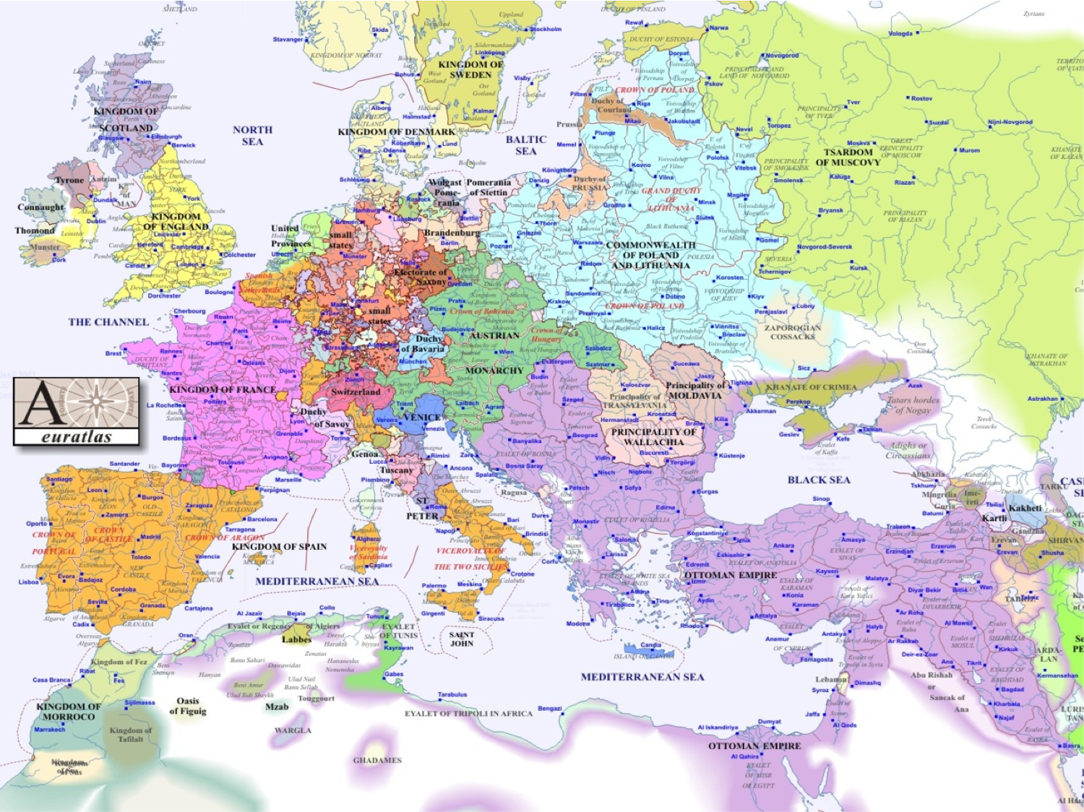

Slide 9
The Phanariots
Links with Greek/Hellenized communities across eastern Mediterranean in Venetian and Ottoman territory.
Links with Greek diaspora as far west as London.
Exposed to European cultural and intellectual developments.
Many spoke Italian as well as Turkish and Greek; in 19th century many learned French.

Slide 10
Sephardi Jews
Some Jews benefitted from association with financial administration in old regime, but this was ended by abolition of Janissaries.
Jews looked to Ottomanism to build a role for themselves in the reformed empire.

Slide 11
Jewish Ottomanism
Learning Turkish
Serving in the Ottoman army
Jews and Ottoman government had common enemy in Russia
Nationalist history of Ottoman Empire as the Jews’ refuge; commemorated 400th anniversary of expulsion from Spain in 1892.
Zionism posed a challenge, but some Ottoman Jews hoped to Ottomanize the movement.

