Slide 1
The Ottoman Empire and Europe, 1453-1922 Reform in the Nineteenth-Century Ottoman Empire
James E. Baldwin
Department of History
University of Warwick

Slide 2
An Age of Reform
Tanzimat: lit. “putting in order,” generally refers to political reforms undertaken between 1839 and 1878
Longer process of reform began under Selim III in late 18th century and continued after 1878 under Abdulhamid II
Parallel process of reforms undertaken in Egypt by Mehmed Ali and his successors

Slide 3
What was reformed?
Political reform: in some ways liberalizing, but with the ultimate objective of centralizing power
Fiscal reform: to increase revenues
Military reform: to face external enemies such as Russia and internal threats
Educational reform: to train bureaucrats to staff new administrative institutions
Legal reform: to handle new concepts of subjecthood and to effect centralization of power
Medical reform: to ensure a healthier and therefore more productive population

Slide 4
Why reform?
Military weakness in late eighteenth century: losses in Russo-Turkish wars of 1768-74 and 1787-92, French occupation of Egypt in 1798
Internal threat of separatist nationalism: autonomy of Serbia in 1815 and independence of Greece in 1830
Military reform at core of reform project; fiscal reform and political reform closely related

Slide 5
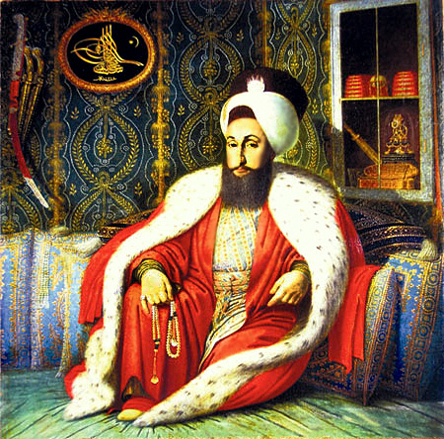
Selim III

Slide 6
Selim III and the Nizam-i Cedid
Selim III becomes Sultan in 1789, midway through Russo-Turkish War of 1787-92.
Selim’s attempt to introduce new hierarchy and regular drill to Janissaries meets with resistance
New army – the Nizam-i Cedid – introduced to operate in parallel to Janissaries
Nizam-i Cedid incorporated innovations of the European military revolution: full-time soldiers with hierarchy, daily roll call and drill, subject to strict discipline

Slide 7
Results of Selim III’s reforms
Nizam-i Cedid partial success: expensive, difficult to recruit despite high salaries, but performed well
Janissaries continue to resist reform, deposing and assassinating Selim III in 1807
Sultan Mahmud II abolishes Janissaries in the Auspicious Incident of 15 June 1826; thousands of Janissaries in Istanbul killed
Mahmud II founds new regiment, the Asakir-i Mansure-yi Muhammadiyye

Slide 8
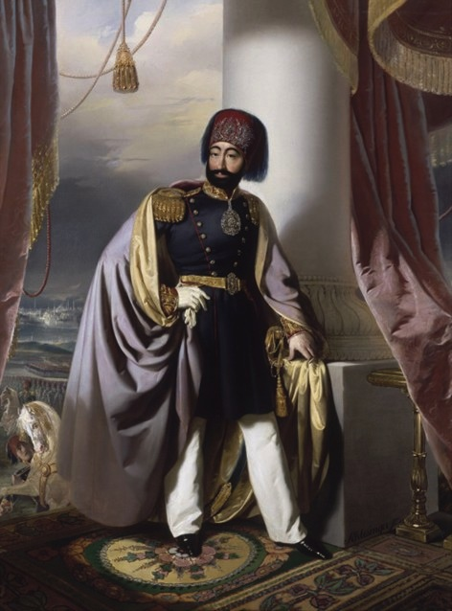
Mahmud II

Slide 9
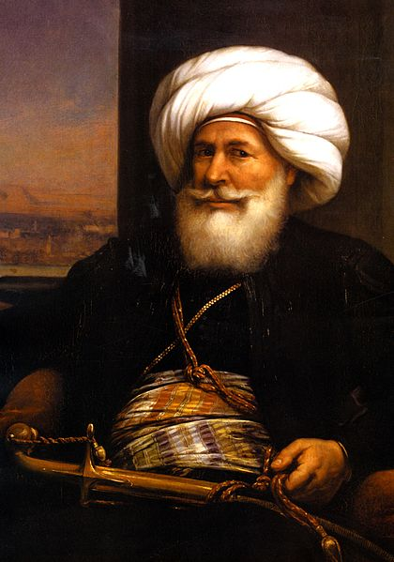
Mehmed Ali

Slide 10
Egyptian Military Reform
After expulsion of French, Mehmed Ali builds new army modeled on both French army and Selim’s Nizam-i Cedid
Also faced fierce resistance from entrenched interests. Mehmed Ali responds with the Massacre of the Mamluks on 1 March 1811
Early attempts to enslave Sudanese soldiers replaced by conscription of Egyptian peasantry in 1820s
Mehmed Ali’s army very successful, assisting Ottomans in Arabia and Greece, challenging them in Syria and Anatolia

Slide 11
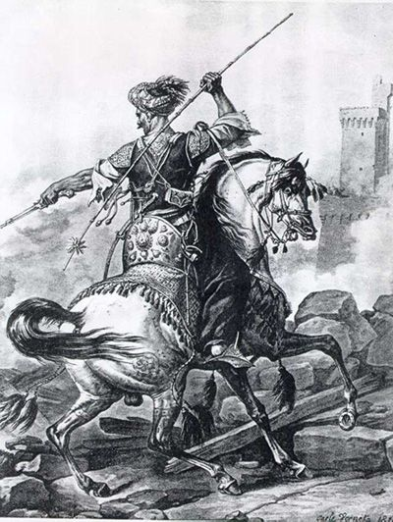
A Mamluk cavalier

Slide 12
Egyptian Military Reform
After expulsion of French, Mehmed Ali builds new army modeled on both French army and Selim’s Nizam-i Cedid
Also faced fierce resistance from entrenched interests. Mehmed Ali responds with the Massacre of the Mamluks on 1 March 1811
Early attempts to enslave Sudanese soldiers replaced by conscription of Egyptian peasantry in 1820s
Mehmed Ali’s army very successful, assisting Ottomans in Arabia and Greece, challenging them in Syria and Anatolia

Slide 13
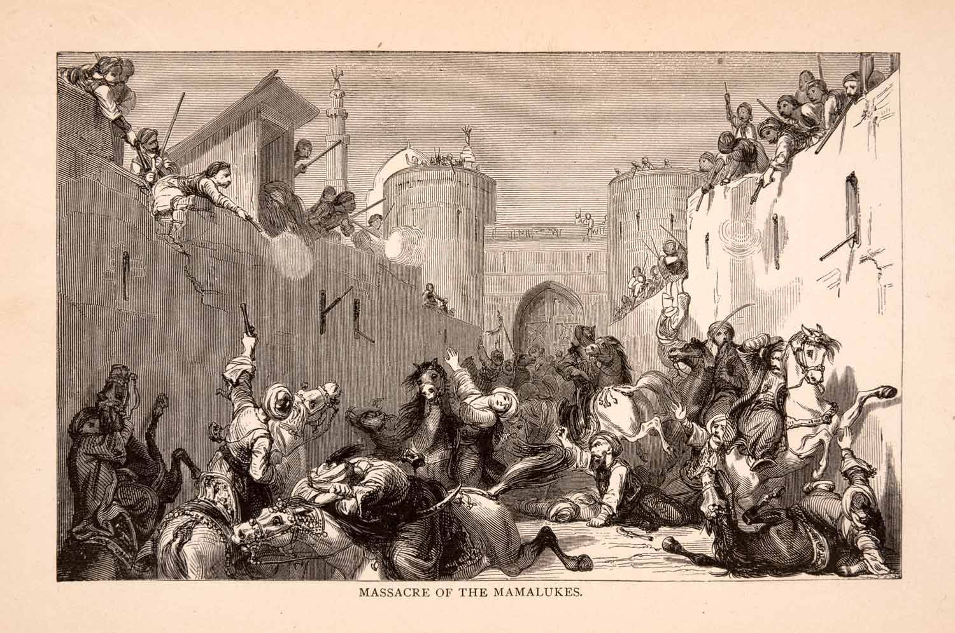
Massacre of the Mamluks, 1811

Slide 14
Egyptian Military Reform
After expulsion of French, Mehmed Ali builds new army modeled on both French army and Selim’s Nizam-i Cedid
Also faced fierce resistance from entrenched interests. Mehmed Ali responds with the Massacre of the Mamluks on 1 March 1811
Early attempts to enslave Sudanese soldiers replaced by conscription of Egyptian peasantry in 1820s
Mehmed Ali’s army very successful, assisting Ottomans in Arabia and Greece, challenging them in Syria and Anatolia

Slide 15
Political reform
Major documents of Tanzimat: Hatt-i Şerif of Gülhane (1839), Islahat Fermanı (1856), Ottoman Constitution (1876)
Tanzimat reformers sought to conform to European norms and to appease Christian subjects
Equal status for Muslims, Christians and Jews
Fostered national identity as “Ottomans”

Slide 16
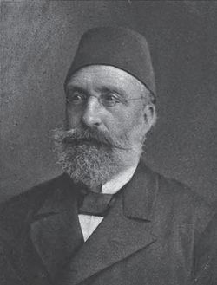
Midhat Pasha

Slide 17
Ottoman Constitution of 1876
Introduced by the Young Ottomans and Midhat Pasha, against opposition from Sultan Abdulhamid II
Essentially autocratic constitution: Sultan invested with full executive power, ministers responsible to him
Check on Sultan’s power provided by bicameral parliament: lower chamber indirectly elected, upper chamber appointed
Abdulhamid II suspends constitution and dissolves Parliament in 1878

Slide 18
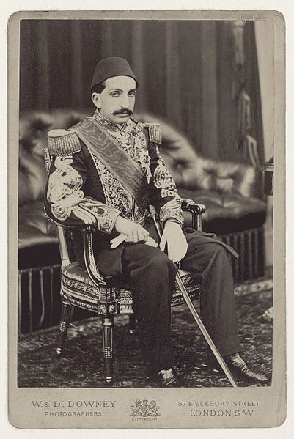
Abdulhamid II

Slide 19
Abdulhamid the reformist
Mecelle-yi Ahkam-i ‘Aliyye: code of sharīʿa law introduced in 1877, that represents assertion of government’s control of sharīʿa.
Traditionally, sharīʿa law’s authority came from transnational community of jurists who interpreted Koran and hadith.
Mecelle was authoritative, within the empire, because the government made it so.
Educational reforms continued under Abdulhamid: reformed schools to produce staff for new courts and new bureaucracy.

