Slide 1
The Ottoman Empire and Europe, 1453-1922 European Intervention in the Ottoman Empire: Lebanon and Bulgaria
James E. Baldwin
Department of History
University of Warwick

Slide 2
Humanitarian intervention in the Ottoman Empire
19th-century Ottoman Empire saw much violence due to nationalist uprisings and emergence of sectarianism
European powers claimed a moral duty to intervene when Christians suffered violence
Humanitarian intervention was also a means for European powers to extend their influence over Ottoman territory; particularly important as colonial conquest was forbidden by European agreement
Humanitarian and imperial motives were inextricably interlinked

Slide 3
The Concert of Europe
Formed in 1815 after Napoleonic Wars, consisted of Britain, France, Prussia, Austria and Russia.
Loose arrangement that agreed basic principles for international diplomacy; little formal institutional structure

Slide 4
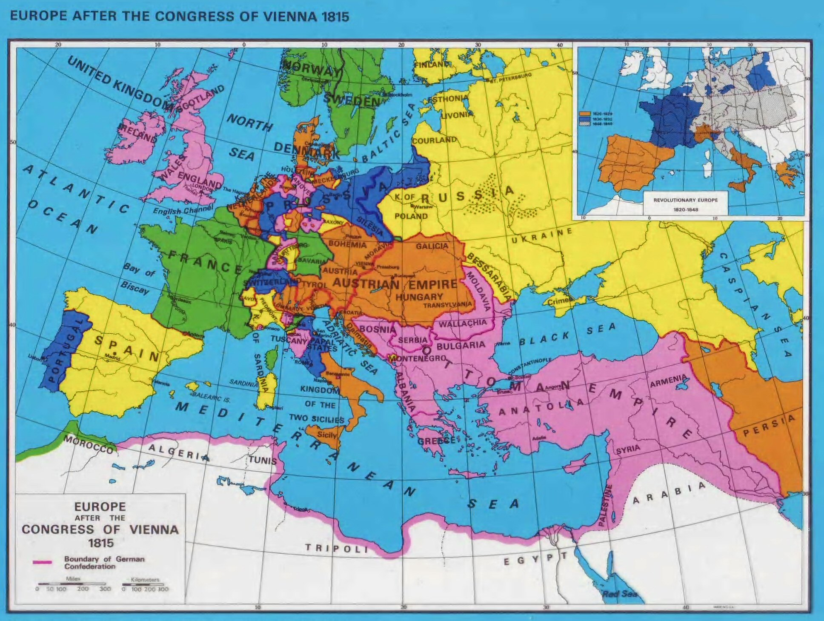

Slide 5
The Concert of Europe
Formed in 1815 after Napoleonic Wars, consisted of Britain, France, Prussia, Austria and Russia.
Loose arrangement that agreed basic principles for international diplomacy; little formal institutional structure

Slide 6
Rules of the Concert of Europe
Only the five great powers should decide great European questions
No power should wage for for territorial gain within Europe, nor foment unrest in another European state
No international question of vital interest to a great power should be raised without its consent
No power should refuse an international conference to resolve a question, nor should any power be excluded
Direct confrontations between the great powers should be avoided by referring disputes to the Concert
Decisions should be unanimous

Slide 7
Legal theory of humanitarian intervention
Humanitarian intervention in tension with sovereignty
Non-intervention in the affairs of another state was the rule within Europe
Legal scholars drew a distinction between civilized and uncivilized states; only the former were held to have sovereignty
The Ottoman Empire typically categorized as uncivilized, on the basis of despotism, Islam, polygamy, slavery, lack of aristocracy, mistreatment of Christians
As they lacked sovereignty, intervention in uncivilized states was in principle permissible, but must be justified by a humanitarian crisis

Slide 8
Lebanon in 1860
Mount Lebanon: the mountainous interior between Beirut and Damascus
Heterogeneous population: biggest communities Maronites (uniate Christians) and Druze (offshoot of Shiite Islam)
Dominated by wealthy Maronite and Druze landowning clans; relatively autonomous from Ottoman control
Before to mid-19th century, Lebanese politics revolved around clan and village rather than sectarian identity

Slide 9
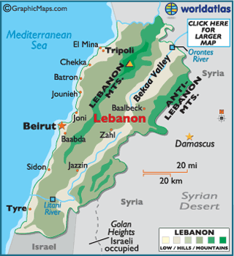

Slide 10
Lebanon in 1860
Mount Lebanon: the mountainous interior between Beirut and Damascus
Heterogeneous population: biggest communities Maronites (uniate Christians) and Druze (offshoot of Shiite Islam)
Dominated by wealthy Maronite and Druze landowning clans; relatively autonomous from Ottoman control
Before to mid-19th century, Lebanese politics revolved around clan and village rather than sectarian identity

Slide 11
Factors leading to sectarian tension in Lebanon and Syria
From 1831-40, region occupied by Egyptian military; Egyptian occupation used divide-and-rule tactics and encouraged European immigration and investment
Restoration of Ottoman rule, with European control, divided Mount Lebanon into Maronite-controlled north and Druze-controlled south, introducing the sectarian principle into Lebanese politics

Slide 12
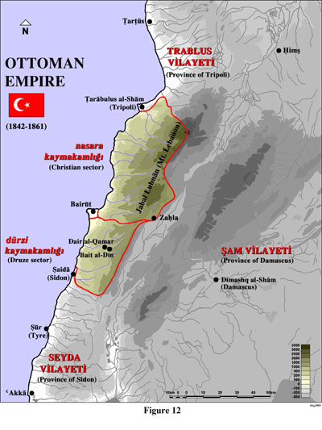

Slide 13
Factors leading to sectarian tension in Lebanon and Syria
Ottoman Land Code of 1858: allowed Europeans and their proteges to own land, which they often bought from cash-poor Muslim landlords
Tanzimat’s grant of formal equality to Muslims and non-Muslims, in combination with rising wealth of Christians, caused Muslim resentment at loss of privilege
Peasant revolt led by Maronite Tanyus Shahin in 1858: initially targeted landlords regardless of religion, but as revolt took hold in the Druze-dominated south, it took on a sectarian dimension

Slide 14
Sectarian violence of 1860
Waves of sectarian violence swept Mount Lebanon in May 1860: villages burned, Maronites and Druzes killed, monasteries besieged and destroyed
On July 9-11, violence spread to Damascus when Druze militias attacked the Christian quarter
Thousands of Christians, including some Europeans, killed in Damascus
Ottoman authorities did not support violence but were overwhelmed and failed initially to control it
Ottoman government sent a military detachment led by Fuad Pasha; he landed in Beirut on July 17 and managed to restore order

Slide 15
European response
Britain and France agreed on the need to protect Christians, but wary of each other’s motives
Conference convened in Paris
European military force, led by France, sent for six-month mission to pacify Syria
European navies patrolled Syrian coast
Despite French desire to undertake a more aggressive action against the Druze, the European force ended up playing a largely humanitarian role: reconstructing the country and supporting refugees

Slide 16
Political intervention
Conference in Constantinople agreed a new administrative structure for Lebanon in document called the Reglement et protocole relatifs a la Reorganisation du Mont Liban
Governor of Lebanon to be a non-Maronite Christian from outside Lebanon
Elected Administrative Council had fixed numbers of Christian, Muslim and Druze representatives
Limited police force (7 police per 1000 people) under governor’s control had right to disarm population
Reglement successful in preserving stability in Lebanon; however further entrenched the sectarian principle in Lebanese politics

Slide 17
Bulgarian Atrocities of 1876
Minor insurgency by Bulgarian nationalists met with violent overreaction by the Ottomans
Ottoman irregular forces massacred Christians in the region of Plovdiv
Massacres received sensational and partisan press coverage in Europe

Slide 18
European debates over intervention
Conservative government in Britain not inclined to intervene due to alliance with Ottomans and fear of Russian expansion
Sought to manage public opinion by censoring official reports and presenting massacres as part of communal conflict that was outside the Ottoman government’s control
Liberal opposition led by Gladstone saw opportunity to harass Disraeli and presented the moral case for humanitarian intervention

Slide 19
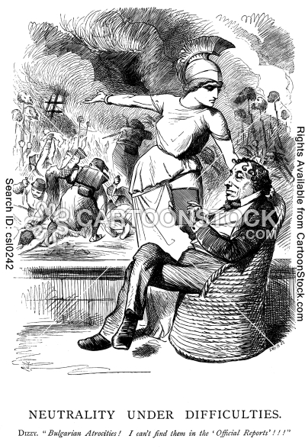

Slide 20
European debates over intervention
Conference failed to achieve agreement on intervention due to mistrust between Britain and Russia
In the absence of agreed international intervention, Russia declared war on the Ottoman Empire in 1877 and won swiftly
Treaty of San Stefano awarded large independent state to Bulgarians

Slide 21
Post-war European political intervention
Other European powers determined to limit Russia’s gains from war: feared that independent Bulgaria would be a vehicle for Russian influence
Treaty of Berlin overturned Treaty of San Stefano, dramatically reducing size of autonomous Bulgarian state
Treaty of Berlin imposes conditions on Ottoman rule in Eastern Rumelia province

Slide 22
