Slide 1
The Ottoman Empire and Europe, 1453-1922 War, Ethnic Cleansing and the Collapse of the Empire
James E. Baldwin
Department of History
University of Warwick

Slide 2
The outcome of the decade of war, 1912-22
Greece and Bulgaria enlarged at Ottoman expense
Ottoman Empire defeated by Allied Powers
Syria, Lebanon, Palestine and Iraq under European rule
Turkish nationalists abolished Ottoman Sultanate and proclaimed a Republic
Christians removed from Anatolia and Muslims removed from Balkans through ethnic cleansing, massacre and a League of Nations-sponsored “population exchange”

Slide 3
The wars of 1912-22
First Balkan War, 1912-13: Greece, Bulgaria, Serbia and Montenegro attack Ottoman Empire
Second Balkan War, 1913: Ottomans join Greece, Serbia and Romania in attacking Bulgaria
First World War, 1914-18: Ottomans ally with Germany and so join Central Powers
Turkish War of Independence, 1919-22: Turkish national movement, which rejects the authority of the Ottoman government, fights separate wars with Greece, Armenia and France

Slide 4
First Balkan War, 1912-13
Ottoman military weakness revealed by failure to resist Italian invasion of Tripoli
Greece, Bulgaria and Serbia overcome mutual hostility to launch joint attack on Ottoman Empire
Ottomans quickly lose almost all territory in Europe; Bulgarians come within 37 miles of Constantinople
Under Treaty of London, Ottomans cede almost all European territory and Crete

Slide 5
Second Balkan War, 1913
Dispute over spoils of First Balkan War leads Bulgaria to invade Greece and Serbia
Greece and Serbia counter-attack and are joined by Romania
Ottomans take opportunity to recover lost territory, retaking Eastern Thrace and Edirne from Bulgaria

Slide 6
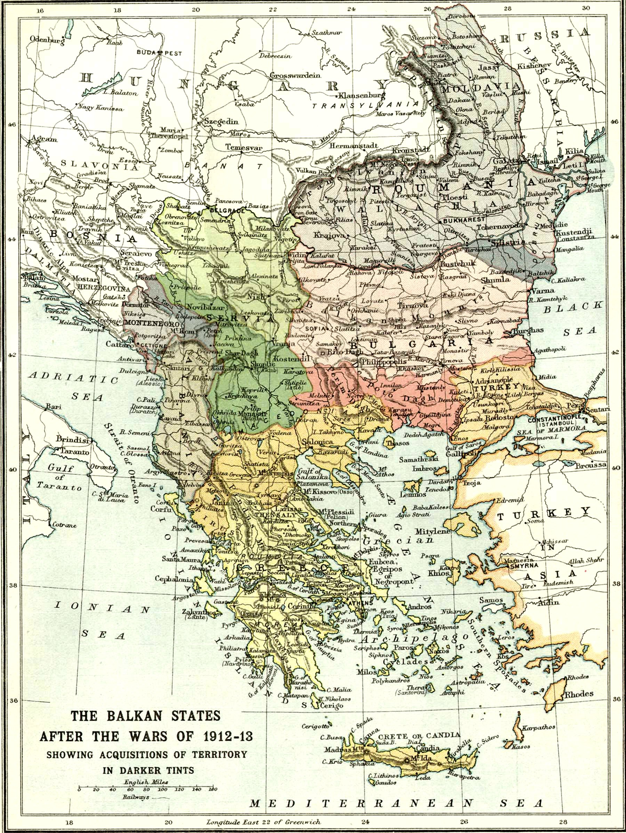

Slide 7
Consequences of the Balkan Wars
The Balkans was historically and emotionally significant for Ottomans
The heartland of the empire and the region of its earliest expansion; Edirne had been Ottoman capital from 1365 to 1453
A homeland for millions of Turks and other Muslims, most of whom ended up refugees

Slide 8
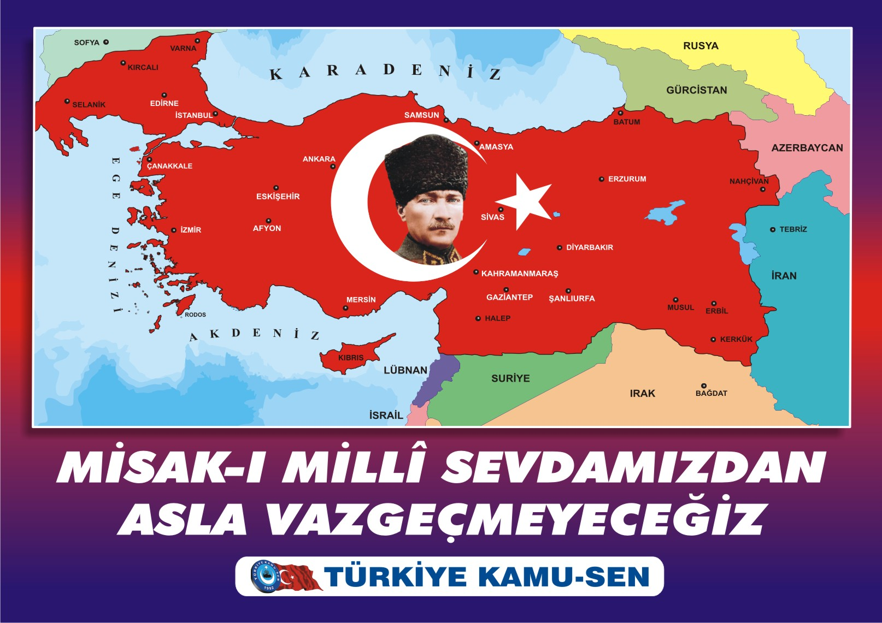

Slide 9
First World War
Ottoman government actively seeking an alliance with a great power after defeat in the Balkan Wars: turned down by Britain, France, Austria-Hungary and Russia
German military command generally hostile to Ottoman alliance, but Kaiser Wilhelm II enthusiastic, hoping to tip balance of power in the Balkans and that Sultan could inspire rebellion among Britain and France’s colonial Muslim subjects
Alliance with Germany signed on 2 August 1914

Slide 10
First World War
Four major fronts for Ottomans: Dardanelles, Palestine/Syria, Iraq and Caucasus
Sultan failed to inspire global jihad, but Ottoman army made significant contribution to Axis war effort, especially in the Dardanelles and Iraq
War ended with loss of Syria, Palestine, Hijaz and most of Iraq, and Allies occupying Constantinople

Slide 11
Treaty of Sevres
Concluded between Ottoman Empire and Allies on 10 August 1920
Palestine, Transjordan and Iraq ceded to Britain
Syria and Lebanon ceded to France
Eastern Thrace and Smyrna region of western Anatolia ceded to Greece
Northeastern Anatolia ceded to Armenia
Zones of influence, within remaining territory, granted to France, Britain and Italy
Constantinople and the Marmara coasts demilitarized and placed under international supervision
Treaty never implemented, because the Ottoman government that signed it ceased to be relevant

Slide 12
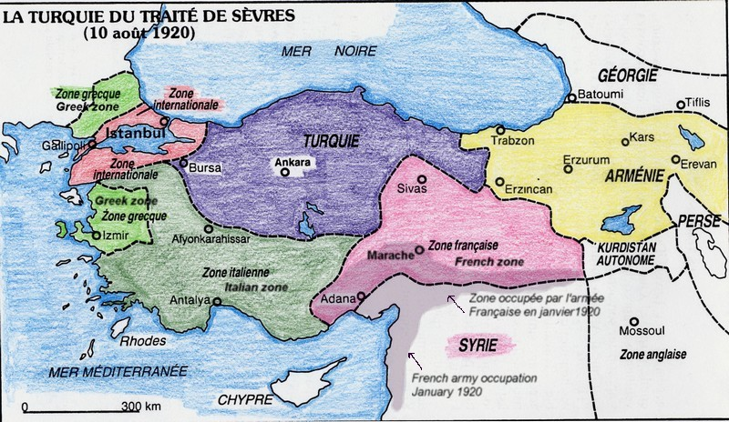

Slide 13
Turkish War of Independence
The Turkish National Movement formed in 1919 after the Greek navy landed at Smyrna
Led by Ottoman general Mustafa Kemal Pasha, later known as Atatürk
National Movement saw the Ottoman government as incapable of preventing further losses and refused its authority
Based in central and northern Anatolia: declaration at Amasya, congress at Sivas and then founding of the Grand National Assembly at Ankara in 1920
Armed forces drew on Ottoman army and locally-recruited militias, and collaborated with Kurdish and Arab tribal militias in eastern and southern Anatolia

Slide 14
Turkish War of Independence
Nationalists fought three wars: against Armenia in northeast Anatolia, against France in southern Anatolia, and against Greece in western Anatolia
War with Armenia fought during summer and autumn 1920
Turkish forces captured Kars in October
In November, Bolshevik-sponsored communist uprising seized power in Armenia and declared it a Soviet Socialist Republic
Bolsheviks not interested in war with Turkey: border agreed at Treaty of Moscow in March 1921

Slide 15
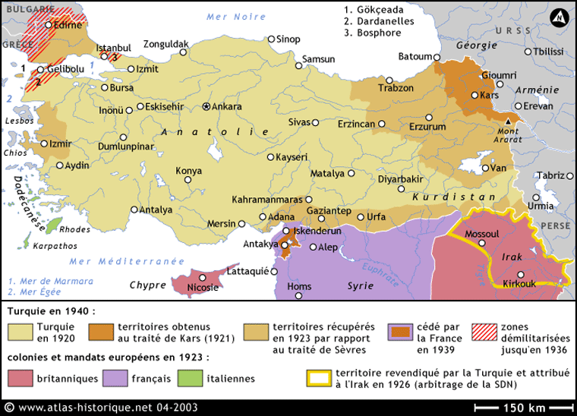

Slide 16
Turkish War of Independence
France began expanding into southern Anatolia from Syria in November 1918, within weeks of armistice
Local militias, supported by Turkish National Movement, rose in revolt against French
Three cities in particular resisted the French: Maraş, Antep and Urfa. Now known as Kahramanmaraş (Hero Maraş), Gaziantep (Warrior Antep) and Şanlıurfa (Glorius Urfa)
Treaty of Ankara revised the border between French Syria and Turkey in Turkey’s favor

Slide 18
Turkish War of Independence
Greek navy landed at Smyrna in May 1919
During summer 1920, Greece captured most of western Anatolia
In October 1920, they marched east, reaching Afyon and Eskişehir in July 1921
Marched on Ankara, but stopped by nationalist forces at the Battle of Sakarya in August/September
Britain, France and Italy declined to support Greece, despite Treaty of Sevres
Nationalists counter-attacked on 26 August, and routed the Greeks at the Battle of Dumlupınar on 30 August
After rapid Greek retreat, Turkish forces enter Smyrna on 9 September; Greek and Armenian property pillaged, around 30,000 Greeks and Armenians killed, the remainder fleeing
Great Fire of Smyrna destroys the Greek and Armenian quarters

Slide 19
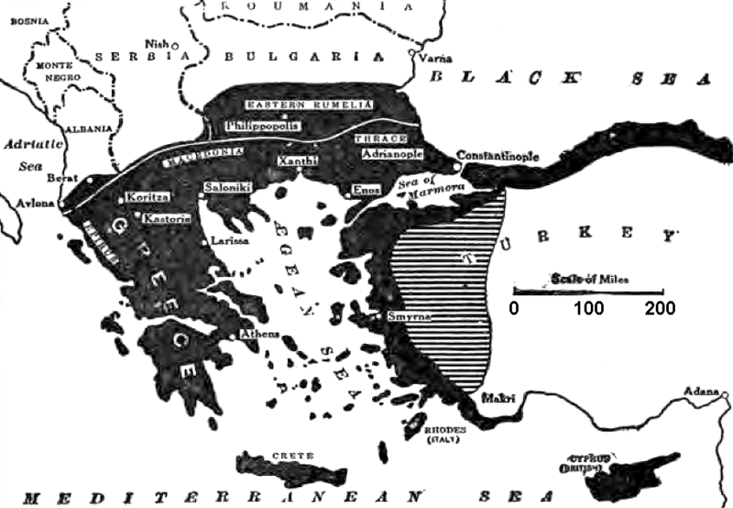

Slide 20
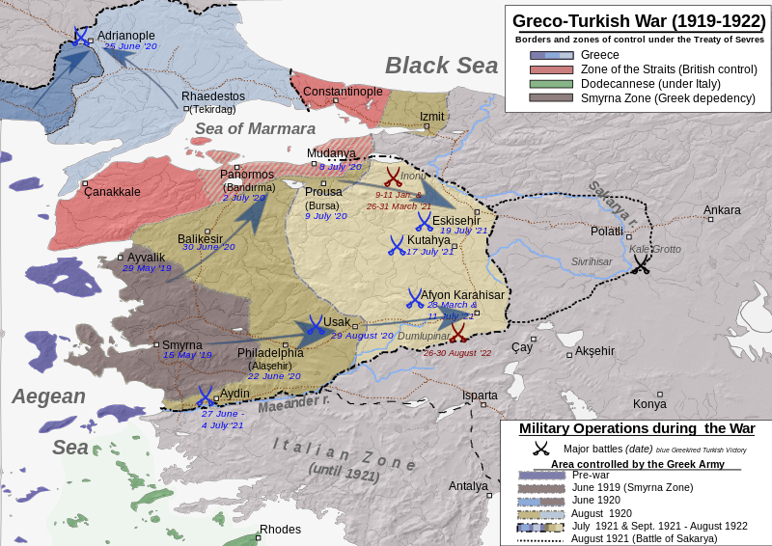

Slide 21
Treaty of Lausanne
Negotiated between the Turkish Nationalists and Britain, France and Italy; Greece subsequently accepted its terms
Greeks withdrew from Eastern Thrace up to Maritsa River, the present-day border
Turks accept freedom of navigation through the Bosphorus straits
Convention Concerning the Exchange of Greek and Turkish Populations saw most remaining Greeks/Orthodox in Anatolia and most remaining Turks/Muslims in Greece deported and resettled in the other country

