Slide 1
The Ottoman Empire and Europe, 1453 - 1922
James E. Baldwin
Department of History
University of Warwick

Slide 2
Why study Ottoman history?
  The history of a large area of the world: the Middle East, eastern Europe, North Africa, the eastern Mediterranean.
  An important but marginalized aspect of European history
  An example of a form of state that defined the early modern world: the large, multi-ethnic, multi-confessional empire.

Slide 3
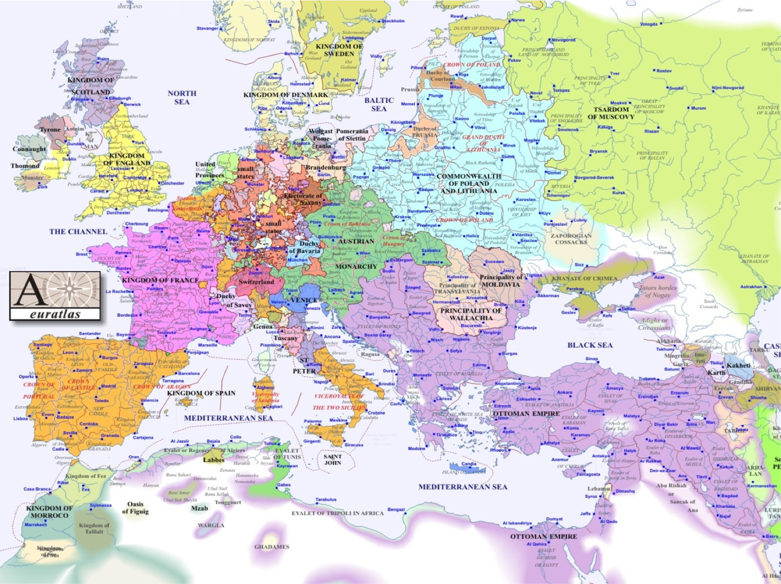

Slide 4
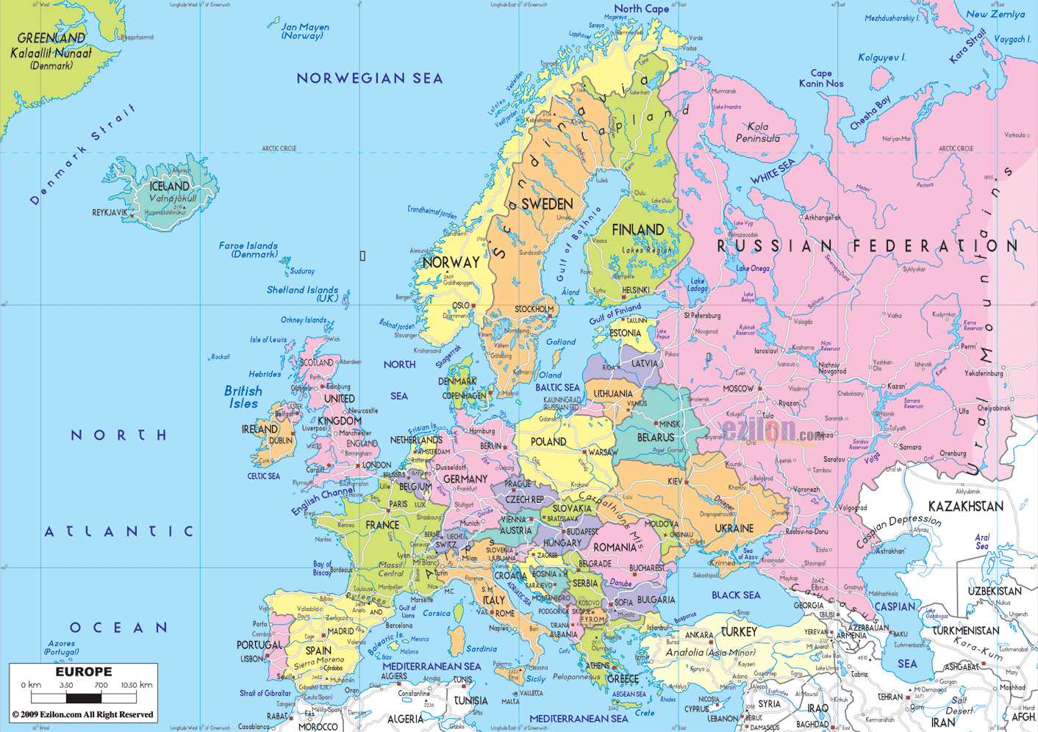

Slide 5
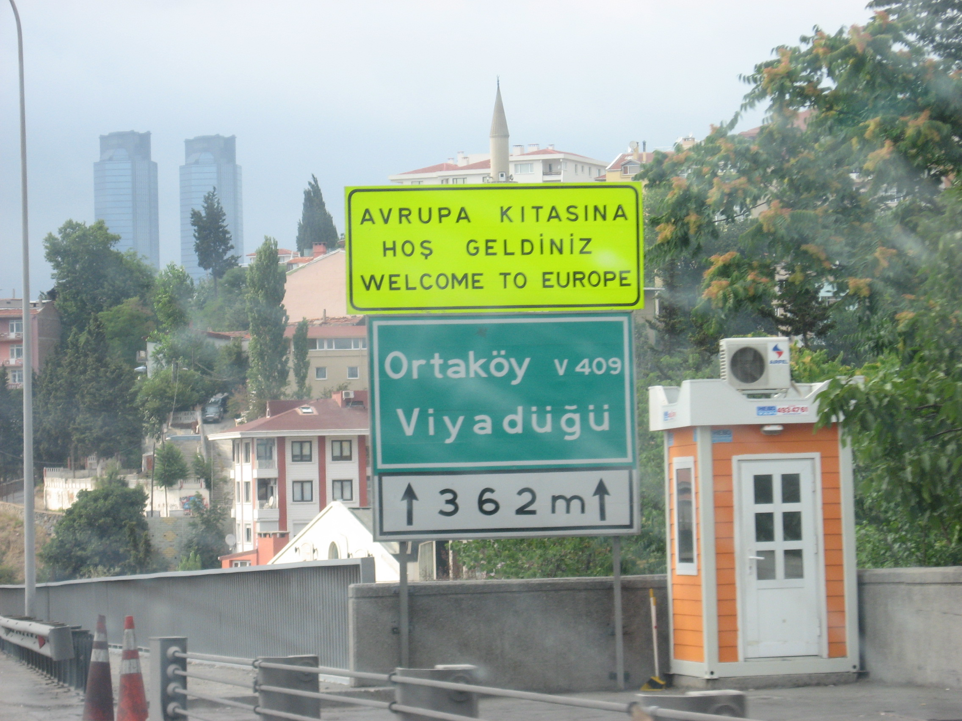

Slide 6
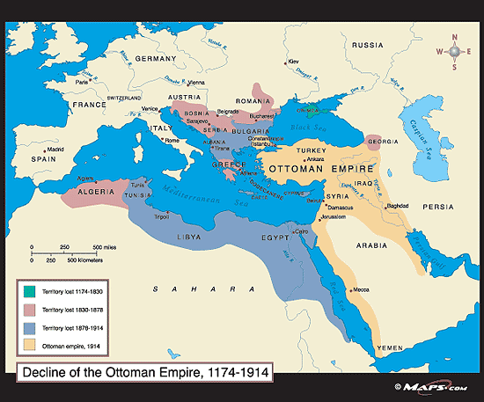

Slide 8
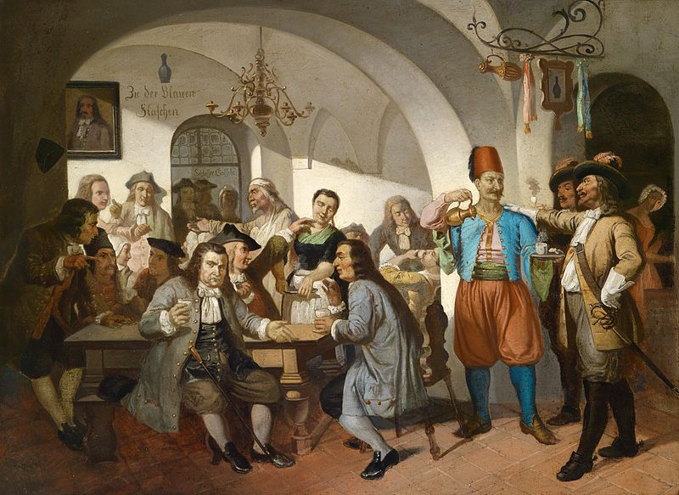

Slide 9
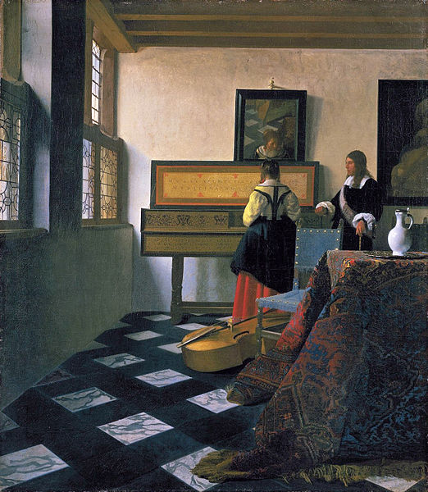

Slide 10
What was the Ottoman Empire?
It was not Turkey – it was an empire of great diversity
Ruling elite called themselves “Ottomans”: this class was very absorptive
Literate elites read Turkish, Persian and Arabic
Significant Christian and Jewish populations
Empire’s Muslim subjects ethnically diverse

Slide 11
Origins of Ottoman Empire
Founded by Osman in 1299
Rapid expansion in early 14th century under Orhan
Expanded at expense of Byzantine empire and neighboring Turkish-Muslim states

Slide 12
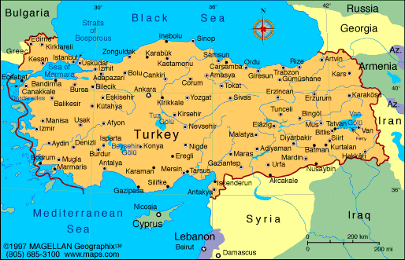

Slide 13
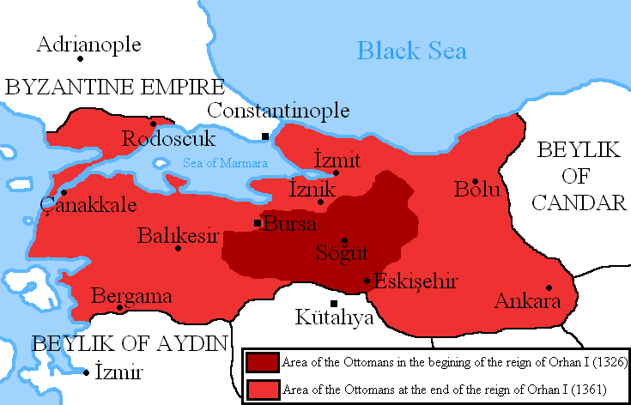

Slide 14
What drove the early Ottomans?
Wittek’s “gazi thesis”: religious fanatics pursuing gaza / jihad against Christendom
However, 14th century saw numerous alliances between Ottomans and Christian states
And early conquests directed as much against Muslim neighbors as against Christians
“Gazi thesis” reflects narrative created by 15th-century Ottomans to Islamicize their history

Slide 15
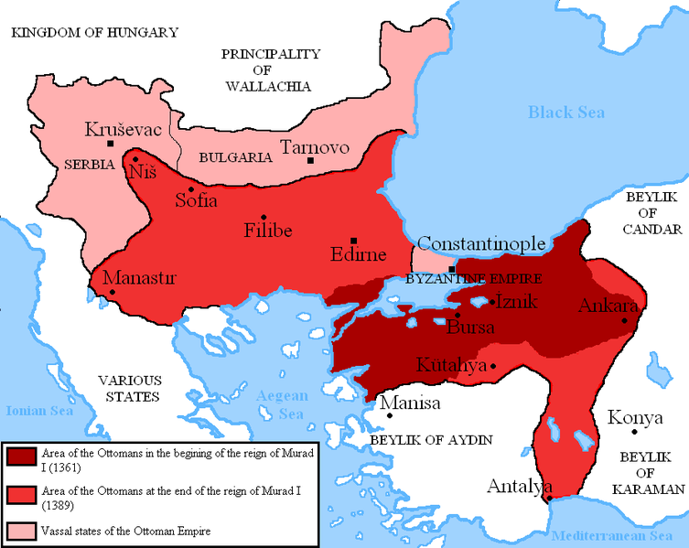

Slide 16
Ottoman Empire under Murad I
Federation of lordships under Ottoman suzerainty
Murad did not call himself “Sultan,” but rather “emir” (prince) or “beylerbeyi” (lord of lords)
Relatively little territory directly ruled by the dynasty: most land held by local lords, Muslim and Christian, who owed Murad tribute and troops

Slide 17
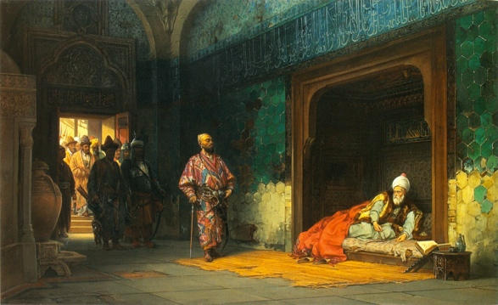

Slide 18
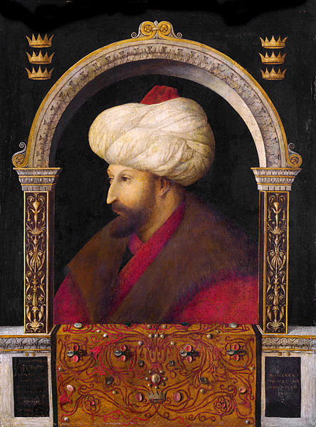

Slide 19
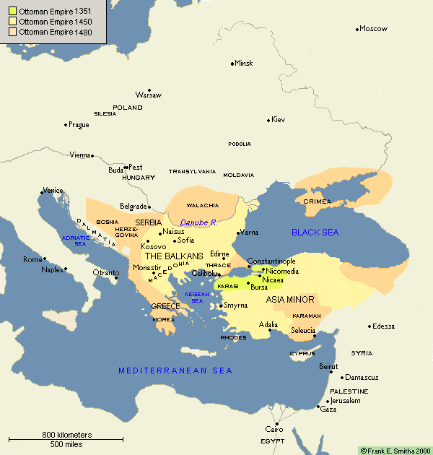

Slide 20
Ottoman Empire under Bayezid II
Transformed from federation of lordships into empire
Majority of territory now directly ruled by appointed governors
Janissary army of slave-soldiers now basis of army
Law regulating fief-holders codified

Slide 21
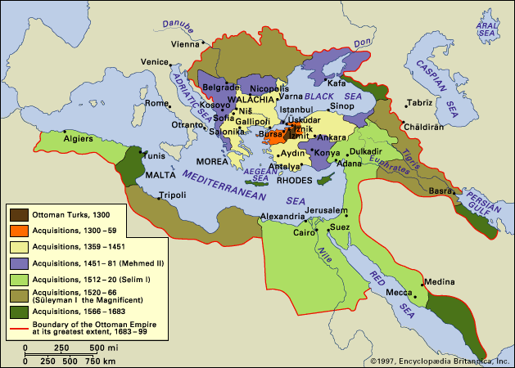

Slide 22
