Slide 1
The Ottoman Empire and Europe,
1453 – 1922
The Ottoman Ruling Class:
The Dynasty and the Slave Institution
James E. Baldwin
Department of History
University of Warwick

Slide 2
Categories of Ottoman subject
ʿAskerī – the “military class”
Encompasses administration, bureaucracy, judiciary and senior scholars as well as military
Provide service to the Sultan
Exempt from taxes, receive government salaries
Estates subjects to confiscation upon death
Reʿāyā – the “flocks”:
Encompasses all subjects not in Sultan’s service
Engaged in agriculture or urban economic activity
Obliged to pay taxes

Slide 3
Features of ʿaskerī class
Diversity in origins: among the military/administrative cadres and palace women, people of non-Muslim and non-Turkish background predominated in 15th and 16th centuries.
Slavery: the majority of these groups, in the 15th and 16th centuries, were legally slaves.

Slide 4
Idealized images of the
“classical” Ottoman state
Meritocracy: both in succession to Sultanate itself and in selection of senior soldiers and administrators.
Absolutism: Sultan created elite over whom he had total control.
Are these generalizations accurate?

Slide 5
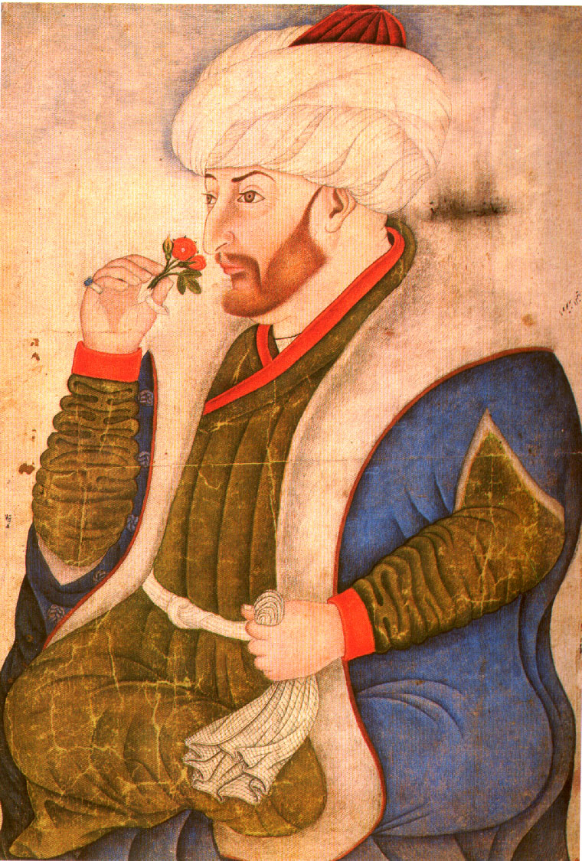
Mehmed II (The Conqueror)

Slide 6
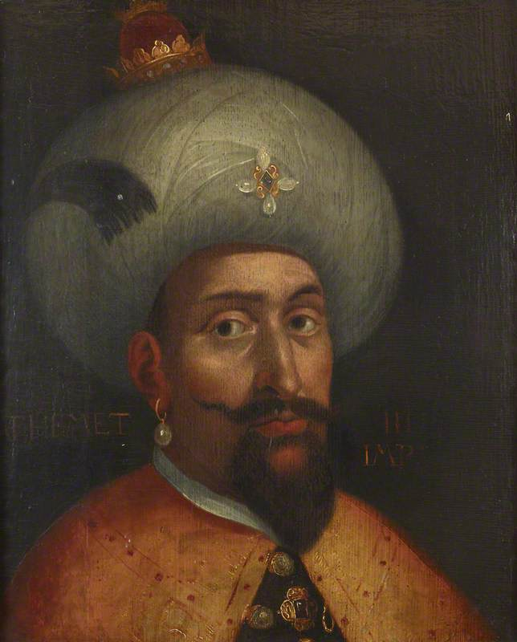
Mehmed III

Slide 7
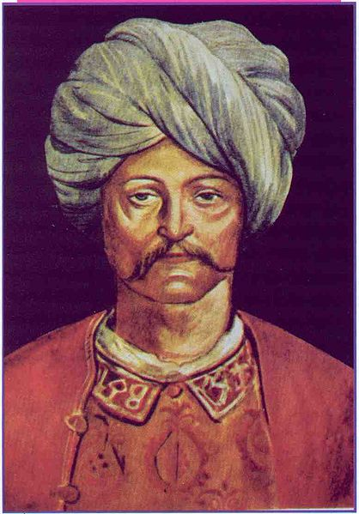
Cem Sultan

Slide 8
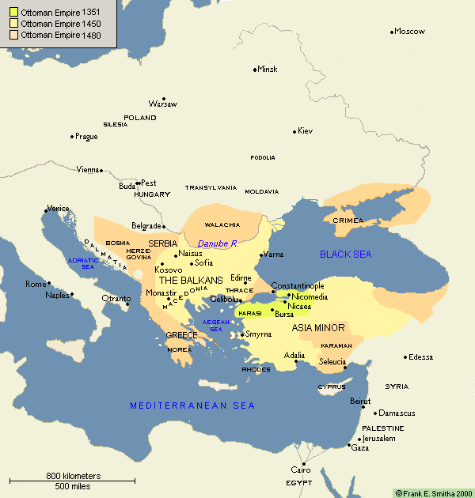

Slide 9
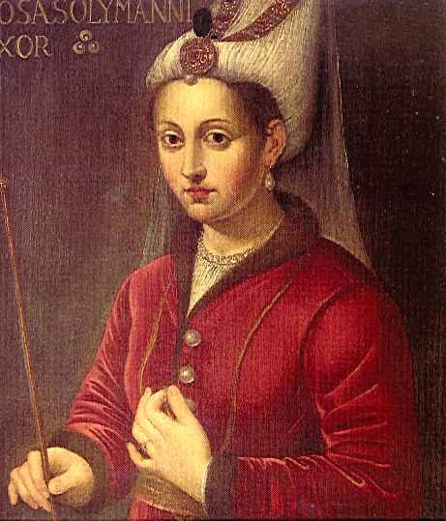
Hürrem Sultan (Roxelana)

Slide 10
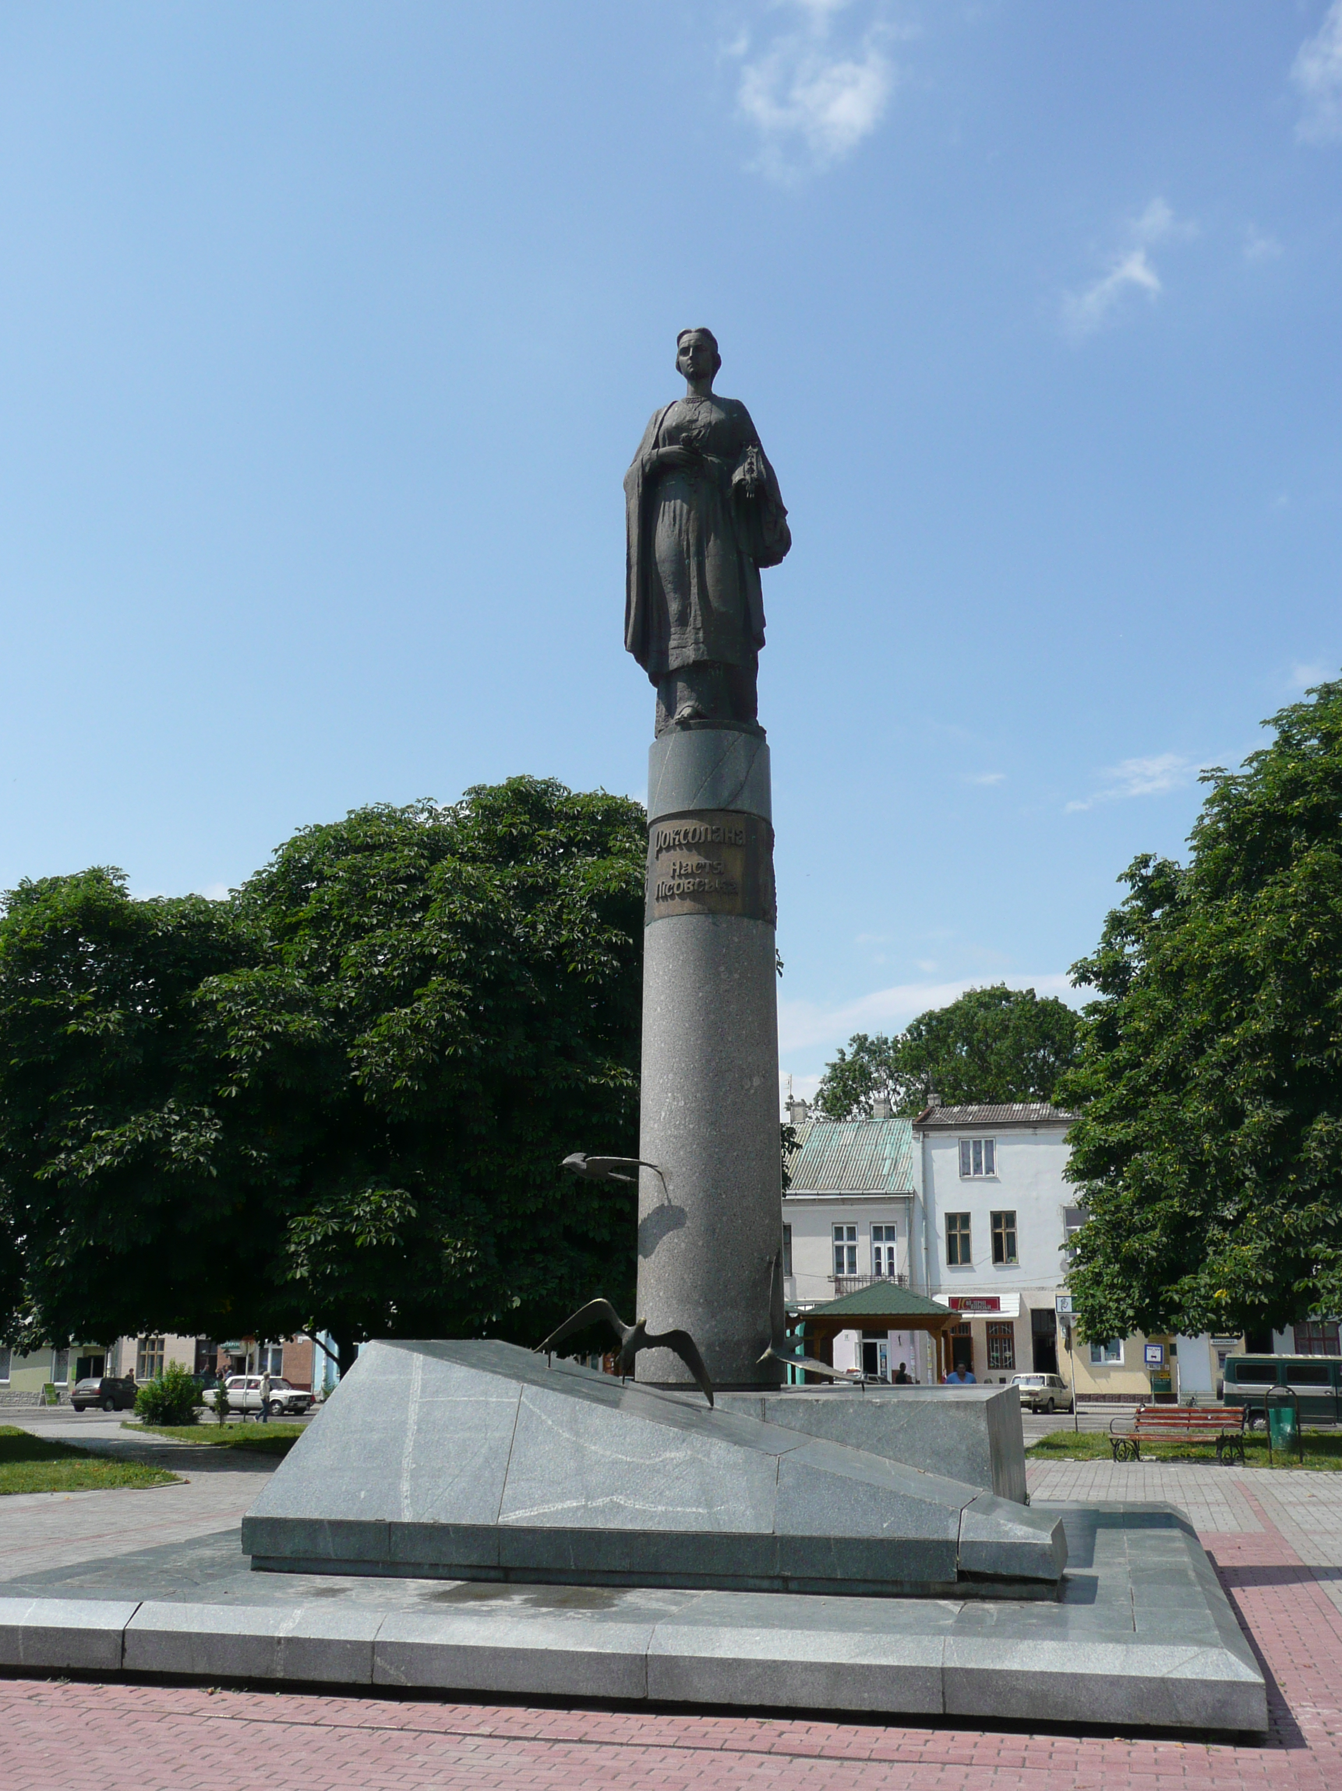
Statue of Hürrem Sultan in Rohatyn, Ukraine

Slide 11
The devşirme
Differed from previous slave-soldier systems in the Muslim world
Sultan sent agents to Balkan provinces to recruit from the empire’s own Christian population
Boys taken as teenagers, converted to Islam, and trained at the imperial palace for state service

Slide 12
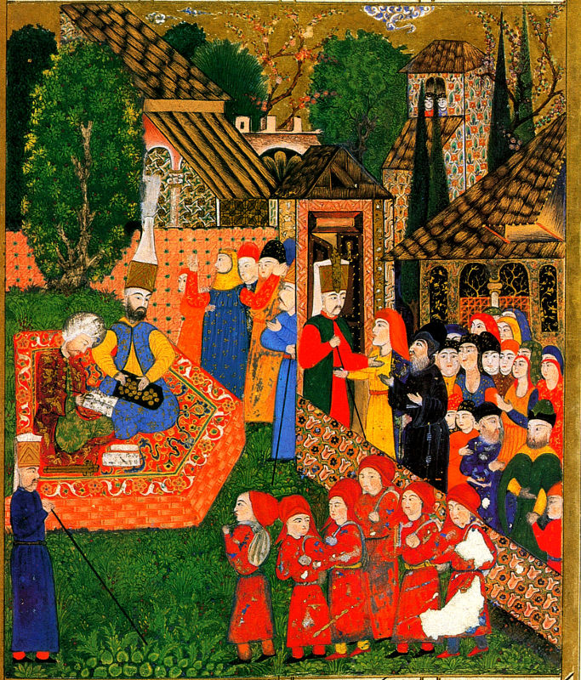
The devşirme

Slide 13
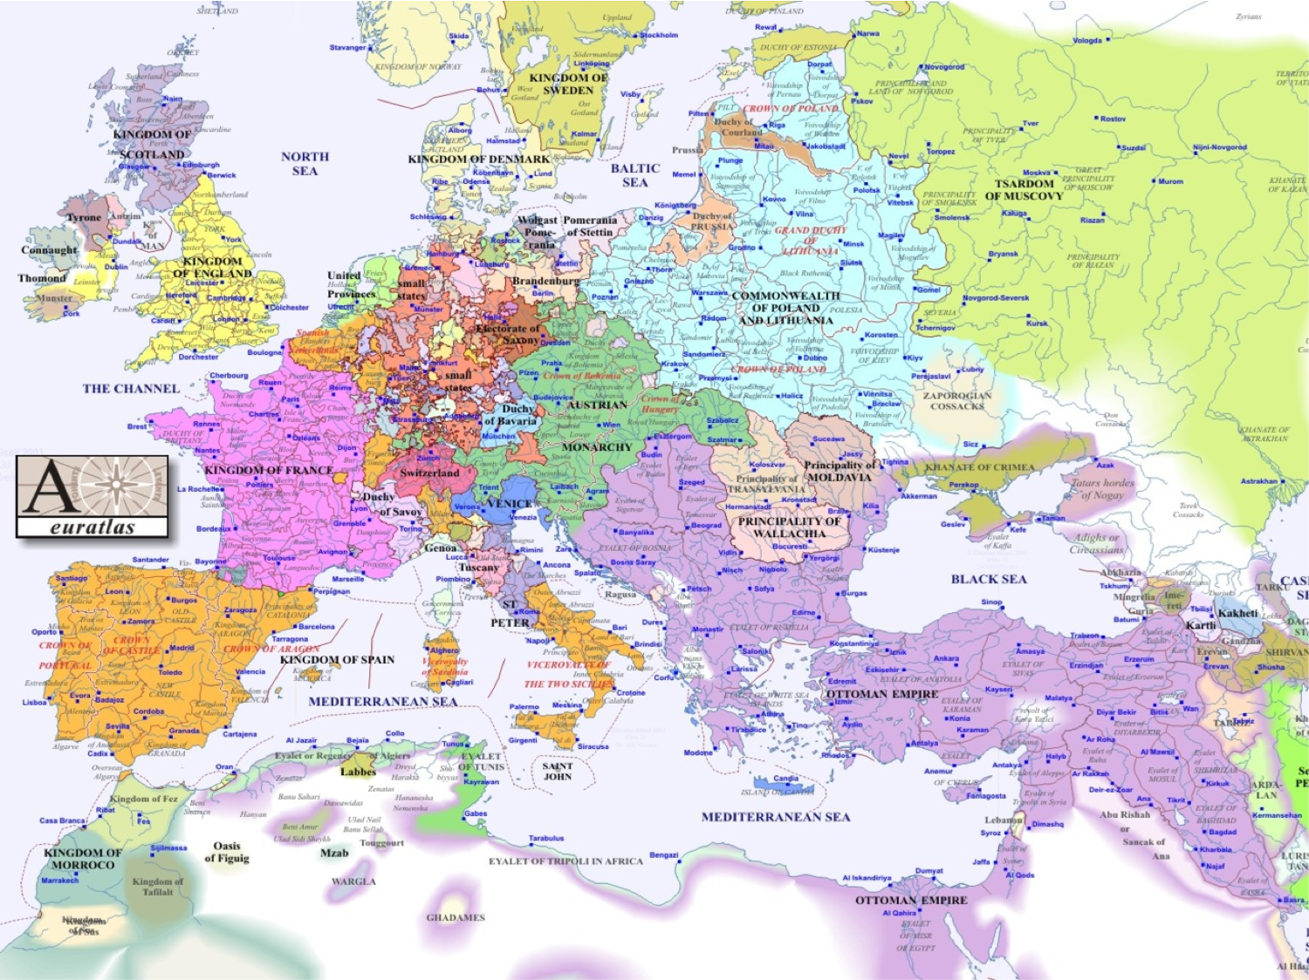

Slide 14
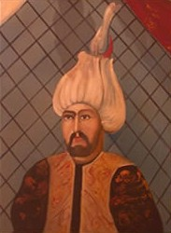
Sokollu Mehmed Pasha

Slide 15
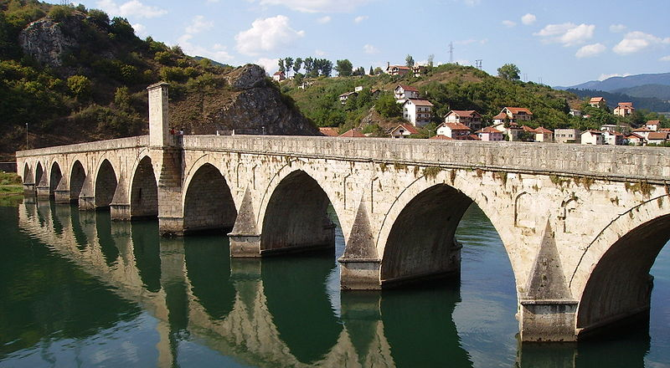
The Bridge on the Drina,
Visegrad, Bosnia

