Slide 1
The Ottoman Empire and Europe, 1453 – 1922 Transformations in the Ottoman Ruling Class: The Rise of New Elites in the Seventeenth and Eighteenth Centuries
James E. Baldwin
Department of History
University of Warwick

Slide 2
The Transformation of the Ottoman Empire
Does this period constitute a “Second Empire”?
Does it make sense to describe this as a period of “decline”

Slide 3
The Sultanate
Süleyman the Magnificent, and other Sultans of the fifteenth and sixteenth centuries, were active rulers and military commanders
From ruling to reigning: seventeenth and eighteenth Sultans were less powerful than their predecessors
Instead, senior officials such as the Grand Vizier controlled imperial affairs

Slide 4
Representations of Sultanic authority and power
The mashrabiyya grille in the Imperial Divan
The importance of hunting

Slide 5
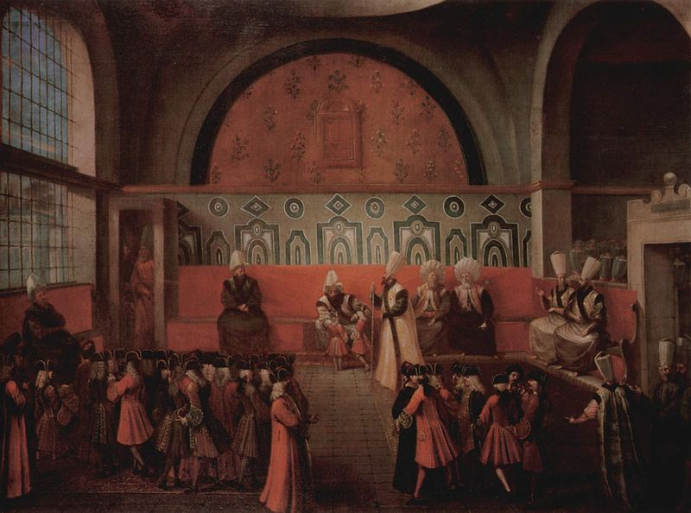

Slide 6
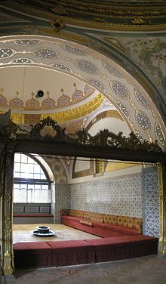

Slide 7
Representations of Sultanic authority and power
The mashrabiyya grille in the Imperial Divan
The importance of hunting

Slide 8
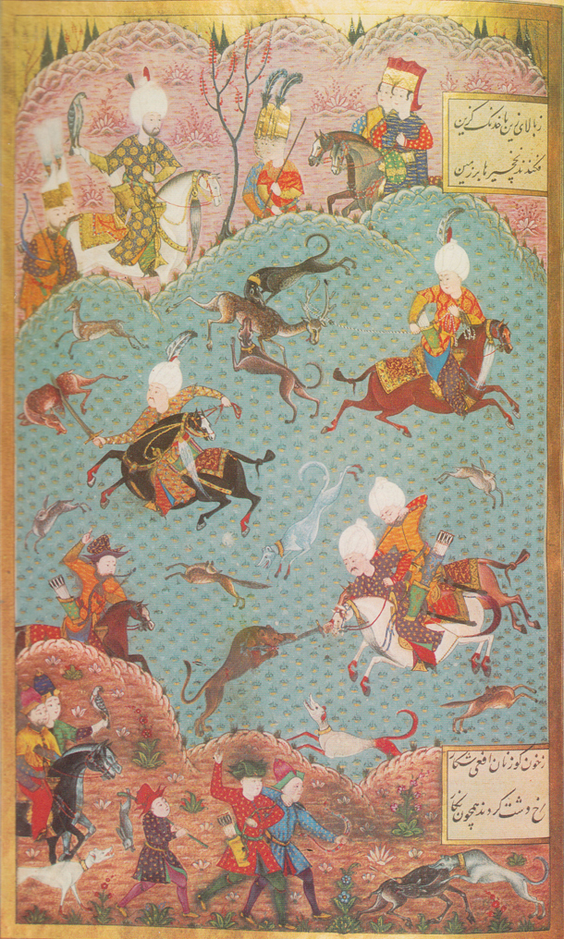

Slide 9
Depositions and enthronements
Military, ulema and courtiers engineered the deposition and enthronement of many Sultans
Loyalty to the dynasty remained: no attempt to enthrone a non-Ottoman
The succession process was subjected to factional politics

Slide 10
Did this lead to decline?
Military had always exercised some influence over succession, via the wars between the sons
Was there a decline in the 17th century? Or simply a series of crises, from which the empire recovered?
Why should we assume that absolutism monarchy = good government?

Slide 11
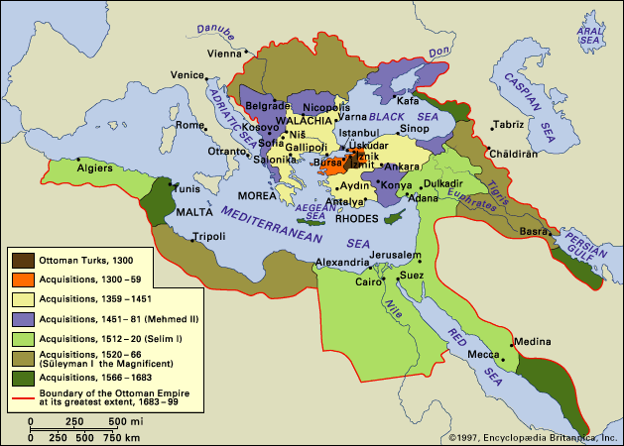

Slide 12
The Janissaries
Theoretically, a salaried standing army
However, engaged in trade to supplement incomes eroded by inflation
Free-born Muslim merchants and artisans in Ottoman cities joined Janissaries for political and economic benefits
Entry to the Janissary corps could be bought for cash

Slide 13
Is this decline?
Military service could be avoided by payment of bedel tax.
The transformation of the Janissaries undermined Ottoman military strength, but did not destroy it
We can see the transformation as the assertion by Muslims of moderate wealth of their right to participate in governance

Slide 14
The expansion of tax-farming
Timar: a revocable grant of the right to collect taxes in return for military service
Iltizam: a contract to collect taxes in return for an upfront payment, auctioned to the highest bidder
Iltizam was a form of government borrowing, and expanded as the government needed immediate cash to finance wars

Slide 15
How did iltizam work?
The mültezim (tax-farmer) paid a significant upfront payment for a fixed-term contract, and then remitted a proportion of annual taxes
The mültezim also covered the expenses of collecting taxes and administering the village. The balance was his profit.
Iltizams differed from timars: they could not be revoked during contract and they were transferrable if fee paid.

Slide 16
The malikane
The malikane, or life-term tax-farm, was introduced in 1695
It effectively allowed the government to borrow larger sums over longer periods
It also incentivized the tax-farmer to invest in the long-term productivity of his lands
Malikanes allowed their holders to build significant wealth and local power bases

Slide 17
Is tax-farming decline?
It solved short-term fiscal problems, but over the long term undermined the empire’s revenue base
On the other hand, it integrated new elites into the Ottoman political class, giving them a stake in the continuation of the empire

