Slide 1
The Ottoman Empire and Europe, 1453-1922 The Multiple Heritages of the Ottoman Empire: Monumental Architecture in Constantinople
James E. Baldwin
Department of History
University of Warwick

Slide 2
How do we categorize Ottoman art?
Museums typically give a general narrative of art history based on the western European experience
The category of “Islamic” art is placed outside this narrative, timeless and culturally determined
Ottoman architecture was influenced by European architecture – shouldn’t it be included in the general narrative of art history?

Slide 3
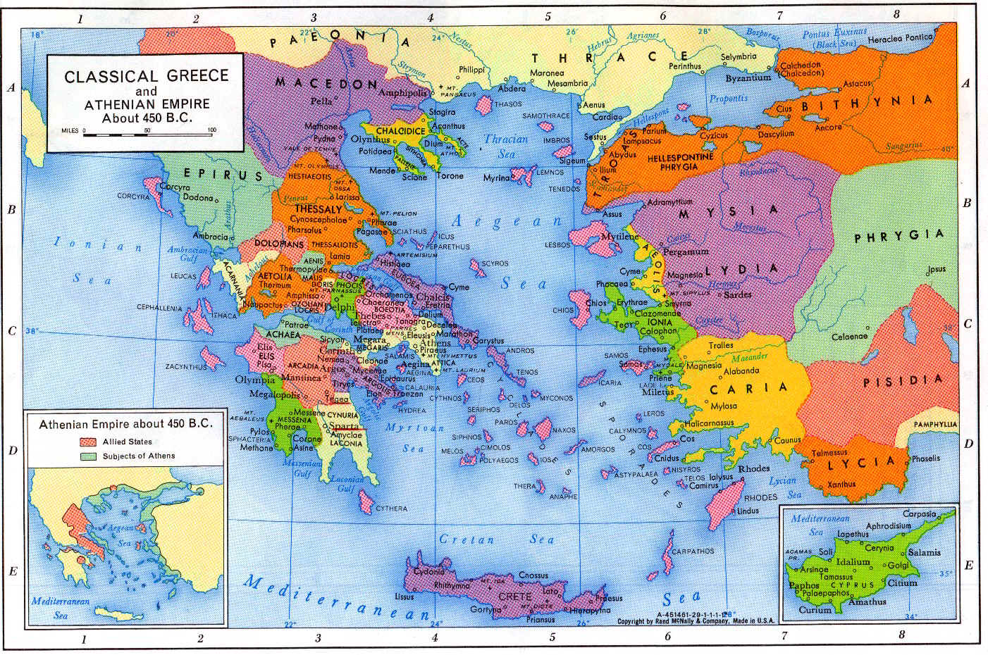

Slide 4
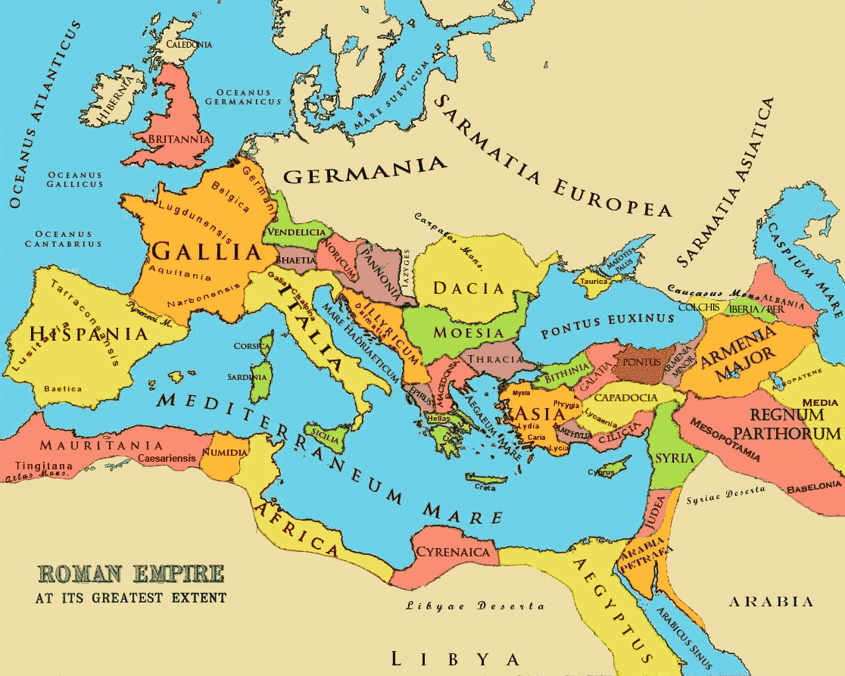

Slide 5
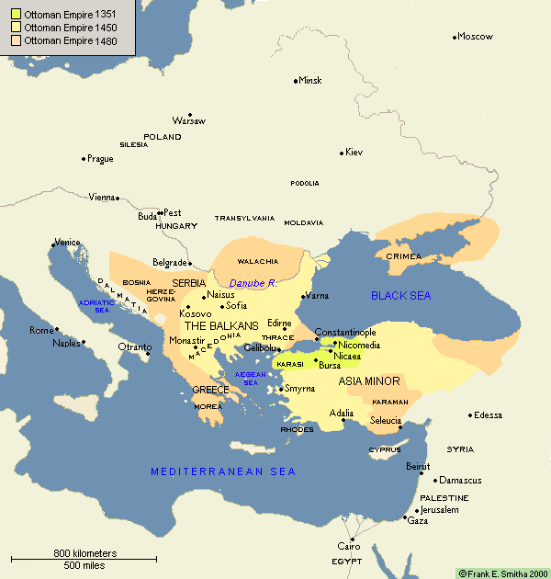

Slide 6
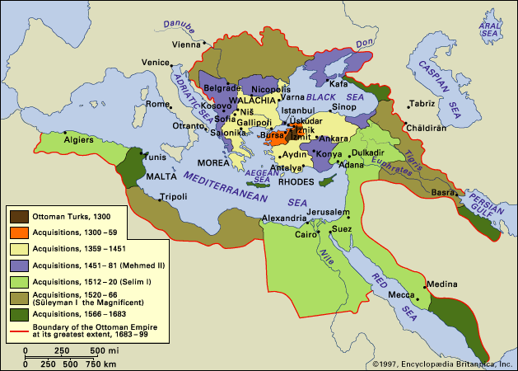

Slide 7
Ottomans and Renaissance Italy
In both Italy and the Ottoman Empire, classical architecture was “rediscovered” in the fifteenth century
Specific architectural innovations of the Italian Renaissance were imitated in the Ottoman Empire
Ottoman and Islamic architecture were influential in Venice

Slide 8
Monumental architecture in 15th-century Ottoman Constantinople
Creation of a new imperial image after the conquest of Constantinople
Reconstruction of Constantinople, which had declined during late Byzantine period
Mehmed II’s monumental architecture intended to convey messages – to Ottoman subjects, to foreign visitors, to foreign rulers

Slide 9
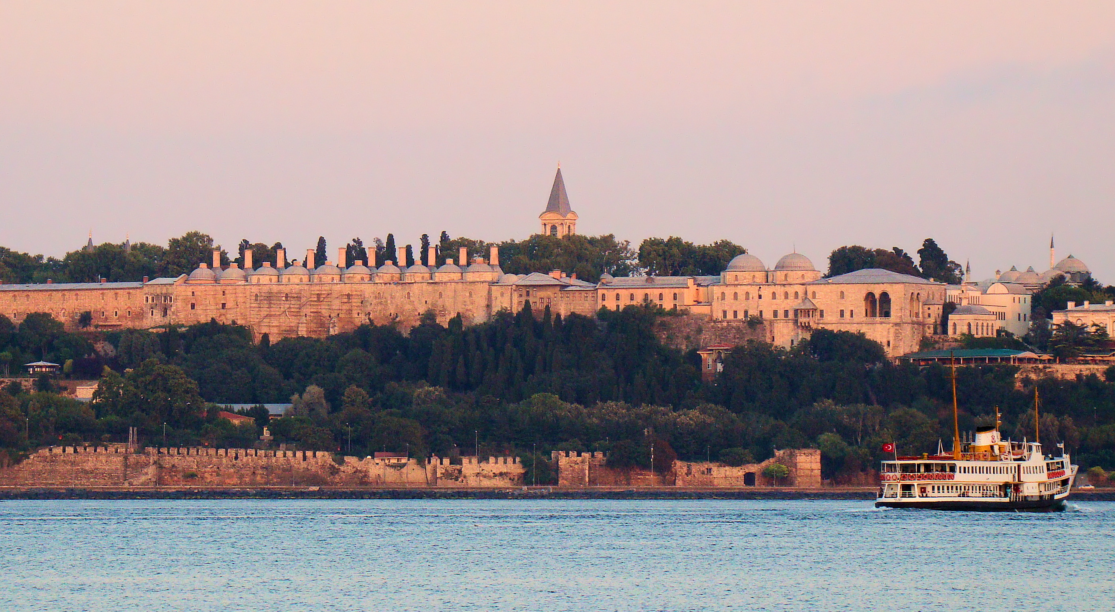
Topkapı Palace

Slide 10
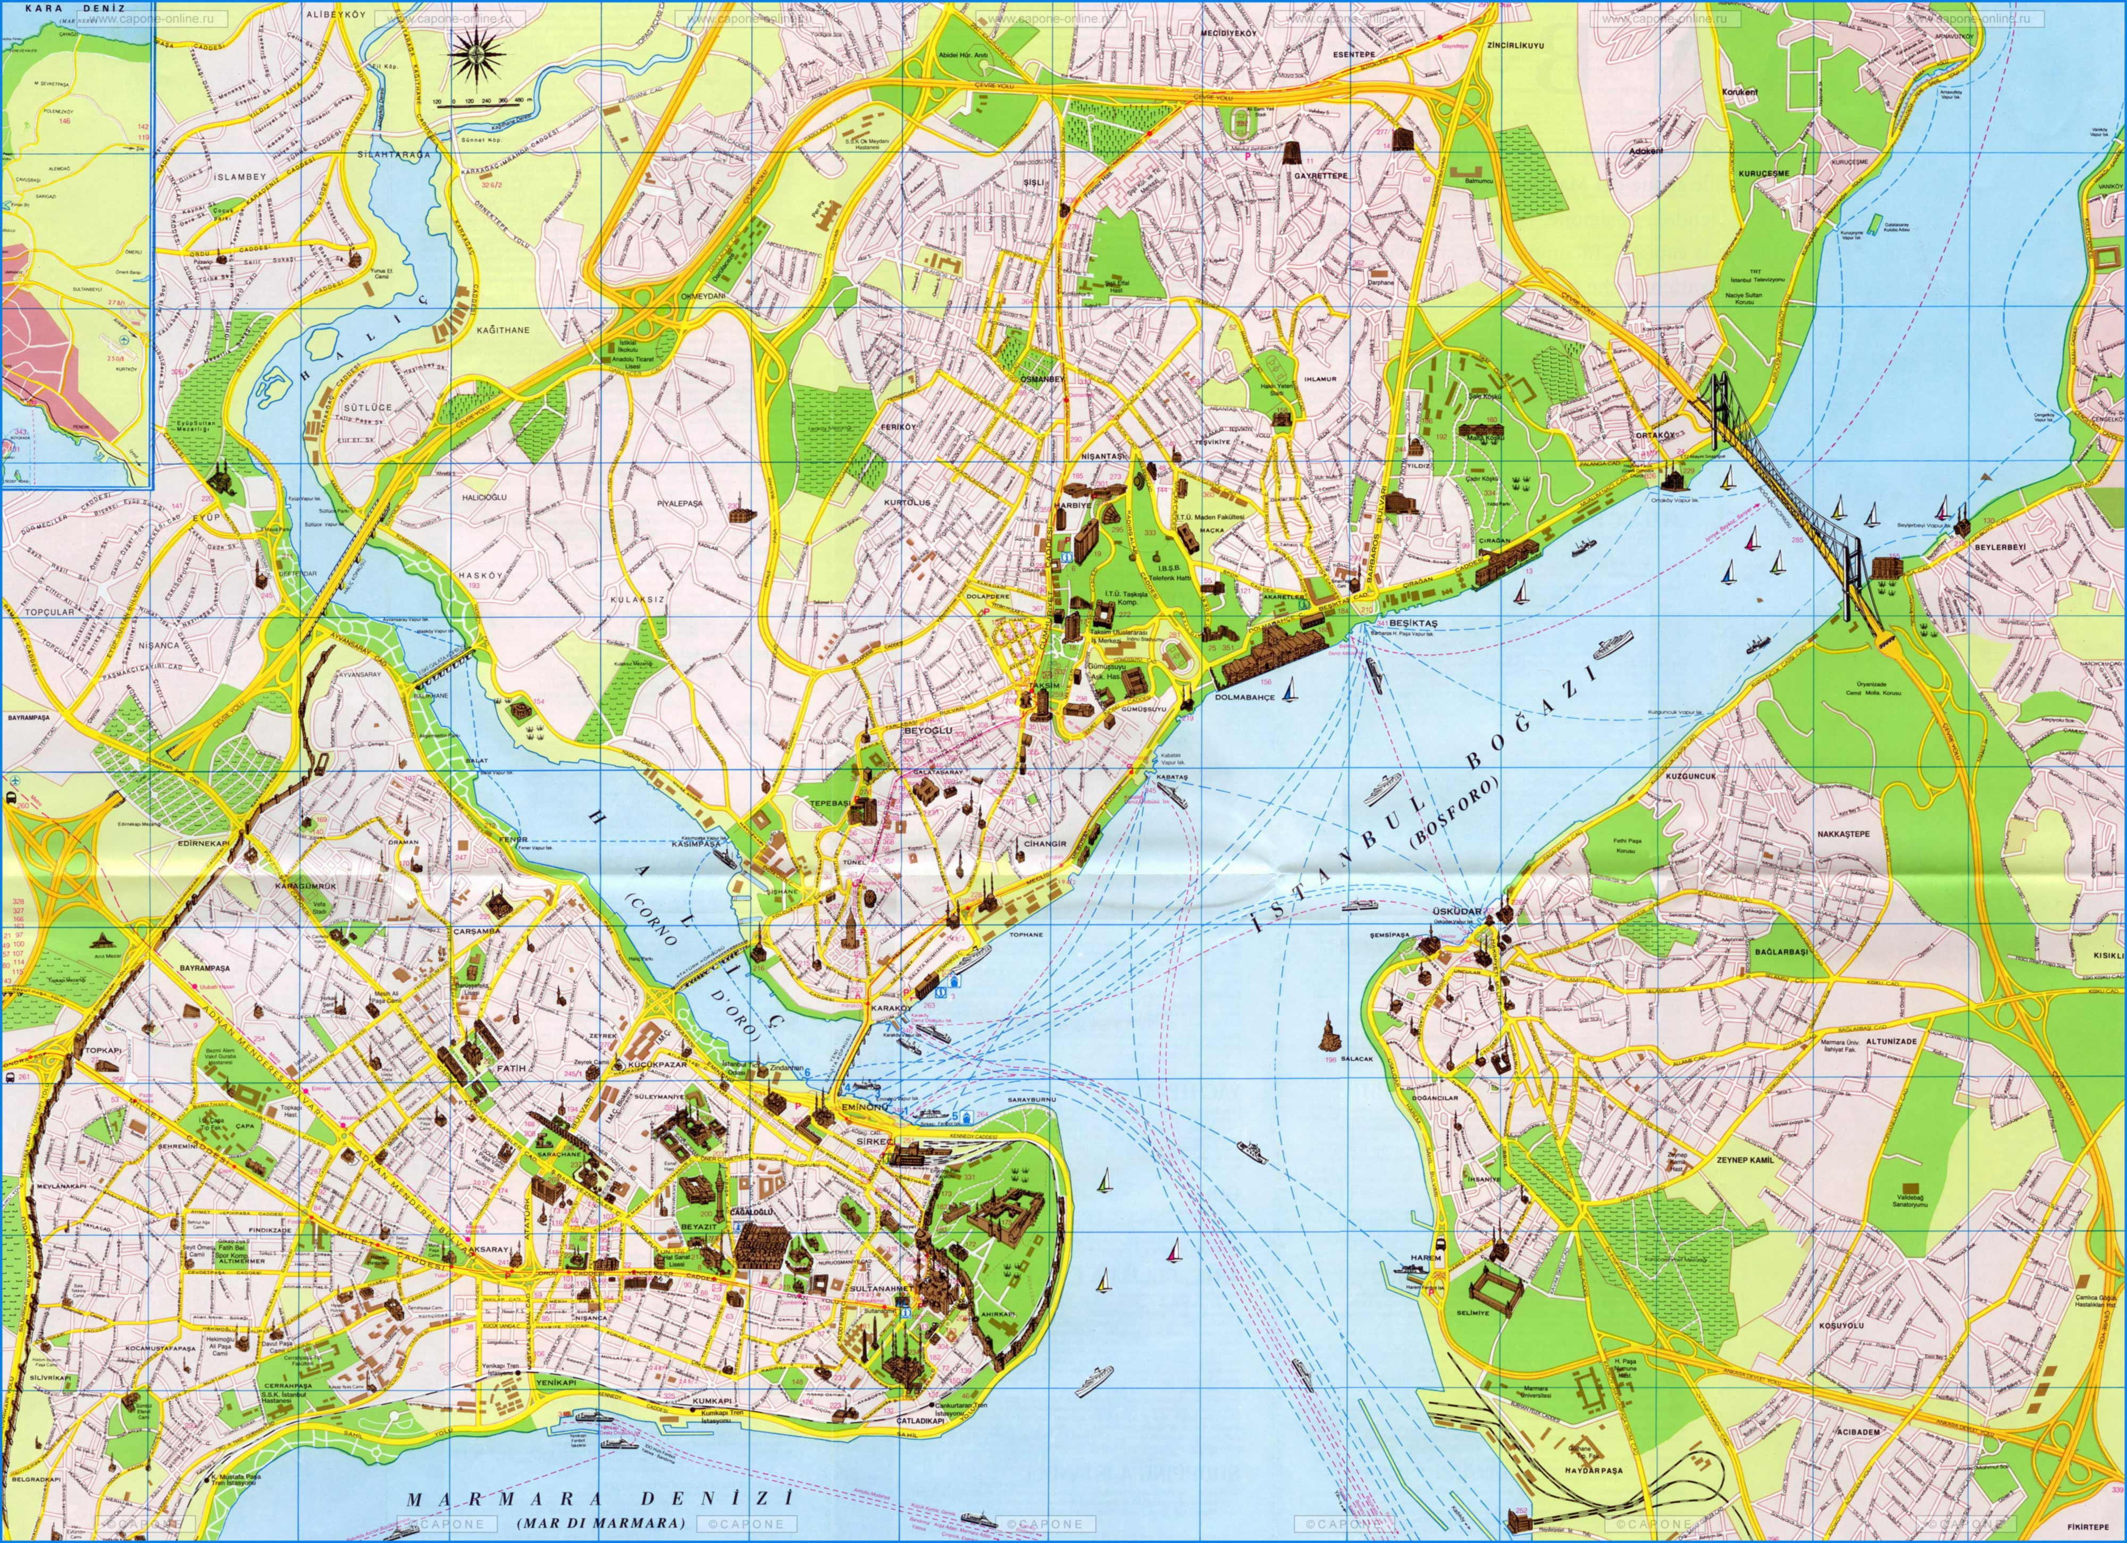

Slide 11
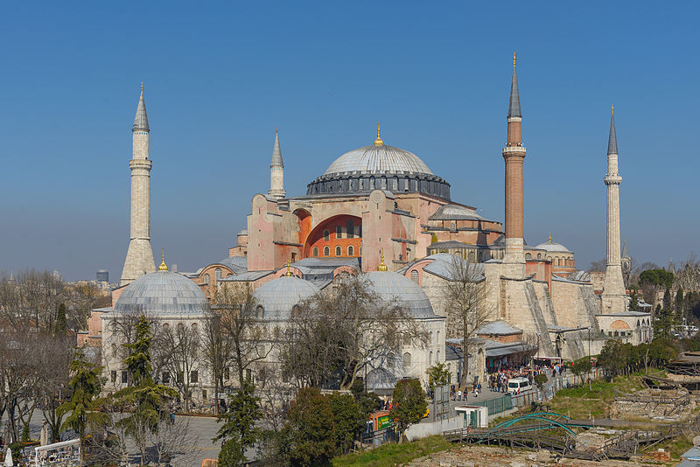

Slide 12
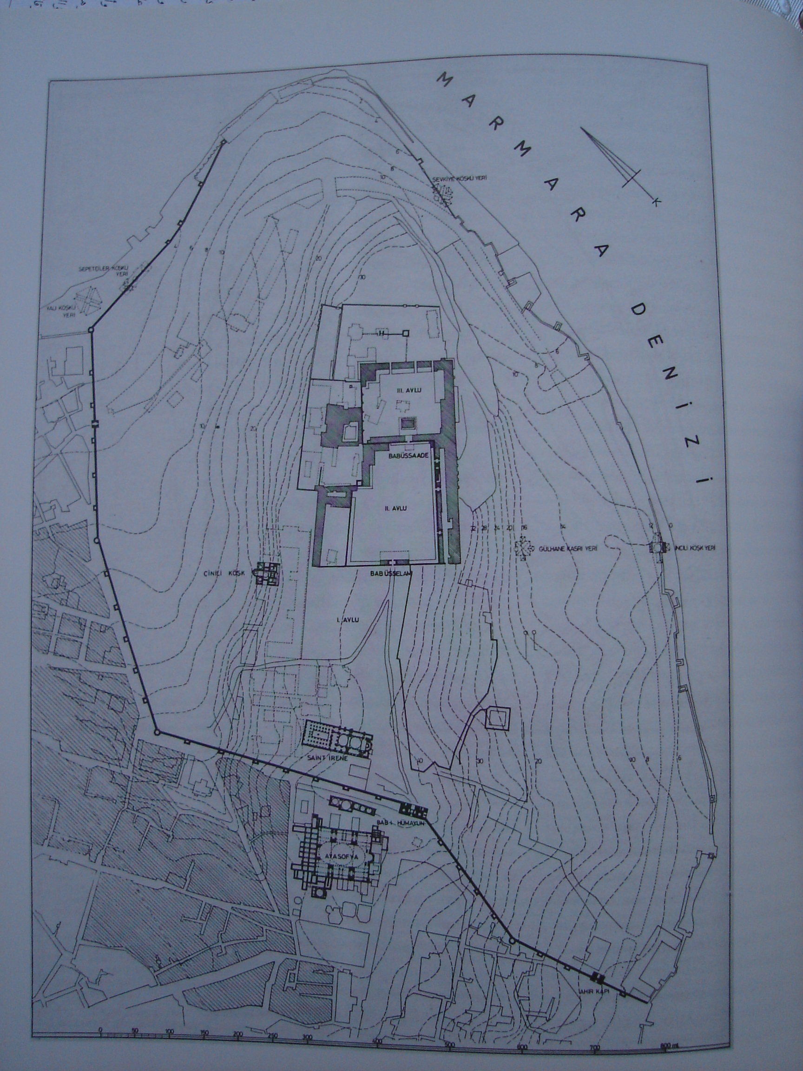
Relationship of palace to imperial mosque to ceremonial square recreated the Byzantine configuration of palace – church - Hippodrome

Slide 13
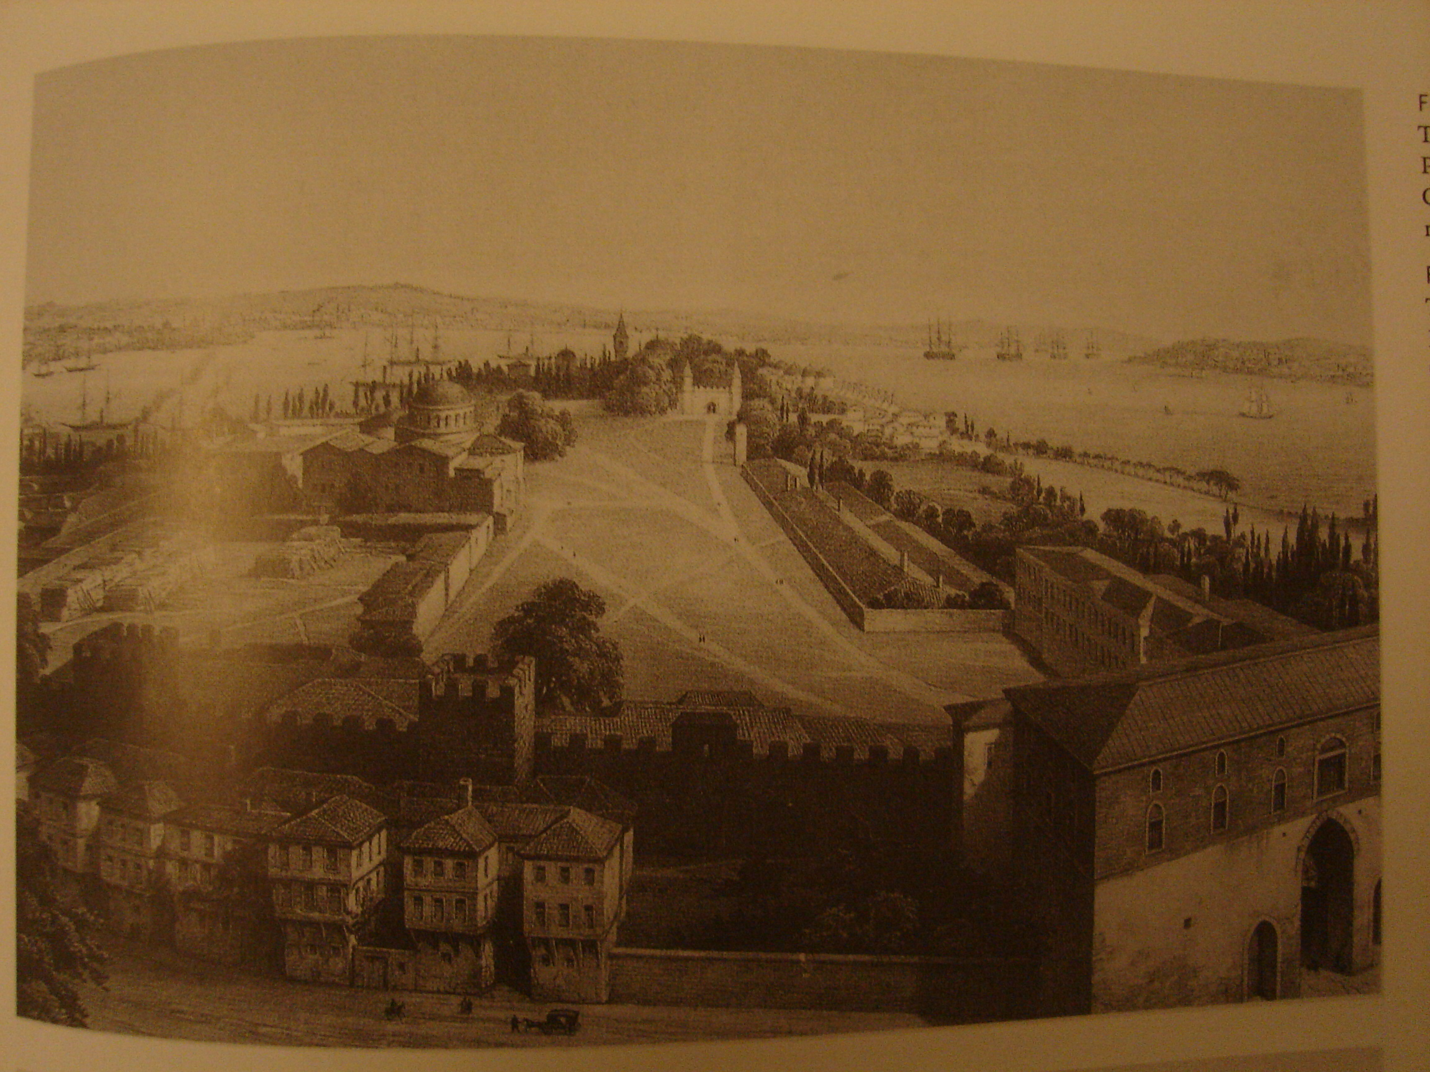
First gate – Byzantine style

Slide 14
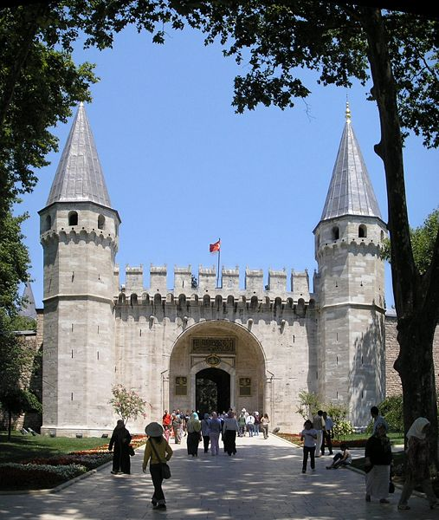
Second gate – Frankish style

Slide 15
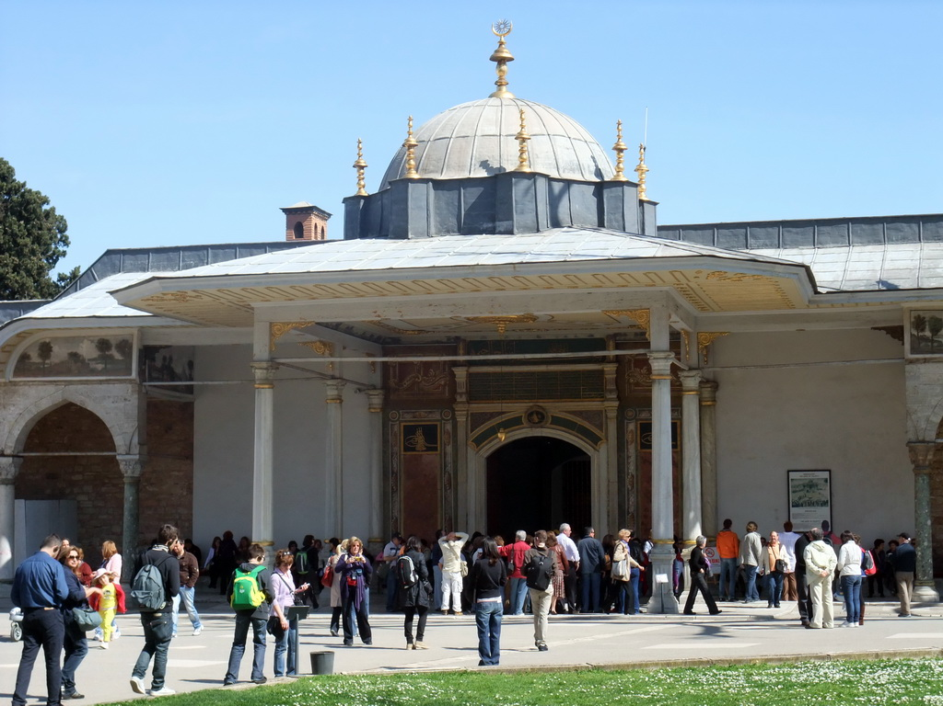
Third gate – the royal tent of Turco-Mongol tradition

Slide 16
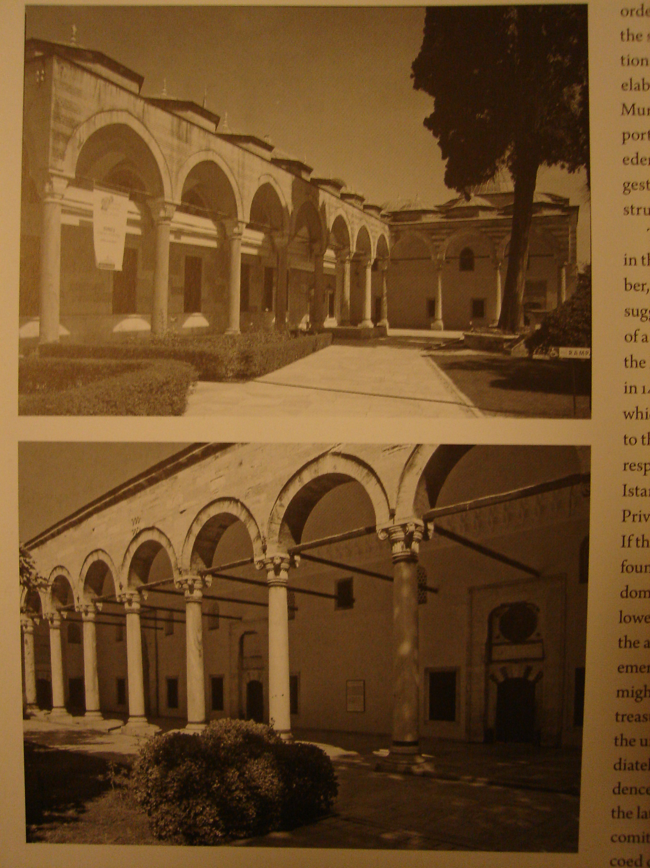
Juxtaposition of different styles:
Ottoman portico of privy chamber faces Italianate portico of treasury / baths across the inner courtyard

Slide 17
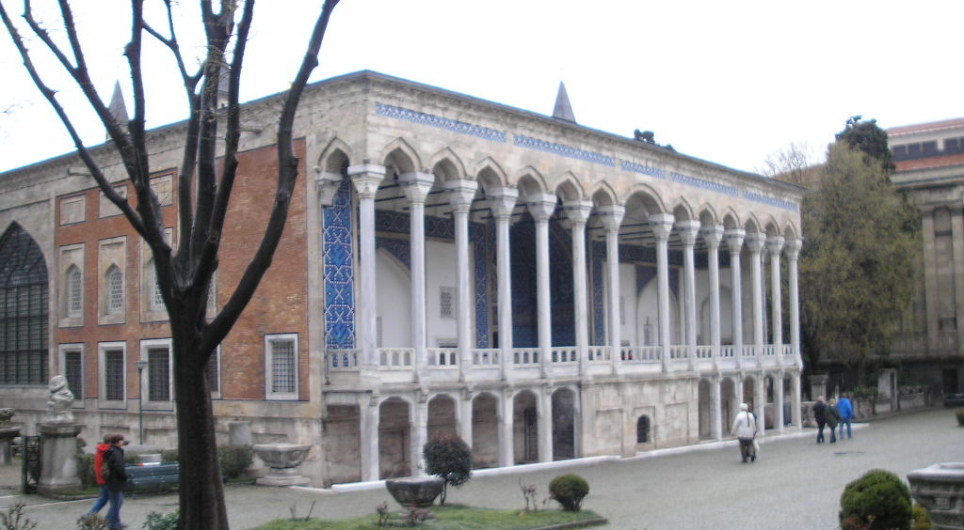
The Timurid-style Tiled Pavilion in the outer gardens

Slide 18
Why the eclecticism of Topkapı’s architecture?
The cultural background of the Ottomans – Turkish and Muslim, but rooted in a Byzantine world with close links to Italy
Symbolized domination – subjugated kingdoms represented by their architecture
Universalist ambition and outlook – the Ottomans aimed to speak in all the architectural languages of power

Slide 19
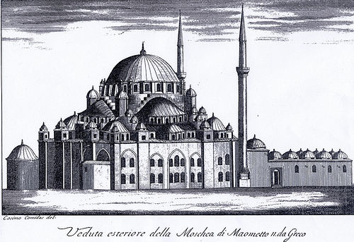
Mehmed II mosque-complex

Slide 20
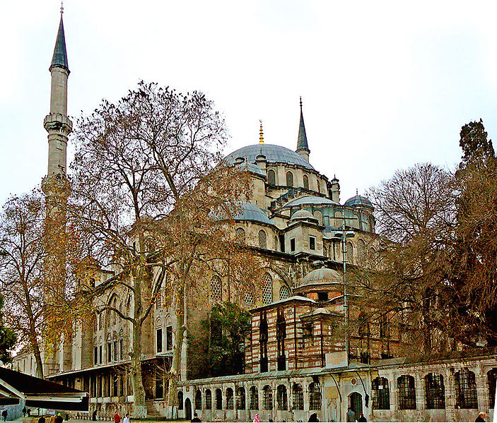
Today’s Fatih mosque, the replacement built in 1771

Slide 21
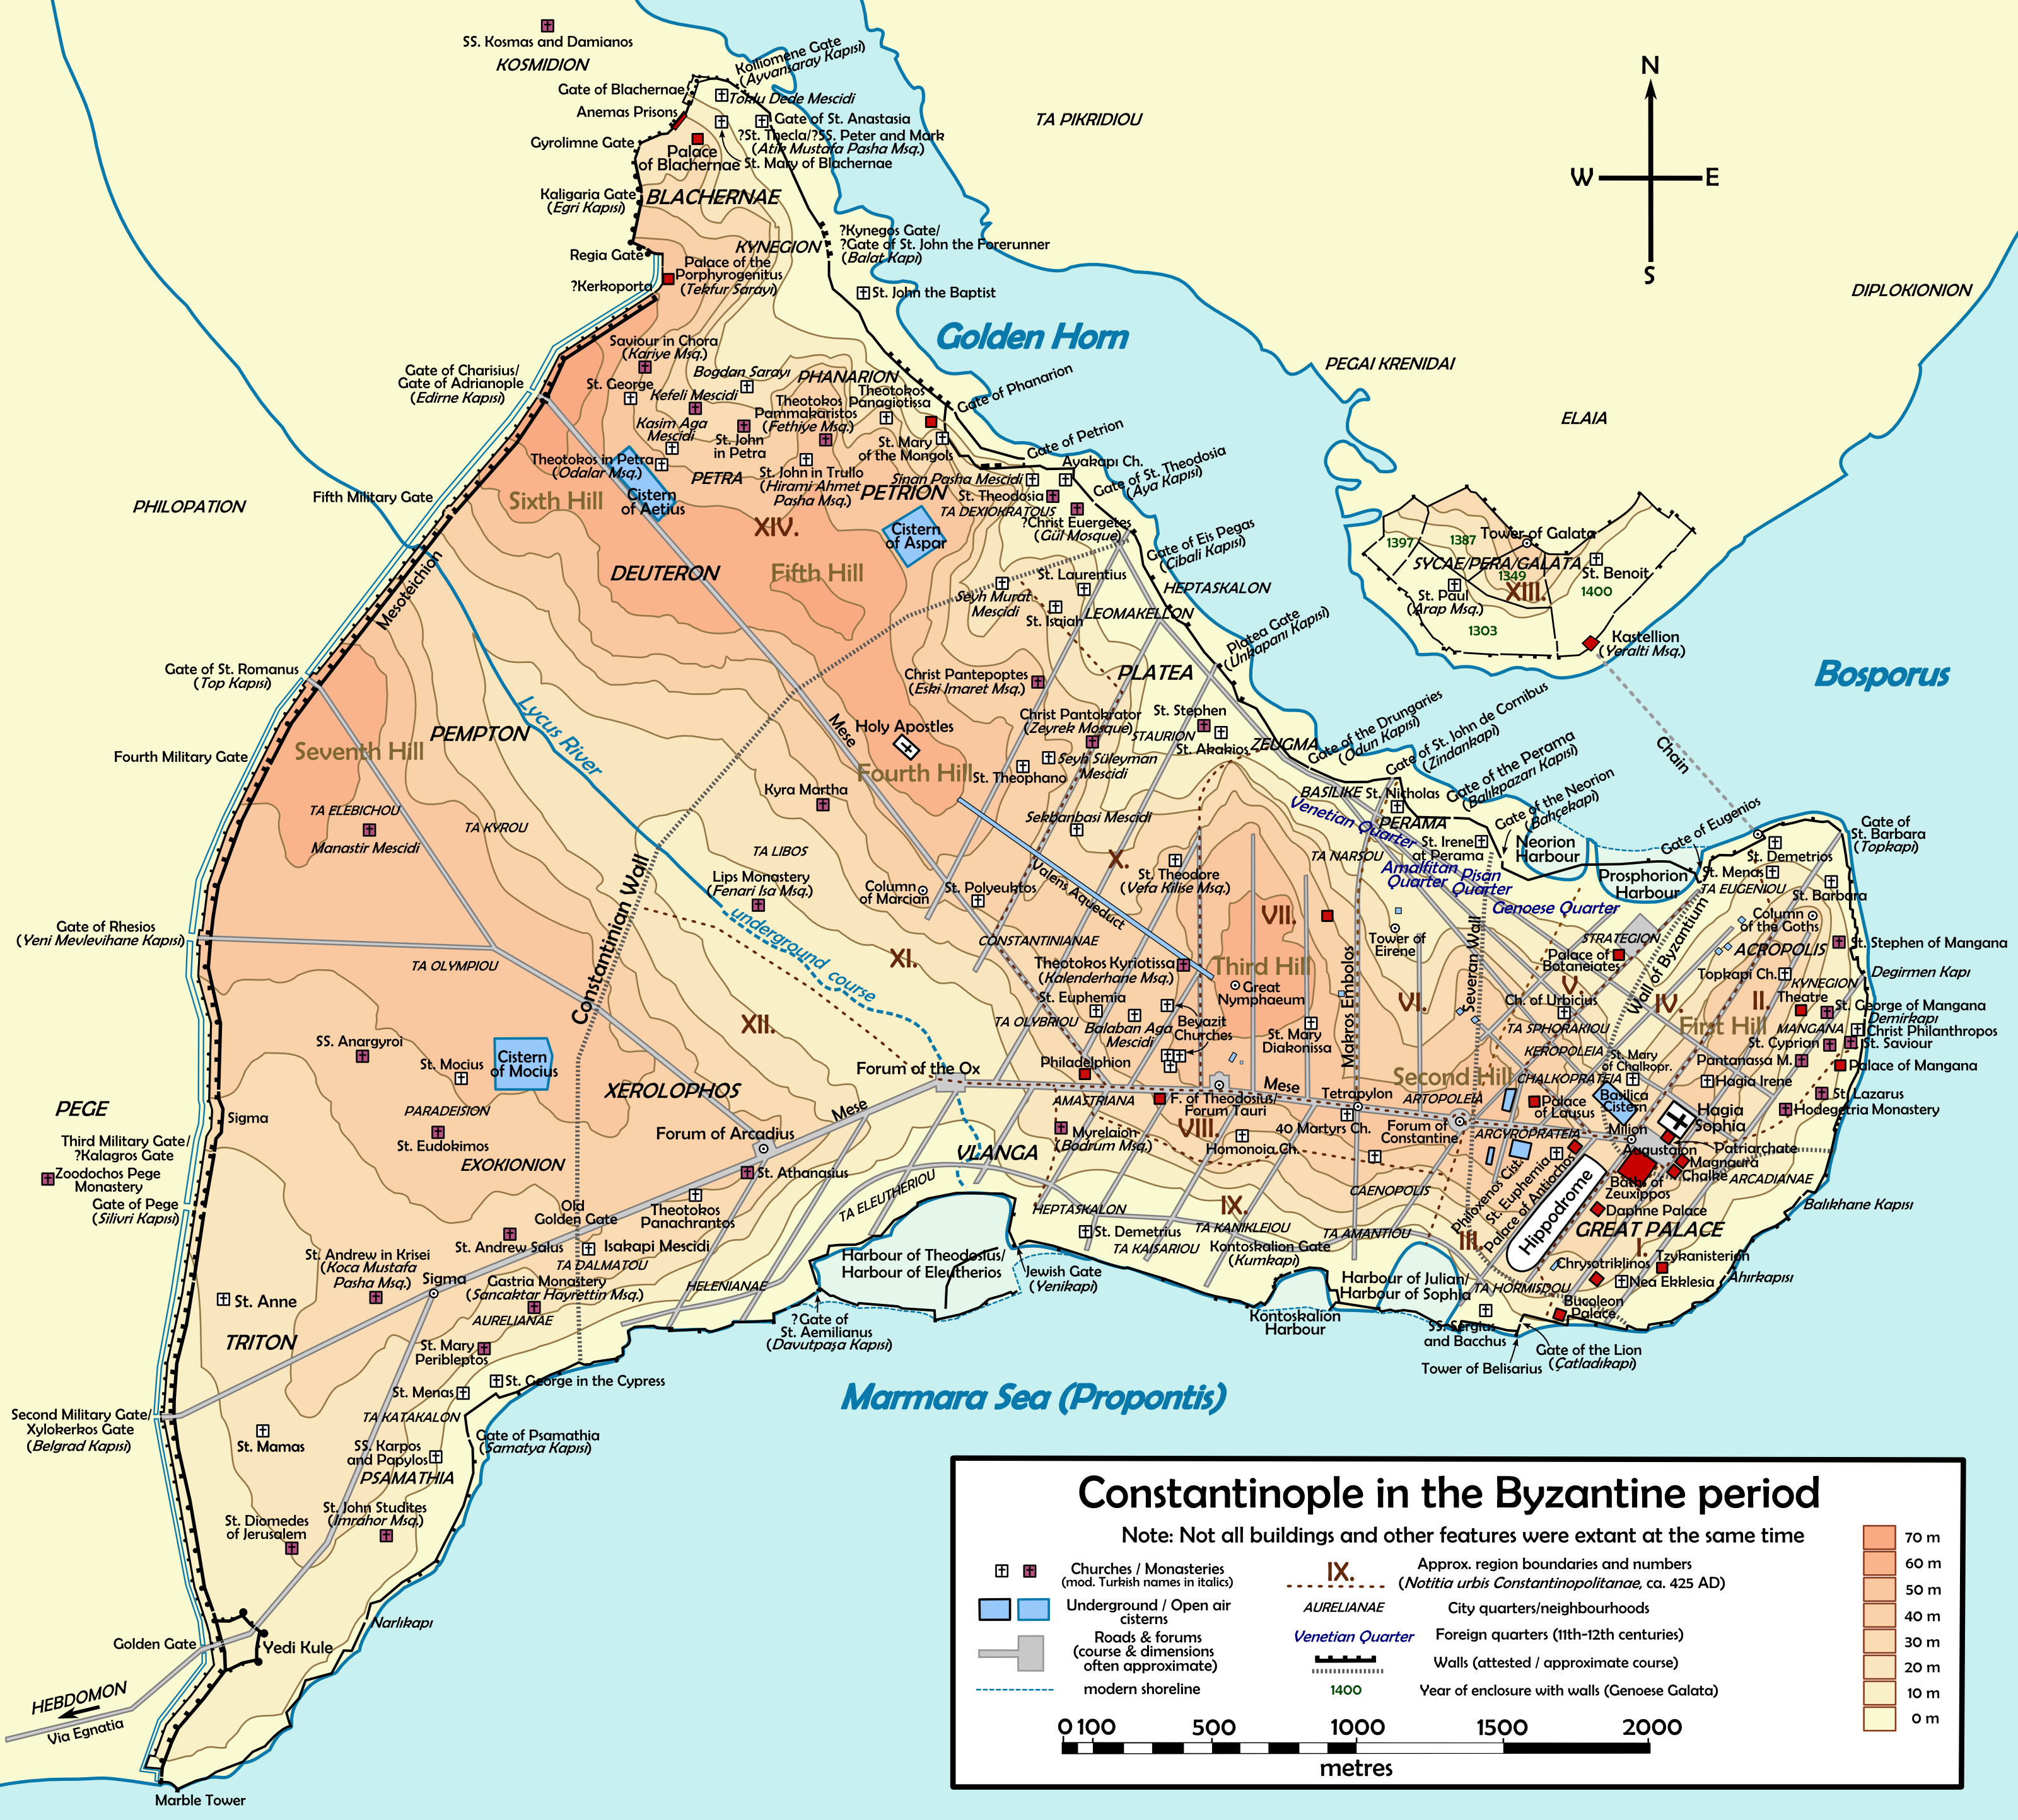

Slide 22
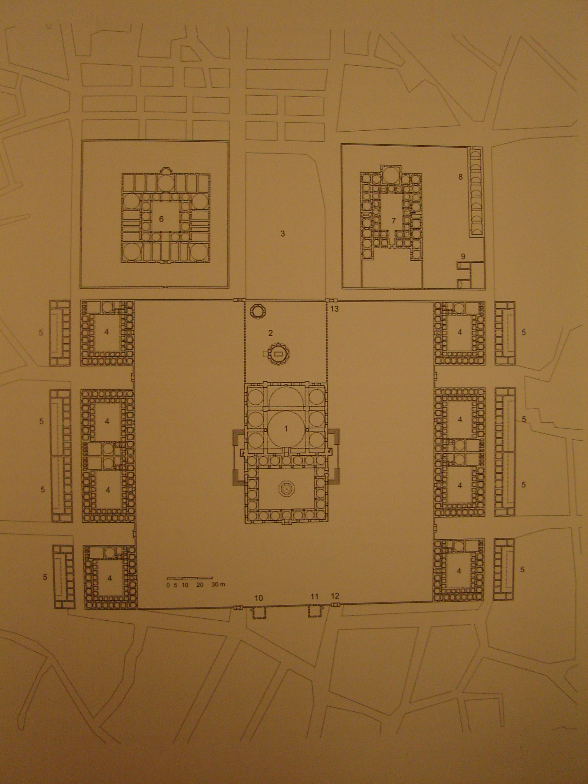
Site plan of the Mehmed II mosque-complex:
note the strict symmetry and geometric regularity

Slide 23
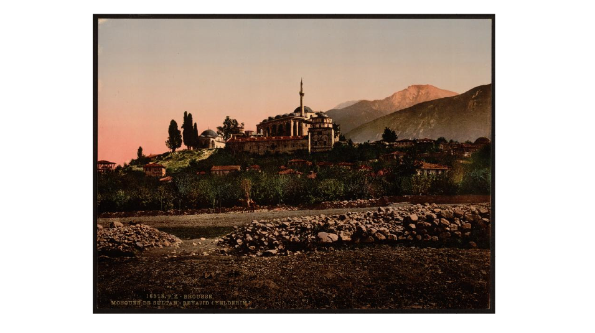
Bayezid I mosque-complex, Bursa

Slide 24
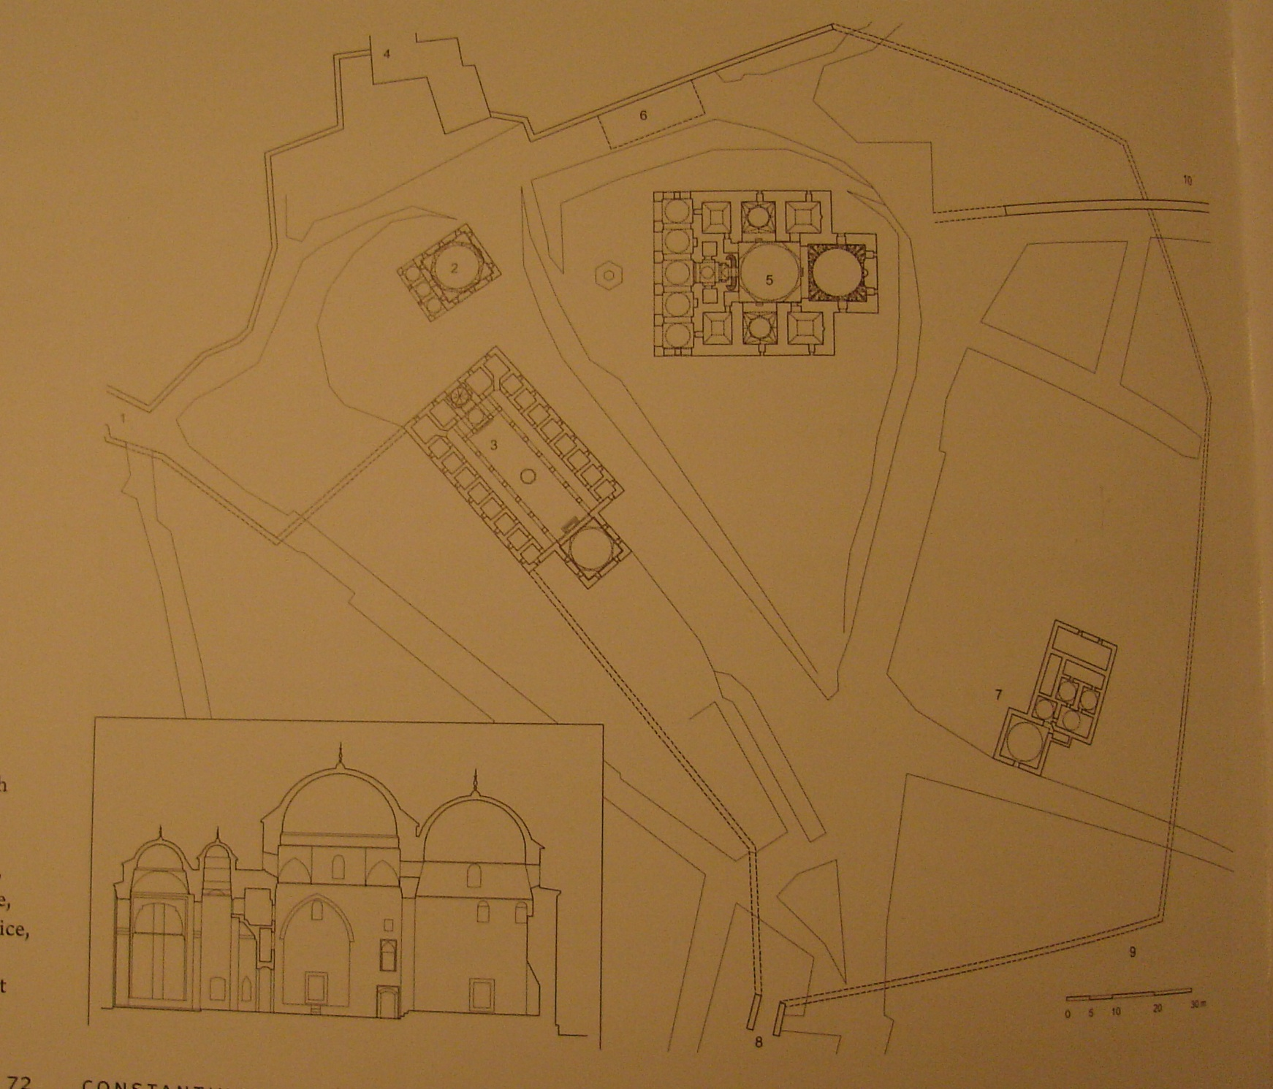
Site plan of Bayezid I mosque-complex

Slide 25
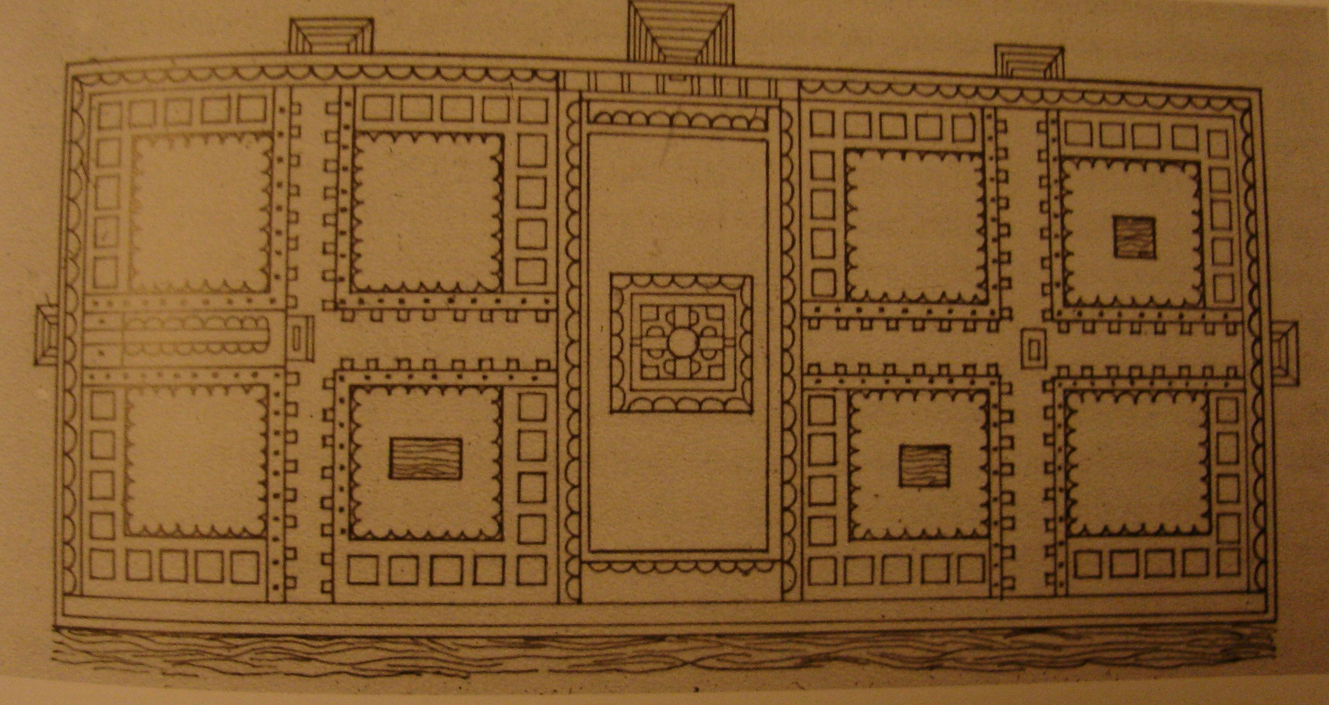
Filarete’s plan for the Ospedale Maggiore in Milan

Slide 28
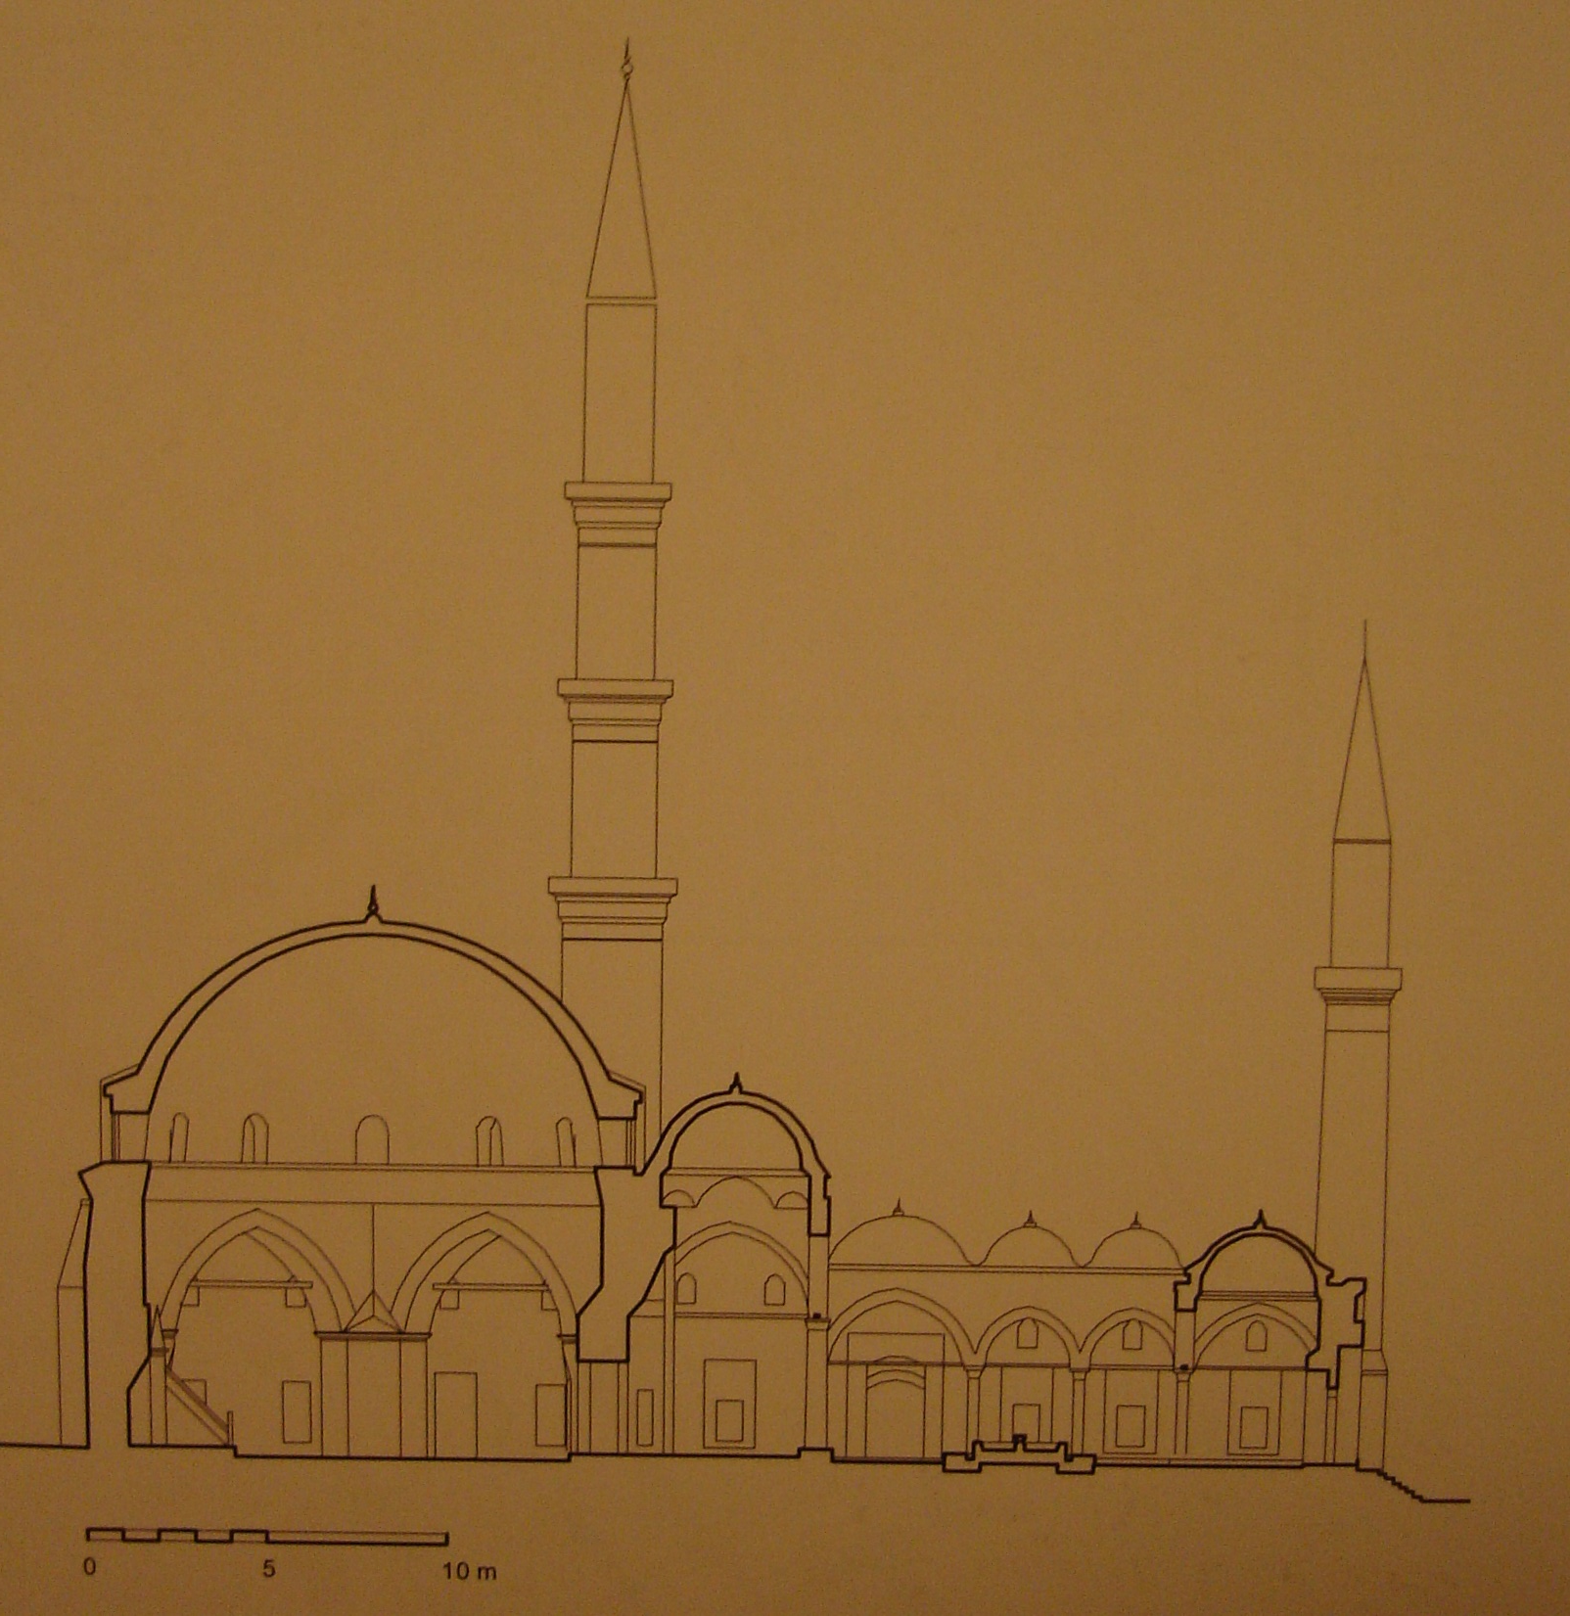
Profile of Üçşerefeli Mosque, Edirne

Slide 29
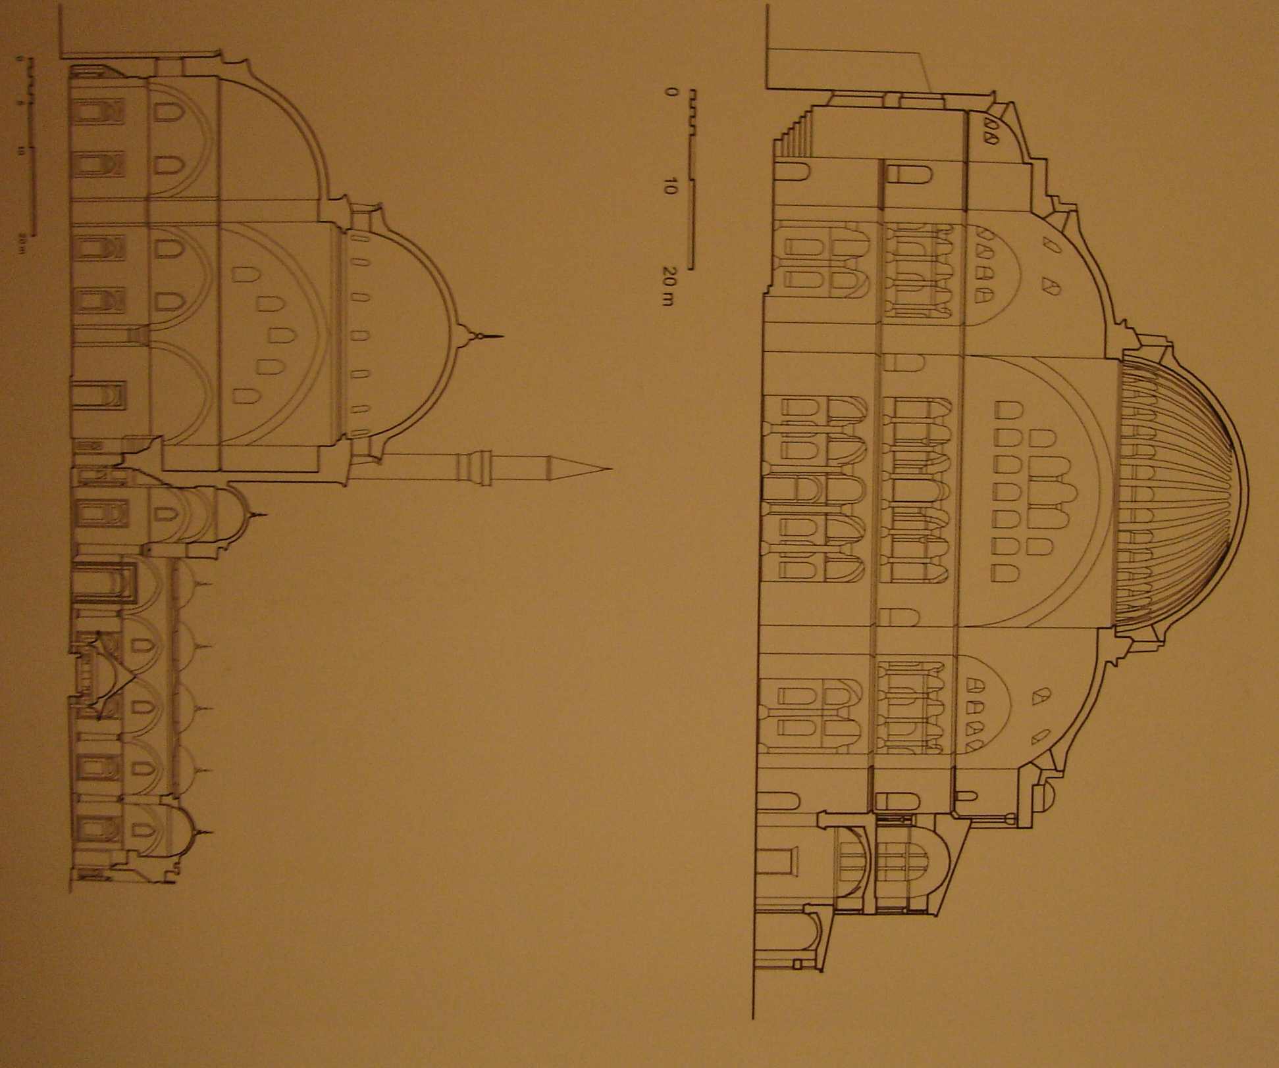
Profiles of Haghia Sophia and the Mehmed II mosque

