Slide 1
The Ottoman Empire and Europe, 1453-1922 Non-Muslims in the Ottoman Empire
James E. Baldwin
Department of History
University of Warwick

Slide 2
Diversity of the Ottoman population
Greek Orthodox Church: included Greek-, Slavic-, Arabic- and Turkish-speakers
Armenian Apostolic Church
Coptic Church of Egypt
Smaller churches: Maronite, various Catholic churches, Syriac Orthodox, Protestants
Long-standing Romaniote and Mizrahi Jewish communities
Emigration of Sephardic Jews to Ottoman Empire after expulsion from Spain in 1492

Slide 3
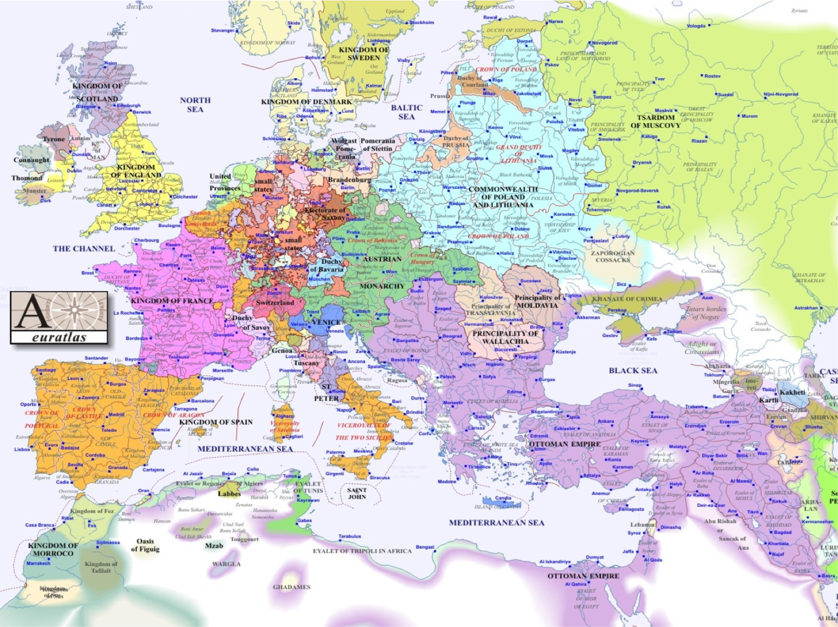

Slide 4
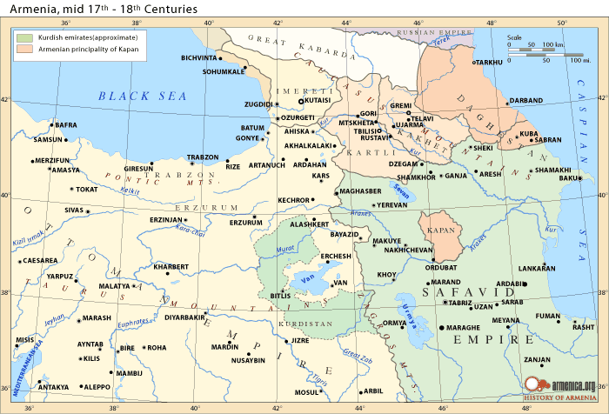

Slide 5
Diversity of the Ottoman population
Greek Orthodox Church: included Greek-, Slavic-, Arabic- and Turkish-speakers
Armenian Apostolic Church
Coptic Church of Egypt
Smaller churches: Maronite, various Catholic churches, Syriac Orthodox, Protestants
Long-standing Romaniote and Mizrahi Jewish communities
Emigration of Sephardic Jews to Ottoman Empire after expulsion from Spain in 1492

Slide 6
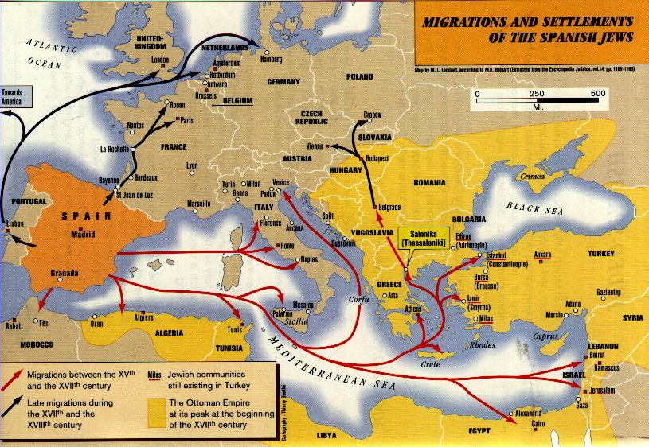

Slide 7
Stereotypes of Ottoman diversity
“Ancient hatreds”: different religious communities naturally hostile; sectarian violence erupts whenever central authority weak
Ottoman tolerance: Ottoman society tolerant, in contrast to western Europe, and inter-communal harmony the result

Slide 8
Ottoman diversity in reality
Both stereotypes contain elements of truth, but twist them to serve modern agendas
Non-Muslims were legally inferior to Muslims; however this did not prevent many non-Muslims from achieving wealth and power
Inter-communal harmony the norm; however there were numerous cases of serious sectarian tension and violence
Analysis must refer to specific historical circumstances, rather than sweeping generalizations

Slide 9
Non-Muslims in Islamic law
Pact of ‘Umar makes Christians and Jews “ahl al-dhimma” / “dhimmi” (people of the contract)
Christians and Jews pay poll tax (jizya)
Muslim government guarantees security of person and property
Christians and Jews do not provide military service
Superiority of Muslims guaranteed in regulations of Christians’ and Jews’ dress, deportment and worship
With exception of jizya tax, most of the rules inconsistently enforced

Slide 10
The Ottoman case
Similar to previous Muslim states, Pact of ‘Umar theoretically in force but inconsistently enforced
Devshirme child-levy is significant departure from previous practice

Slide 11
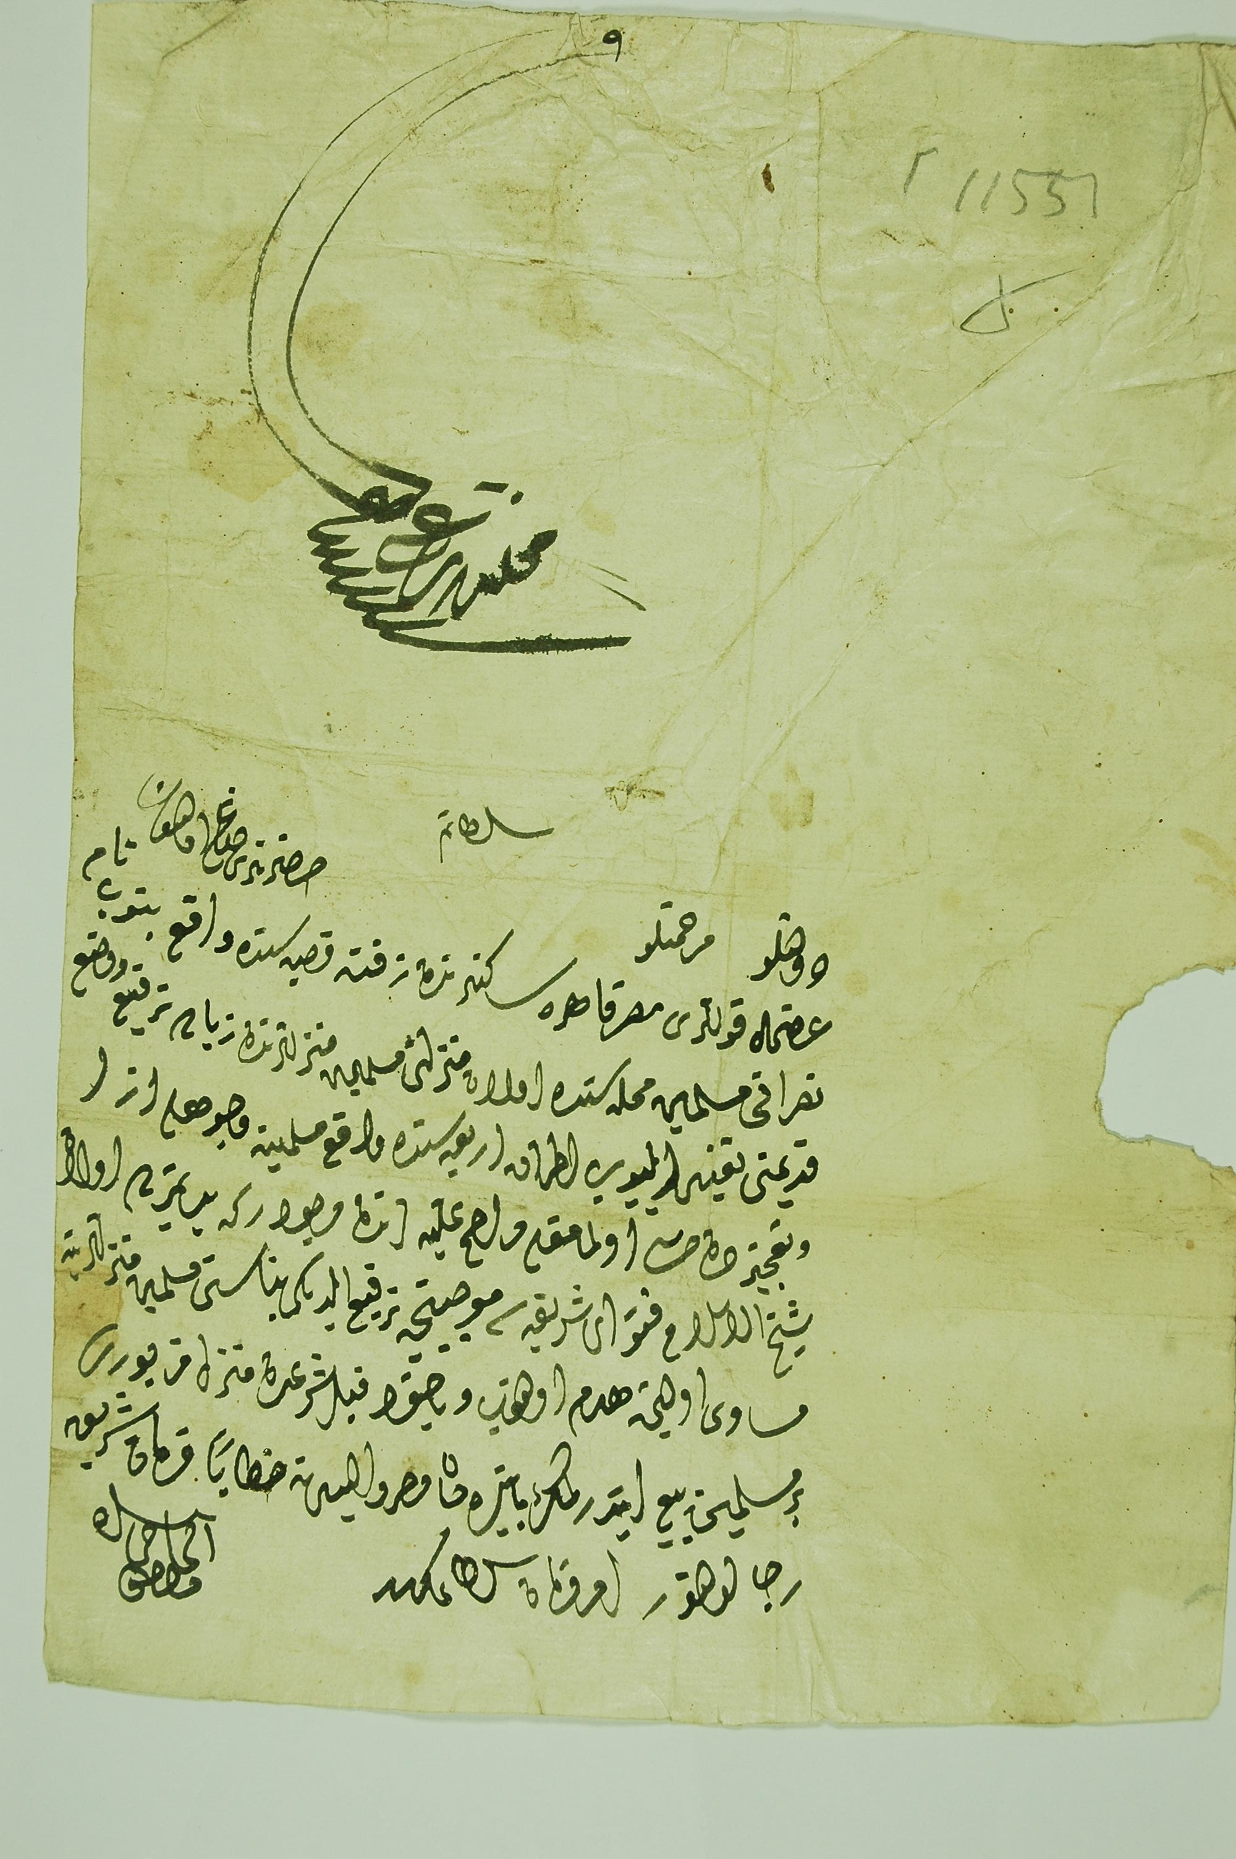
A petition from al-Hajj Mustafa, resident of Zifta, Egypt, complaining about the height of his Christian neighbour Banub’s house. Dated 1742.

Slide 12
The Ottoman case
Similar to previous Muslim states, Pact of ‘Umar theoretically in force but inconsistently enforced
Devshirme child-levy is significant departure from previous practice

Slide 13
Non-Muslim Institutions under Ottoman Rule
Ottomans conquer Constantinople, the seat of the Greek Orthodox Patriarch
Orthodox Church incorporated into Ottoman system of dominance
Judaism had no centralized, formal institution like the Church
Political leadership of Jewish communities varied from city to city: in some places it was the chief rabbi, in others it was another distinguished and powerful member of the community

Slide 14
The debate over the “millet” system
The concept of the “millet system” asserted that different religious communities given full communal autonomy under their religious leaders
Recent scholarship has shown that the millet system is a myth
Christians and Jews chose sharia courts over Christian / Jewish courts, even for intra-communal disputes
Ottoman government happy to allow non-Muslims to follow their own laws if they wishes, but it did not formally recognize Christian or Jewish courts

Slide 15
Where did the “millet system” idea come from?
19th-century legal reforms introduced the confessional basis for law: historians projected this backwards
Non-Muslim, Ottoman sources (the “founding myths”) talk about a millet system: however these texts were advancing claims rather than describing reality
The founding myths show non-Muslims arguing within an Ottoman frame of reference, by claiming precedents from the reign of Mehmed II

