Slide 1
The Ottoman Empire and Europe, 1453-1922
Conversion to Islam and Islamization
James E. Baldwin
Department of History
University of Warwick

Slide 2
Population in central regions of empire (Balkans and Anatolia)
Anatolia had seen widespread conversion to Islam before the Ottomans, starting in the 11th century
Significant Christian populations remained: Greeks in west and north, Armenians in east
Balkans largely Christian prior to Ottoman conquest

Slide 3
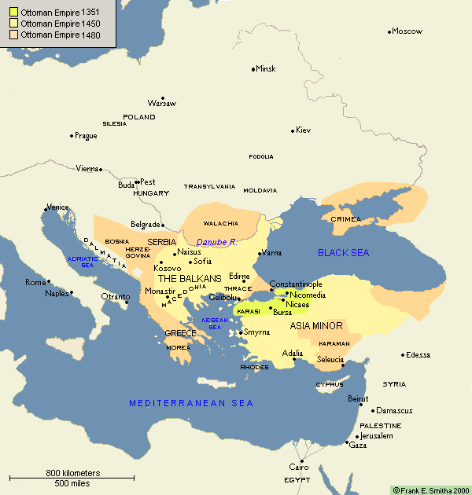

Slide 4
Population in central regions of empire (Balkans and Anatolia)
Anatolia had seen widespread conversion to Islam before the Ottomans, starting in the 11th century
Significant Christian populations remained: Greeks in west and north, Armenians in east
Balkans largely Christian prior to Ottoman conquest

Slide 5
Various modes of conversion
Conversion often meant changing language and culture: i.e. adopting Turkish in Anatolia and the Balkans
In Syria, Egypt and Iraq, Muslims and most Christians spoke Arabic, and so conversion did not involve adopting new language
In some cases in the Balkans and Aegean, large communities converted rapidly, retaining their language: Bosnians, Albanians and Greek Muslims of Crete

Slide 6
Theories of conversion
Compulsion: a popular stereotype among nationalists, but little evidence for it
Economic coercion: the jizya tax. But rates of conversion don’t correlate with jizya rates or poverty levels
Conversion sometimes a means of preserving or enhancing social status and prestige: e.g. Balkan nobility in the 15th century, urban merchants in the 17th
Intermarriage leading to conversion of women

Slide 8
Conversion in the countryside
Urban religiosity tended towards the scriptural and orthodox, due to literacy and presence of clerics
Rural population largely illiterate and had limited access to clerics. Rural religiosity centered around saints and shrines
Rural cosmologies could be syncretic, incorporating Christian and Muslim elements
Rural conversion was therefore a gradual process
The Church, which could have countered this process, was weak in many rural areas due to the Bogomil heresy

Slide 9
Ottoman government’s attitude to conversion
In 15th and 16th centuries, the Ottomans did not encourage conversion of ordinary subjects, possibly for fiscal reasons
In 17th century, the state began to actively encourage conversion
Context was rise of Kadızadeli pietist movement
Kadızadelis aimed to reform Muslims rather than make converts. But their influence over Sultan led to identification of Ottoman identity with promotion of orthodox Sunni Islam

Slide 10
How did 17th-century Ottomans promote orthodox Islam?
Financial rewards provided for new converts
Non-Muslims increasingly excluded from positions of power
Public space increasingly Islamized

Slide 11
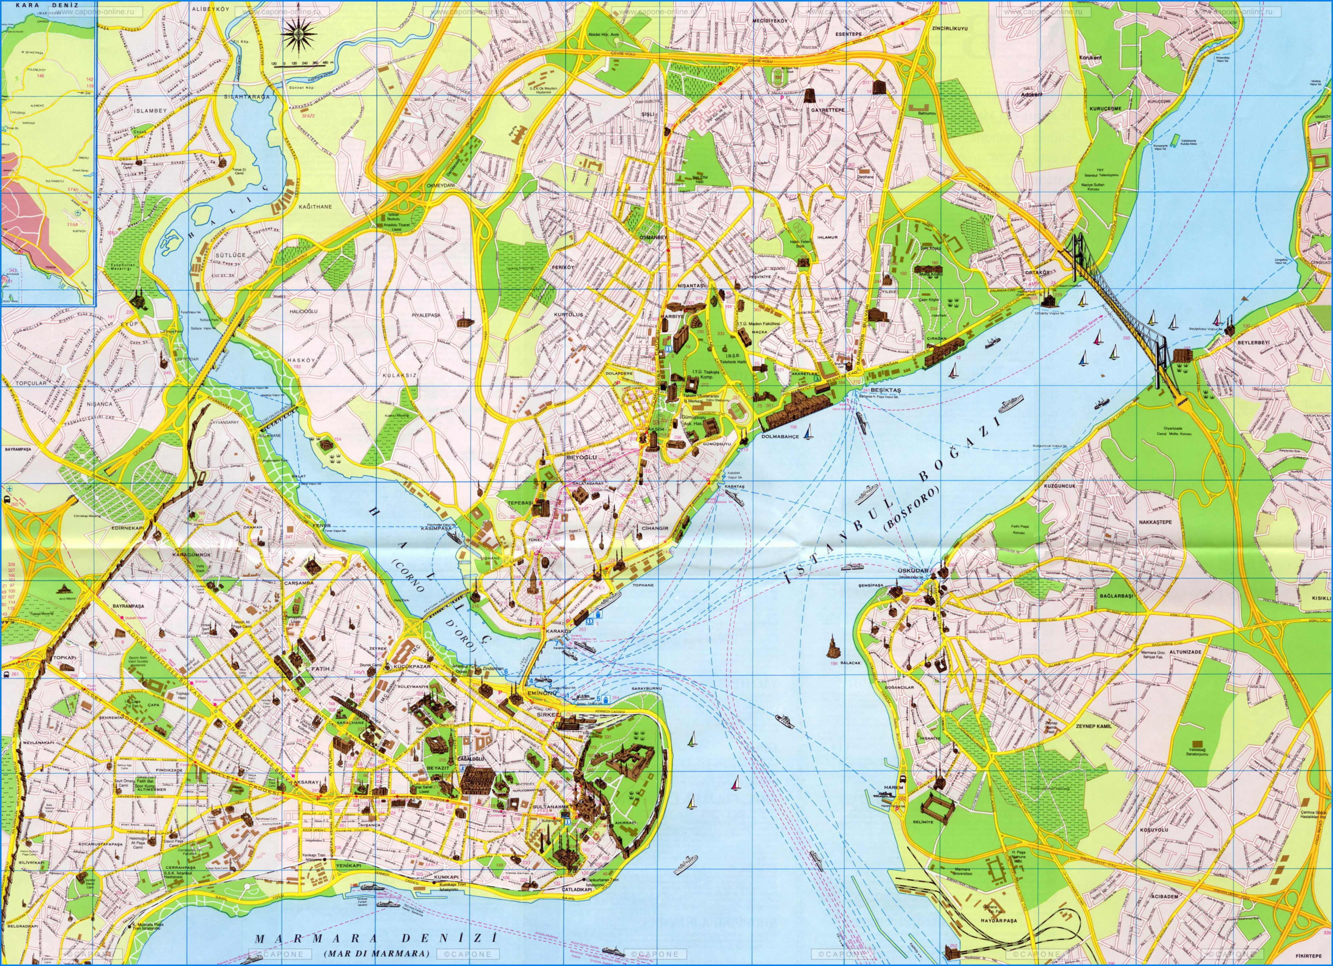

Slide 12
The Istanbul fire of 1660
Ottoman government took opportunity to rebuild Eminönü as a Muslim space
Valide Sultan mosque-complex replaced synagogues and apartment buildings that had mainly housed Jews
Jewish population moved to Hasköy
Christians of Galata prevented from rebuilding burned churches; land used to compensate Muslim landlords of Eminönü

Slide 13
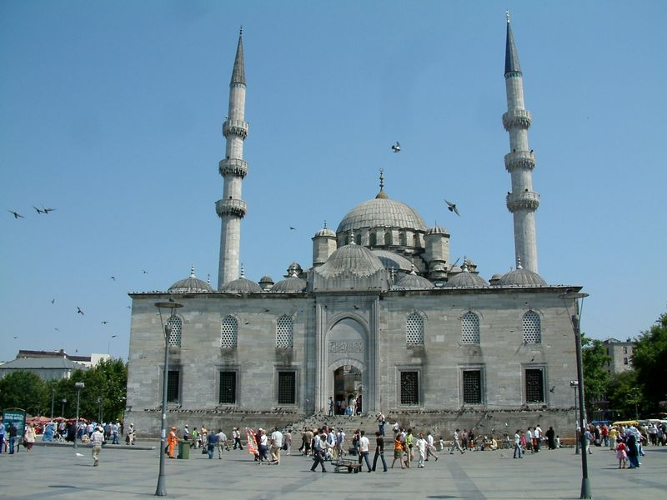

Slide 14
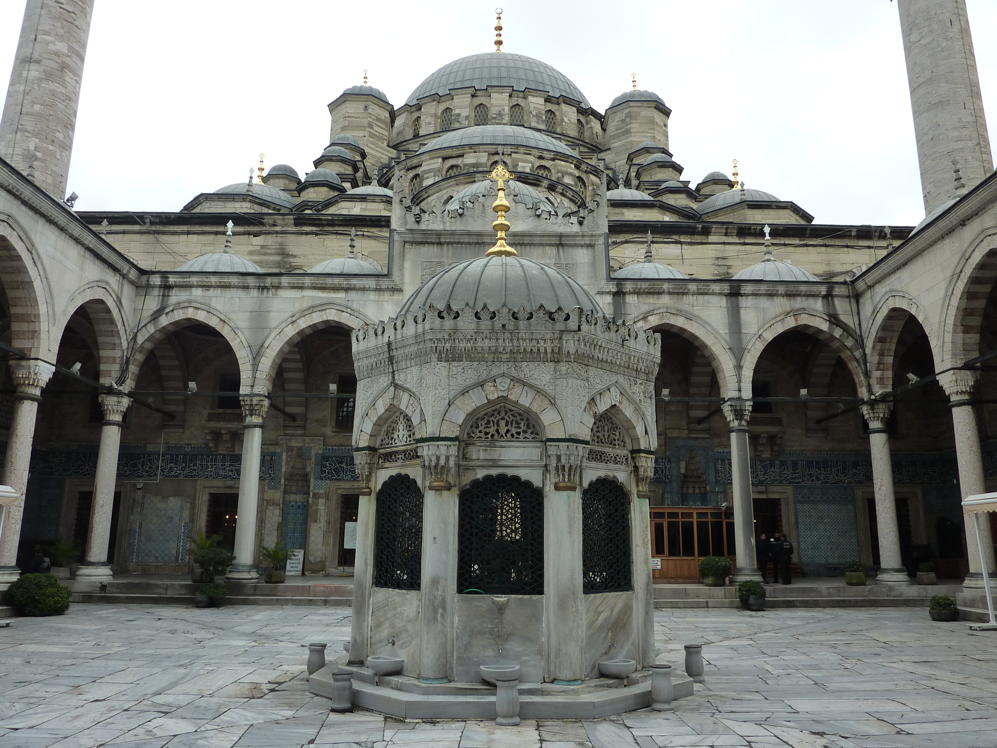

Slide 15
