Slide 1
The Ottoman Empire and Europe, 1453-1922 Ottoman Territorial Contraction in the Eighteenth Century
James E. Baldwin
Department of History
University of Warwick

Slide 2
The Seventeenth Century
In first half of century, Ottoman Empire faced agricultural and fiscal crises and internal rebellions
By the middle of the century, the empire had recovered, and there was further expansion in Crete and Podolia
Rate of expansion much slower than sixteenth century: empire was approaching natural limits of expansion

Slide 3
The Eighteenth Century
Ottomans suffered major territorial losses, particularly to their chief rivals the Habsburg Monarchy and Russia
Diplomatic service increased in importance within the empire, as the Ottomans sought to preserve their territory through negotiation rather than military victory
The treaties of the eighteenth century entailed fundamental changes in Ottoman attitudes to international relations

Slide 4
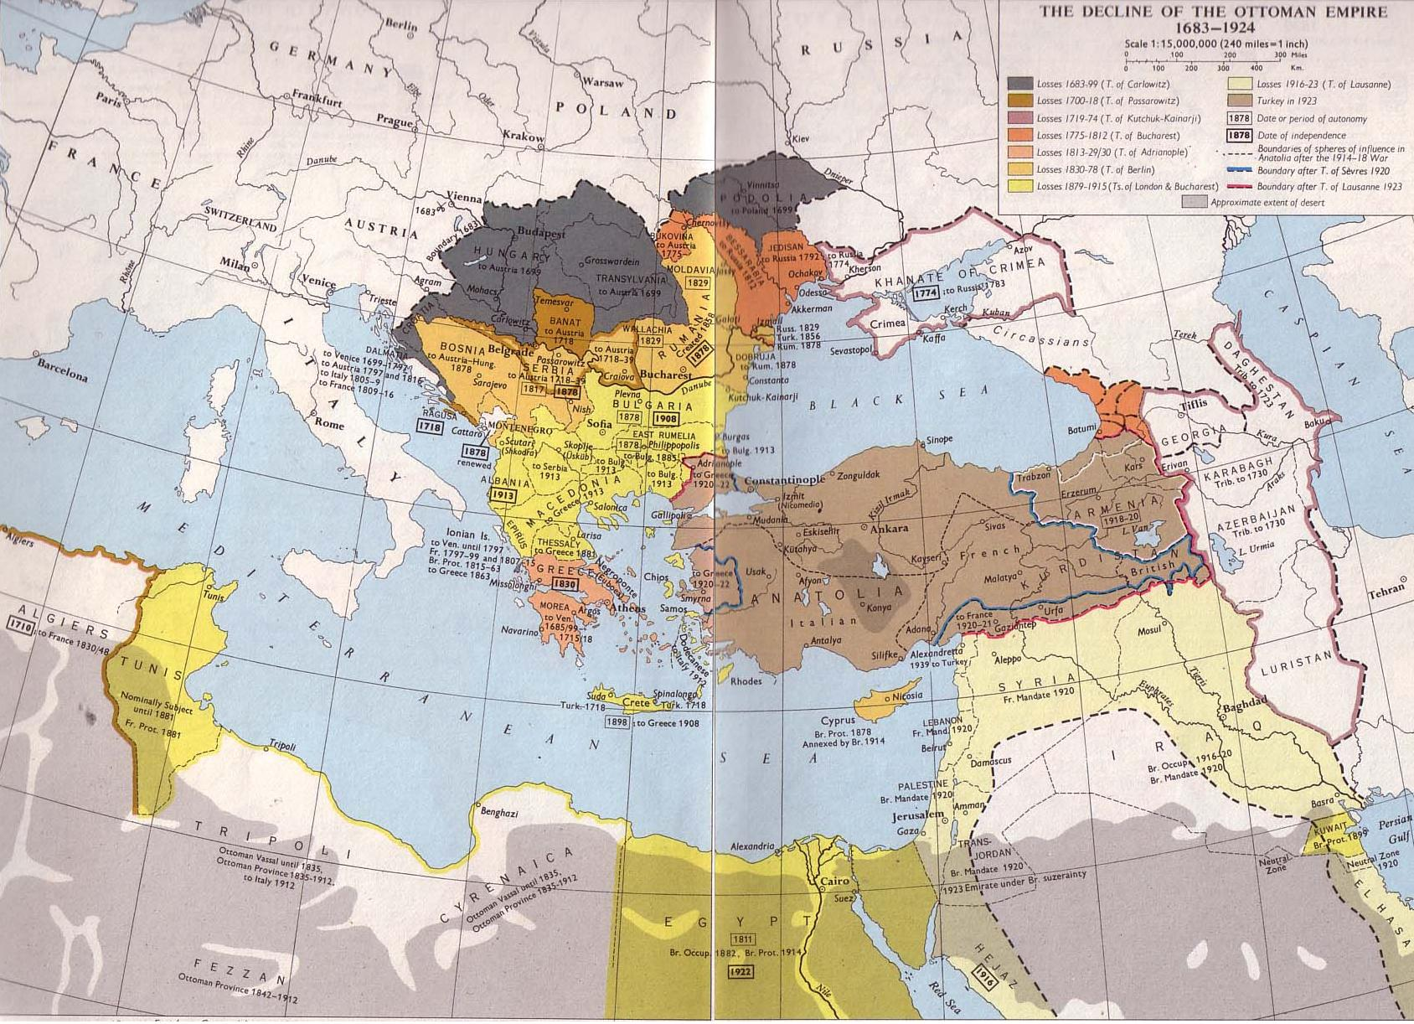

Slide 5
The Great Turkish War, 1683-99
War between the Ottoman Empire and a coalition of the Habsburgs, Holy Roman Empire, Poland, Venice and Russia
Ottomans besiege Habsburg capital Vienna
Relief force led by King Jan III of Poland breaks siege
Ottomans lose significant territory, especially at Battle of Mohacs in 1687 and Battle of Zenta in 1697

Slide 6
Treaty of Karlowitz, 1699
Peace conference held at Karlowitz, Serbia, during late 1698 and early 1699
Uti possidetis: territory currently held is starting point for negotiation
Ottomans lost Bosnia, most of Hungary and part of Temesvar to Habsburgs
Ottomans lost Podolia to Poland and Dalmatia and Peloponnese to Venice
Truce agreed with Russia; Treaty of Constantinople in 1700 gave Azov to Russians

Slide 7
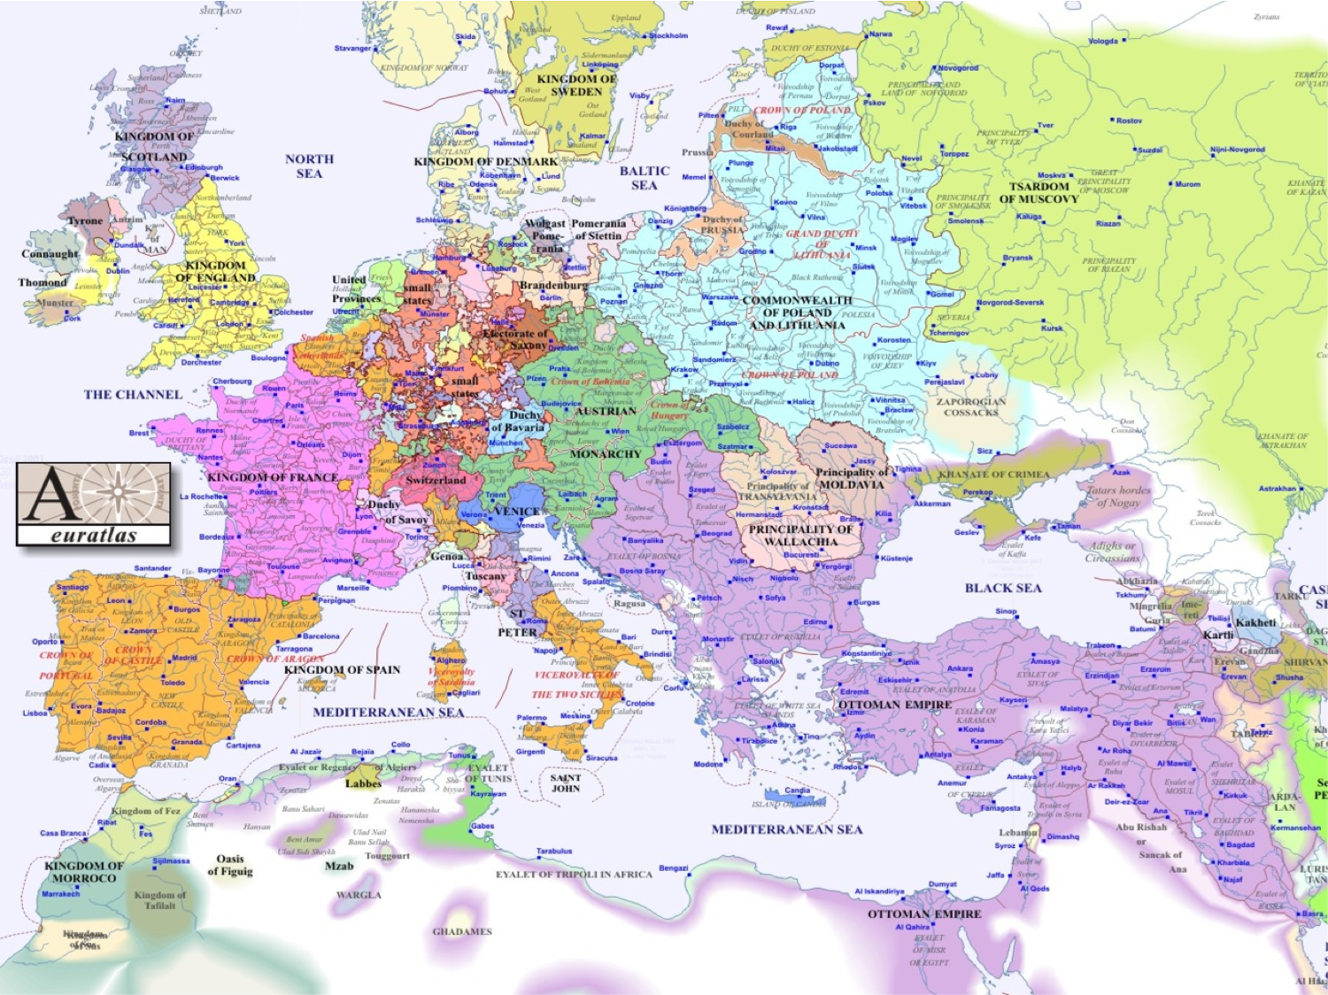

Slide 8
First half of 18th century
Ottomans reasonably successful in wars of the first half of the 18th century
Regained Azov from Russia in war of 1710-11
In 1714-18, regained Peloponnese and defended Crete against Venice, but lost remainder of Temesvar, central Serbia and part of Wallachia to Habsburgs
1735-39: Ottomans regained most of territory lost to Austria in 1718; surrender Azov to Russia, but Russians may not fortify it

Slide 9
Second half of 18th century
Russo-Ottoman war of 1768-74: Russians advance deep into Moldavia and Wallachia, occupying Bucharest, routing Ottoman army at Kartal
Treaty of Kucuk Kaynarca is humiliation for Ottomans: Karbadia in north Caucasus ceded to Russia, Crimea declared independent, Russia allowed Black Sea fleet, Russia claims protectorship over Ottoman Christians
Russo-Ottoman war of 1787-92 fails to reverse Kucuk Kaynarca; Treaty of Jassy cedes Yedisan to Russia and confirms Russian annexation of Crimea
France invades and occupies Egypt in 1798

Slide 10
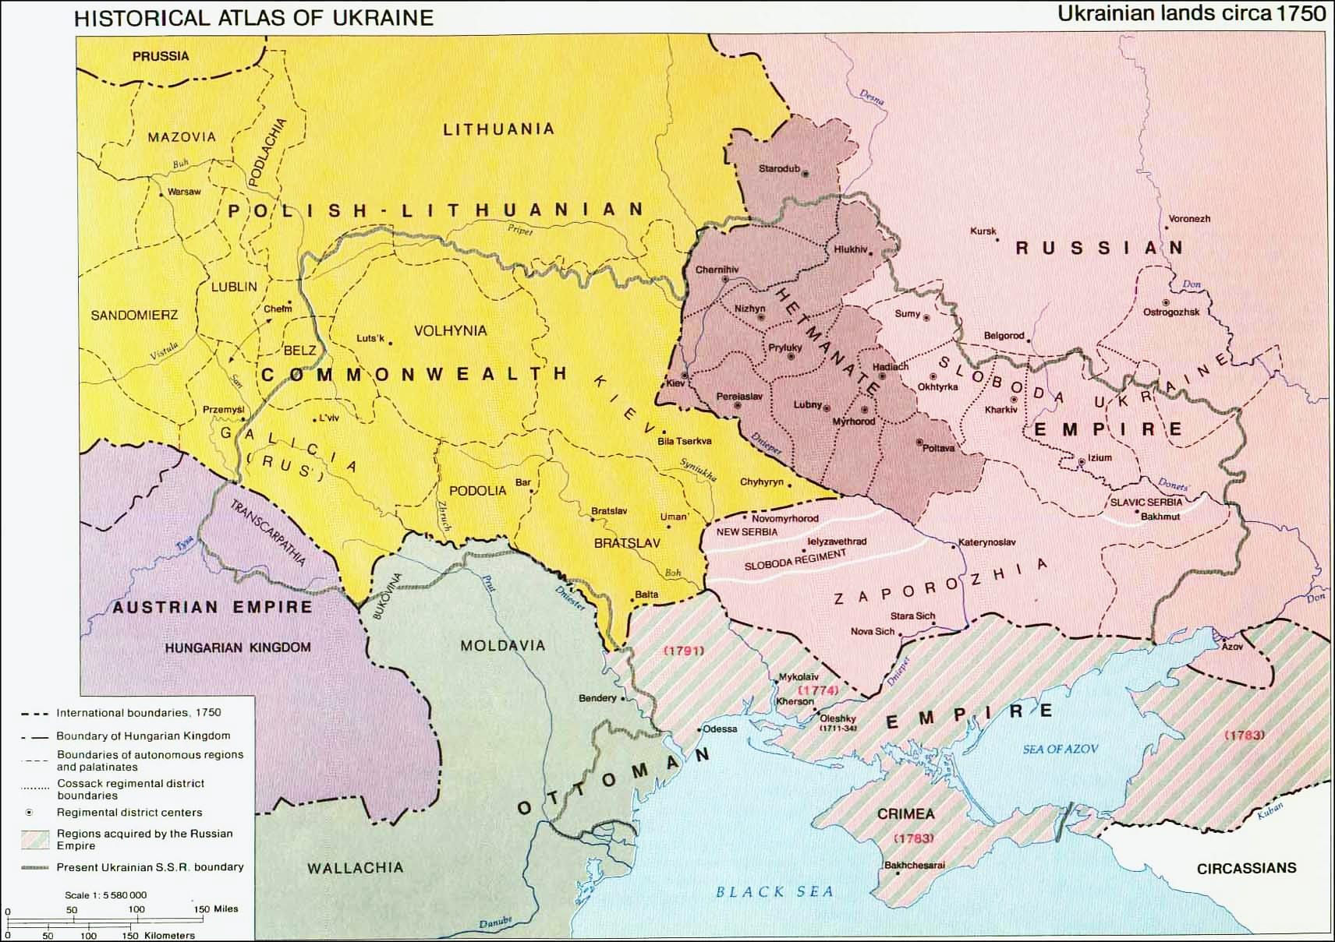

Slide 11
The significance of Karlowitz
Significant territories lost: 60,000 sq miles to the Habsburgs
Ottomans formally conclude a permanent peace, and agree borders, for the first time
This entails acceptance of international law, and abandonment of the gazi tradition
This causes friction with Ottoman subjects in frontier regions, particularly the Tatars of the Crimea and Caucasus

Slide 12
Why relative military decline in the 18th century?
Traditional argument: inherent conservatism of Muslims made the Ottomans unwilling to copy “infidel” innovations and unable to innovate themselves
Recent scholarship disproves this: in the field of military technology, the Ottomans kept pace with European developments
Ottomans were not able to imitate European military reforms such as conscription and drill
This was due to the entrenched political power of the military regiments, who resisted reforms that would affect their interests

