Slide 1
The Ottoman Empire and Europe, 1453-1922 Early Modern Diplomacy and Intermediaries
James E. Baldwin
Department of History
University of Warwick

Slide 2
Ottoman-European relations
Frequent wars should not obscure the other dimensions of Ottoman-European interaction, in particular trade
France, and later England and the Dutch Republic, maintained friendly relations with the Ottoman Empire most of the time
In the case of the Ottomans’ principal rivals, Austria and Venice, there were long periods of peace during which commercial relations were pursued
The main purpose of European diplomacy in the Ottoman Empire was to facilitate trade

Slide 3
The English embassy
Before 1580, most English trade with the Ottoman Empire was conducted via Venice or Antwerp
Levant Company formed in the 1570s
The company receives a charter from Queen Elizabeth I in 1580
In 1578, the company sends William Harborne to Constantinople to negotiate right of English to trade independently
Sultan Murad III granted capitulations (‘ahdname) to England in 1580
Harborne stays on in Constantinople as English ambassador: appointed by the Queen, but his salary paid by the Levant Company
Levant Company still paying salaries of ambassador William Trumbull in the late seventeenth century

Slide 4
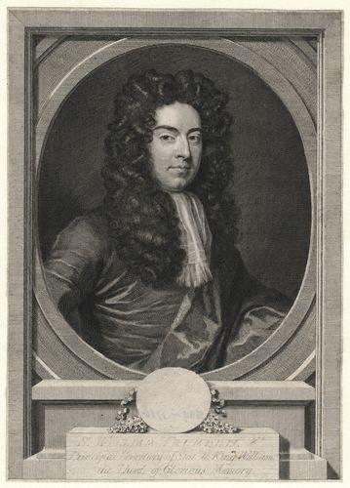
Sir William Trumbull, ambassador at Constantinople, 1686-91

Slide 5
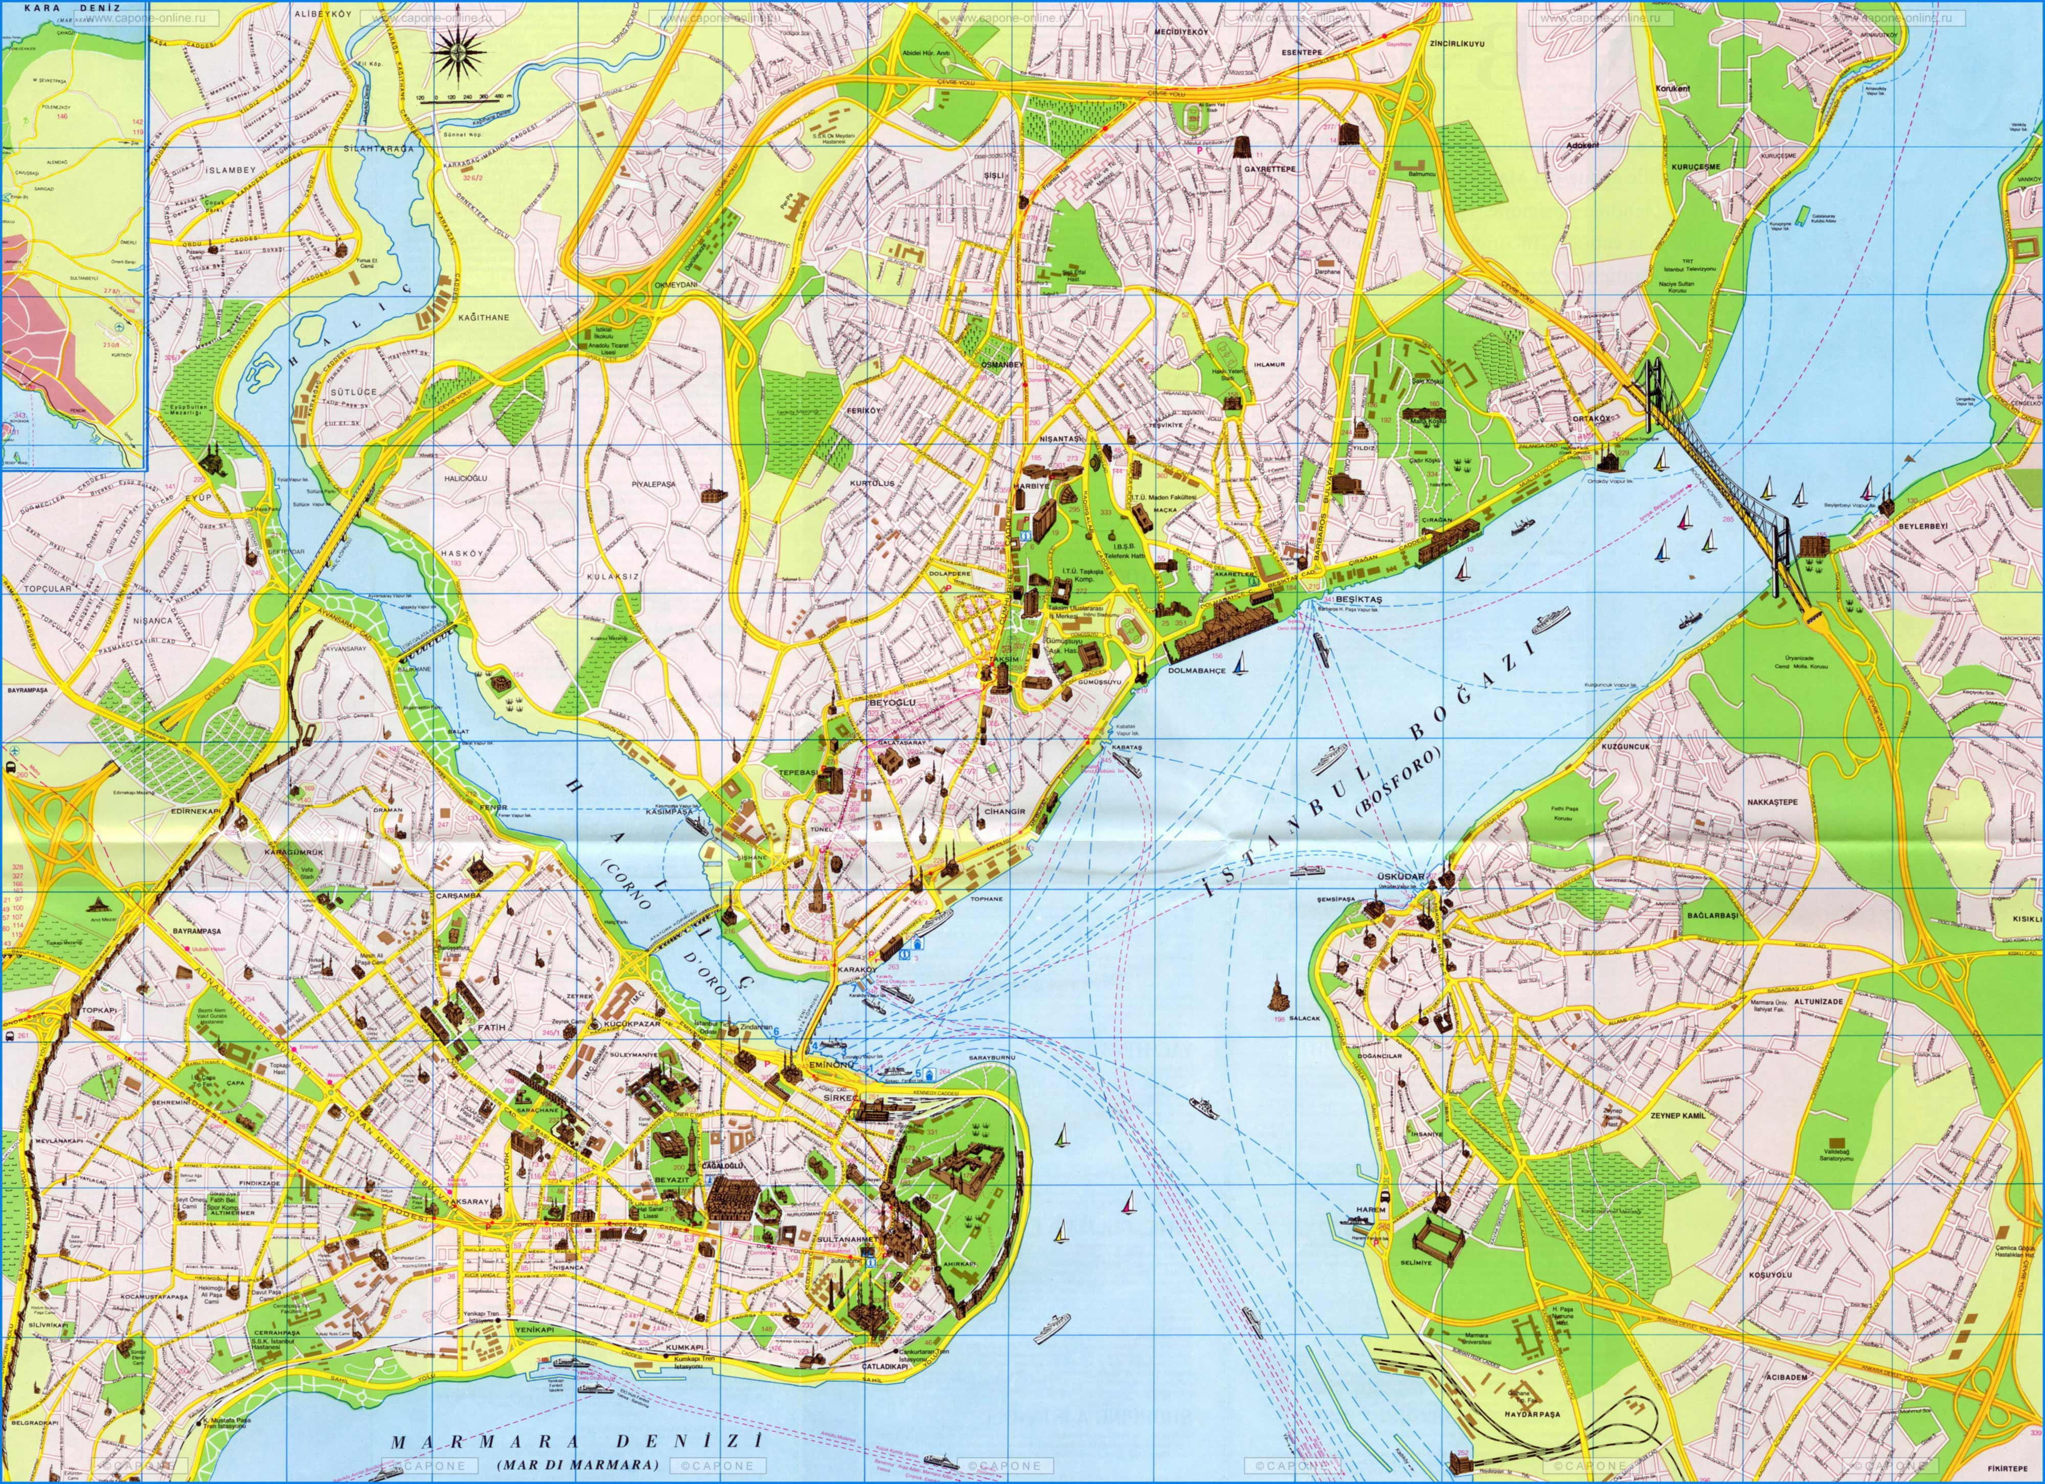

Slide 6
What about Ottoman diplomacy?
Ottomans sent envoys to European capitals for specific missions, but they did not maintain permanent embassies until 1793 when embassy established in London
Constantinople a more hospitable environment for foreigners than most European capitals due to diverse population and religious tolerance
More importantly, trans-Mediterranean trade was much more significant to west Europeans than it was to Ottomans
West Europeans depended on Ottoman Empire for many key commodities including coffee, pepper, spices and silk
Mediterranean trade accounted for only 5-10% of total volume of Ottoman trade

Slide 7
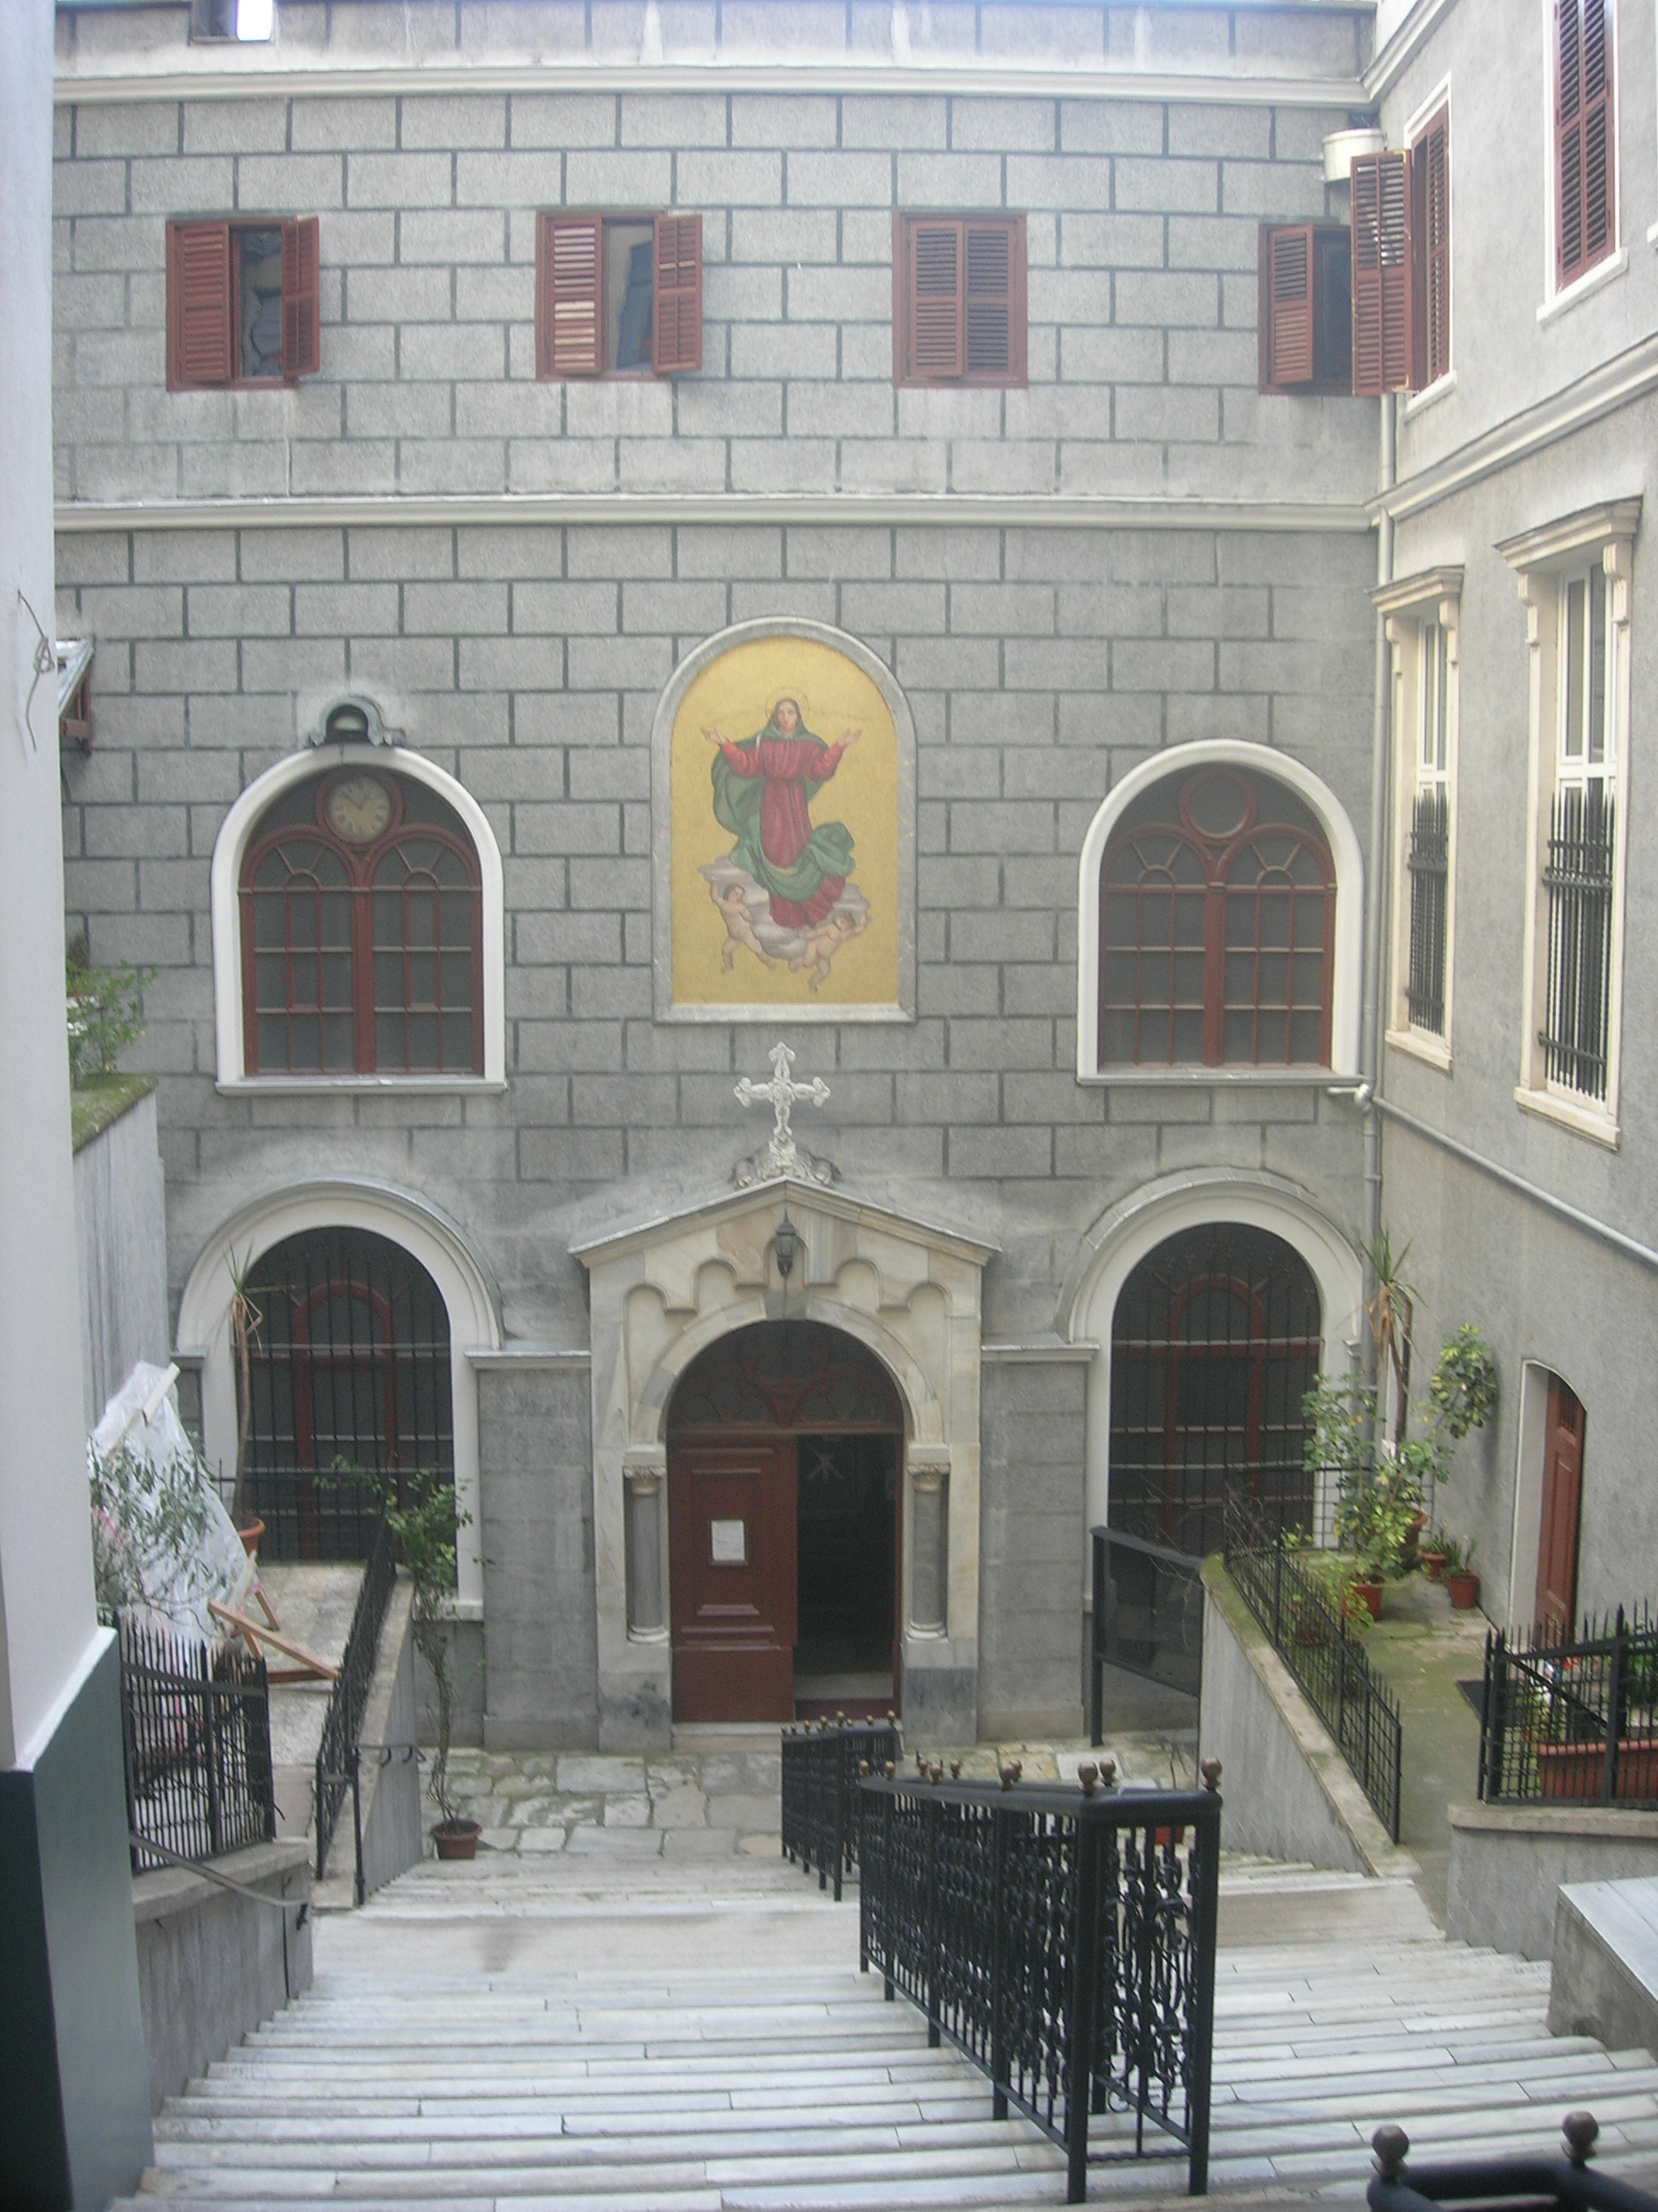
Santa Maria Draperis, est. 1584
(current building dates from 1769)

Slide 8
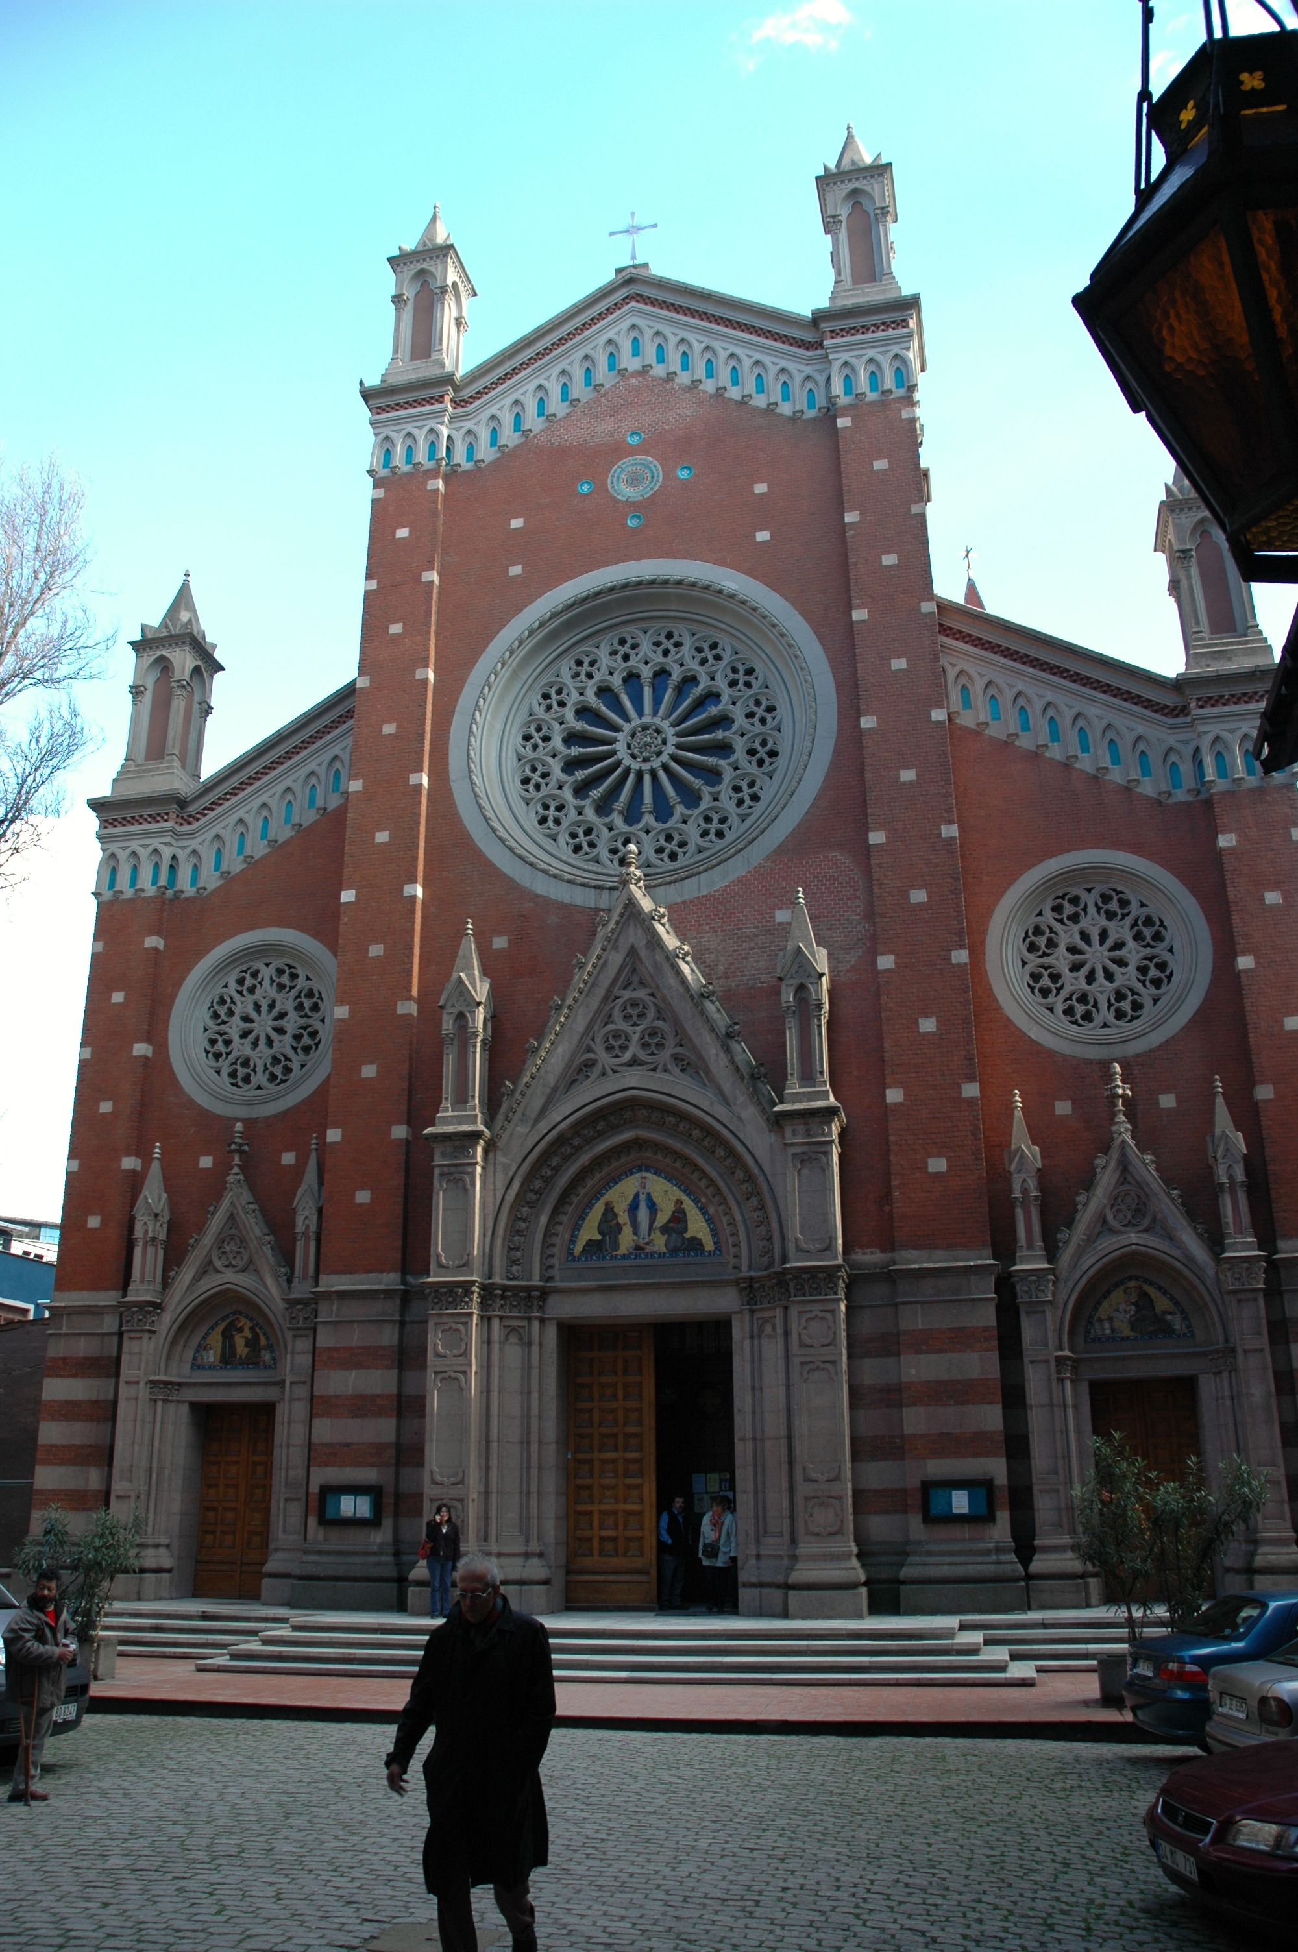
St Antony di Padua, est. 1725
(current building dates from 1912)

Slide 10
The practice of diplomacy
Diplomacy conducted through face to face meetings
Importance of gifts: Venice treacle, fabrics, manuscripts, telescopes, barometers, clocks
Hospitality: coffee, sherbets, water, perfume
The circulation of news was an important aspect of diplomacy
Ambassadors sought favorable terms for their country’s trade, and supported individual merchants facing difficulties
Ambassadors also responsible for supervising their own nationals: capitulations granted partial extra-territoriality

Slide 11
The importance of intermediaries
European diplomats typically spoke Italian but little Turkish
Ottoman officials rarely spoke Italian or other European languages
Dragomans (interpreters) employed during meetings; they also translated and wrote letters and documents, and often conducted diplomacy themselves
Dragomans provided cultural as well as linguistic translation

Slide 12
Who were the dragomans
Dragomans employed by European embassies tended to be drawn from Greek and Levantine families resident in Constantinople
Ottomans recruited dragomans from the same population, but also employed converts to Islam of European background
Greek families from the Phanar district of Constantinople increasingly dominated the Ottoman dragoman service in the eighteenth century: these wealthy families were known as “Phanariotes”
The need for intermediation allowed communities that transcended cultural and political boundaries, Natalie Rothman’s “trans-imperial subjects,” to prosper

