Slide 1
Who Do You Think You Are? The Question of Power/Knowledge and the Construction of the Human Subject:
Michel Foucault
Dr Claudia Stein

Slide 2
Linguistic Turn (def.):
Major philosophical development in the 20th century that focusses primarily on the analysis of language (not only spoken language!) and the relations between language, language users and ‘the world’ (also called ‘reality’).
The term ‘the linguistic turn’ is coined in the 1970s in the US and covers different theoretical approaches (e.g. French theorist such as Barthes, Derrida, Lyotard etc. and American literary critics such as Hayden White).

Slide 3
At stake in the problematization of language is the big question of ‘reality’ (i.e. how do we understand ‘the world’ around us and ourselves as human beings)
Can humans ever ‘get’ at truth of ‘the world’, considering that they always have to use some form of language to communicate their experiences of ‘reality’? (This includes scientific ‘languages’)
For historians, in particular, this raises the big question whether they can ever get at the ‘experiences’ of their actors in the past? After all, their main tool is ‘language’.

Slide 4
The answer of postwar ‘linguistic turn’ enthusiasts is clear:
Reality is NOT representable in any form of human culture (whether written, spoken, visual or dramatic)
Because ‘reality’ is not representable in any form, no authoritative account can exist of anything)
Nobody (including historians) can make claims of possessing a ‘universal’ truth of anything. There is never a single single authority on a given subject of knowledge (this includes claims made in the natural sciences!)
Reminder: ‘The Death of the Author’ (Barthes)

Slide 5
Because there is no authoratative account of anything, postmodern ‘linguistic turn’ practitioners target accounts which claim to represent such a ‘universal truth’.
Target: the hidden ‘metanarratives’ of modernity that originated in the Enlightenment – the ‘grand narratives’ or ‘metanarratives’ of modernity
‘Simplifying to the extreme, I define postmodern (scholarship) as incredulity toward metanarratives. ... The narrative function is losing its function, its great heroes, its great dangers, its great voyages, its great goal. It is being dispersed in clouds of narrative language ... Where, after the metanarratives, can legitimacy reside?’
Jean-François Lyotard, The Postmodern Condition: A Report of Knowledge (1979).

Slide 6
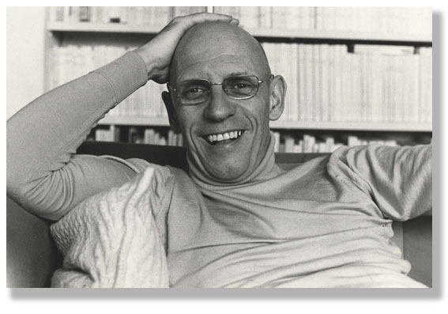
Attacking Enlightenment ‘metanarratives’: the nature of knowledge and the nature of power and the nature of history writing
Michel Foucault 1926-1984

Slide 7
History Writing as a Demasking of ‘the Present’
‘It (history writing) consists in uncovering ... thought and trying to change it: showing that things are not as obvious as people believe, making it so that what is taken for granted is no longer taken for granted. To practice criticism is to make harder those acts which are now too easy... [A]s soon as people begin to no longer be able to think things the way they have been thinking them, transformation becomes at the same time very urgent, very difficult and entirely possible.’
M. Foucault, ‘So, is it important to think?’ in
The Essential Foucault: Selections from Essential Works of Foucault, 1954-1984, ed. by P. Rabinow and N Rose (New York, 1994).

Slide 8
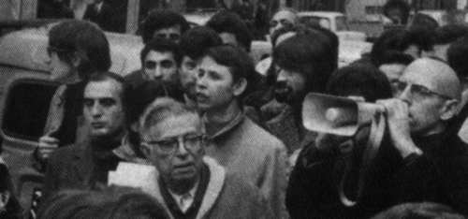
Foucault is an ‘intellectual engage’ who takes this critique of ‘the present’ serious….
Foucault and Jean-Paul Sartre at a political manifestation
Prison reform movement (e.g. Discipline and Punish)
Anti-psychiatry movement (e.g. History of Madness; his dissertation)

Slide 9
Towards the end of his life, he identifies the key concern that runs through all his work as….
A history of the human subject and ‘the self’
‘… the interaction between oneself and others and in the technologies of individual domination, the history of how an individual acts upon himself (or herself);
I am interested in the technologies of the self and a history of the subject.’
Claim: What we experience as our ‘selfhood’ (or our ‘identity’) is
a construct of knowledge/power

Slide 10
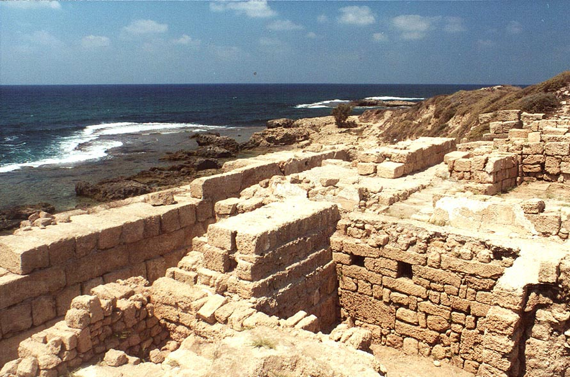
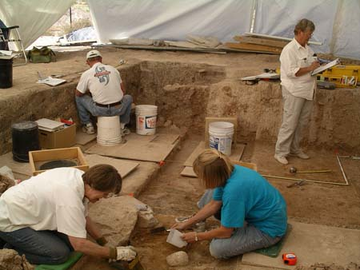
The history of the human subject
Phase I
I. Method of Archaeology (early works until ‘Crime and Punishment’)
Investigation of the rules of
language at a given moment
in time. These rules, he argues, ‘create’ a certain kind of reality about the human subject and the world.
All works are based on his close engagement with ‘linguistic turn’.

Slide 11
Method of Archaeology
Explores the conditions of possibility what can be said and thought at a particular moment in time
Is concerned with the analysis of language as a system of the possibility of human expression; it is synchronic – at one moment in time
It does never try to explain historical change or the origin or distribution of power; power is not discussed in archaeology
Inspired by ‘structuralism’ (see slides last week!)
Foucault’s idea is that every mode of thinking (based on the structure and rules of language) involves implicit rules (maybe not even consciously formulated by those following them) that materially restrict the range of possible thoughts an individual is able to have.
Note: This is the case for the past as it is for the present: you can only speak what the current rules of language allows you to think and speak!

Slide 12
New Periodisation in History Writing : Epistemes
‘In any given culture and at any given moment there is always only one episteme that defines the conditions of possibility of all knowledge, whether expressed in theory or silently invested in a practice.’
Renaissance Episteme (1450-1650)
Classical Episteme (1650-1800)
Modern Episteme (1800-1966)
Postmodern Episteme (late1960s -?)
Where are we now? Post-Postmodern Episteme?

Slide 13
The historian as an archaeologist
laying bare the ‘the episteme’
An historian-archeologist uncovers the underlying rules (maybe not even consciously formulated by those following them) that materially restrict the range of possible thoughts
(he goes here beyond a mere analysis of language systems suggested by Saussure or Barthes)

Slide 14
The archaeologist-historian uses ‘discourse analysis’ to uncover
the invisible rules of language that organize what we can say and
not say at a particular moment in time
What makes thought possible at a particular moment in time? How do people speak about it? Analysis of the rules of what is possible to say?
‘Discourse’ and ‘discourse’ analysis aims to overcome the
problems of traditional history writing which takes what is ‘said’ as a given.

Slide 15
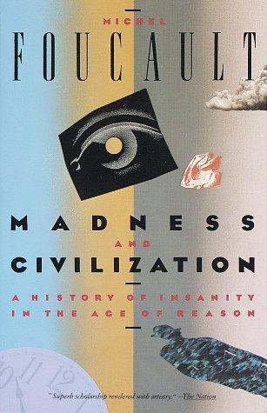


Use of this method in the following books:
Examination of the evolving meaning of madness in European culture, law, politics, philosophy and medicine from the Middle Ages to the end of the eighteenth century, and a critique of historical method and the idea of history and its ideas of tracing origins
Excavates the origins of the human sciences, which have their root in "life, labour, and language", that is: biology, economics, and linguistics; puts forward the idea of ‘epistemes’
Developing the themes explored in his previous work, Madness and Civilisation, Foucault traces the development of the medical profession, and specifically the institution of the Clinique; the rise of the modern ‘medical gaze’ in the eighteenth century

Slide 16
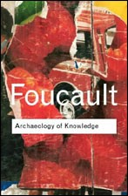
His Critique of traditional ‘Enlightened’ History Writing:
Takes the human subject for granted (instead
of historically understanding its ‘making’;
Search for origins of ideas/practices (no questioning of the
present ideas or practices; when did they start? How did they
Develop; focus on ‘authors’)
Focus on ‘discoveries’ and ‘break throughs’ by individuals in control of ‘reality’
Linear or stadial development of history from origins to now; history can offer ‘lessons’ from the past; history can tell us how to change the present (Marxism)

Slide 17
Move to Phase II:
Realisation: It is not language and speech and thinking that make people ‘act’ but also ‘everyday practices’ and their engagement with the material world (e.g. objects)
And he is dissatisfied with traditional explanations for historical change in history writing at this time:
‘The traditional explanations as the spirit of the time, technology, social cultural influences struck me for the most part as being more than magical effective’.

Slide 18
2. Method of Genealogy (early 1970s)
How can we think ‘power’ differently?
It is concerned with the analysis of historical ‘emergence’ – not search for ‘origins’
A historical causal explanation that is material, multiple, and corporeal.
It is conceptualised not as a ‘discovery’, the culmination of events, or as the end of a process of development but rather as a particular momentary manifestation of chances or as a struggle between forces of power.

Slide 19
Genealogy is a the critical ‘history of the present’
The subject matter of this kind of history is the origins of present rules, practices or institutions that claim authority over us. It starts from an investigation of the present.
What claims authority over us now? What makes us think that certain ideas, practices, institutions in the present are ‘normal; what makes us acept labels?
The aim is not to understand the past for its own sake, but to understand and evaluate the present, particularly with a view to discrediting unjustified claims of knowledge authority and power.

Slide 20
Genealogy involves an investigation of how knowledge and power are always closely linked
knowledge/power
Aim of all knowledge/power strategies: to discipline the individual human body and to regulate large numbers of human bodies in form of populations

Slide 21
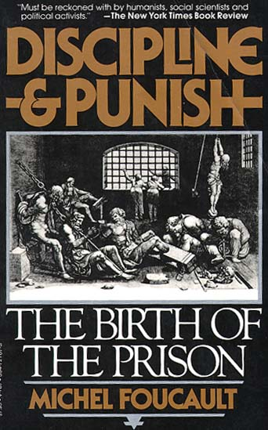
1. Discipline
Claim: Disciplinary power is a modern form of power emerging in the course of the seventeenth-century (note: the time of what we call traditionally ‘the Enlightenment’! So, his book is a critique of an Enlightenment )
Overarching question:
Are modern forms of punishment (prisons and attempts at reabilitation) really more ‘humaine’ than direct corporeal punishment in the pre-modern era? What knowledge/power strategies are hiding behind the ‘grand story’ of Western humanitarianism?

Slide 22
What is ‘discipline’ as a form of power?
‘Discipline’ (or disciplinary power) may be defined neither with an institution nor with an apparatus; it is a type of power, a modality for its exercise, comprising a whole set of instruments, techniques, procedures, levels of applications, targets.’
Ultimate goal of all disciplinary measures:
Discipline produces ‘docile’ bodies. Bodies which act without being told to act in a particular way. The do it voluntarily and even ‘like’ doing it. Docile bodies feel pleasure when they discipline themselves!

Slide 23
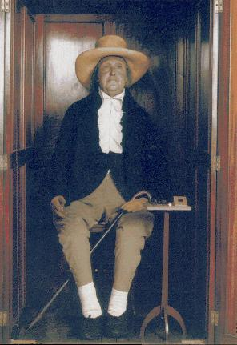
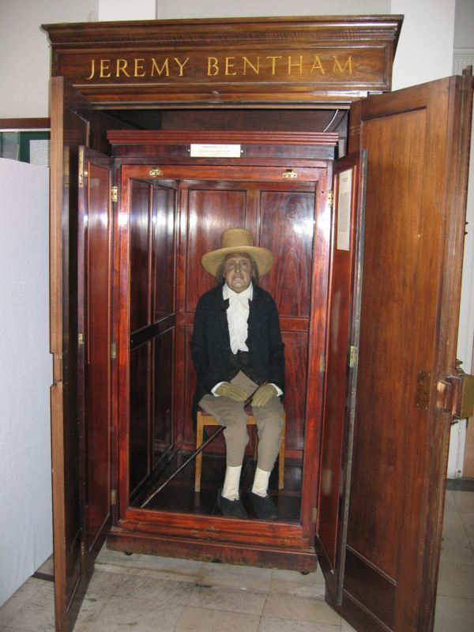
Discipline and Punish investigates the 3 forms of ‘discipline’ directed at individual body
1. Hierarchical Spatial Observation
Foucault uses ideas of Jeremy Bentham, the founder of British utilitarianism to show this in form of a specific architecture….

Slide 24
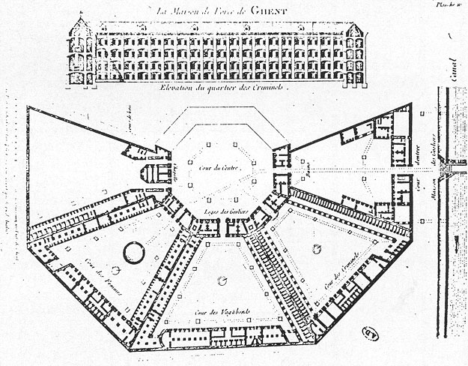
Bentham’s idea of the prison panopticum
‘Discipline’
inbuild in
architecture

Slide 25
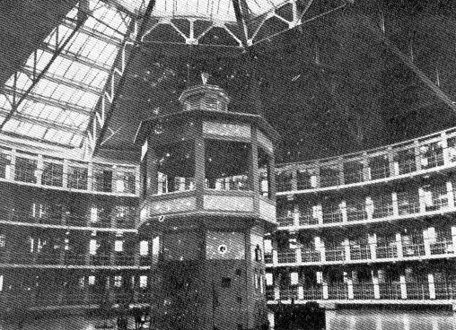
‘….we induce in the inmate a state of consciousness and permanent visibility that assures the automatic functioning of power.’
They discipline themselves and behave as expected from them
Foucault claims that this type of discipline is not only visible in
Buildings but permeates in other forms throughout modern society (e.g.
security systems at aiports)

Slide 26
Individuals are judged not by the intrinsic rightness or wrongness of their acts but by where their actions are placed on a ranked scale that compares them to everyone else.
2. Normalising Judgement
We are subjected to a whole set of micro-normalising judgements (regarding time keeping, speech, practices of body etc). We use ‘discipline’ to punish those who do not conform to the ‘normalizing judgement’.
Question: In what ways is a school and university marking system a form of ‘normalizing judgement’? What are the punishments?

Slide 27
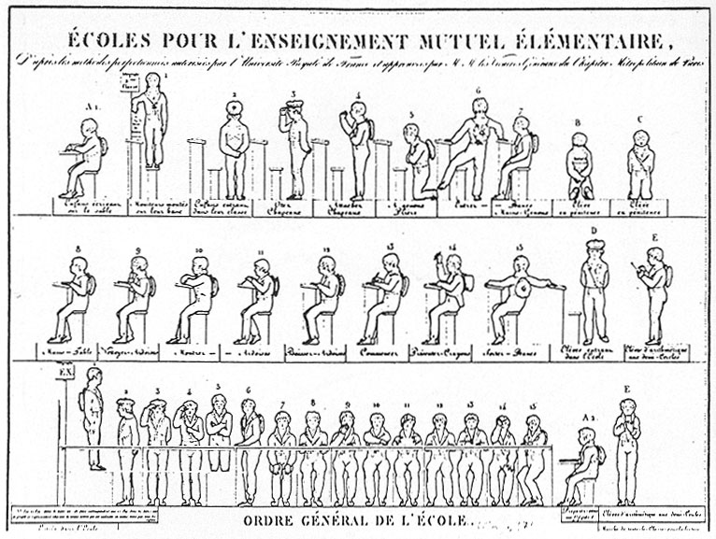
Example of how normalizing judgement works: micro-management of the body in 19th school

Slide 28
Another example of ‘normalising judgement’
https://www.writerstoolbox.com/about/blog/why-peel-is-causing-good-schools-to-underperform
Question: Why do educators still embrace PEEL (and its following systems) although they know that it is reduces human capacities of ‘thinking’ to a one fits all model – a model that has failed long ago and didn’t deliver what it promised.

Slide 29
3. Examination
This form of discipline combines ‘normalising judgement’ with ‘hierarchical observation’ to create a ‘normalising gaze’ through which individuals may be classified or judged. The ultimate form of discipline to turn bodies into ‘docile bodies’.
The medical examination in a doctor’s office is a prime locus of modern power/knowledge.
There is no knowledge without power and vice-versa (medical knowledge is the most striking example)

Slide 30
A reminder: how fast knowledge categories change…
Homosexuality was classified as a ‘disease’ until it became ‘normal’ in
the 1970s:
In 1973, the American Psychiatric Association (APA) removed the diagnosis of “homosexuality” from the second edition of its Diagnostic and Statistical Manual (DSM). This resulted after comparing competing theories, those that pathologized homosexuality and those that viewed it as normal.
Question: Which medical classifications (diagnoses) did you encounter? What does it mean when you are classified as ‘a medical case'? Can you identify ‘normative judgement’ and ‘hierarchical observation’ in a medical classification (e.g. diagnosis)? What if you resist such a medical classification (diagnosis (e.g. in school, at university, at the workplace)? Where is ‘knowledge/power’ hidden behind a medical diagnosis?

Slide 31
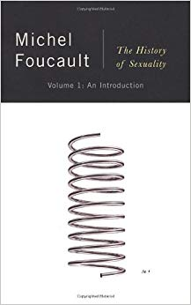


Foucault realizes that power is not only disciplinary and directed at the individual human body; it also targets groups of people (e.g. as a population, for example)
Investigation of regulatory power directed at many bodies, entire ‘populations’ emerging in the seventeenth/eighteenth century (e.g. health of populations)
Human sexuality is THE central mechanism to exercise power over both individual bodies and large population; it is prime tool of modern governmental power

Slide 32
Biopower:
‘I mean a number of phenomena that seem to me to be quite significant, namely, the set of mechanisms through which the basic biological features of the human species became the object of a political strategy, of a general strategy of power, or, in other words, how, starting from the 18th century, modern Western societies took on board the fundamental biological fact that human beings are a species. This is what I have called biopower.’
Sexuality is a main target of knowledge/power strategies

Slide 33
‘Sexuality’ since Foucault’s death in 1984
‘Who Do You Think You Are’ – what is your identity -- is today often answered by referring to one’s sexuality.
We have seen an explosion of new categories in this area of human identity:
https://warwick.ac.uk/fac/cross_fac/academy/activities/learningcircles/transqueerpedagogies/keyterms/
What about ‘knowledge/power’ in each of these language categories? Are you ‘living’ what you really are or are you part of the strategic knowledge/power game? Are your really ‘freeing’ yourself or are you performing a sexual identity that is ‘given’ to you by knowledge/power as Foucault might say? Are you in fact being ‘normalised’?

Slide 34
The End

