Slide 1
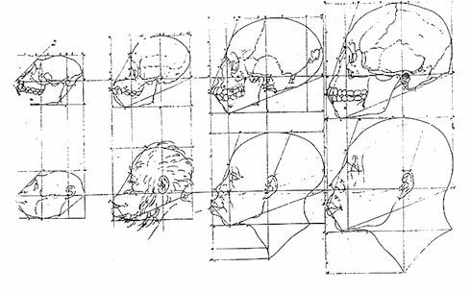
Lecture 9/Term 1:
What is Man? The Quest for Human Nature and the ‘Science of Man’ in the Enlightenment

Slide 2
Descartes’ importance for what our overall question in this module ‘what it means to be human’ or ‘what is human nature’:
‘I noticed that whilst I thus wished to think all things false, it was absolutely essential that the ‘I’ who thought this should be somewhat, and remarking that this truth ‘I think, therefore I am’ was so certain and so assured …I could receive it without scruple as the first principle of the philosophy for which I was seeking’.
Consequences: Thought and knowledge were no longer the properties of the world outside (ordained by God) but are strictly confined to the head. Ideas, became internalised and exist solely within us.

Slide 3
Consequences for the understanding of ‘reason’:
In the Cartesian world the world exhibits order but only humans manifest ‘reason’
‘Reason’ thus becomes an instrument, a means of acquiring knowledge (and thereby a means of control over the external world.)
‘I can have no knowledge of what is outside of me except by means of ideas I have within me.’

Slide 4
The search for ‘what it means to be human’ begins to focus on the individual human:
Descartes’ reasoning leads in the long run to the idea of the isolated individual as the only source of knowledge about what it meant to be human.
By arguing that ‘I think therefore I am’ Descartes established the ‘I’ as the central subject – and object – of debate in the ‘science of man’.

Slide 5
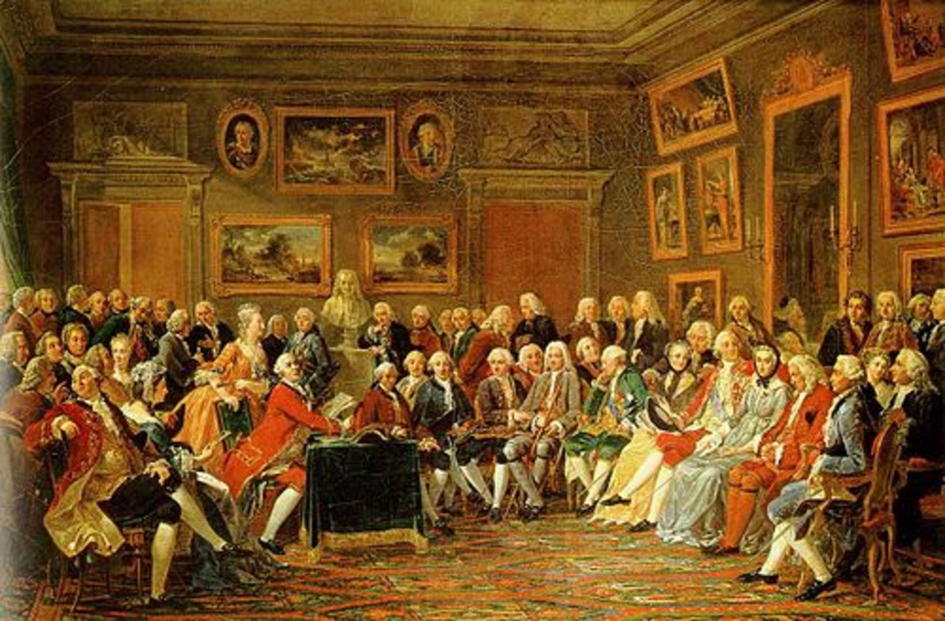
The Age of Enlightenment (also ‘the Enlightenment’ or ‘Age of Reason’: is an period in Western history from the 1650s to the 1780s. It is a period in which Western European culture began to emphasized reason and empirically-based analysis in the investigation of man and nature rather then following traditional lines of authority (e.g. Church, the ancient authorities). It was a movement that aimed at reforming individuals and society at large and was initiated by philosophers. However, due to the emergence of a ‘public sphere’ during the 18th century, these ideas, promoted human progress, tolerance, and skepticism, reached a wide public and were discussed in many new public spaces such as urban coffeehouses and salons.

Slide 6
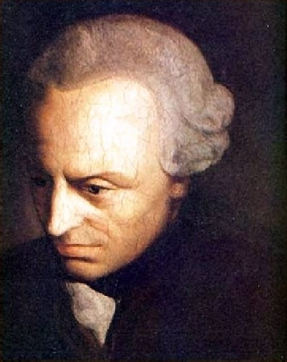
Immanuel Kant, 1724-1804

Slide 7
‘Enlightenment is mankind’s exit from self-incurred immaturity. Immaturity is the inability to make use of one’s own understanding without the guidance of another. Self-incurred is the inability if its cause lies not in the lack of understanding but rather in the lack of the resolution and the courage to use it without the guidance of another. Sapere aude! Have the courage to use your own understanding! It is thus the motto of the enlightenment.’
(From: Immanuel Kant, ‘An Answer to the Question: What is Enlightenment?’ Berlinerische Monatsschrift (1784): 481-494, 481.)

Slide 8
In search of humanities ‘true’ nature – ‘the science of man’
By leading people to escape or control their basic physical and emotional drives through the exercise of ‘reason’, enlightened philosophers sought to lead humanity towards its’ true nature’, a nature that they deemed free from the desire to terrify or compel others.

Slide 9
‘It is now asked “whether we live at present in an enlightened age?”, the answer is: “No, but we do live in an age of enlightenment.” As matters stand now, much is still lacking for men to be completely able – or even to be placed in a situation where they would be able – to use their own reason confidently and properly in religious matters without the guidance of another. Yet we have clear indications that the field is now being opened for them to work freely towards this , and the obstacles to general enlightenment or to the exit out of their self-incurred immaturity become even fewer.’
From: Immanuel Kant, ‘An Answer to the Question: What is Enlightenment?’ Berlinerische Monatsschrift (1784): 481-494, 481

Slide 10
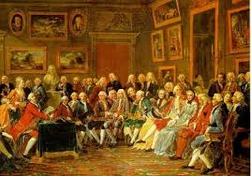
What is new in the pursuit of knowledge:
Collective and increasingly international project which reaches out to wider audience (Republic of Letters)
Although still mainly a project of educated classes but increasingly women became central to it (salon culture)
We see the development of a ‘public sphere’.
Def. public sphere: is an area in social life where individuals can come together to freely discuss and identify societal problems, and through that discussion influence political action
Jürgen Habermas, The Structural Transformation of the Public Sphere – An Inquiry into a Category of Bourgeois Society (1962; 1987)

Slide 11
The ‘ideal’ of an enlightened personality:
polymathic (‘literate’ NOT narrow ‘expert’)
autonomous AND sociable at the same time
practical in order to produce ‘useful’ knowledge for the individual but also for society at large
The overall aim was to achieve ‘happiness’ for everyone and everywhere.

Slide 12
Why such a fuss about ‘man’ in the Enlightenment?
Search for ‘what is man’ – or human nature -- is not entirely new but different from earlier times:
Search for ‘man’ or ‘human nature’ in the Renaissance:
A twin-project: uniting the good virtuous man and the good Christian
“Moralists believed that from Classical poets, philosopher moralists, historians and statesmen – models of virtue could be derived which the truly civilised man of the Renaissance could pursue, in harmony with the Christian progress towards spirituality and salvation.’ (Porter, Enlightenment, p. 12).
During the seventeenth century ‘man’ became de-centered; no longer the centre of the micro-macrocosm universe;

Slide 13
The Science of Man
Since the latter part of the seventeenth century, European thinkers began to believe that in order to understand the true history and destiny of the human race, one could no longer blindly rely on the authority of the Greek and Roman thinkers (the Ancients) or on the Bible. Man’s nature – so they began to believe—was not yet properly known; it must become the subject of inquiry.
Important:
‘science’ is not understood as ‘natural science’ – as we do today. The Enlightenment understood in a much broader sense as a general ‘inquiry following a rational method’. So, ‘history writing’ or ‘theology’ could be part of this ‘science of man’ – if undertaken by a rationally reasoning mind, of course!

Slide 14
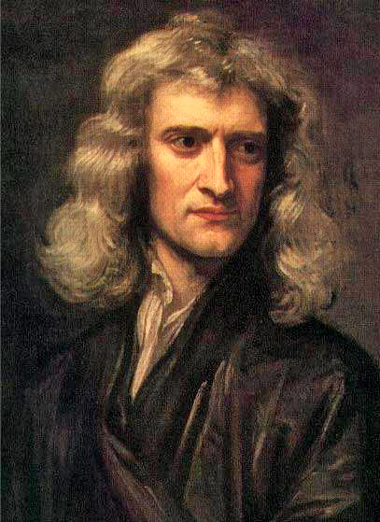
1. Human Nature follows Laws which can be ‘discovered’ by the experimental method
Application of Newton’s laws of nature to human nature
18th century experienced a virtual ‘Newtonmania’
‘Mathematical Principles of Natural Philosophy’ (1687)
becomes one of the most popular texts all over Europe; even children read it!
Isaac Newton, 1642-1726

Slide 15
1. Human Nature follows Laws
Hume:
Experimental method of reasoning:
‘the empirical observation of human
activities in the present and past.’
He and many others applies Newton’s laws of
nature to human nature
‘Mankind are so much the same, in all times
and places, that history informs us of nothing
new or strange in this particular. Its chief use is
only to discover the constant and universal
principles of human nature, by showing mean
in all varieties of circumstances and situations
and furnishing us with materials from which
we may form our observations and become
acquainted with the regular spring of human
action and behaviour…’
(Hume, Enquiry Concerning Human
Understanding, pp. 83-4)
Isaac Newton, 1642-1726 1687 Mathematical Principles of Natural Philosophy

Slide 16
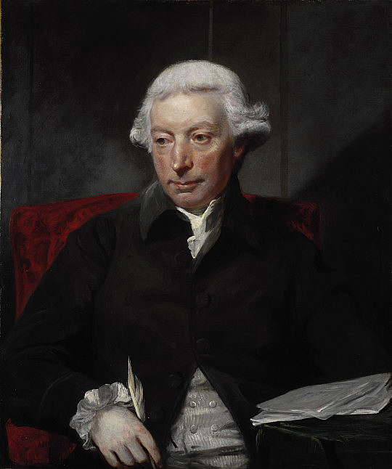
2. Human nature develops in stages and this development is universal
An Essay on the History of Civil Society, 1767
‘…if we are asked therefore, Where the state of nature is to be found? we may answer, It is here; and it matters not whether we are understood to speak in the island of Great Britain, at the Cape of Good Hope, or the Straits of Magellan. While this active being is in the train of employing his talents, and of operating on the subjects around him, all situations are equally natural.’
(Ferguson, Essay, pp. 11–12)
Adam Ferguson, 1723-1816

Slide 17
‘Stage history’ of the universal development of mankind:
1.Hunting – no property, no wealth to accumulate, stage of savagery’
2. Pasterage – less mobile but still nomadic, wealth can be accumulated
3. Agriculture -- even less mobile, farmer lives on land in own house,
more wealth and greater inequality
4. Commerce – property ownership, laws governing property, complex societies

Slide 18
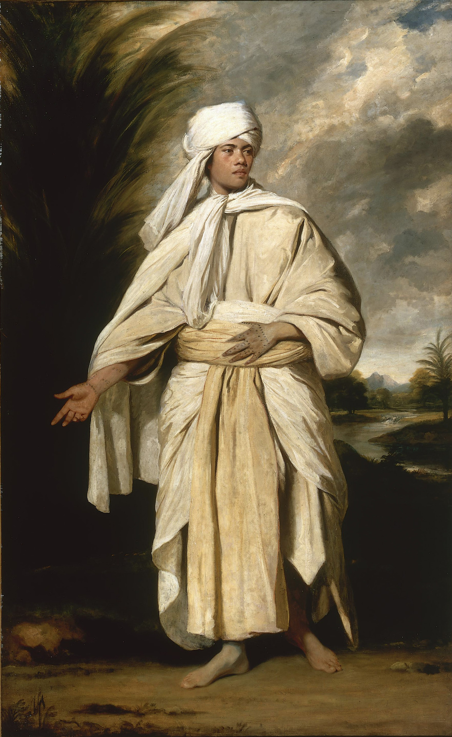
Foreign cultures as ‘proof’ for stage theory of human development
Intense interest in the morals and values of such people but also their physical difference
Note: difference to the 16th century exlorers
The southlander Omai who came to Britain in 1776 by captain Cook.

Slide 19
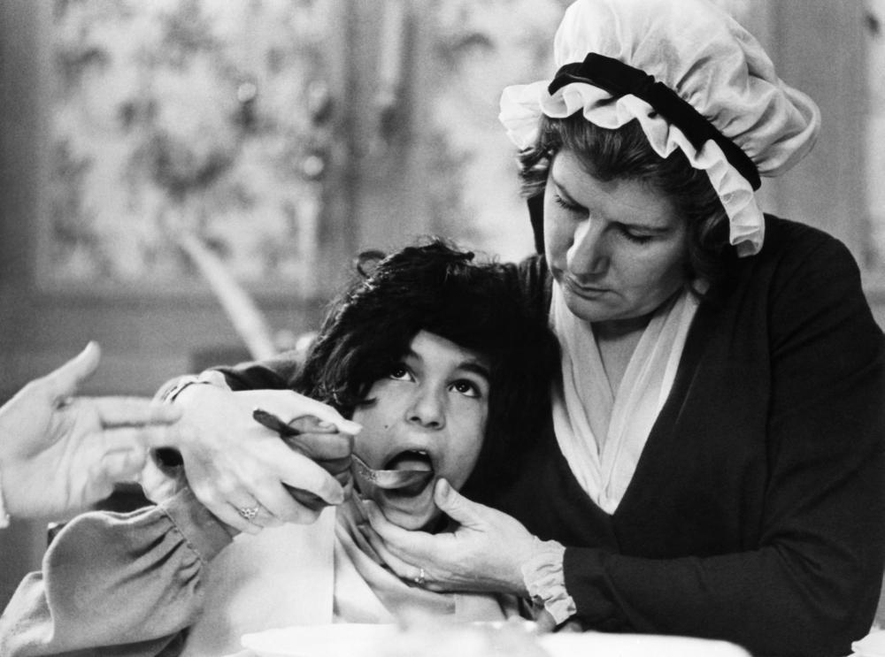
Wild children as ‘proof’ for stage theory of human development
(L’enfant sauvage, 1970, film on the most famous wild child in the
Enlightenment, Victor of Aveyron

Slide 20
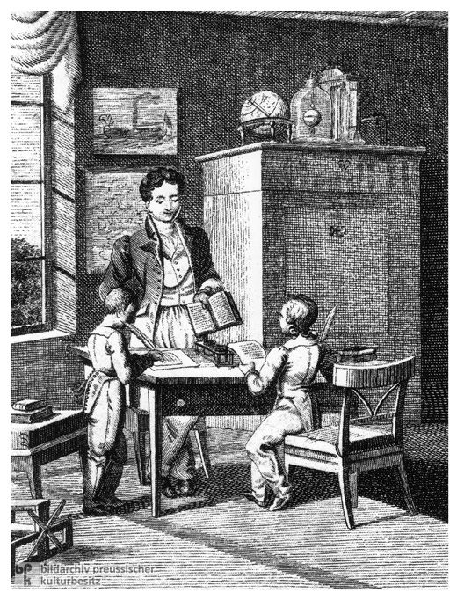
3. Perfectibility of Human Nature
great Importance of education (of children and adults, particularly women)
new ideas about how the human mind functions and why and how it can/must be trained
John Locke (1632-1704)
Essay Concerning Human Understanding (1609) and Some Thoughts Concerning Education (1663)
the mind as ‘tabula rasa’
First attempts at a theory of evolution to align human development and the development of nature; idea that capacity of learning is passed on from parents to children (Erasmus Darwin, Jean-Baptiste Larmarck)

Slide 21
4. Human nature no longer innately sinful but can be trained to contribute to the ‘common good’ and ‘happiness’ of all
Bernard Mandeville, or Bernard de Mandeville (1670 – 1733)
The Fable of the Bees, 1714
central claim: private vice can become public benefit
Adam Smith (1732-1790)
An Inquiry into the Nature and Causes of the Wealth of Nations (1776)
Central claim:
the selfish behaviour of individual producers and consumers, of pursued in accordance with the competitive laws of the market, would result in the common good

