Slide 1
Lecture 1/Term 2
1. The Enlightenment’s Central Project: ‘The Science of Man’
2. Was the Savage Noble?:
Exploration and Cross-Cultural Encounter and the Universal History of Mankind

Slide 2
Descartes’ importance for what our overall question in this module ‘what it means to be human’ or ‘what is human nature’:
‘I noticed that whilst I thus wished to think all things false, it was absolutely essential that the ‘I’ who thought this should be somewhat, and remarking that this truth ‘I think, therefore I am’ was so certain and so assured …I could receive it without scruple as the first principle of the philosophy for which I was seeking’.
‘I think therefore I am’ (‘je pense, donc je suis’, or ‘cogito ergo sum’)
Consequences: Thought and knowledge were no longer the properties of the world. Ideas, became internalised and exist solely within us.

Slide 3
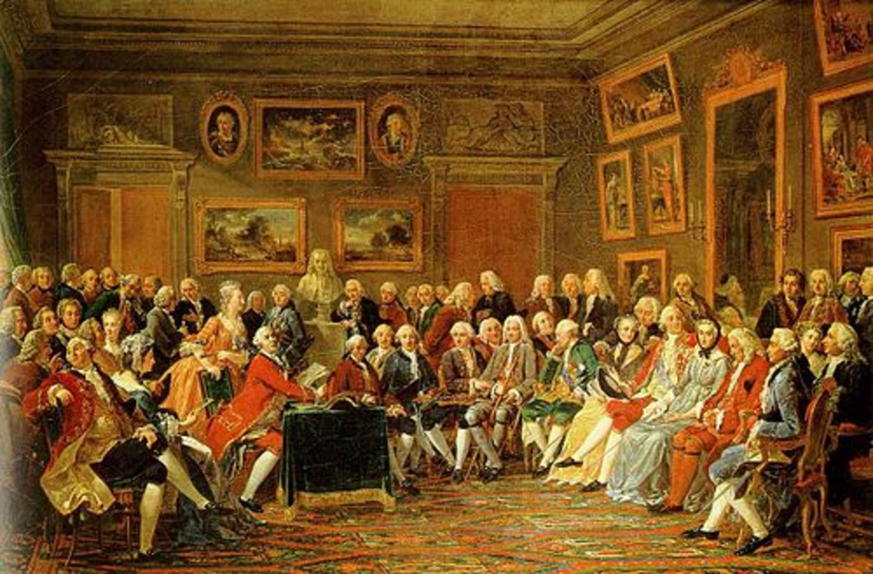
The Age of Enlightenment (also ‘the Enlightenment’ or ‘Age of Reason’: is an period in Western history from the 1650s to the 1780s. It is a period in which Western European culture began to emphasized reason and empirically-based analysis in the investigation of man and nature rather then following traditional lines of authority (e.g. Church, the ancient authorities). It was a movement that aimed at reforming individuals and society at large and was initiated by philosophers. However, due to the emergence of a ‘public sphere’ during the 18th century, these ideas, promoted human progress, tolerance, and skepticism, reached a wide public and were discussed in many new public spaces such as urban coffeehouses and salons.

Slide 4
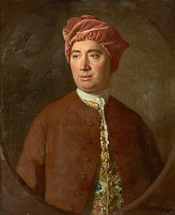
“The Science of Man” – what is human nature?
The central project of the Enlightenment.
The ‘science of man’ – a term first introduced by the Scottish philosopher David Hume – aimed to expand the understanding of facets of human nature, including senses, ideas, imagination, passions, morality, justice, and man’s relationship to society.
Hume’s Publications:
Treatise of Human Nature Being an Attempt to Introduce the Experimental Method of Reasoning into Moral Subjects’ (1738)
Essays Moral, Political and Literary (1741-41)
An Enquiry Concerning Human Understanding (1748)
Political Discourses (1751)
David Hume, 1711-1776

Slide 5
Why such a fuss about ‘man’ in the Enlightenment?
Search for ‘what is man’ – or human nature -- is not entirely new but different from earlier times:
Search for ‘man’ or ‘human nature’ in the Renaissance:
A twin-project: uniting the good virtuous man and the good Christian
“Moralists believed that from Classical poets, philosopher moralists, historians and statesmen – models of virtue could be derived which the truly civilised man of the Renaissance could pursue, in harmony with the Christian progress towards spirituality and salvation.’ (Porter, Enlightenment, p. 12).
During the seventeenth century ‘man’ became de-centered; no longer the centre of the micro-macrocosm universe;

Slide 6
The Science of Man
Since the latter part of the seventeenth century, European thinkers began to believe that in order to understand the true history and destiny of the human race, one could no longer blindly rely on the authority of the Greek and Roman thinkers (the Ancients) or on the Bible. Man’s nature – so they began to believe—was not yet properly known; it must become the subject of inquiry. (Porter, Enlightenment)
Important:
‘science’ is not understood as ‘natural science’ – as we do today. The Enlightenment understood in a much broader sense as a general ‘inquiry following a rational method’. So, ‘history writing’ or ‘theology’ could be part of this ‘science of man’ – if undertaken by a rationally reasoning mind, of course!

Slide 7
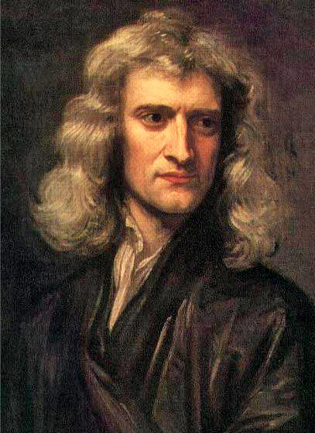
1. Human Nature follows Laws which can be ‘discovered’ by the experimental method
Application of Newton’s laws of nature to human nature
18th century experienced a virtual ‘Newtonmania’
‘Mathematical Principles of Natural Philosophy’ (1687)
becomes one of the most popular texts all over Europe; even children read it!
Isaac Newton, 1642-1726

Slide 8
1. Human Nature follows Laws
David Hume:
Experimental method of reasoning:
‘the empirical observation of human
activities in the present and past.’
He and many others applies Newton’s laws of
nature to human nature
‘Mankind are so much the same, in all times
and places, that history informs us of nothing
new or strange in this particular. Its chief use is
only to discover the constant and universal
principles of human nature, by showing mean
in all varieties of circumstances and situations
and furnishing us with materials from which
we may form our observations and become
acquainted with the regular spring of human
action and behaviour…’
(Hume, Enquiry Concerning Human
Understanding, pp. 83-4)
Isaac Newton, 1642-1726

Slide 9
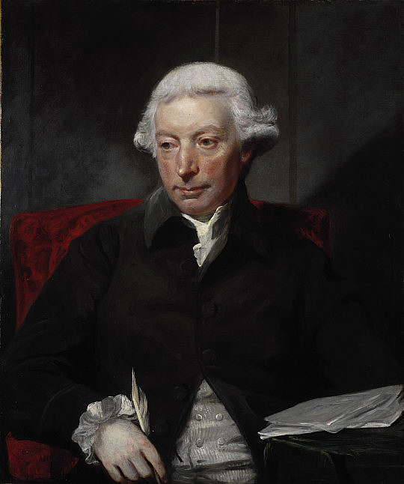
2. Human nature develops in stages and this development is universal (stage theory)
An Essay on the History of Civil Society, 1767
‘…if we are asked therefore, Where the state of nature is to be found? we may answer, It is here; and it matters not whether we are understood to speak in the island of Great Britain, at the Cape of Good Hope, or the Straits of Magellan. While this active being is in the train of employing his talents, and of operating on the subjects around him, all situations are equally natural.’
(Ferguson, Essay, pp. 11–12)
Adam Ferguson, 1723-1816

Slide 10
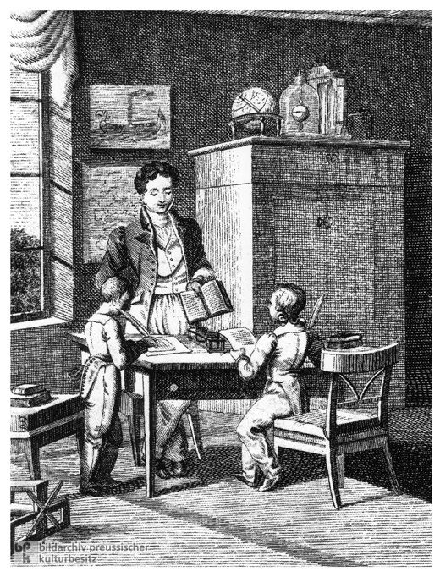
3. Perfectibility of Human Nature
great Importance of education (of children and adults, particularly women)
new ideas about how the human mind functions and why and how it can/must be trained
John Locke (1632-1704)
Essay Concerning Human Understanding (1609) and Some Thoughts Concerning Education (1663)
the mind as ‘tabula rasa’
First attempts at a theory of evolution to align human development and the development of nature; idea that capacity of learning is passed on from parents to children (Erasmus Darwin, Jean-Baptiste Larmarck)

Slide 11
4. Human nature no longer innately sinful but can be trained to contribute to the ‘common good’ and ‘happiness’ of all
Bernard Mandeville, or Bernard de Mandeville (1670 – 1733)
The Fable of the Bees, 1714
central claim: private vice can become public benefit
Adam Smith (1732-1790)
An Inquiry into the Nature and Causes of the Wealth of Nations (1776)
Central claim:
the selfish behaviour of individual producers and consumers, of pursued in accordance with the competitive laws of the market, would result in the common good

Slide 12
Assumptions underpinning the ‘Science of Man’
1. Human nature follows laws.
2. Human nature develops in stages and this development is universal (stage theory).
3. Human nature is perfectible.
4. Human nature no longer innately sinful but can be trained to contribute to the ‘common good’ and ‘happiness’ of all.

Slide 13
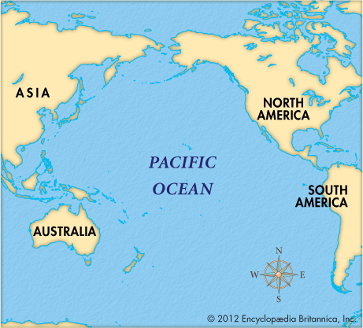
The Pacific

Slide 14
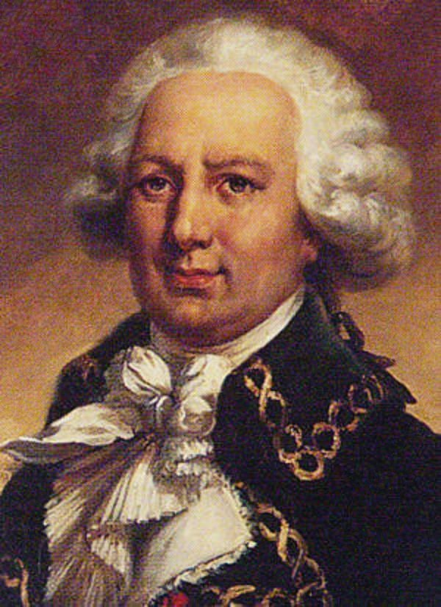
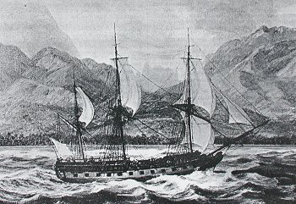
Louis-Antoine, Comte de Bougainville (1729 – 1811)
In 1766-1769 Bougainville circumnavigated the globe. First expedition (circa 300 people) with professional naturalists and geographers aboard.
botanist Philibert Commerçon(who named the flower Bougainvillea); he traveled with his mistress Jeanne Bare, disguised as a valet and his assistant, which was discovered at some point.
One of Bougainville’s ships La Boudeuse,

Slide 15
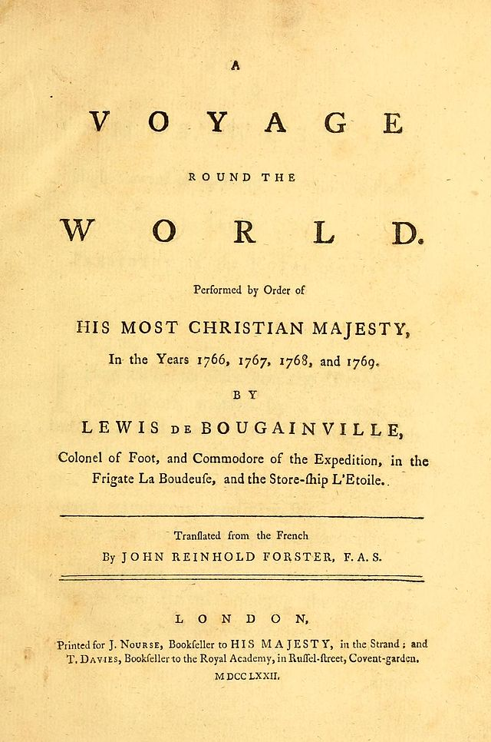
‘Voyage au tour du monde (1771)
Travel log of expedition which describes geography, biology and anthropology of Argentina (then a Spanish colony), Patagonia, Tahiti and Indonesia (then a Dutch colony).
Becomes an international bestseller
Description of Tahitian society as an earthly paradise where men and women lived in blissful innocence, far from the corruption of civilisation becomes popular.

Slide 16
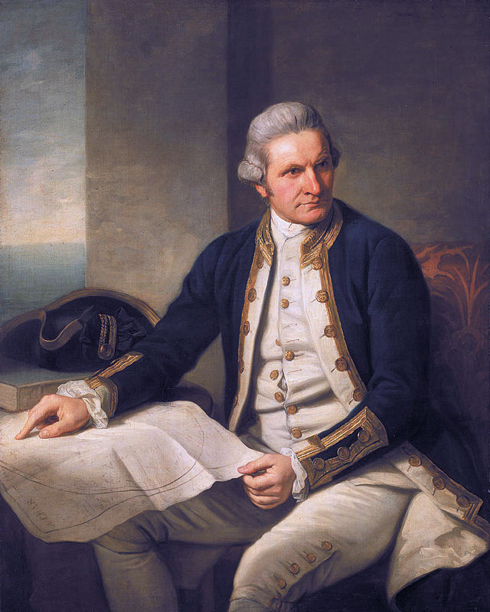
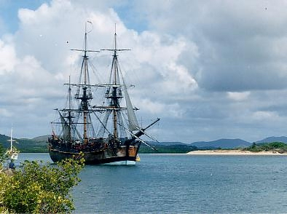
Cooks three Pacific voyages:
1. 1768–71
2. 1772–75
3. 1776–80 (killed by islanders people)
MS Endevaour
James Cook (1728-1779)

Slide 17
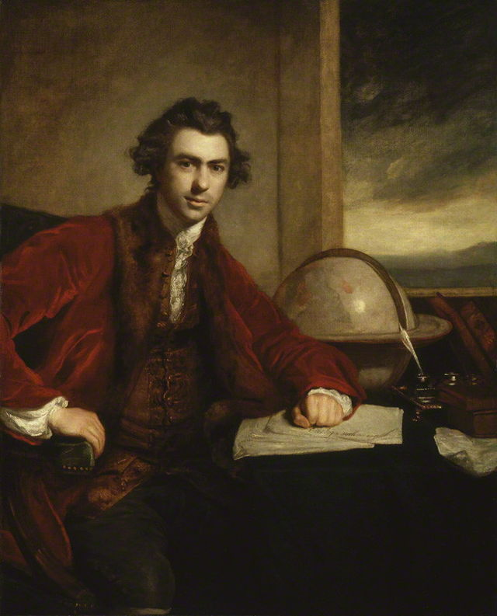
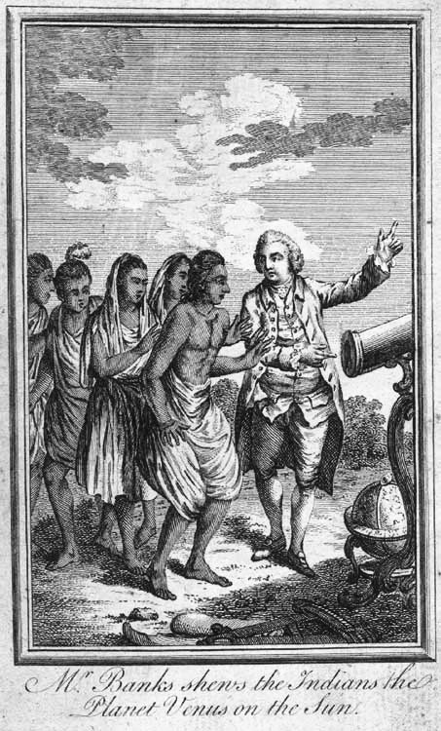
Botanic expertise on board:
Sir Joseph Banks, 1743 – 1820, finances other naturalists’ journey with him

Slide 18
How 18th-Century Voyages of Discovery differed from 16th-Century voyages
We’re no longer dealing with religious quests (this wasn’t predominantly about the saving souls like in the 16th century)
With 18th voyages imperialistic and economic aims now fused with a new thirst for reasoned ‘knowledge’ about the people and nature in these worlds
This new enthusiasm for knowledge of foreign human nature triggered a commercial success (and this did not happen to the same extent in the 16th century because in the 18th century we have a much wider reading public.)
Various objects were brought home and displayed in new museums and collections which were increasingly accessible to the public. We get stage plays based on Tahitian society that packed London theatres. And a flood of images and travel writings were disseminated to the public at a rate hitherto unknown.

Slide 19
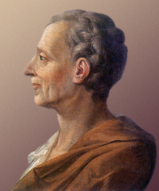
‘The Spirit of the Laws’ (1748):
the first consistent attempt to survey the varieties of human society, to classify and compare them and, within society, to study the inter-functioning of institutions.
He identified three kinds of political system and the laws, or principles, of human nature that underpin them:
1. Democratic republics – the love of virtue
2. Monarchies – the love of honour
3. Despotisms – fear of the ruler
Charles-Louis de Secondat, Baron de La Brède et de Montesquieu (1689-1755)

Slide 20
‘Stage Theory’ of Human Civilisation and Conjectural History of Man
Developed from Montesquie’s ideas by Scottish thinkers who grafted the movement of a gradual progress onto the classification of individual and social phenomena
‘There is [ . . . ] in human society, a natural progress from ignorance
to knowledge, and from rude to civilized manners [ . . . ]. Various
accidental causes, indeed, have contributed to accelerate, or to
retard, this advancement in different countries.’
(Adam Smith)
Human society develops in 4 distinct chronological stages:
‘1st, the Age of Hunters, 2dly, the Age of Shepherds, 3dly, the Age of Agriculture; and 4thly, the Age of Commerce.’ (Adam Smith)
From savage state to state of full civilisation

Slide 21
Human nature develops in stages and this development is universal
An Essay on the History of Civil Society, 1767 (pp.1-12)
On Human Progress
“‘not only the individual advances from infancy to manhood, but the species itself from rudeness to civilisation”…
“human kind the species has a progress as well as the individual; they build in every subsequent age on foundations formerly laid, and in a succession of years tend to a perfection in the application of their faculties…
If we admit that man is susceptible of improvement, and has in himself a principle of progression and a desire of perfection, it appears improper to say that he has quitted the state of his nature when he has begun to proceed… he only follows the disposition, and employs the powers that nature has given.”
Adam Ferguson, 1723-1816

Slide 22
‘Voyage au tour du monde (1771)
Description of Tahitian society as an earthly paradise free from the corruption of civilisation.
Draws on classical ideas: women depicted as Venus, men as classical heroes.
Neoclassicism: Western movement in the decorative and visual arts, literature, theatre, music, and architecture that drew inspiration from the ‘classical’ art and culture of Ancient Greece or Ancient Rome. Main neoclassical movement coincided with the Age of Enlightenment, and continued into the early 19th century, latterly competing with Romanticism.

Slide 23
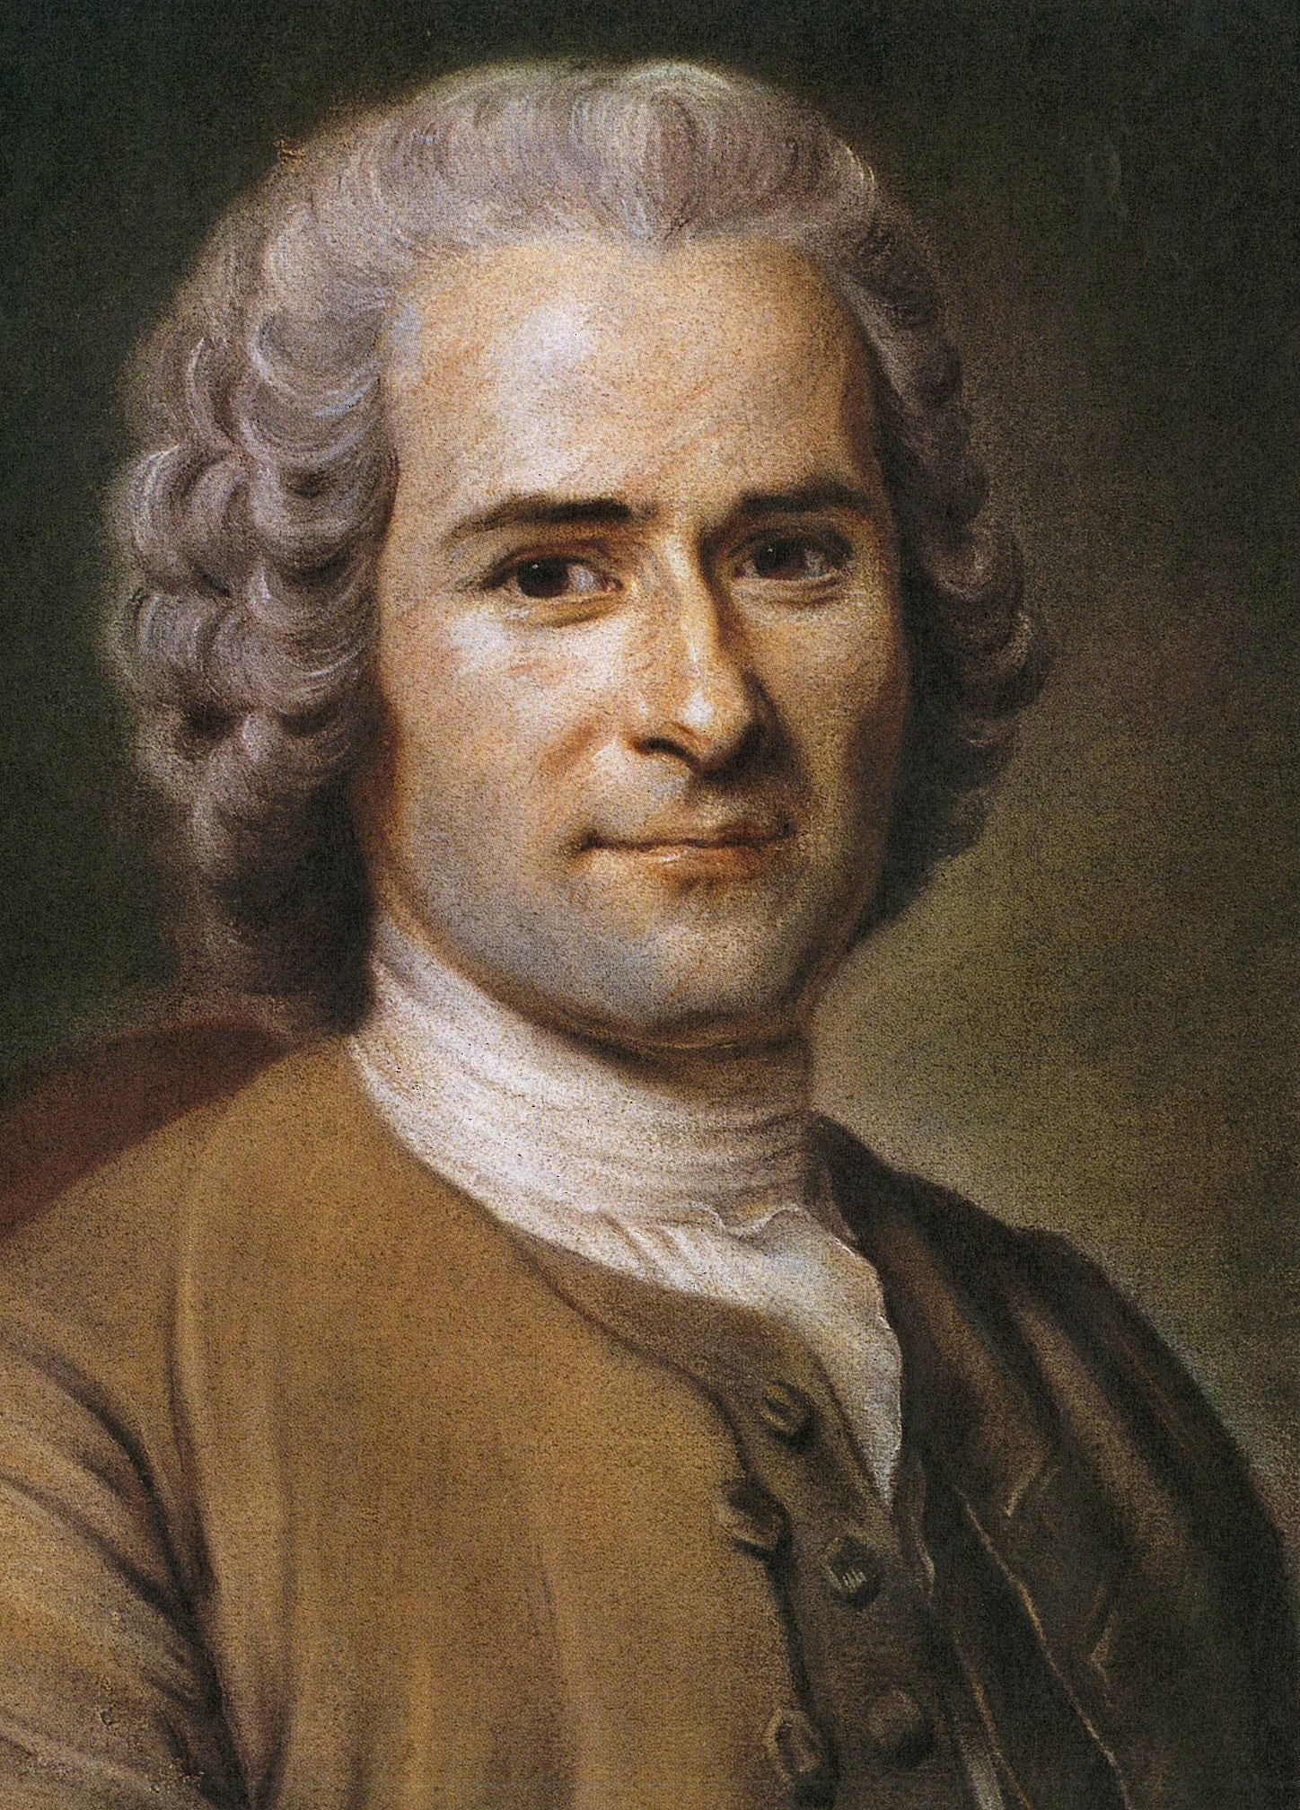
‘...[N]othing is so gentle as man in his primitive state, when placed by nature at an equal distance from the stupidity of brutes and the fatal enlightenment of civil man…’
Discourse on the Origin of Inequality (1754)
Jean-Jacques Rousseau (1712 – 1778)

Slide 24
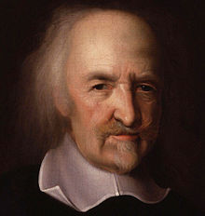
Rousseau directly critiques Thomas Hobbes’ ideas of human nature.
According to Hobbes man needs a strong controlling government, because he is incapable of living a moral life without one.
Man….’in the state of nature . . . has no idea of goodness he (man) must be naturally wicked; that he is vicious because he does not know virtue’
In contrast to Hobbes, Rousseau believed:
In the natural goodness of man, and that
man's morality was not a societal construct, but rather "natural” or innate.
Thomas Hobbes, 1588 – 1679
Leviathan (1651) puts forward the
idea of a social contract

Slide 25
The ‘noble savage’: The term expresses the concept of an idealized indigeneous ‘other’ who
has not been ‘corrupted’ by civilization, and therefore symbolizes humanity's innate
goodness.
The Theme can be found in the 16th century in Montaigne.
A typical 18th century use in Alexander Pope’ "Essay on Man" (1734).
Lo, the poor Indian! whose untutor'd mind Sees God in clouds, or hears him in the wind… Yet simple Nature to his hope has giv'n, Behind the cloud-topp'd hill, a humbler heav'n; Some safer world in depth of woods embrac'd, Some happier island in the wat'ry waste, Where slaves once more their native land behold, No fiends torment, no Christians thirst for gold! To be, contents his natural desire; He asks no angel's wing, no seraph's fire: But thinks, admitted to that equal sky, His faithful dog shall bear him company.
Bougainville uses ‘the noble savage’ theme in his Voyage au tour du monde; it becomes very popular in 18th century Europe

Slide 26
Ambivalence about own culture and those of others becomes stronger the more
European live through wars and upheaval:
‘What is still more to our shame as civilised Christians, we debauch their morals already too prone to vice, and we introduce among them wants and perhaps diseases which they never before knew, and serve only to disturb that happy tranquillity which they and their forefathers enjoyed. If anyone denies that truth of this assertion, let him tell me what the natives of the whole extent of America have gained by the commerce they have had with the Europeans.’.
(James Cook, in Outram, p. 60)

Slide 27
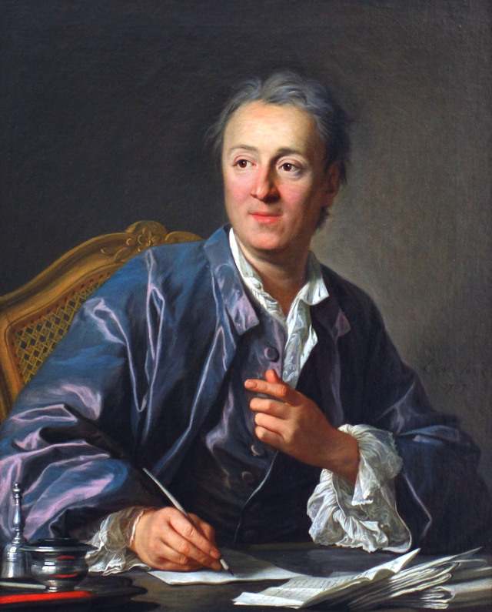
Supplement to the Voyage of Bougainville (1772, published in 1776)
‘The life of savages is so simple, and our societies are such complicated machines! The Tahitian is close to the origin of the world, while the European is close to its old age…They understand nothing about our manners or our laws, and they are bound to see in them nothing but shackles disguised in a hundred different ways. Those shackles could only provoke the indignation and scorn of creatures in whom the most profound feeling is love of liberty.’
Denis Diderot, 1713-1784

Slide 28
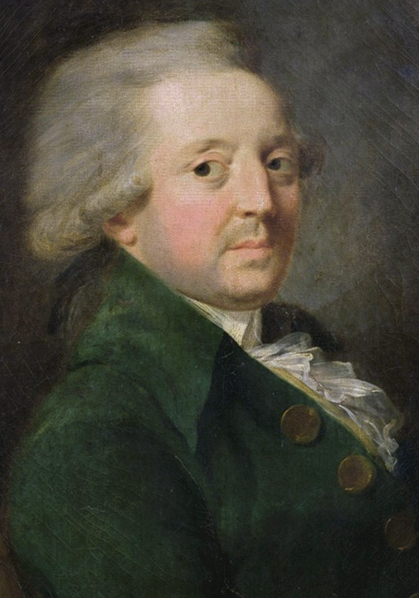
Development of human society in history
Model Rousseau: he discusses the mixed benefits of civilization. Presents a model of regress in which we become increasingly corrupt.
Condorcet famous ‘progress model’ (10 stages of progress)
Sketch for a Historical Picture of the Progress of the Human Spirit (1795)
“A picture of the progress of the human intellect, subject to general laws observable in the individual development of our faculties”.
1. men untied in hords
2. pastoral state of mankind
3. agricultural to alphabetical writing
4. progress of human mind in Greece and division of sciences
5. progress of sciences
6. decline and restoration of learning during Crusades
7. progress of sciences to invention of art of printing
8. when sciences and philosophy threw off yoke of authority
9. time of Descartes to formation of French Republic
10. future progress of mankind
Marie Jean Antoine Nicolas de Caritat, marquis de Condorcet (1743-1794)

Slide 29
Great interest in explaining ethnic difference:
From antiquity: geography and climate played a significant role in the physical appearance of
different peoples.
Mixed with biblical explanations: notion that humanity as a whole was descended from Shem,
Ham and Japheth, the three sons of Noah, producing distinct Asiatic,
African, and Indo-European peoples.
Enlightenment thinker begin to focus more on the explanation of physical differences; no
concensus of issue of race

