Slide 1
Lecture 7:
Bringing the Psyche into Focus –
a Historical Overview and Introduction

Slide 2
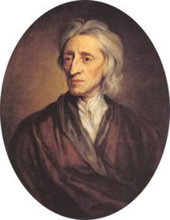
Essay Concerning Human Understanding (1690; 1694)
presents a new idea about human nature and the self which becomes the basis for all thinking about self and mind during the 18th century
Thesis: all is based on the working of the senses
Locke is engaging with two very pressing and animating issues at the time:
the unresolved relationship between mind and body – thrown up by Descartes theory.
2. the developing consensus that knowledge is gained through individual sense experience (based on the popularity of Newton’s method).
John Locke 1632-1704

Slide 3
Aristotelian Psyche – the study of the soul/psyche (in De Anima); the study of the nature of the soul (or psyche), which he considers the basis of all life; the soul is the essence of all living things that makes them behave in the ways distinctive of living things.

Slide 4
Three kinds of soul according to Aristotle:
vegetative/nutritive soul: was the lowest soul which included the functions basic to all living things: nutrition,
growth and reproduction.
sensitive soul: second highest of the three souls which included all of the powers of the vegetative soul as well as the powers of movement and emotion as well as the ten internal and external senses.
Intellective/rational soul: included not only the vegetative and sensitive powers — the organic
faculties of the other two souls - but also the three rational powers of intellect, intellective memory (memory of concepts, as opposed to mere sense images) and will.

Slide 5
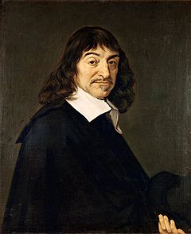
Descartes’ mechanical philosophy:
‘The only principles which I accept, or require, in physics are those of geometry and pure mathematics; these principles explain all natural phenomena, and enable us to provide quite certain demonstrations regarding them.’
everything in the natural world can be explained by mathematics and mechanics
For Descartes the totality of all possible existence in the world was composed of two kinds of substances:
matter/extension of dead matter
‘res cogitans’, thinking stuff, he also refers to it as ‘mind’ or as ‘soul’
  This ‘split’ applies to the human body – we are dead matter and mind
René Descartes, 1596-1650

Slide 6
Essay Concerning Human Understanding (1690; 1694)
Thesis: all is based on the working of the senses
Based on ideas of Thomas Hobbes and his ideas on human reasoning in Leviathan (1651) – (follows
mechanical understanding of sense perception of his time (e.g. Galieo Galilei)
Hobbes first presented idea that sense perception is key to understanding human behavior – to govern humans we need to understand their behavior. To understand the sense is therefore key
‘Leviathan’ is the first attempt at ‘social engineering’ (based on a negative assumption about human nature that drove his investigation of the senses)
John Locke 1632-1704
‘father’ of liberalism

Slide 7
Locke’s Essay deals with the possibilities and limits of human understanding (second edition 1694 adds chapter ‘Of Identity and Diversity’)
“Before setting ourselves upon Enquiries of that Nature, it was necessary to examine our Abilities and see what Objects our understandings were and were not fitted to deal with.”
His method is Newtonian: an empirical investigation into understanding of human reasoning and the understanding and human morality
He questions:
Aristotelian reasoning which is still around at his time (syllogism; deductive)
Cartesian “I’; innate ideas and particularly the innate idea of the ‘I’

Slide 8
Locke’s central claim:
Mind is a ‘blank slate’ at birth; thus any person’s character -- his or her self -- is not innate but ‘made’ throughout life due to ongoing sense perception; mind is in constant development; the blank slate is thus slowly filled
He questions with many earlier beliefs:
Immaterial innate soul that by its very nature maintains unity both at a time and over time and is naturally immortal; this idea rests on a metaphysical a priory, rather then empirical investigation.
Cartesian idea that humans are machines and made conscious somehow through God’s immortal soul; this is a static idea of a soul which allows no development over time

Slide 9
Locke breaks with these ideas (but retains idea of immaterial soul and the self-reflexive mind from Descartes)
A serious problem that arises: How can a human being have the impression to be whole or the same over time, if all the human self is, derives from the ongoing imprint of external sense impression?
Introduces the term consciousness:
Defined as any sort of reflexive knowledge
‘It is impossible for anyone to perceive, without perceiving that he does perceive’, which ‘makes every one to be, what he calls ‘self’’ and thereby distinguishes himself from all other thinking beings, and in this alone consists personal Identity’
Locke’s solution to the problem:
He defines ‘selfhood’ (or ‘the self’) as a combination of consciousness (defined as reflexive reasoning) and memory that ensures its unbroken continuity.

Slide 10
Unity of the self is morally important to Locke. Why?
Human terrestrial knowledge is necessarily imperfect and being aware of this ‘fact’ we always need to exercise moral judgment on other people’s state of consciousness

Slide 11
Sensationalism:
a form of empirical epistemology that limits experience as a source of knowledge to sensation or sense perceptions. It imagines the mind as a tabula rasa, or “clean slate at birth, only to be filled subsequently by ideas through sense perception.
Under the aegis of sensationalism, the eighteenth century saw – at least in England, its American colonies, and France – something of a pedagogical mania. We see a renewed focus on education. Locke provided the specific as well as the general impetus: He wrote a book titled Some Thoughts Concerning Education (published in 1693), which was reprinted twenty times by 1764, spelling out the implications for child rearing based on sense perception.

Slide 12
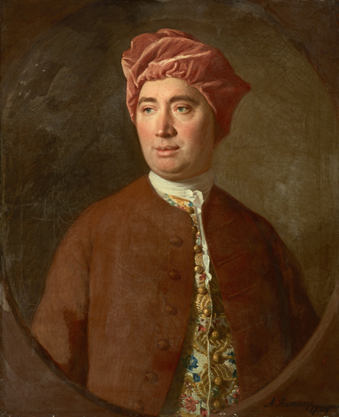
Critique: a stable and coherent self could have its origin solely in sensation and reflection
Hume shares Locke’s sensationalist
epistemology
Far from being unitary creatures who are ‘every
moment intimately conscious of what we call our Self’ we are instead ‘nothing but a bundle or Collection of different perceptions, which succeed each other with an inconceivable rapidity, and are in flux and movement’.
Claim: The self is a’ fiction’ or an ‘artifice’ and a construction of the most unreliable of human mental faculties: the imagination (next to memory, and reason).
David Hume (1711-1776)

Slide 13
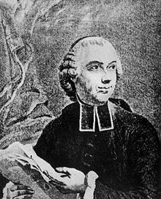
Locke’s followers on the continent:
Essai sur l'origine des connaissances humaines (1746) – follows Locke and promotes is ideas in France
Traité des sensations (1754)”
Questions Locke’s idea that sense give is intuitively knowledge of objects.
Consequence: We need to study each sense and have to train them.
Claim: all human faculties and knowledge are transferred sensation (exclude the idea of self-reflection from Locke)
Example of statue that is ‘awaken’ by one sense after another
Étienne Bonnot de Condillac 1714-1780

Slide 14
Traité des sensations (1754)”
The conclusion of the whole work is that in the natural order of things, everything has its source in sensation, including our passions and feelings – so the passions are nothing but sensation transformed.
In addition, such concepts, underpinned the belief that humans could be trained via their senses into useful citizens – the construction of individual Man who would be able to fit into a new, better society.
Condillac provides a focus on the trainability of a person’s senses, and by extension, their feelings and sentiments.
Étienne Bonnot de Condillac 1714-1780

Slide 15
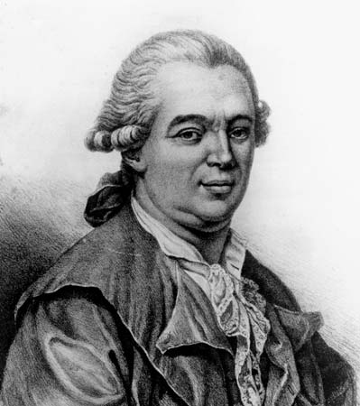
He proclaimed to have discovered a superfine fluid of sensation and feeling that penetrated and surrounded all bodies…. It was a disequilibrium of this fluid within the body that lead to disease.
Luckily the fluid was polarised, like a magnet, and capable of being manipulated and redirected by a specialised physician in order to cure the disease in a process that Mesmer called ‘animal magnetism’.
His theory attracted a wide following between about 1780 and 1850 all over Europe.
Franz Anton Mesmer, 1743-1815

Slide 16
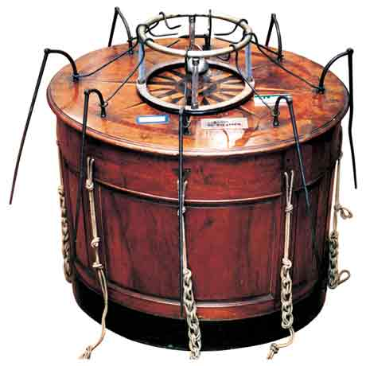
His patients would sit around the mesmeric tub. Among these devotees, the ability to succumb to an affective or emotional crisis, or convulsive seizure, was prized as a mark of sensibility – the capacity for intense feeling thought to be rooted in nervous physiology.
The most sensible effects were produced on the approach of Mesmer, who was said to convey the fluid by certain motions of his hands or eyes. And many patients claimed to feel peculiar sensations or had convulsions that were interpreted as crises and were supposed to bring about the cure.

Slide 17
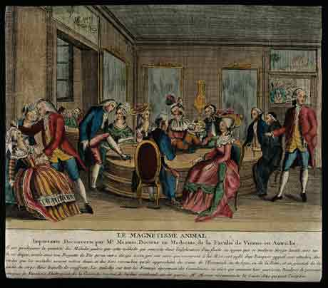
in the 1780s at the height of Mesmer’s notoriety two royal commissions launched an investigation into his practices, as they feared it might cause civil unrest if the passions and feelings of patients became un-ruled
The commission conducted a series of experiments aimed, not at determining whether Mesmer's treatment worked, but whether he had really discovered a new physical fluid. They accepted the authenticity of the convulsions produced by the treatment, however they ascribed them to the over-stimulated imagination of patients seated around the mesmeric tub.

Slide 18
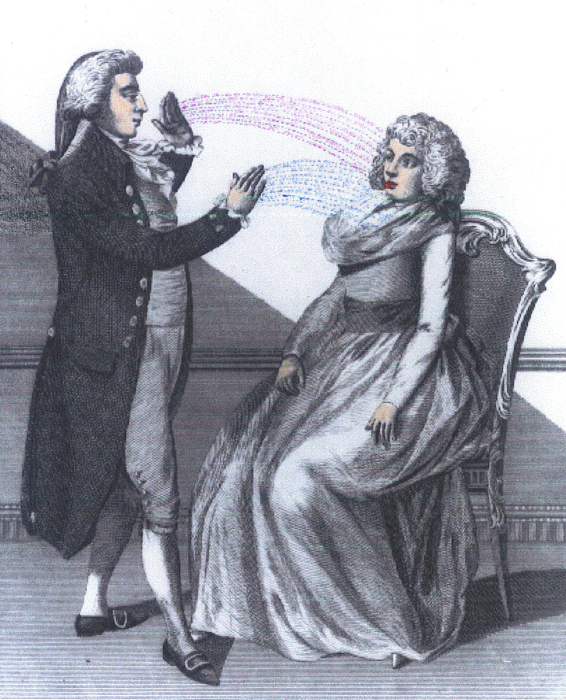
Claim: mesmerism did pose a problem for the scientific committee not by departing from the science of his time, nor by violating the rules but by too literally applying its credo. The credo of sensation and sensibility. Mesmer was a kind of caricature of natural science in the sentimental-empiricist idiom. (Jessica Riski, Science in the Age of Sensibility)

Slide 19
Sensationalism is extremely successful and is spreading through wider culture (e.g. diaries, memoires and novel reading spreads idea of sensationalism and feeling as a response – the drama of the subjective)
Sensationalism shaped the entire 18th century culture, a culture of sensibility; Locke is applied to other subjects (literature; morals, emotions etc.)
Denis Diderot on sensibility in 1760:
‘A vivid effect on our souls of an infinity of delicate observations’
Sentiment: an emotional ‘movement’ in the body in response to a physical sensation
sensibility is the’ first germ of thought’ deriving directly from nature; BUT by middle of 18th century is a physical sensation AND a moral sentiment (distinction and chronology gets lost)

Slide 20
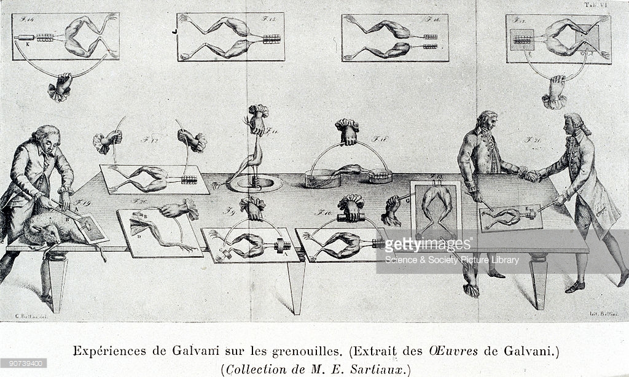
18th century search for new solution to the mind-body problem
How to solve the mind/body
problem
Anatomic and physiological research into ‘nerves’ and fascinations with all kinds of mystical ‘fluids’ (including the newly discovered fluid of ‘electricity’.
Problem remains: how does mind control passions which according to Descartes are
mechanical?

Slide 21
18th century search for new solution to the mind-body problem
Physicians in the 18th century discussed the nerves as the motorways in which perception travelled. Most of them imagined some kind of sensorium commune:
def. An area of unified function which both presented all sensations to the mind and through which the will impressed itself upon the body.
All of these discussion were not fixed on the exact place of the mind. And the discussion – even by physicians - always hovered between the philosophy and the physiology of the body….
This will change dramatically in the 19th century

