Slide 1
Revision Lecture 2
2020

Slide 2
‘Enlightenment is mankind’s exit from self-incurred immaturity… Sapere aude! [Dare to Know!] Have the courage to use your own understanding! It is thus the motto of the enlightenment.’
(From: Immanuel Kant, ‘An Answer to the Question: What is Enlightenment?’ Berlinerische Monatsschrift (1784): 481-494, 481.)
If we ‘Dare to Know’, then a system of equality and individual and collective freedom would emerge where the exercise of political and religious authority was consistent with ‘reason’.
The centrality of ‘reason’ is used in a Cartesian sense here. Through your individual thinking you will be able to control the world, yourself and your passions. By leading people to escape their basic physical and emotional drives through the exercise of ‘reason’, enlightened philosophers like Kant sought to lead humanity towards its true nature, a nature that they deemed free from the desire to terrify or compel others.

Slide 3
The Enlightenment’s Central Project: ‘The Science of Man’
In search of our ‘true’ nature
Term coined by the Scottish philosopher David Hume, who sought to apply Newton’s laws of nature to human nature.
The Science of Man sought to uncover what Human Nature is.
The project celebrated human ‘reason’ above everything else and nurtured the strong belief that ‘reason’, and its application via the empirical method, would enable people to get at what man really was.
It sought to expand the understanding of all kinds of facets of human nature, including the human senses, ideas, imagination, passions, morality, justice, and man’s relationship to society. And of course once you’ve achieved this one could foster man’s best traits – his or her individual traits -- for the happiness of all.

Slide 4
The Science of Man
‘science’ is not understood as ‘natural science’ – as we do today. The Enlightenment understood in a much broader sense as a general ‘inquiry following a rational method’. So, ‘history writing’ or ‘theology’ could be part of this ‘science of man’ – if undertaken by a rationally reasoning mind, of course!

Slide 5
Assumptions about ‘Human Nature’
1. Human nature follows laws.
2. Human nature develops in stages and this development is universal (stage history).
3. Human nature is perfectible.
4. Human nature no longer innately sinful but can be trained to contribute to the ‘common good’ and ‘happiness’ of all.

Slide 6
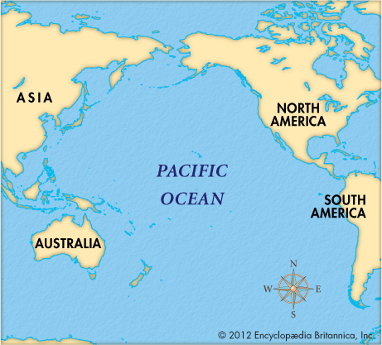
The Pacific

Slide 7
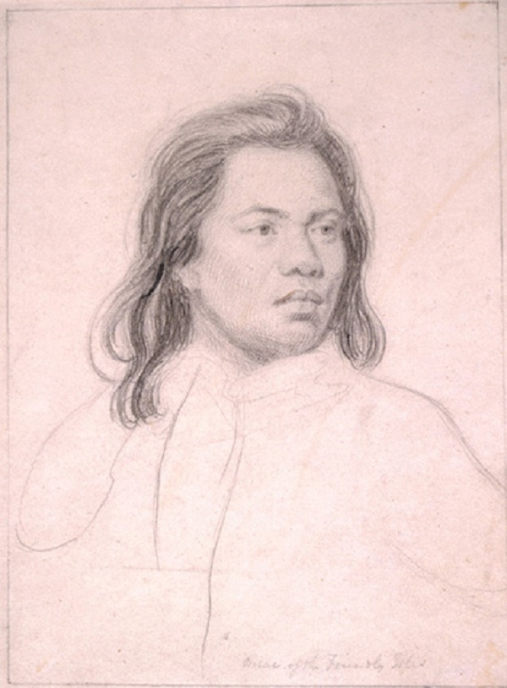
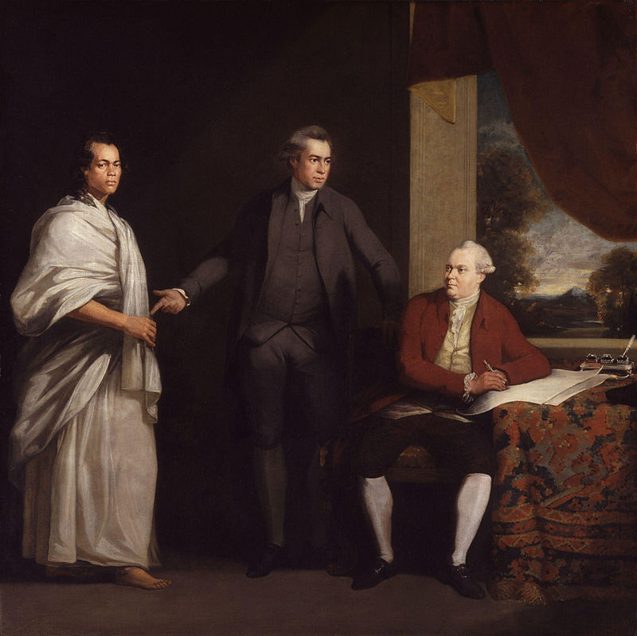
The Nobel Savage
Exotic islanders from Tahiti as sensations in British polite society:
Omai or Mai painted by Sir Joshua Reynolds, c. 1774; his visit to Britain inspires all sorts of artistic productions
Sir Joseph Banks with Omai and Daniel Solander, circa 1775-76

Slide 8
Discussions about the place of the ‘new’ Pacific people within theories of civilization
‘Stage Theory’ of Human Civilisation and Conjectural History of Man
Developed from Montesquie’s ideas by Scottish thinkers who grafted the movement of a gradual progress onto the classification of individual and social phenomena
‘There is [ . . . ] in human society, a natural progress from ignorance
to knowledge, and from rude to civilized manners [ . . . ]. Various
accidental causes, indeed, have contributed to accelerate, or to
retard, this advancement in different countries.’
(Adam Smith)
Human Society develops in 4 Distinct Chronological Stages:
‘1st, the Age of Hunters, 2dly, the Age of Shepherds, 3dly, the Age of Agriculture; and 4thly, the Age of Commerce.’ (Adam Smith)
From savage state to state of full civilisation

Slide 9
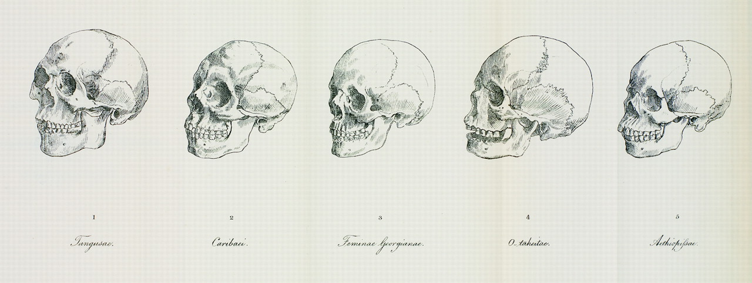
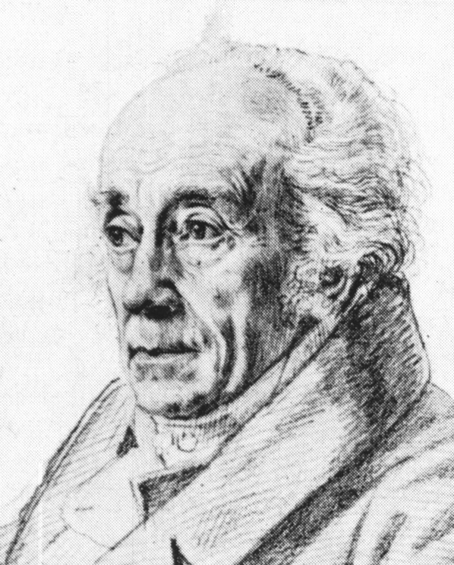
Race and Equality
De generis humani varietate nativa (On the Natural Variety
of Mankind) (1775)
New:
The notion of a natural hierarchy of racesbased NOT on external characteristics such as skin colour but on internal structures of the body
Johann Friedrich Blumenbach, 1752-1834

Slide 10
Natural Hierarchy of Races
Blumenbach divided the human species into five races:
the Caucasian or white race
the Mongolian or yellow race, including all East Asians and some Central Asians.
the Malayan or brown race, including Southeast Asian and Pacific Islanders.
the Ethiopian or black race, including sub-Saharan Africans.
the American or red race, including American Indians.
Equality or inequality of humans starts to be imbedded within physical differences. The
Normative ‘model’ is the white European male body

Slide 11
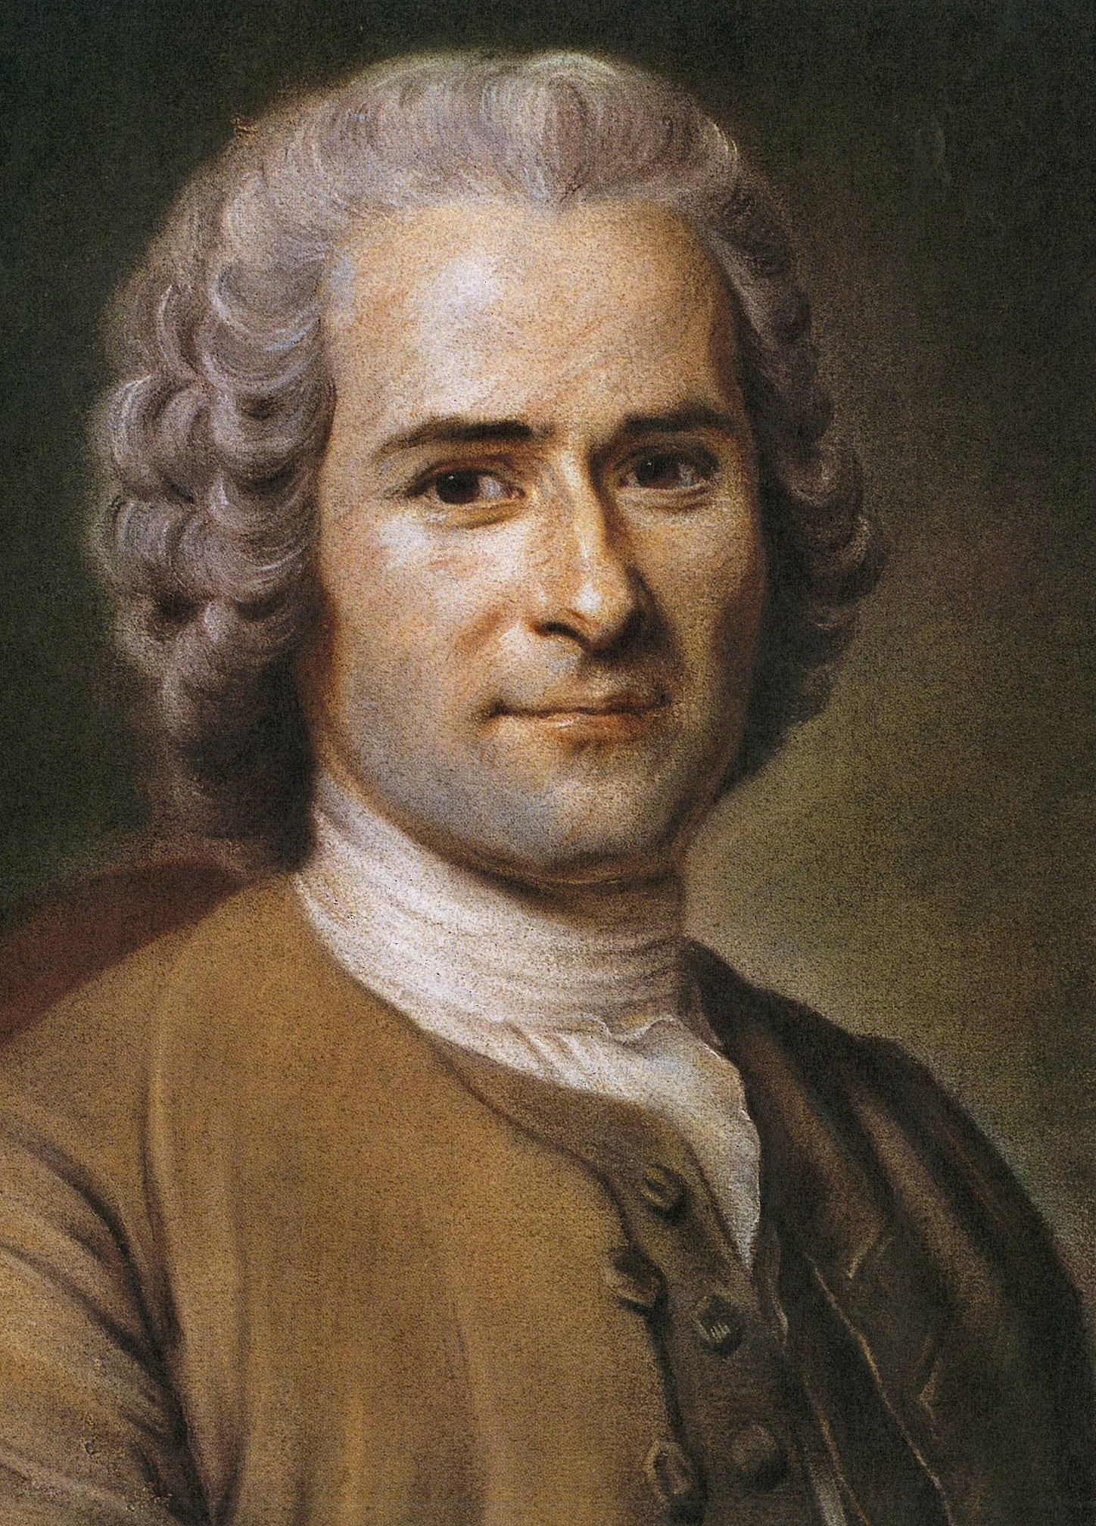
Women and Equality
1. Rousseau’s view on women’s nature
Émile, or On Education (1762)
Rousseau was a believer in the moral– because he believed ‘natural’ --superiority of the patriarchal family based on the antique Roman model
Jean-Jacques Rousseau , 1712-1787

Slide 12
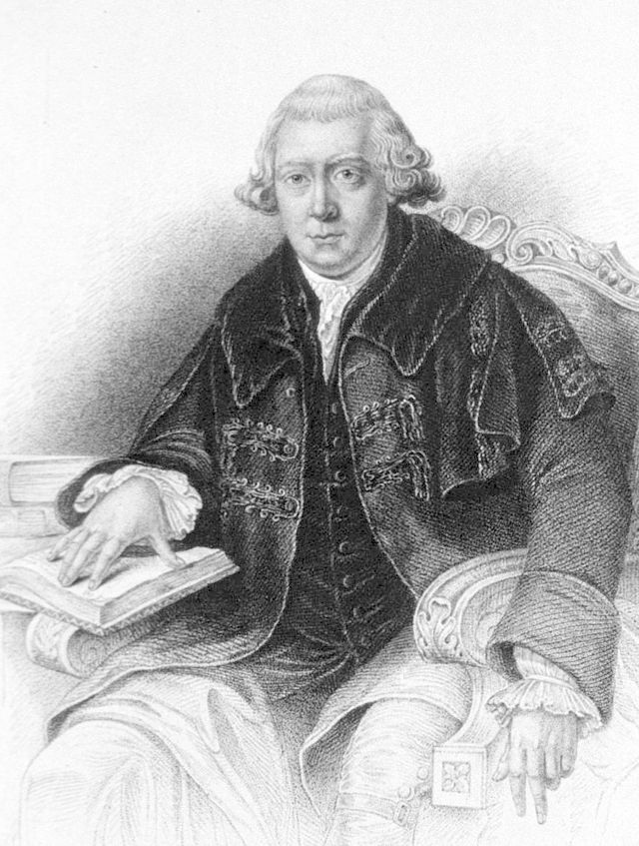
2. Dr John Gregory
Comparative Views of the State and Faculties of Man with Those of the Animal World (1765)
A father’s legacy to His Daughter (1774)
‘…your natural character and place and society there arises a certain propriety of conduct peculiar to your sex’
‘I do not want to make you anything: I want to know what Nature has made you, and to perfect you on her plan’
Dr John Gregory, 1724-1773

Slide 13
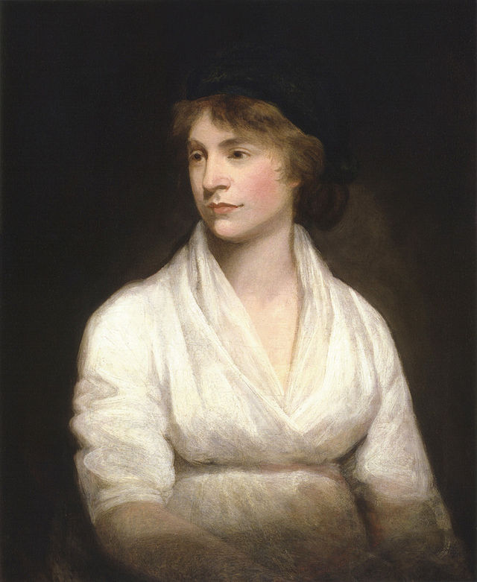
‘I may be accused of ignorance, still I must declare what I firmly believe, that all the writers who have written on the subject of female education and manners from Rousseau to Dr Gregory, have contributed to …degrade one half of the human species, and render women pleasing at the expense of every solid virtue’.
Mary Wollstonecraft, A Vindication of the Rights of Women (1792)

Slide 14
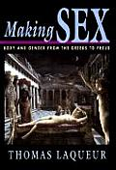
Spreading assumption that ‘differences’ of sexes is carved into the physical body
Such perceived physical difference were shaped by socio-cultural discussion on women

Slide 15
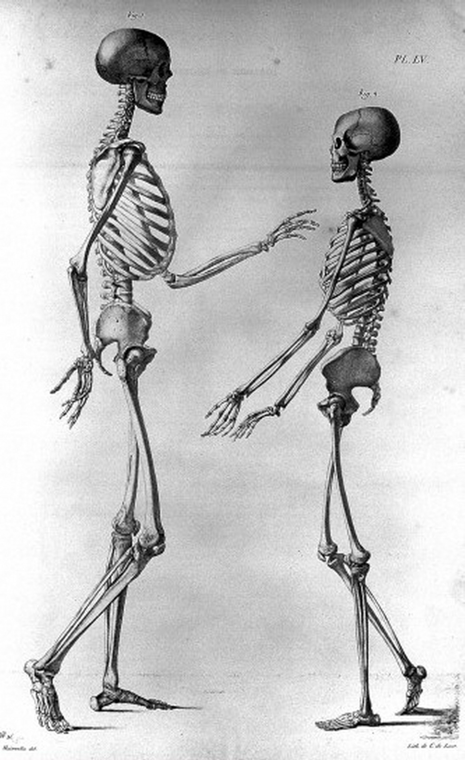
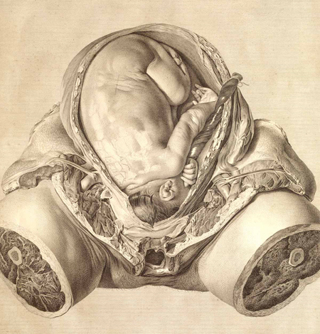
Physical Differences are also Social and Moral Differences between the Sexes
Women’s bodies are becoming ‘different’ from that of men during 18th century; cases
female inferiority start to be based on their ‘different’ physicality and its classification

Slide 16
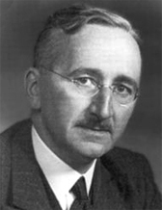
Human Nature and Economics
Hayek on Smith whom he celebrates as the inventor of economic liberalism:
“Adam Smith’s decisive contribution [to the history of liberalism] was the account of a self-generating order which formed spontaneously if the individuals were
restrained by appropriate rules of law. His Inquiry into the Nature and Causes of the Wealth of Nations marks perhaps more than any other single work the beginning of the development of modern liberalism. It made people understand that those restrictions on the powers of government which had originated from sheer distrust of all arbitrary power had become the chief cause of Britain’s economic prosperity.”
“homo economicus”, or economic man, is the concept in many current economic theories portraying humans as consistently rational and narrowly self-interested agents who usually pursue their subjectively-defined ends optimally.
(term first used in late nineteenth century)
Friedrich Hayek 1899-1992

Slide 17
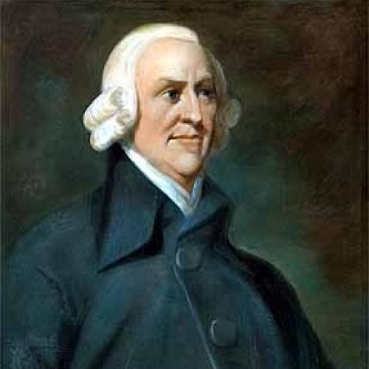
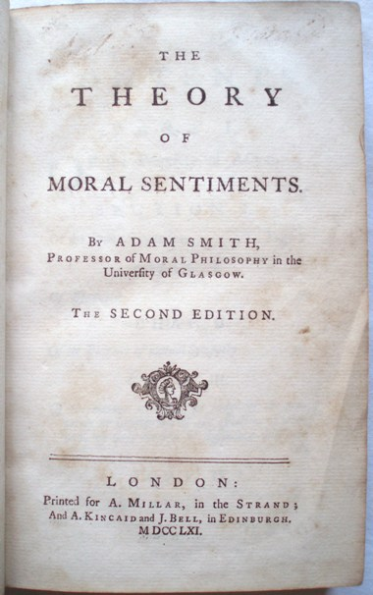
Adam Smith (b.1732, d.1790)
The Theory of Moral Sentiment (1759):
Central concept is ‘sympathy’:
Smith great achievement is that he turned sympathy into the governing principle of a theory of sociability on which a theory of commerce could be based.
‘[The] greatest human happiness arises from the consciousness of being beloved’

Slide 18
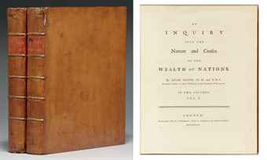
The Wealth of Nations, 1776

Slide 19
How Do People “Think”: the question of the mind....
Theory of Sensationalism:
a form of empirical epistemology that limits experience as a source of knowledge to sensation or sense perceptions. It imagines the mind as a ‘tabula rasa’, or ‘clean slate’ at birth, only to be filled subsequently by ideas through sense perception.
A serious problem that arises from sensationalism: How can a human being have the impression to be whole or the same over time, if all the human self is, derives from the ongoing imprint of external sense impression?
Locke’s solution to the problem:
He defines ‘selfhood’ (or ‘the self’) as a combination of consciousness (defined as reflexive reasoning) and memory that ensures its unbroken continuity.

Slide 20
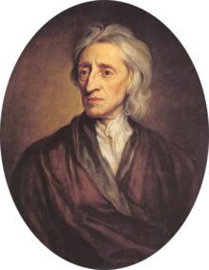
Essay Concerning Human Understanding (1690; 1694)
presents a new idea about human nature and the self which becomes the basis for all thinking about self and mind during the 18th century
Thesis: all is based on the working of the senses
John Locke 1632-1704

Slide 21
Locke’s central claim:
Rather than ideas being innate, Locke claims that the mind is a ‘blank slate’ at birth; therefore any person’s character is not innate but ‘made’ throughout life due to ongoing sense perception; so the mind is in constant development.
All our mental contents are derived from, he argued, discrete sensory impressions. So the human mind was an empty slate – a tabula rasa – which was successively filled with ideas which derived from our perceptions of sensation. And these sensations – Locke understood them as our ‘ideas’, were ‘impressed’ on the mind or the soul, like words on a wax tablet.

Slide 22
Locke’s Essay engages with:
1. The unresolved relationship between mind and body – thrown up by Descartes theory.
2. The developing consensus that knowledge is gained through individual sense experience (based on the popularity of Newton’s method).
Locke follows a Newtonian method: an empirical investigation into understanding of human reasoning and human morality
He questions:
Aristotelian reasoning which is still around at his time (syllogism; the deductive method)
And he also questions the Cartesian principle that ideas were innate

Slide 23
Locke retains idea of immaterial soul and the self-reflexive mind from Descartes
A serious problem that arises: if we are continually being bombarded by sense impressions, how can a human being maintain a sense of sameness, a unified soul, a unified self?
To solve the problem Locke Introduces the term consciousness:
Defined as any sort of reflexive knowledge
‘It is impossible for anyone to perceive, without perceiving that he does perceive’, which ‘makes every one to be, what he calls ‘self’’ and thereby distinguishes himself from all other thinking beings, and in this alone consists personal Identity’
Locke’s solution to the problem:
He defines ‘selfhood’ (or ‘the self’) as a combination of consciousness (defined as reflexive reasoning) and memory that ensures its unbroken continuity.

Slide 24
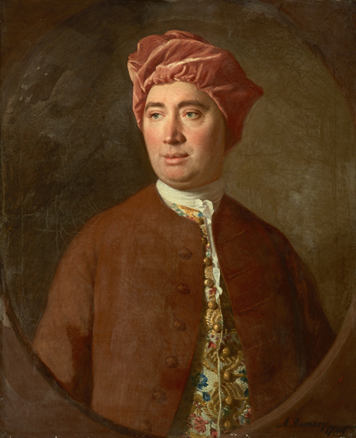
Critique of Locke’s ideas from other moral
philosophers
1. Central problem of Locke: a stable and coherent self could have its origin solely in sensation, reflection in combination with memory
Suggest that the self is ‘nothing but a bundle or collection of different perceptions, which succeed each other with an inconceivable rapidity, and are in flux and movement’.
Claim: The self is a’ fiction’ or an ‘artifice’ and a construction of the most unreliable of human mental faculties: the imagination (one of the three faculties of the mind next to memory, and reasons, responsible for the processing of sense perception)
Big question for many became: Can we trust our sense perception?
David Hume

Slide 25
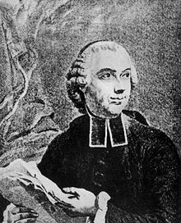
Trainability of the senses is related to Condillac’s adaptation of Locke’s ideas:
Condilliac: asks: if the mind is passive and just gets impressed by external sensations, how can such a mind know anything that is outside of its sense experience?
Essai sur l'origine des connaissances humaines (1746) – follows Locke and promotes is ideas in France
Traité des sensations (1754)
he uses the famous example of statue that is ‘awaken’ by one sense after another
Étienne Bonnot de Condillac, 1714-1780

Slide 26
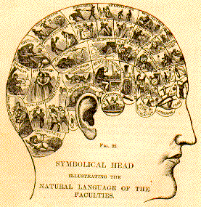
The 19th century ‘self’ and its relation to society:
Part I
Def. phrenology: a science that was primarily focused on measurements of the human skull, based on the concept that the brain is the organ of the mind, and that certain brain areas have localized, specific functions or modules.
Phrenology claims that the brain is composed of many particular "organs", each one of them related or responsible for a given mental faculty.

Slide 27
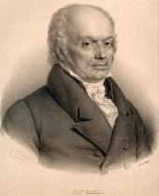
A material object as the principle organ of mind: the rise of the brain
Gall’s central claims:
The brain is the organ of the mind
The brain is not a homogenous unity, but an aggregate of mental ‘organs’ with specific functions (27)
The cerebral ‘organs’ are topographically localized
the relative size of any particular mental organ is indicative of the power or strength of that organ
Since the skull ossifies over the brain during infant development, external craniological means could be used to diagnose the internal states of the mental characters
Franz Joseph Gall, 1758 – 1828)
‘Cerebral physiology’

