Slide 1
Revision I: Term I Dr. Claudia Stein

Slide 2
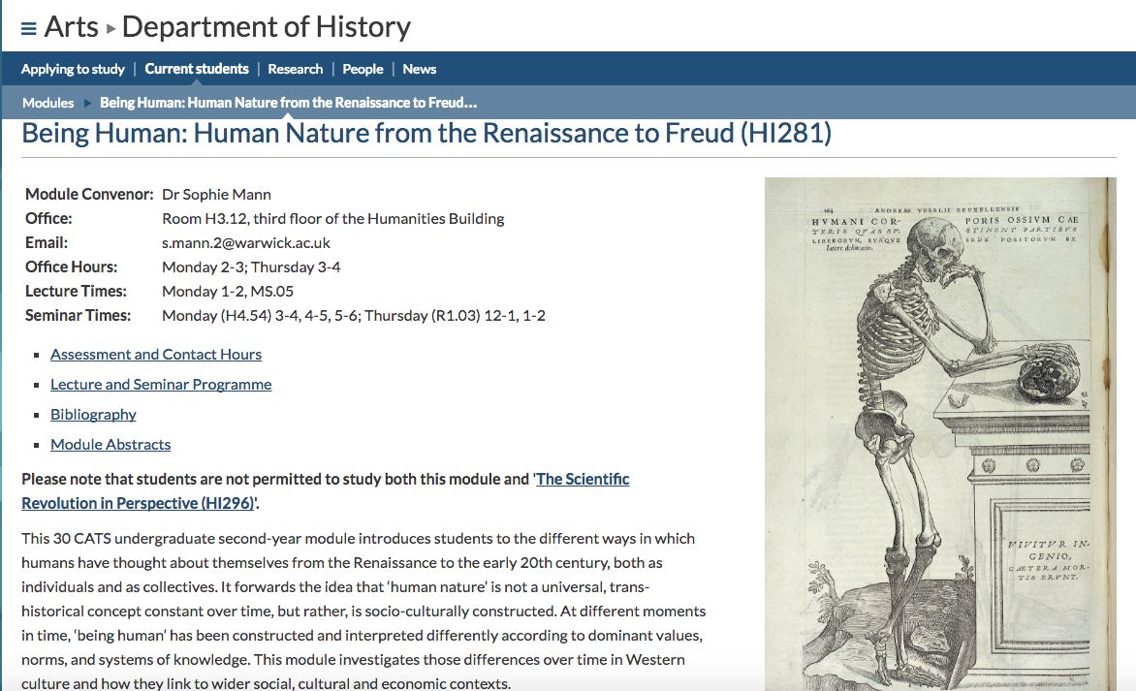

Slide 3
3. The precise contexts in which knowledge about ‘human nature’ is produced
The socio-cultural and economic context in which particular ideas about human nature come to the fore is an important subject that warrants careful reflection, and it’s a subject that requires a historical perspective.
If ‘human nature’ is entirely dependent on the specific context in which people think about. It is not some naturally given ‘thing’ out there which stays the same throughout time and is successively discovered by clever people. Rather, human nature is relative, it is relative to a specific culture at a particular moment. It is thus socially and culturally ‘contructed’. What people believe human nature is changes with time.
Therefore, there is no universalism, no successive discovery of ‘human nature’ by clever people throughout history.
We must not forget that this process is still going on today, i.e. it includes discussions going on today in the natural sciences, and the conversation about what human nature is is not over (even if today’s cognitive neurosciences today ‘pretend’ that they are close to solving the riddle!)

Slide 4
So, if ‘human nature’ changes throughout history, can we trust ‘historians’ to tell us the truth about ‘what it means to be human’?
Like scientists historians, too, are part of a culture and what they think ‘human nature’ is also reflects their own culture and time. They interpret the archival and literary sources they use in light of their own time and culture.
Two examples of this:
Topic 1: Famous Stories We Tell Ourselves (I): The ‘Discovery’ of the Individual or the ‘Self-Fashioning’ of Renaissance Man? Burckhardt and Greenblatt.
Topic 2: Famous Stories We Tell Ourselves (II): ‘The Scientific Revolution’

Slide 5
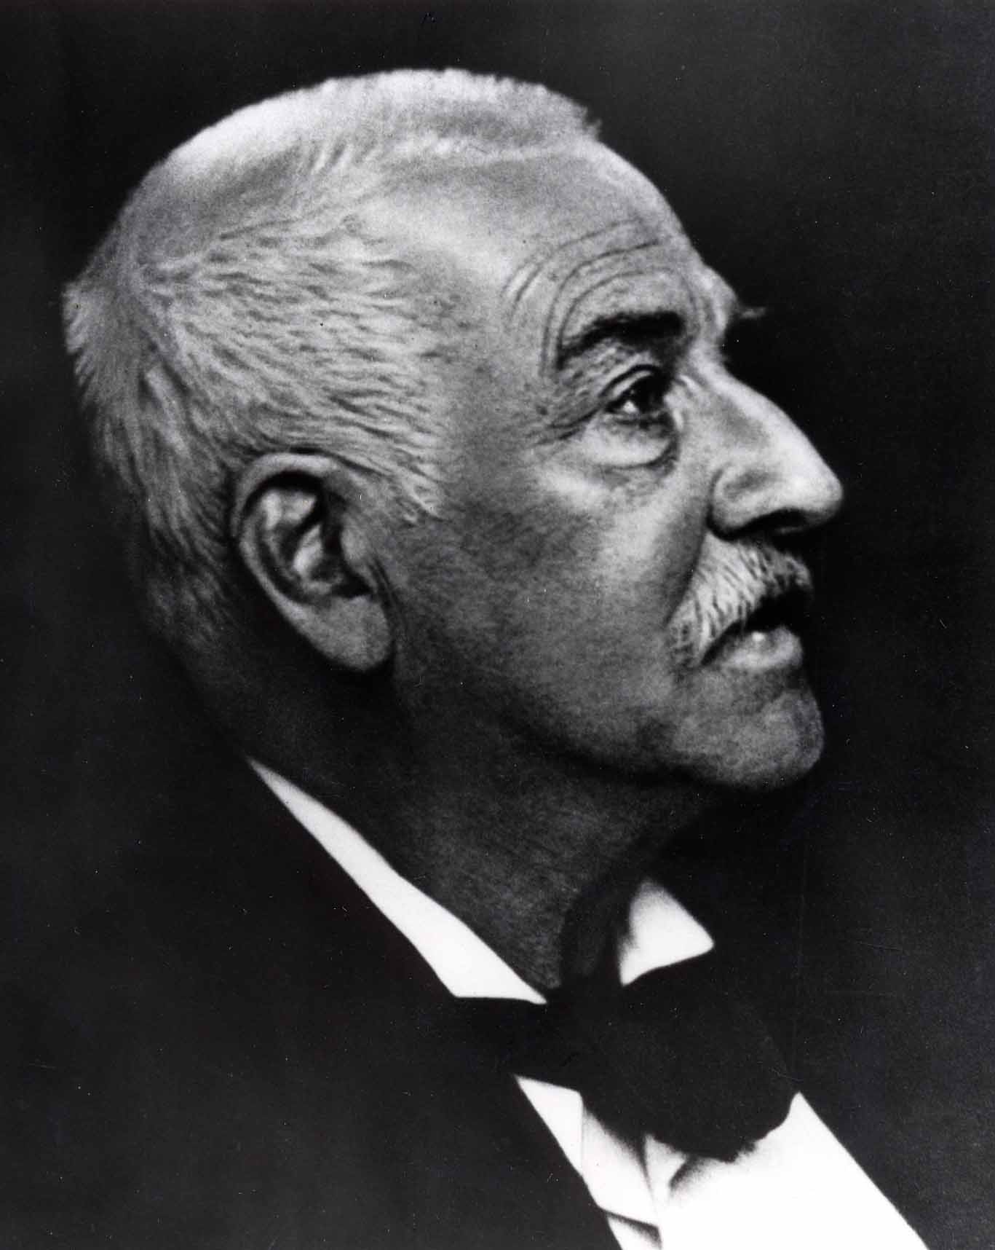
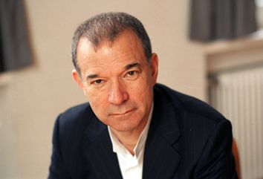
Famous Stories We Tell Ourselves (I): The ‘Discovery’ of the Individual or the ‘Self-Fashioning’ of Renaissance Man? Burckhardt and Greenblatt
Stephen Greenblatt, 1943
Jacob Burckhardt, 1818-1897
Postmodern human nature
Modern human nature

Slide 6
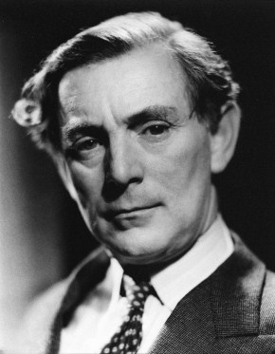
Topic 2: Famous Stories We Tell Ourselves (II): ‘The Scientific Revolution’
The Whig Interpretation of History ( 1931)
The Origins of Modern Science, 1300-1800 (1948)
Human nature will be progressively discovered
by almost superhuman scientists (male and neutral)
Herbert Butterfield, 1900-1979
Reflects British post war-attempt to strengthen
the support for the natural sciences

Slide 7
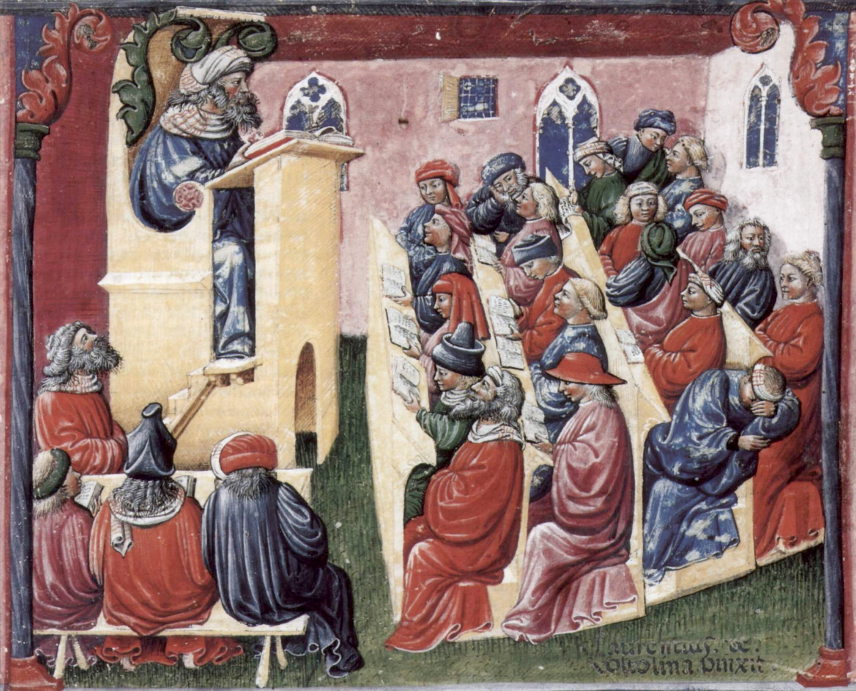
How to seriously discuss ‘human nature’ in the Renaissance?
Central author who is discussed is the Greek philosopher Aristotle.

Slide 8
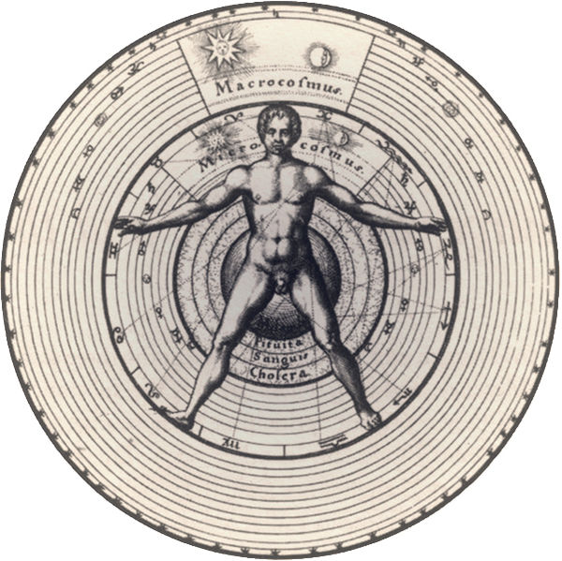
Micro-Macrocosm – Man as the mirror of the wider cosmos

Slide 9
What do natural philosophers (this includes physicians), do in 1500?
Collecting and cataloguing the wonders of God’s Creation – all the things we
have forgotten due to the Fall.
To explain why things are the way they are (why does the sun rises and sets every day); Natural philosophers did not aim to discover something (as we wish to do!) because in a world created and run by God, there is nothing new to discover by humans.
Their enterprise is thus closely linked to theological questions; it is a spiritual exercise.
The method is ‘deductive’ – from what we know to why it is the way it is.
They follow a particular logic called syllogism e.g. All men are mortal, Socrates is a man, therefore Socrates is mortal

Slide 10
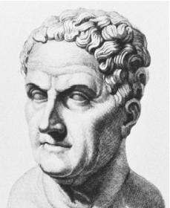
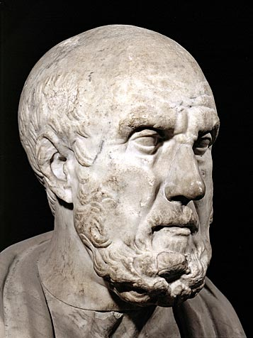
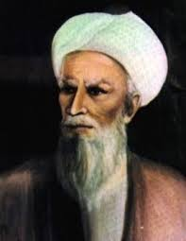
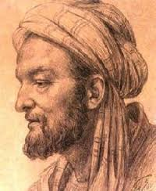
Reliance on written texts on medicine by ancient philosophers whose thinking was ‘christianized’ over the centuries
Hippocrates of Cos, c. 460 – c. 370 BC
Galen of Pergamon, 130 AD – 200 AD
Avicenna (Latinate form of Ibn-Sīnā),
c. 980 AD – 1037 AD
Rhazes, 854 AD – 925 AD

Slide 11
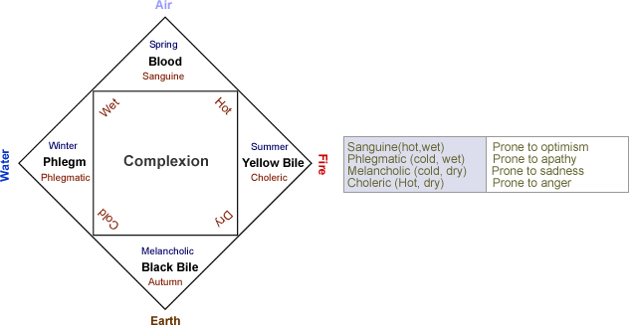
Some of the central beliefs about the physical human body put forward by these classical
thinkers:
the six-non naturals: air, food and drink, sleeping and waking, motion and rest,
excretions and retentions, and the passions of the soul

Slide 12
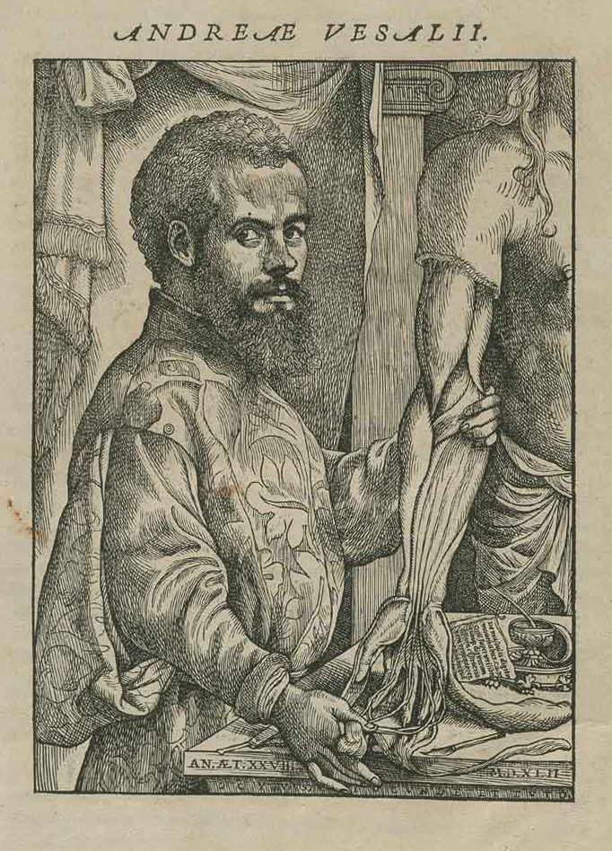
Revolutionizing Anatomy or
Reforming it?
Vesalius wished to reform it by
Going back to the original ancient
texts and to practice dissection
‘Let them use their hands…as the
Greeks did and as the essence of
the art demands’
Book 1: skeleton
Book 2: myology, all the muscles and their relations
Books 3 and 4: venous, arterial and nervous systems
Books 5-6: organs of the abdominal and thoracic cavities and the brain
Book 7: he reports own experiments and vivisections

Slide 13
But the physical understanding is only one side of the story. Almost more important was the question of the ‘the soul’
Christianity in the Renaissance believed that:
“Man” is a soul-body composite or ‘ensouled’ body
“A person” was in Christian belief denoted someone who possesses an immortal soul

Slide 14
The belief in the importance of ‘the soul’ for the functioning of the human body goes back to the pagan philosopher Aristotle:
Aristotle subdivides ‘the soul’ into three kinds:
vegetative/nutritive soul: was the lowest soul which included the functions basic to all living things: nutrition,
growth and reproduction.
sensitive soul: second highest of the three souls which included all of the powers of the vegetative soul as well as the powers of movement and emotion as well as the ten internal and external senses.
Intellective/rational soul (possessed only by Man): included not only the vegetative and sensitive powers — the organic
faculties of the other two souls - but also the three rational powers of intellect, intellective memory (memory of concepts, as opposed to mere sense images) and will.

Slide 15
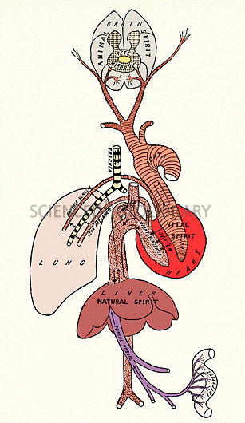
Souls and the organs where they were believed to reside
relied for the operation on ‘spirits’ -
goes back to medical ideas of Galen (who relied on Aristotle)
spirit/pneuma: means ‘air’ or ‘breath’, and is imagined
as a sort of hot vapor fused in blood
1. natural spirit: resided in the liver, the center of
nutrition and metabolism.
2. vital spirit was located in the heart, the center of
blood flow regulation, heart beat, respiration, and body temperature.
3. animal spirit was created in the brain, the center of sensory perceptions and movement.
Galen’s idea of body and spirits

Slide 16
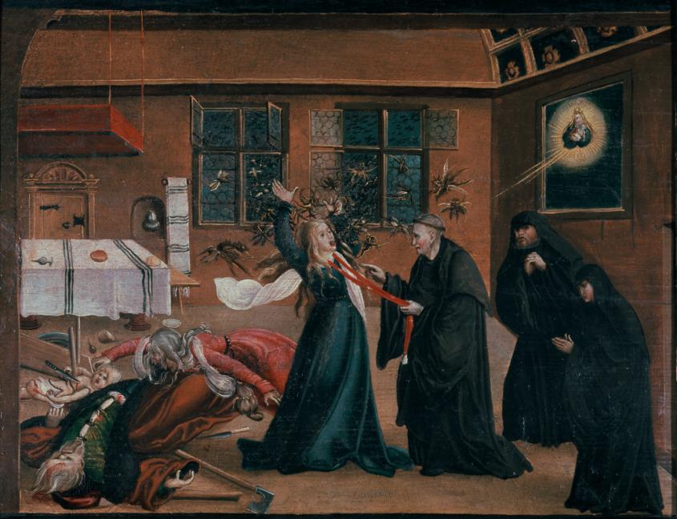
Spiritual Possession
Is not ‘irrational’ because, as we have seen, there was a very rational and logic basis to it (theory of the soul, and spirits)
Def. exorcism: the practice of evicting demons or other spiritual entities from a
person believed to be possessed.

Slide 17
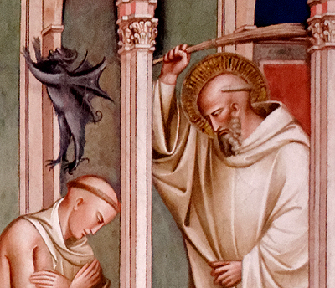
‘Let us no one have any doubt that demons are in the body, not the soul. Only God, not a created thing, can enter into the human soul through the inhabitation of grace.’
(Thomas of Cantimpre, in Caciola, p. 283)
Demons can disrupt human
senses and sense communication

Slide 18
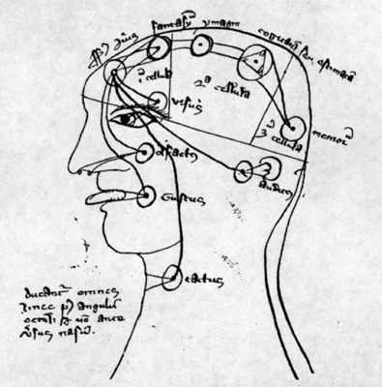
Def. species: object’s forms/images
radiated out by itself
mid- 14th century illustration, showing the five internal senses located in the three cells of the brain and connected to each other.
Five internal sense: common sense, imagination, estimation, cognition, and memory or further use.
(Bayerische Staatsbibliothek München (Clm., 527, fol. 64v)

Slide 19
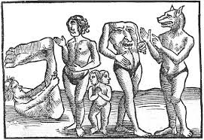
Of Monsters and Cannibals: Europeans and their Encounter with the New World ‘Other’
Early modern contemporaries understood
These people through their ancient
Sources
Problem: how to believe in eye-witness
Accounts of these explorers because this
Would ask for a questioning of the
Ancient authorities

Slide 20
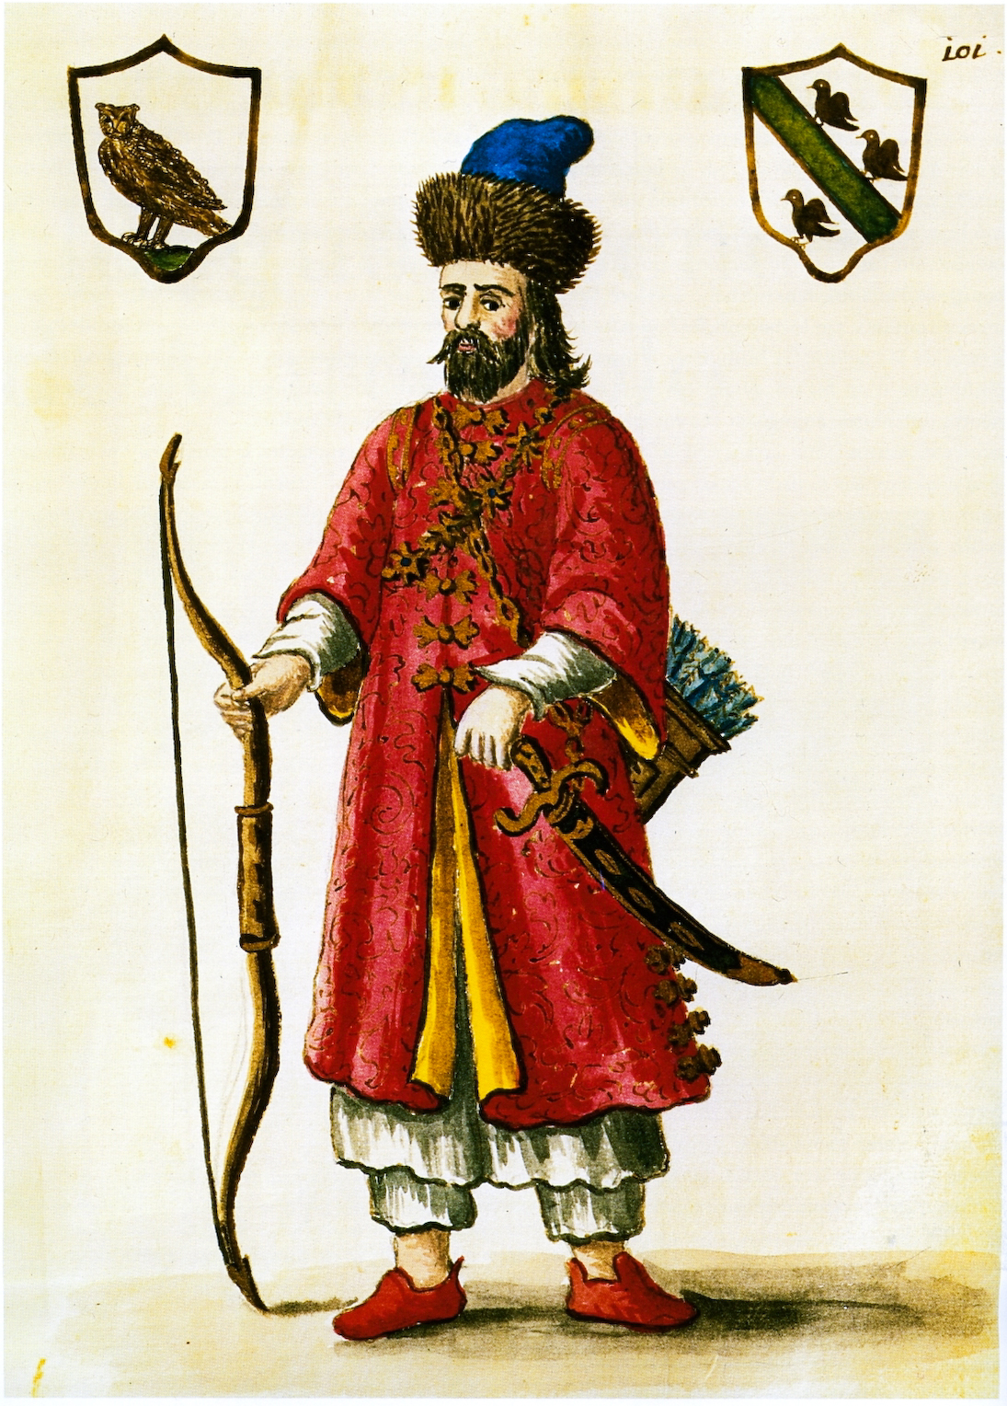
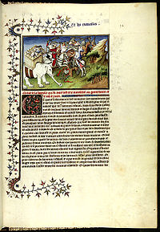
Polo at the court of Kublai Khan
A page from ‘The Travels of Marco Polo’, c. 1300
His travels lasted 24 years (1271-1295); he then returned to Venice where he was briefly imprisoned; he dictated his account to a fellow prisoner
His account was considered to be ‘real’ –
including his description of monsters--
at the time of Columbus and used as an
‘authorative texts’ by all travellers (very
much like Galen’s writings by physicians)

Slide 21
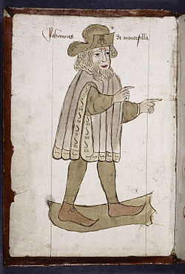
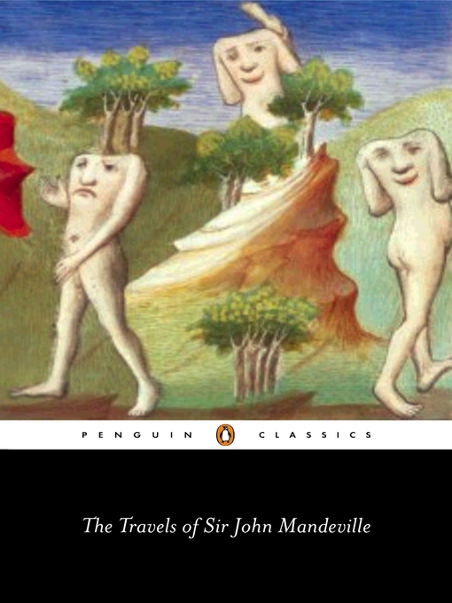
The Travels of Sir John Mandeville, c. 1370
‘Portrait’ of ‘Sir John Manderville’ who, according to historians, is most probably just a fictional character.
But at times of Columbus his account was believed as a ‘real travel’

Slide 22
Arawaks: The term Arawak originally applied specifically to the South American group who self-identified as Arawak. Columbus encounters them in Caribbean
Caribs: The Island Caribs, also known as the Kalinago or simply Caribs, are an indigenous people of the Antilles in the Caribbean.
Columbus refers to them as ‘Caniba’ ---- due to a misunderstanding.
(Columbus in letter)
‘I therefore repeat what I have said several times already: That the Caniba are none other than the people of the Great Khan, who must be neighbours to these. They have ships, they come and capture these people, and as those who are taken never return, the others believe that they have been eaten.’

Slide 23
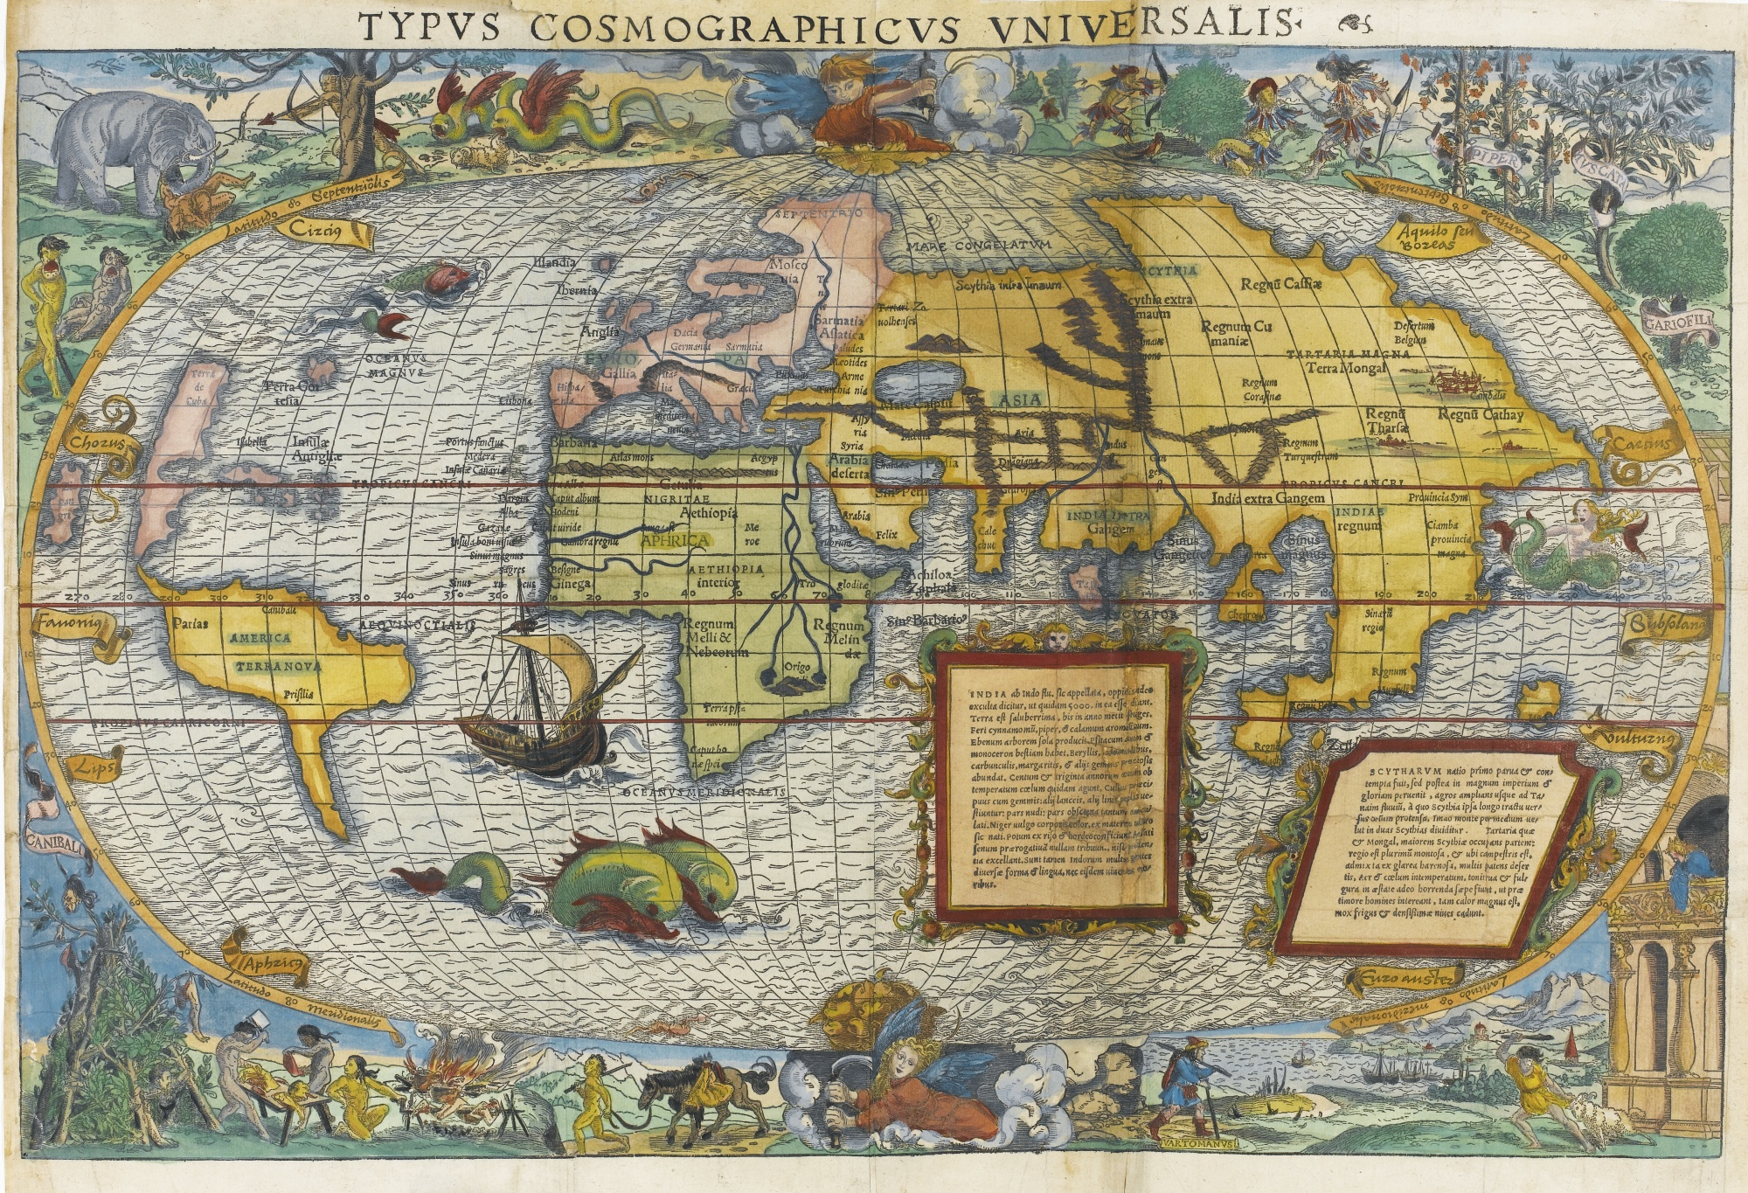
Waldseemüller, Martin, Universalis cosmographia secundum Ptholomæi traditionem et Americi Vespucii aliorv. que lustrationes, 1516
Map depicts the Americas, Africa, Europe, Asia, and the Pacific Ocean separating Asia from the Americas.
Note: the cannibals in the left corner!

Slide 24
The question of human curiosity, that is the drive to know ‘new’ things in the world
‘Curious’ humans challenge God’s creation and was punished, the Bible says:
‘Christians have special knowledge of the extent to which curiosity is a natural and evil in man. The desire to increase in wisdom and in knowledge: that was the first ruin of mankind. That is the path by which it hurled itself into eternal damnation.’
Montaigne, in, Apology for Raymond Sebond

Slide 25
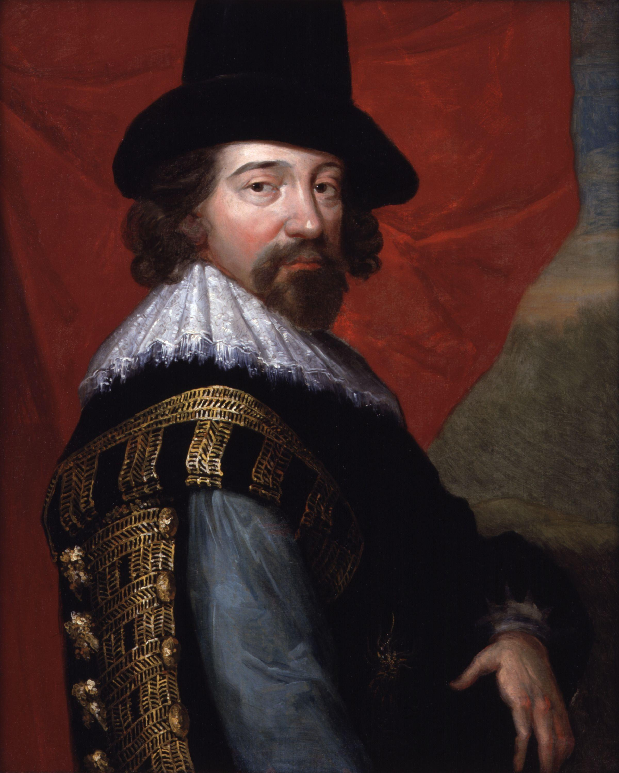
Making ‘Curiosity’ a Christian Activity
Francis Bacon (1561 – 1626), Lord Chancellor.
He challenged the most common biblical objections to the promotion of learning by providing a re-reading of the narrative of the temptation in the Garden Eden
Empiricism: a philosophical stance that holds that all knowledge is rooted in the
senses and the experience that they provide.
Bacon is celebrated as ‘the father’ of the modern scientific method.

Slide 26
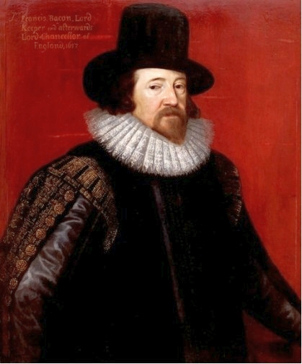
‘So as what so ever is not God but parcel of the world, he hath fitted it for the comprehension of man's mind, if man will open and dilate the powers of understanding as he may. But yet evermore it must be remembered that the least part of the knowledge passed to man by this so large a charter from God must be subject to that use for which God hath granted it; which is the benefit and relief of the state and society of man; for otherwise all manner of knowledge becometh malign and serpentine, and therefore as carrying the quality of the serpent's sting and malice it maketh the mind of man to swell; ast he Scripture saith excellently: knowledge bloweth up, but charity buildeth up.’
Bacon cleverly re-interpreted the Bible:

Slide 27
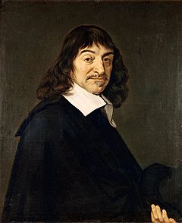
Cartesianism
Central claims:
“I think therefore I am was so certain and so assured…I could receive it without scruple as the first principle for the philosophy which I was seeking ” 1637. Discours de la méthode (Discourse on the Method)
The totality of all existence composed of two substances, matter and ‘res cogitans’ (or thinking stuff).
On the basis of this he divides the body into mind and matter, the physical body is simply a machine
Humans have a rational soul and are therefore unique and different from machine-like animals
René Descartes, 1596-1650

Slide 28
The Body as Machine
“I suppose the body to be nothing but a statue or machine made of earth, which God forms with the explicit intention of making it as much as possible like us.”
Everything can be mechanistically explained in a body:
…the digestion of food, the beating of the heart and arteries, the nourishment and growth of the limbs, respiration, waking and sleeping, the reception by the external sense organs of light, sounds, smells, tastes, heat and other such qualities, the imprinting of the ideas of these qualities in the organ of the ‘common’ sense and the imagination, the retention or stamping of these ideas in the memory, the internal movements of the appetites and passions, and finally the external movements of all the limbs”

Slide 29
Descartes radically changes relationship between humans and animals:
Central claim: Animals are machines (automata), they lack the rational soul which is unique to humans; therefore they are fundamentally different from humans
‘…it is nature which acts in them according to the disposition of their
organs, just as a clock, which is only composed of wheels and weights
is able to tell the hours and measure the time more correctly than we
can do with all our wisdom.‘
How do we know that they have no rational soul? Because they cannot speak and communicate their thoughts and feelings.
“Thus, in animals, there is neither intelligence nor souls as ordinarily meant. They eat without pleasure, cry without pain, grow without knowing it; they desire nothing, fear nothing, know nothing; and if they act in a manner that demonstrates intelligence, it is because God, having made them in order to preserve them, made their bodies in such a way that they mechanically avoid what is capable of destroying them.”
(Nicolas Malebranche, The Search after Truth)

