Slide 1
Lecture 4:
Discovering Human Nature? The Case of Sixteenth–Century Anatomy

Slide 2
What do natural philosophers do?
Collecting and cataloguing the wonders of God’s Creation – all the things we
have forgotten due to the Fall.
To explain why things are the way they are (why does the sun rises and sets every day); Natural philosophers did not aim to discover something (as we wish to do!) because in a world created and run by God, there is nothing new to discover by humans.
Their enterprise is thus closely linked to theological questions; it is a spiritual exercise.
The method is ‘deductive’ – from what we know to why it is the way it is

Slide 3
Where is personal sense experience in all this?
This way of thinking does not value personal sense experience as key to the understanding of nature. Aristotle admits that all thinking about something starts with such a sense experience. But that is not the aim. He is after ‘the essence’ or ‘nature’ of the thing he is thinking about. This essence/nature is invisible and lies
beyond the mere sense experience. Only philosophical discussion will lead the way to its understanding.
nature/essence: is what makes a thing act the way it does

Slide 4
seven liberal arts: arithmetic, geometry, astronomy, music theory, grammar, logic,
and rhetoric which was studied for a BA and MA.
trivium: grammar, logic, and rhetoric.
quadrivium: arithmetic, geometry, astronomy, music theory (mathematical
subjects and assumed to be knowledges towards a practical end –
therefore not considered real sciences which treated
only ‘universals’
Physics: a general term for the study of the natural world; whether animate or inanimate. A practical synonym for ‘natural philosophy’.
Metaphysics: branch of knowledge, which considers the the fundamental categories of reality such as existence, being, matter, space, etc.
Moral philosophy: branch of knowledge that is concerned with theories of ethics, with how humans ought to live their lives.

Slide 5
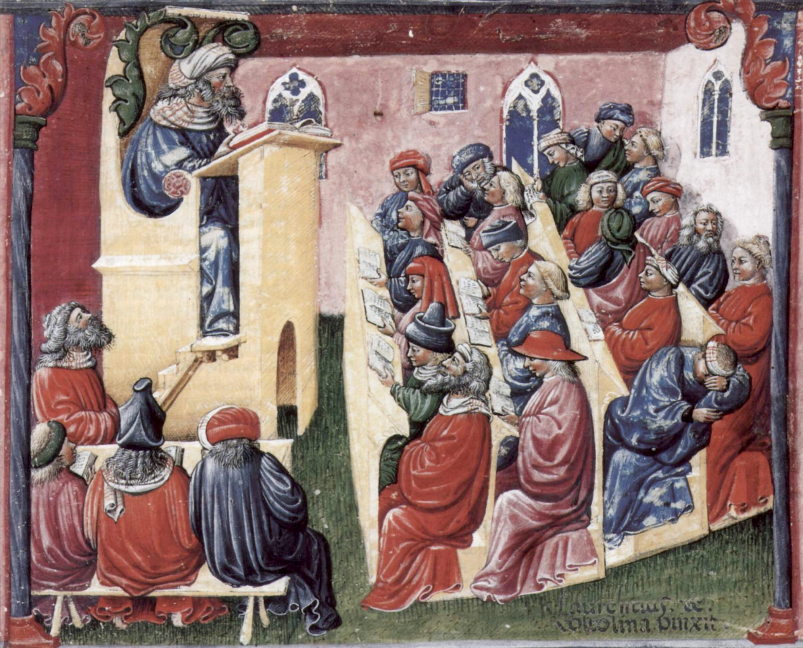

Slide 6
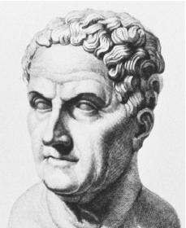
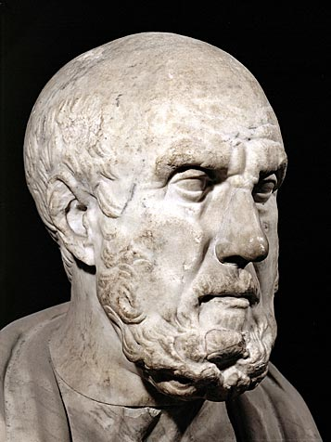
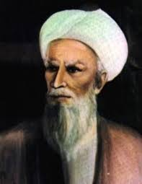
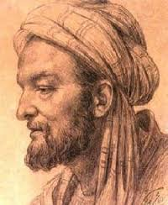
Galen of Pergamon, 130 AD – 200 AD
Hippocrates of Cos, c. 460 – c. 370 BC
Avicenna (Latinate form of Ibn-Sīnā),
c. 980 AD – 1037 AD
Rhazes, 854 AD – 925 AD

Slide 7
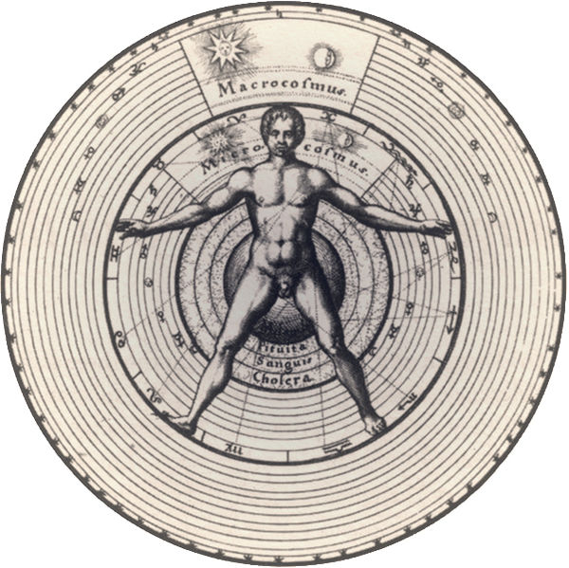
Micro-Macrocosm – Man as the mirror of the wider cosmos

Slide 8
The four humours
blood
phlegm
bile (also termed choler, or red or yellow bile)
black bile (or melancholy)
Two central functions of the humors:
Nourishment of the body. The four humors were believed to be fused in the blood, the actual liquid in the veins, which was thought to be produced in the liver. From there it was sent throughout the body to nourish its individual parts. Each organ was believed to have an individual complexion and thus needed specific humours: brain needed predominantly phlegm, heart needed the humor blood etc.
the means whereby an individual's overall complexional balance was maintained or altered

Slide 9
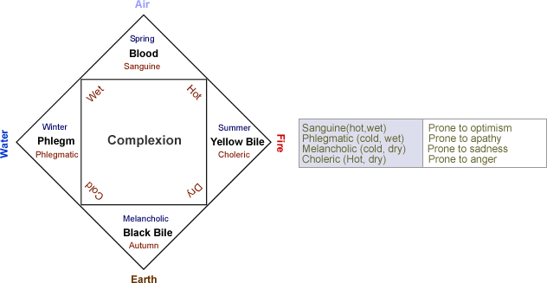
the six-non naturals: air, food and drink, sleeping and waking, motion and rest,
excretions and retentions, and the passions of the soul

Slide 10
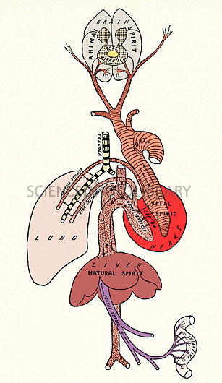
Pneuma: air or breath
Three forms:
1. natural spirit: resided in the liver, the center of
nutrition and metabolism
2. vital spirit was located in the heart, the center of
blood flow regulation and body temperature,
3. animal spirit was animal spirit was created in the
brain, the center of sensory perceptions and
movement.

Slide 11
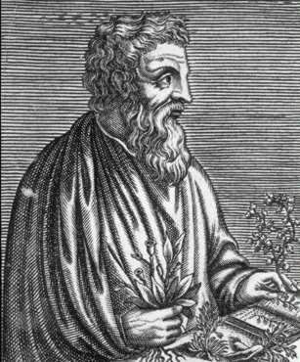
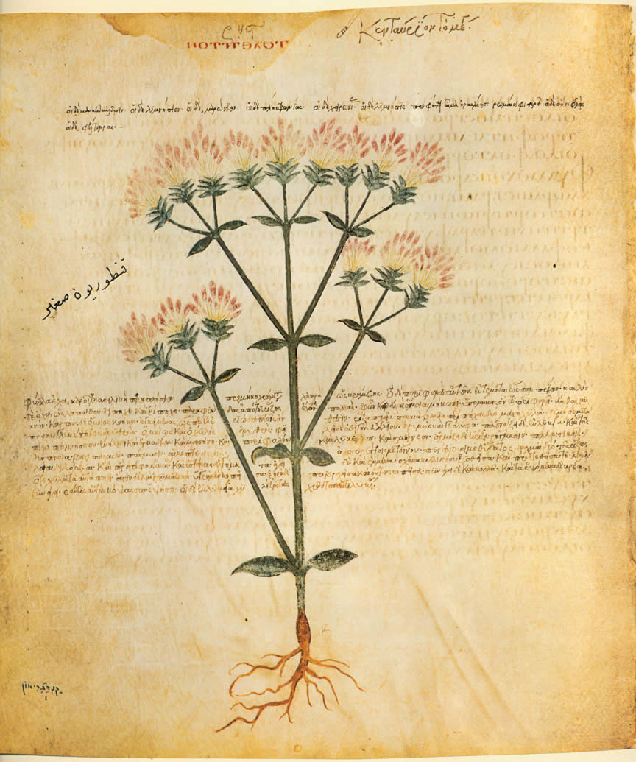
materia medica: something from which medical
remedies can be prepared
De materia medica, 5 vols.
Dioscorides, 40 AD - 90 AD

Slide 12
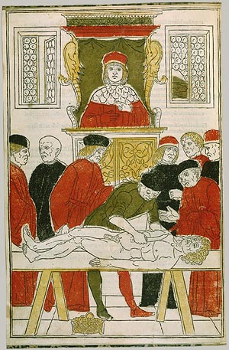
A ‘traditional disssetion
Joannes von Ketham, 1493

Slide 13
Humanism: a cultural movement originating in Italy in the late fourteenth Century and the fifteenth century. It consisted of a reverence for and close study of the writings
of Greek and Roman antiquity and promoted attempts at the emulation of ancient
cultural achievements.
Thomas Linacre (1460-1524) translates Galen’s On the Natural Faculties (1523)
Johannes Guinter of Andernach (1487-1574), professor in Paris, translated the newly
discovered and most important text of Galen, On Anatomical Procedures, 1531. Vesalius was one of his students.

Slide 14
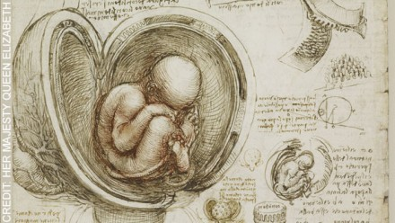
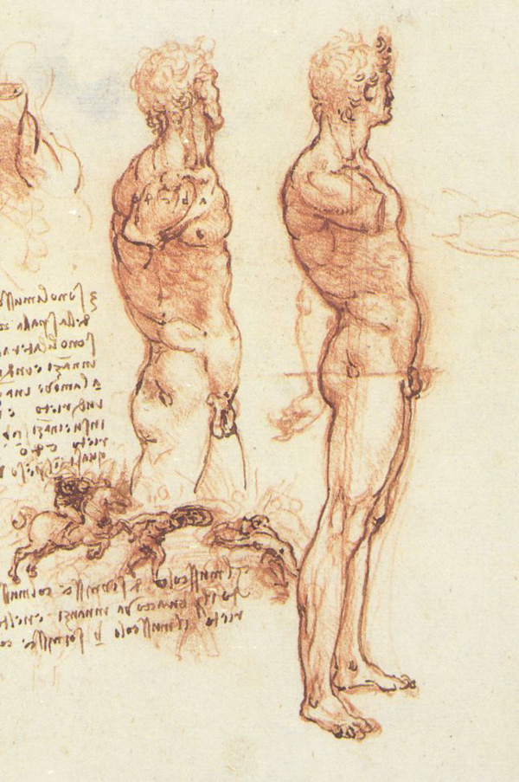
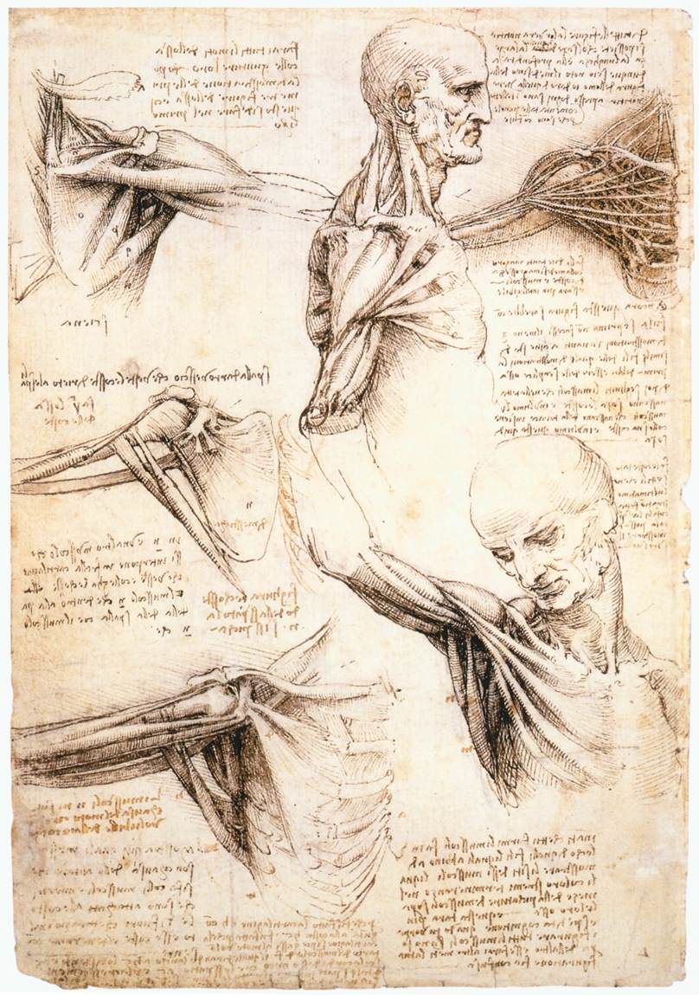
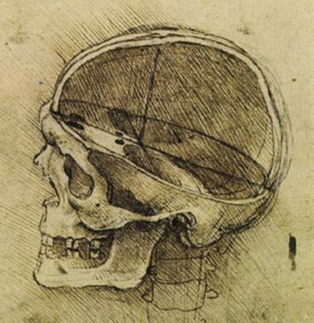
Leonardo da Vinci, 1452-1519

Slide 15
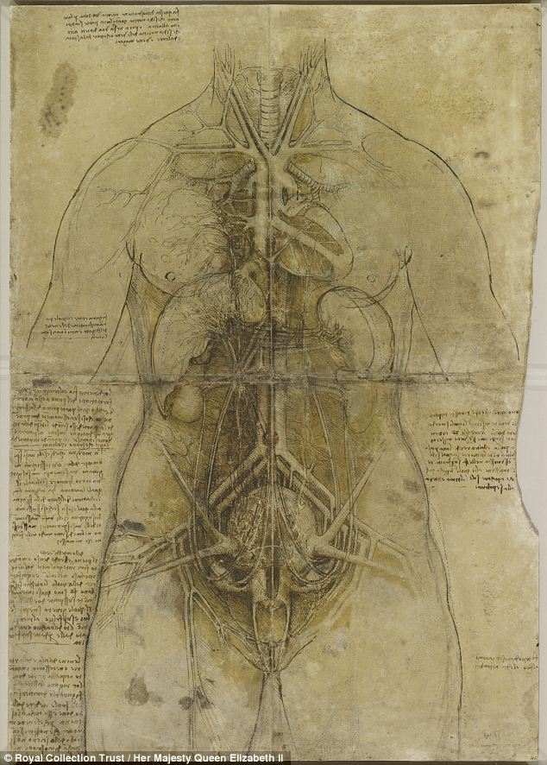
‘Very beautiful and most worthy of such a famous artist, but indeed useless; he did not even know the number of intestines. He was a pure painter, not a medicus or philosopher.’
(Girolamo Cardano (1501-1576)
A dissection of the principal organs and
The arterial system of a female figure,
c. 1508

Slide 16
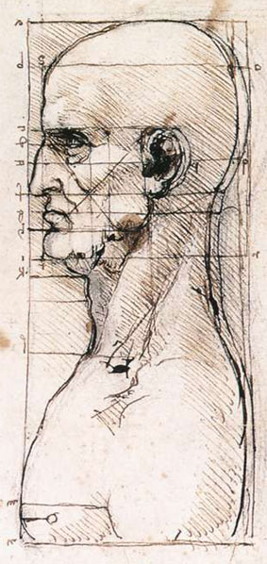
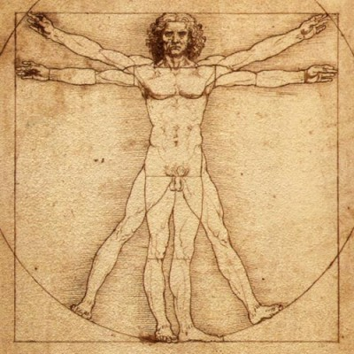
Geometry and proportion of the ‘perfect man’

Slide 17
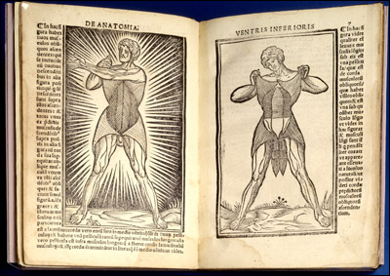
Increasing collaboration between physicians and artists
Giacomo Berengario da Carpi (1460–1530)
Anatomia Carpi. Isagoge breves perlucide ac uberime, in Anatomiam humani corporis, 1530

Slide 18
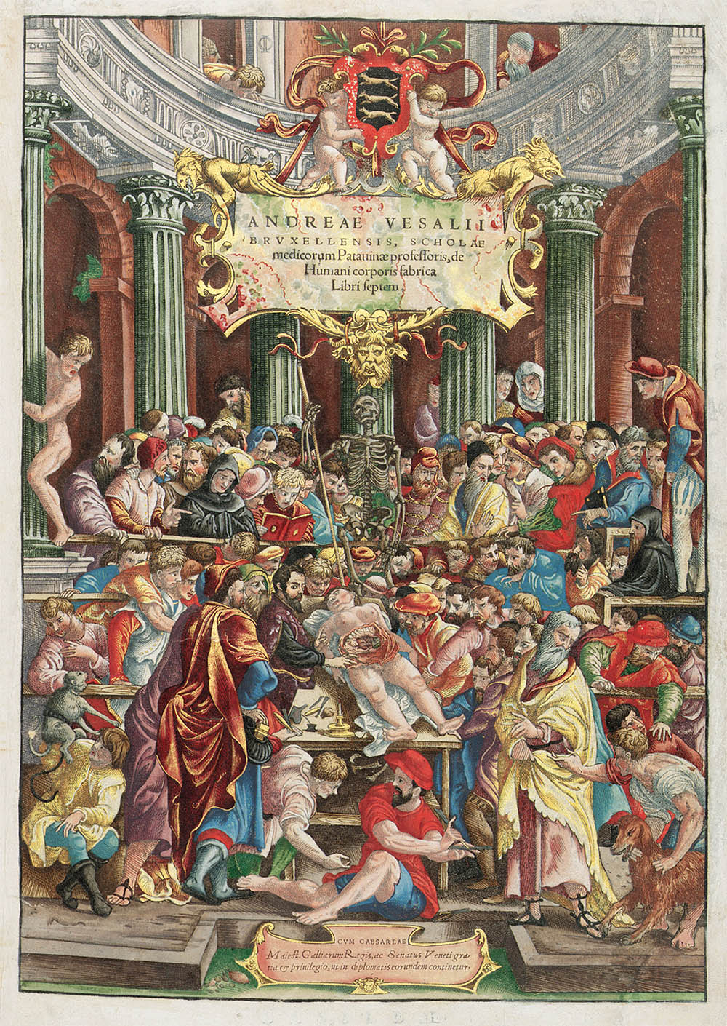
‘I decided that this branch of natural philosophy ought to be recalled from the region of the dead. If it does not attain a fuller development among us then ever before or elsewhere among the early professors of dissection, at least it may reach such a point that one can assert without shame that the present science of anatomy is comparable to that of the ancients, and that in our age noting has been so degraded and then wholly restored as anatomy.’ (quote Preface, in Dear, p. 38)

Slide 19
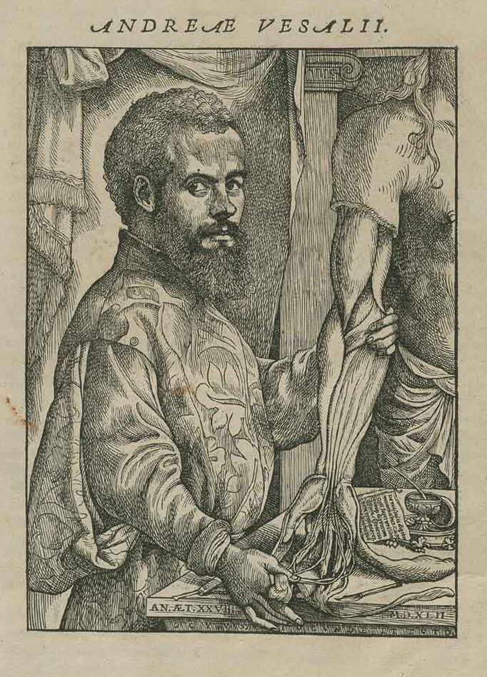
‘Let them use their hands…as the
Greeks did and as the essence of
the art demands’
Book 1: skeleton
Book 2: myology, all the muscles and their relations
Books 3 and 4: venous, arterial and nervous systems
Books 5-6: organs of the abdominal and thoracic cavities and the brain
Book 7: he reports own experiments and vivisections

Slide 20
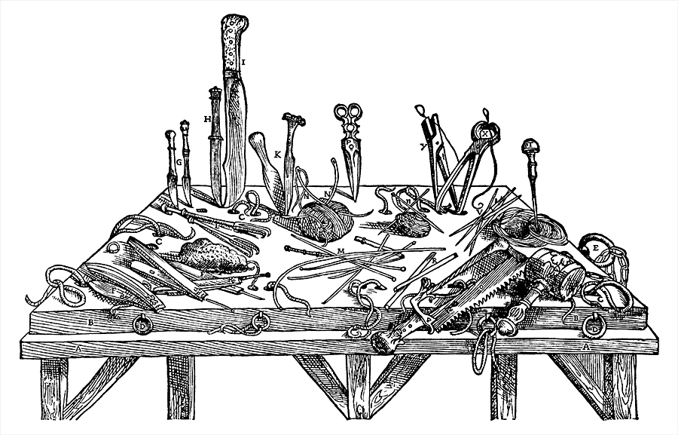

Slide 21
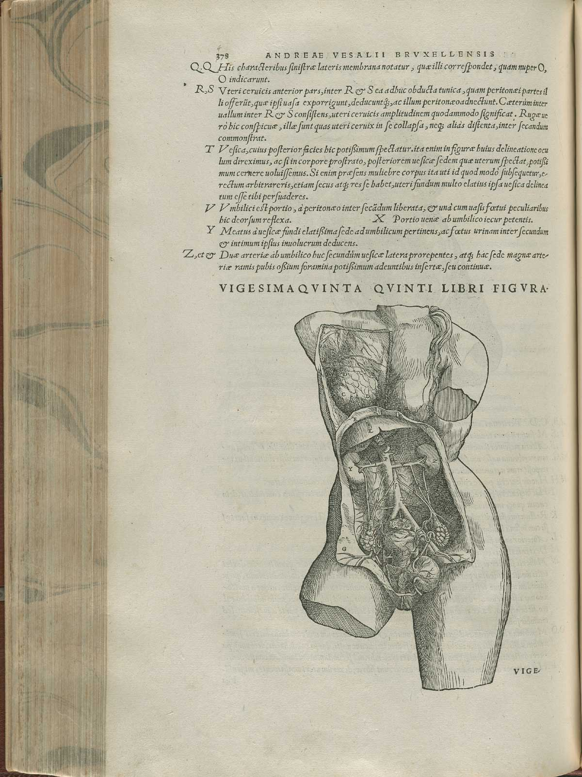
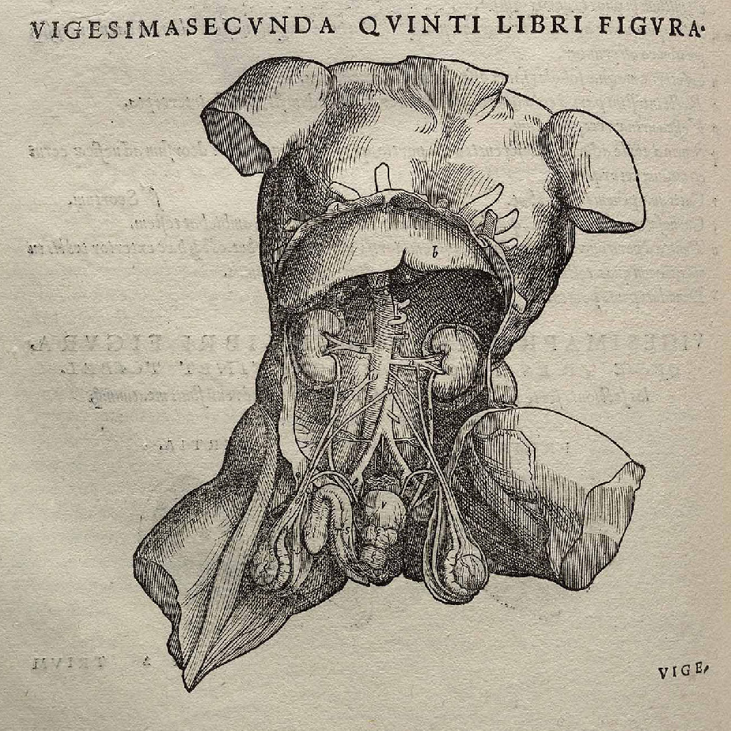

Slide 22
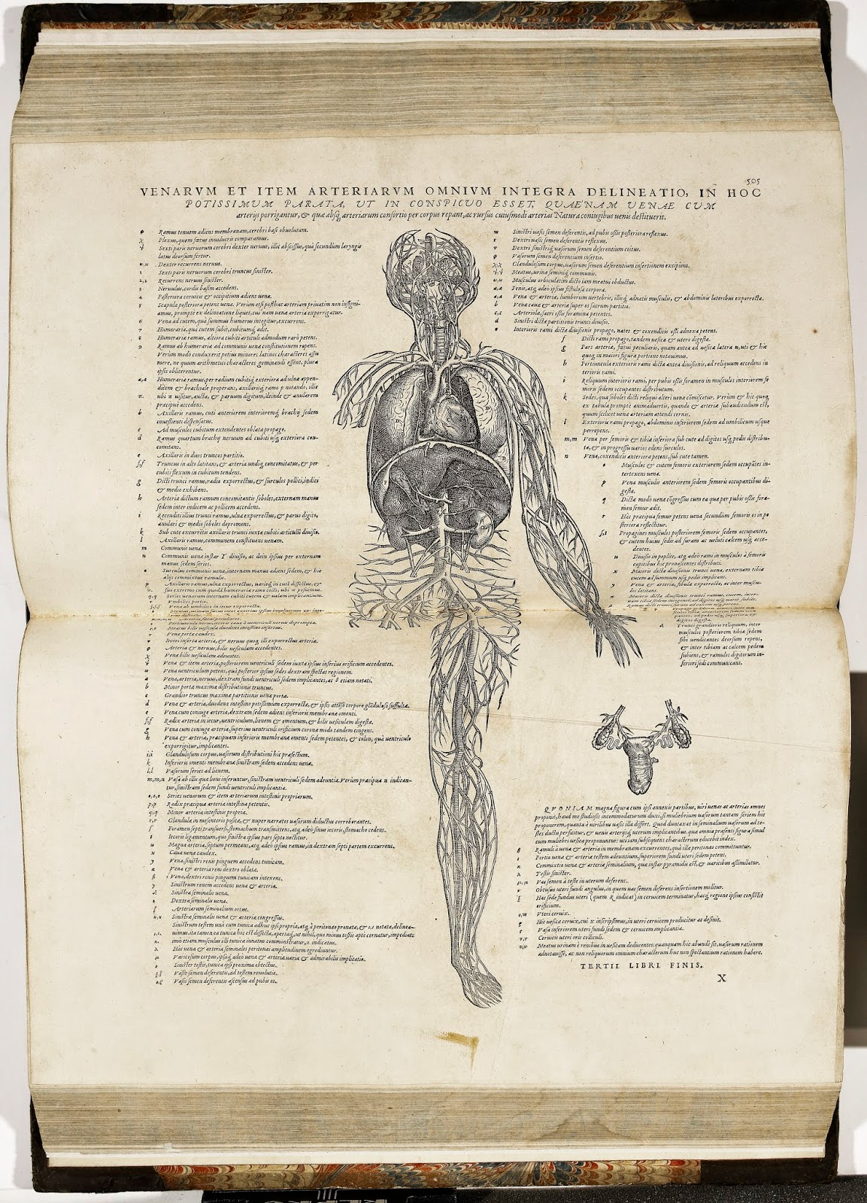

Slide 23
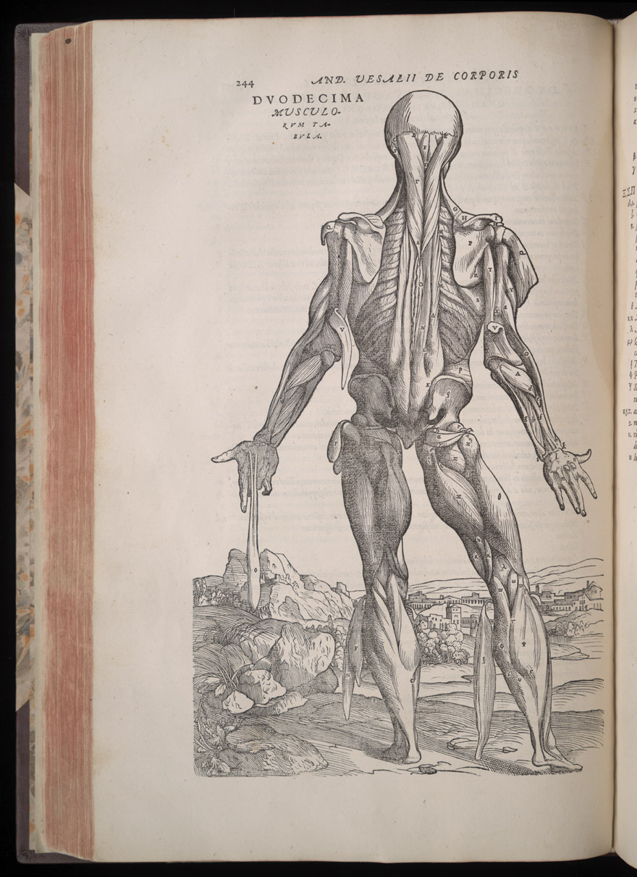
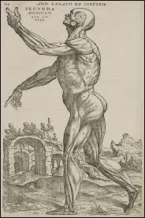

Slide 24
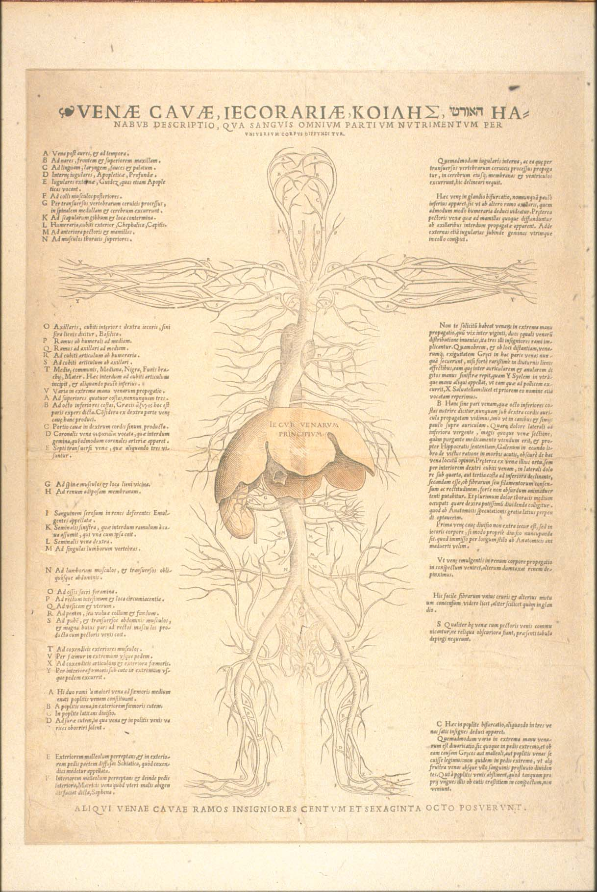

Slide 25
‘Furthermore, lest I should here meet with any charges of heresy, I shall straightaway abstain from this discussion about the species of the soul and of their seats. For today, and particularly among our countrymen you may find many judges of our most true religion, who if they hear anyone murmur something about the opinions on the soul of Plato, or of Aristotle and his interpreters, or of Galen … they straight away imagine he’s wandering from the faith, and having I don’t know what doubts about the immortality of the soul. Not bothering about that, doctors must (if they don’t wish to approach the art rashly, not to prescribe and apply remedies for ailing members improperly) consider those faculties that govern us, how many kinds of them there are, and what member of the animal the individual ones are constituted, and what medication they receive. And especially, besides all this, (if our minds can attain it) what is the substance and the essence of the soul.’

Slide 26
‘Just as the substance of the heart is endowed with the force of the vital soul and the unique flesh of the liver with the faculty of the natural soul, in order that the liver may make the thicker blood and the natural spirit and the heart make the blood that rushes through the body with the vital spirit and thus these organs may bring material to all parts of the body through channels reserved for them, so…the brain prepares the animal spirit. ‘

Slide 27
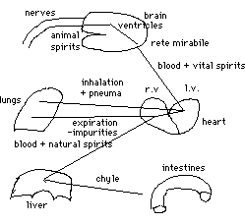
Galen’s system of spirits:
The chyle, or digested food, is brought to the liver, where it is worked up into an impure blood, imbued with the first form of pneuma innate to all things, the natural spirits. This concoction passes into the veins, which are believed to leave from the liver.
This blood, charged with natural pneuma, then goes to the right chamber of the heart, where impurities are exhaled through the lungs.
The purified part then trickles through the invisible pores (in the pits) of the inter-ventricular septum to the left ventricle, entering it drop by drop. (These invisible pores do not exist; performation of the septum leads to "blue babies", who must be operated to repair the holes immediately upon birth if they are to live)
There, the blood is imbued with more pneuma, drawn from the outside by inhalation through the lungs. The net result is that the blood is now charged with a higher form of pneuma, the vital spirits.
This blood, along with its associated natural spirits, goes via the arteries issuing from the heart to the brain, in particular, the fine net of arteries at the base of the brain, the reta mirabile. There the blood is further refined and charged with the final and highest form of pneuma, the animal or psychic spirits.
The psychic spirits pass through the solid part of the brain and the ventricles of the brain and then to the nerves, which are hollow tubes. It is through the agency of the animal spirits that movement and thought are affected.
Liver: transforms the cooked food (chyle) into impure blood and imbuing it with the first form of pneuma, the natural pneuma.
Heart: purifying the blood and charging it with the second form of pneuma, the vital spirits
Brain:works up the highest form of pneuma, the animal spirits.

