Slide 1
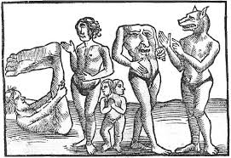
Lecture 6
Of Monsters and Cannibals: Europeans Encounter the New World ‘Other’

Slide 2
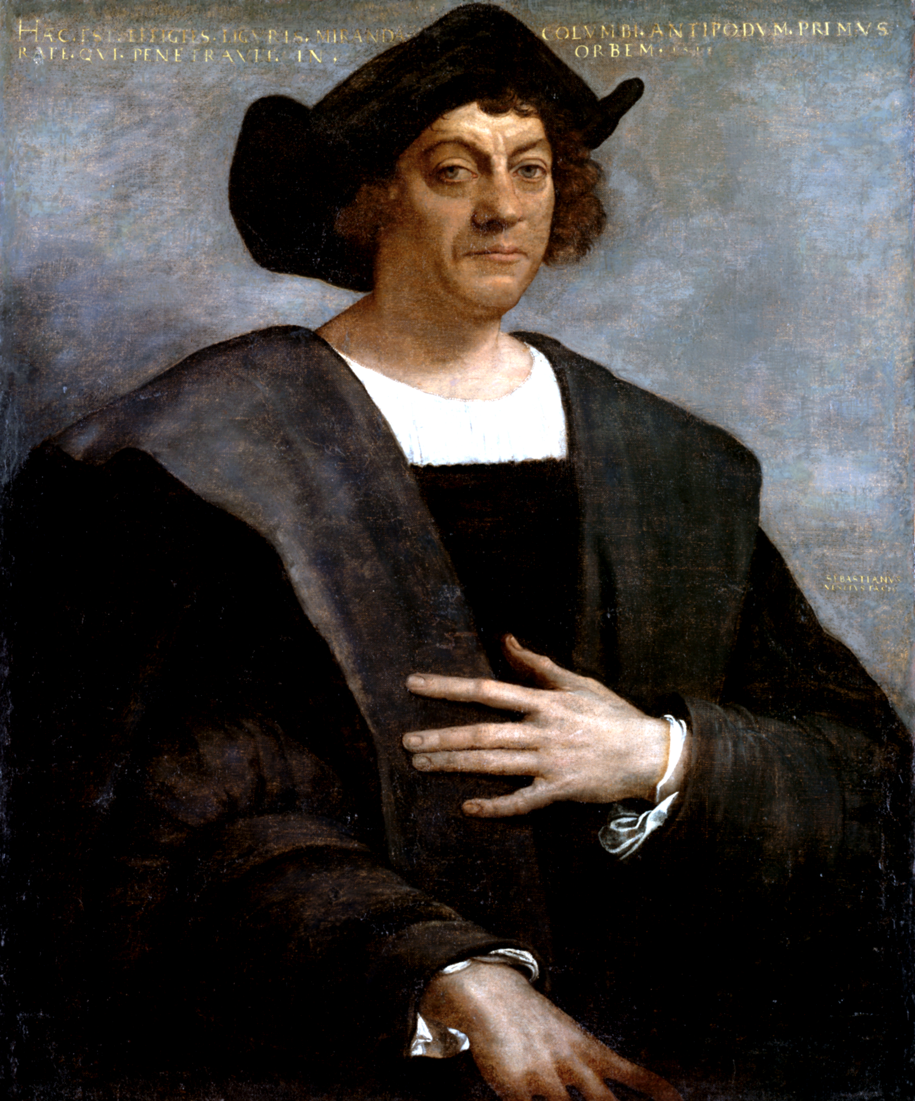
Christopher Columbus, 1450-1506

Slide 3
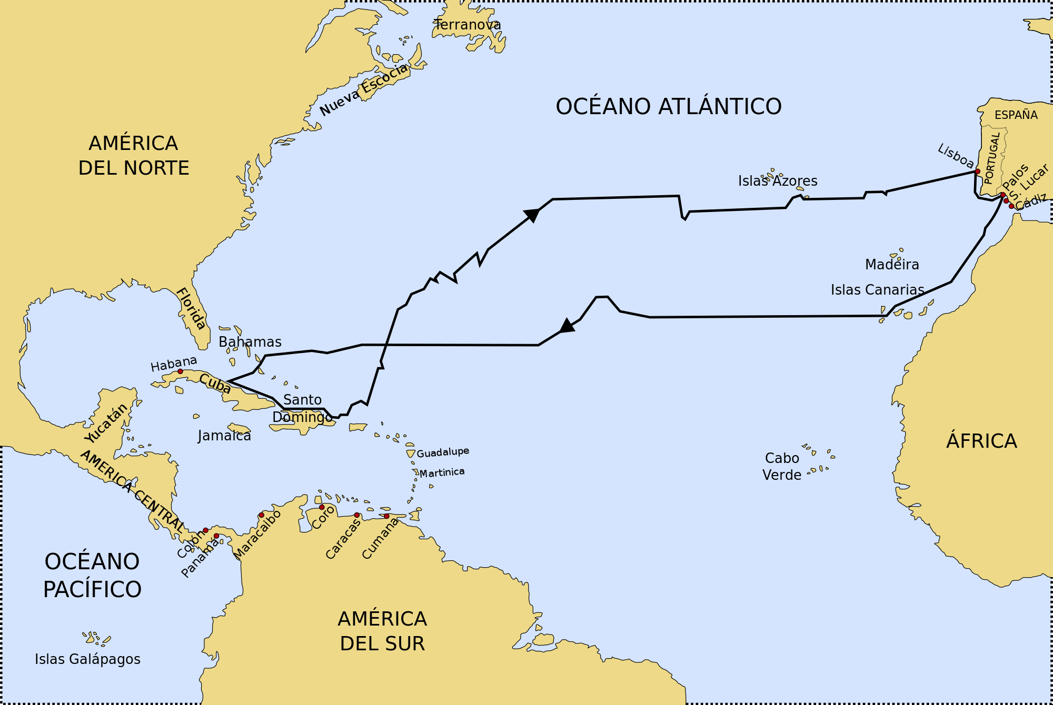
First voyage of Christopher Columbus 1492/93

Slide 4
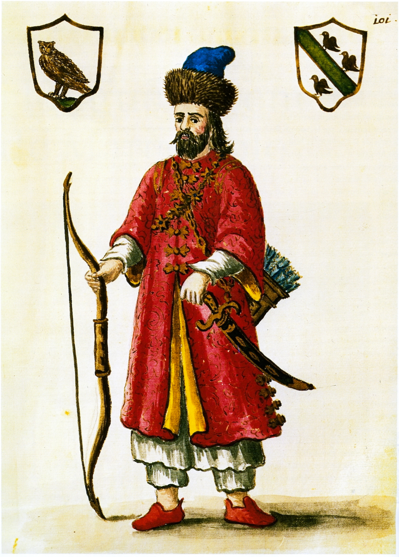
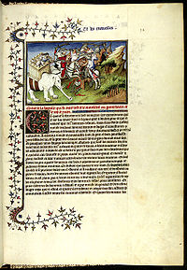
Marco Polo at the court of the Kublai Khan
A page from ‘The Travels of Marco Polo’, c. 1300

Slide 5
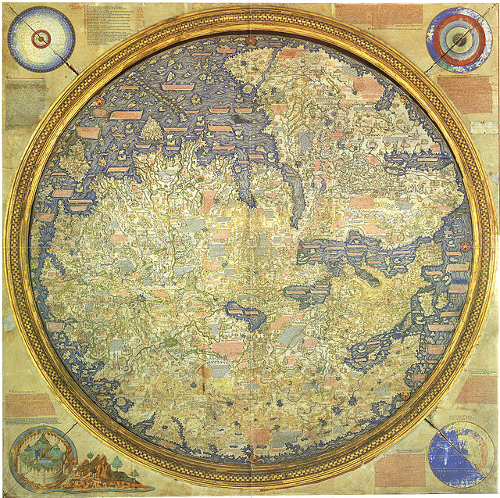
World map by the Italian monk Fra
Mauro, c. 1450 which relies heavily
on Marco Polo’s travel account as well
as on ancient geographers such as
Ptolemy.
(note: the south is on the top here
according to conventions of the time)
The map first depicts Cipangu (Japan),
also mentioned by Polo. He described it as a land of extraordinary riches.
Columbus is aware of these accounts and geographical descriptions and they
Clearly shaped his expectations.

Slide 6
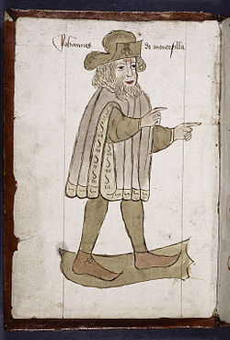

The Travels of Sir John Mandeville, c. 1370
Portrait of ‘Sir John Manderville’

Slide 7
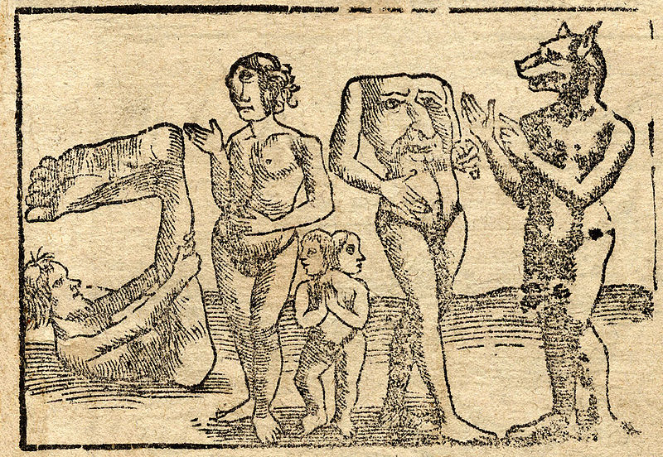
cyclopes: giants, each with a single eye in the middle of his forehead.
sciapodes/monopodes: mythological human creatures with a single, large foot extending
from a leg centered in the middle of their bodies.
blemmyes: species of headless men
Cynocephalus/i: dog-headed species of men
Anthropophagus/i: man-eater(s), a mythical race of cannibals, described
first by Greek historian Herodotus (84–425 BC) in his Histories

Slide 8
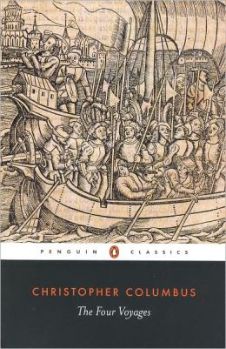
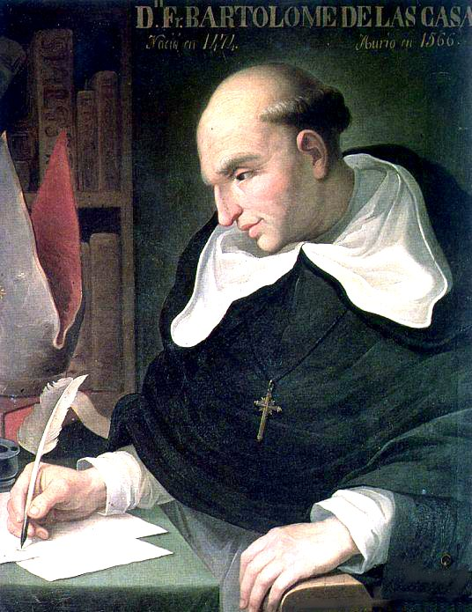
Bartolome de las Casas, 1484-1566, copies log of 1st voyage. Original now lost.
A Short Account of the Destruction of the Indies, 1552
Historia General de las Indias, 1561

Slide 9
cyclopes: giants, each with a single eye in the middle of his forehead.
sciapodes/monopodes: mythological human creatures with a single, large foot extending
from a leg centered in the middle of their bodies.
blemmyes: species of headless men
Cynocephalus/i: dog-headed species of men
Anthropophagus/i: man-eater(s), a mythical race of cannibals, described
first by Greek historian Herodotus (84–425 BC) in his Histories

Slide 10
Arawaks
Caribs (Caniba)
‘I therefore repeat what I have said several times already: That the Caniba are none other than the people of the Great Khan, who must be neighbours to these. They have ships, they come and capture these people, and as those who are taken never return, the others believe that they have been eaten.’

Slide 11
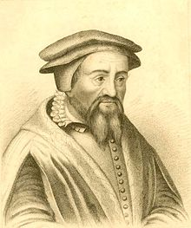

‘Decades’, a series of letters and reports,. Grouped in 10 chapters, of the early explorations of Central and South America that was published beginning 1511 and later anthologized. Include Columbus letter.
‘De Orbe Novo (On the New World, 1530)
Peter Martyr of Angleria, 1457-1526

Slide 12
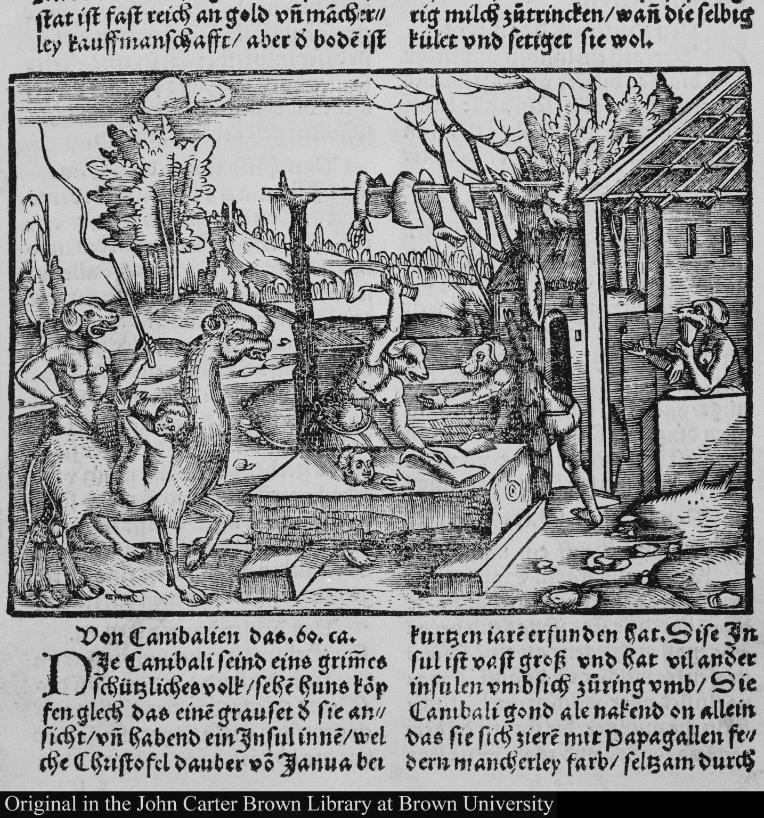
Lorenz Fries, c.1490- 1550
Auslegung der Mercarthen oder Cartha Mariana, 1525
Note: The image illustrates the chapter ‘on cannibals’ who are depicted as dog-headed humans

Slide 13
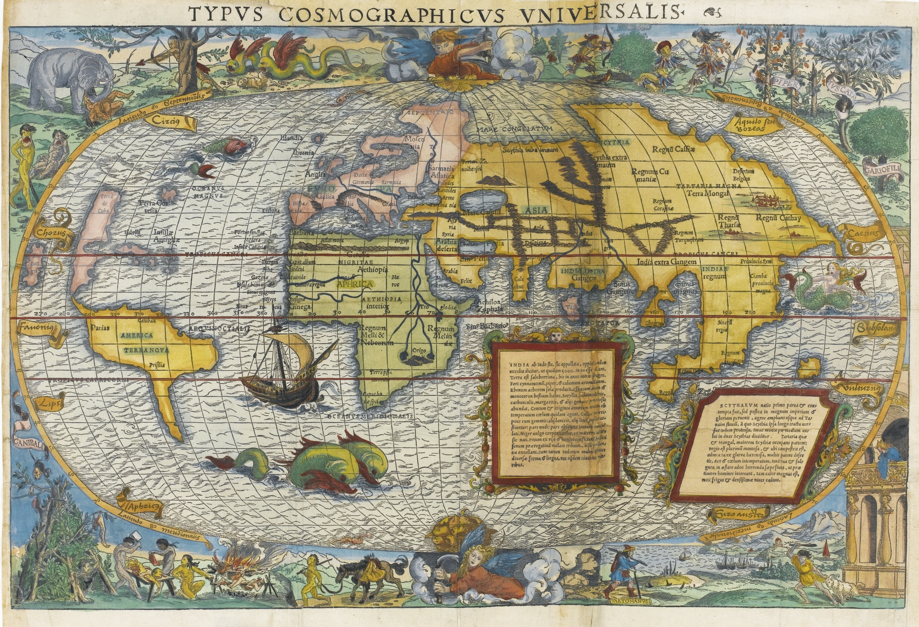
Waldseemüller, Martin, Universalis cosmographia secundum Ptholomæi traditionem et Americi Vespucii aliorv. que lustrationes, 1516
Map depicts the Americas, Africa, Europe, Asia, and the Pacific Ocean separating Asia from the Americas.

Slide 14
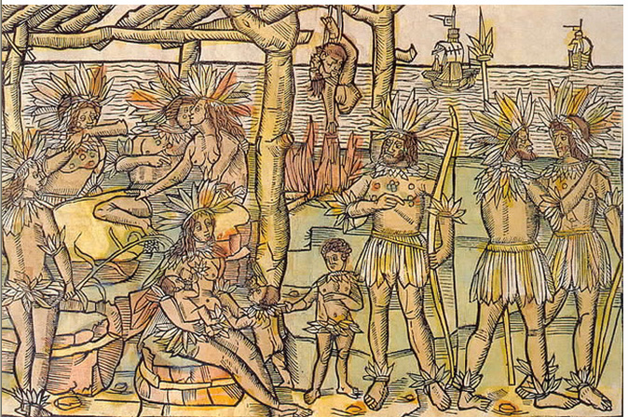
‘This figure represents to us the people and island which have been discovered by the Christian King of Portugal or by his subjets. The people are thus naked, handsome, brown, well shaped in body, their heads, necks, arms, private parts, feet of men and women are a little covered in feathers. The men also have many precious stones in their faces and breasts. No one also has anything, but all things are in common. And the men have as wives those who please them, be they mothers, sisters, or friends, therein they make no distinction. They also fight with each other. They also eat each other, even those who are slain, and hang the flesh of them in the smoke. They become one hundred and thirty years old. And have no government.’
The incesteous cannibal
Amerigo Vespucci, Mundus Novus, published by Johann Froschauer in Augsburg in 1505.
This is the first depiction of cannibals

Slide 15
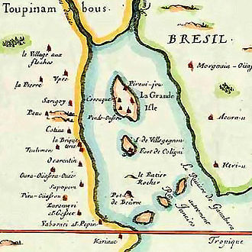
The ‘good’ and the ‘bad’ cannibal
André Thevet, 1516-1590
Accompanied Nicolas Durand de Villegaignon (1510–1575) and a group of Hugenots to find a refuge against persecution in France. He writes about experiences in:
‘Singularities of France Antarctique’ (first published in 1557)
’Antarctique’ refers to the French colony south of the Equator, on an island in front of today’s Rio de Janeiro. The colony existed between 1555 and 1567 and was ultimately destroyed by the Portuguese in 1567.
The Hugenots were later joined by Calvinist from Geneva in 1557, including Jean de Léry. Because of conflicts over the Eucarist – the Holy Communion, or the Lord's Supper -- Calvinists were banned from colony. They settled among the Tupinamba until January 1558, when some of them managed to return to France by ship together with Jean de Léry.

Slide 16
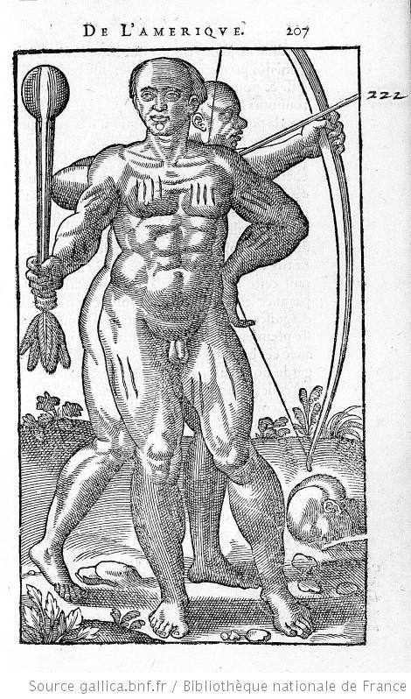
Jean de Léry (1536–1613), History of a Voyage to the Land
of Brazil, Also Called America (1578)
History of the City of Sancerre (1574)
‘To those who will read these horrible things, exercised ritually between the barbarous nations of the land of Brazil, can come somewhat closer to understanding such dangers among us ourselves.’ (Léry, 228).

Slide 17
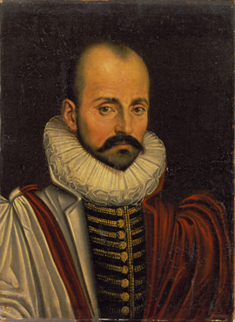
Montaigne popularises ‘the essay’ as a literary genre
As Essai is French for "trial" or "attempt”. Montaigne attempted to explore his thoughts, his life and learning in written form.
His own Essays were first published in 1580 in 3 volumes. They contain 107 chapters of varying length.
In two essays he explores cannibalism: ‘On
Cannibals’ and ‘Of Coches’
(you might want to read them online?)
Michel de Montaigne, 1533-1592

Slide 18
‘I think … that there is nothing barbaric or uncivilized (in the New World…) except that everyone calls ‘barbarism’ whatever he is not accustomed too…In our country alone is there always the perfect religion, the perfect political system, the perfect and achieved usage of all things. They are wild men, just as we call those fruits wild which Nature as produced unaided and in her usual course; whereas, in truth, it is those it is those that we have altered by our skill and removed from the common kind which we ought rather to call wild. In the former the real and most useful and natural virtues are alive and vigorous-we have vitiated them in the latter, adapting them to the gratification of our corrupt taste.’
(Montaigne, On Cannibals.)

Slide 19
“We can, then rightly, call them barbarians with respect to the rules of reason, but not with respect to ourselves, who surpass them in every sort of barbarism.’
(Montaigne, On Cannibals)

