Slide 1
Lecture 7:
Challening God’s Creation: The invention of a Curious Human Nature

Slide 2
“Christians have special knowledge of the extent to which curiosity is a natural and evil in man. The desire to increase in wisdom and in knowledge: that was the first ruin of mankind. That is the path by which it hurled itself into eternal damnation”.
Michel de Montaigne, An Apology for Raymond Sebond, 1580

Slide 3
‘
‘Twenty-first-century economies are rewarding those who have an unquenchable desire to discover, learn and accumulate a wide range of knowledge. It’s no longer just about who or what you know, but how much you want to know. The curious are more likely to stay in education for longer. A hungry mind isn’t the only trait you need to do well at school… it is the best single predictor of achievement, allied as it is with the other two quantifiably important traits: intelligence and conscientiousness. Students entering the workplace need to stay curious, because the wages for routine intellectual work, even in professional industries such as accountancy and law, are falling. Technology is rapidly taking over tasks historically performed by human beings, and it’s no longer enough to be merely competent or smart: computers are both. But no computer can yet be said to be curious. As the technology writer Kevin Kelly puts it, “Machines are for answers; humans are for questions.
….
Industries are growing more complex and unpredictable and employers are increasingly looking for curious learners: people with an aptitude for cognitively demanding work and a thirst for knowledge…Curiosity may be a fundamental human trait but intellectual curiosity is hard work. It requires a willingness to learn things that can seem pointless at the time but turn out to be useful later, and to perform boring tasks such as writing out equations over and over again…’
Ian Leslie, http://www.newstatesman.com/culture/2014/05/why-curiosity-will-rule-modern-world

Slide 4
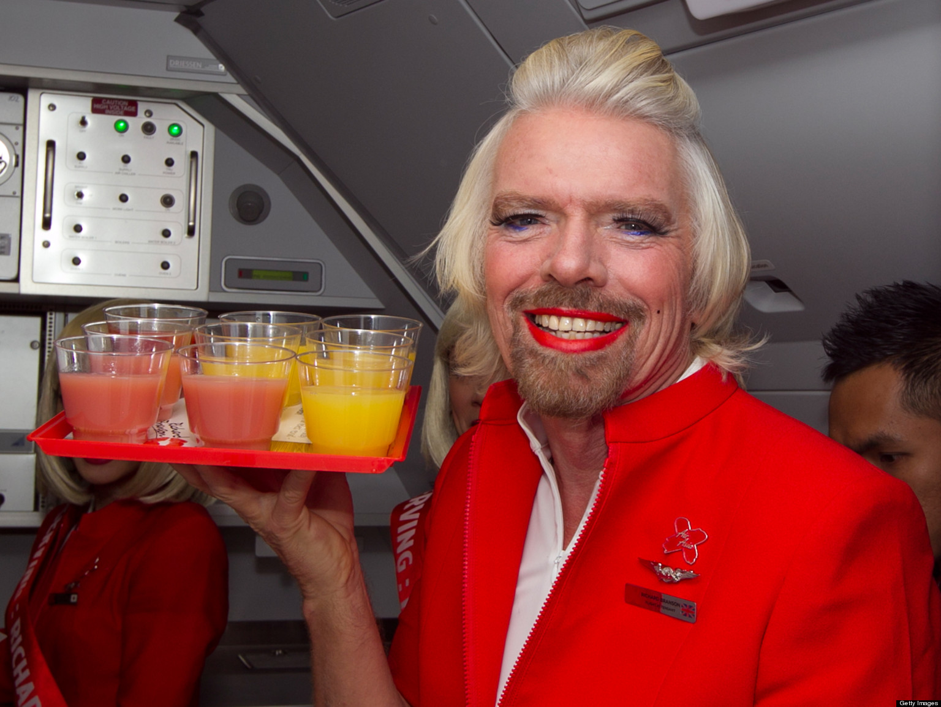
‘I suspect I might be one of the most curious entrepreneurs alive today, in that most entrepreneurs just specialize in one area, because I keep on - you know, I'll fly in America on - have done for many years on dirty, horrible, big American carriers, and my curiosity drives me to think I can do better. "Let's set up Virgin America." Somebody tells me that 80 per cent of the species in the ocean have not been discovered, so I think, well, maybe we should try to build a submarine to go down to the bottom of the oceans and explore them…
I love learning, and I just find that my general motto in life - "Screw it, just do it" - is great fun. Sometimes we fall flat on our face. Sometimes we succeed. But I'm learning all the time because I'm a curious person.’
Sir Richard Branson

Slide 5
The Career of ‘Curiosity’:
Among the ancient authorities ‘curiosity’ was not inherently ‘bad’:
Aristotle saw it as a human trait but was not too interested in discussing it in detail.
The Roman philosopher Seneca – who discussed it a lot – was not negative either, just cautious. Too much, he thought is not good because it imbalances the character of a person.
‘The desire to know more than enough is a form of intemperance’.
So, before the advent of Christianity ‘curiosity’ seemed not be have been a particular problem.

Slide 6
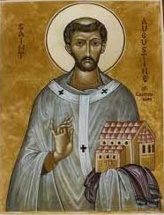
Augustinus of Hippo (354 – 430 BC)
The Confessions: autobiography in 13 volumes written by Augustine when he was around 40 years old. It outlines his sinful youth and eventual conversion to Christianity. It is considered to be the first autobiographical work in the West and became a model for many other autobiographical writers during the Middle Ages until roughly the 17th century.

Slide 7
1. Curiosity and the sin of lust:
‘Besides this there is yet another form of temptation still more complex in its peril. For in addition to the fleshly appetite which strives for the gratification of all senses and pleasures--in which its slaves perish because they separate themselves from thee--there is also a certain vain and curious longing in the soul, rooted in the same bodily senses, which is cloaked under the name of
knowledge and learning; not having pleasure in the flesh, but striving for new experiences through the flesh.
This longing--since its origin is our appetite for learning, and since the sight is the chief of our senses in the acquisition of knowledge--is called in the divine language “the lust of the eyes.’ (Augustine, Confessions)

Slide 8
2. Curiosity related to the sin of pride:
‘investigate the works of nature, which do not concern us and which it is useless to know, but which people desire to know only for the sake of knowing’.
‘The proud cannot find you (God), even though with curious skills they number the stars and grains of sand, and measure the starry heavens, and track the courses of the planets…People that do not know these things marvel and are amazed, and those that know them exult and are puffed up. And turning from your light impious pride, they foresee an eclipse of the sun far in the future but even in the present do not see their own eclipse’
‘Wonder’ is the appropriate way to approach the natural world, according to Augustine

Slide 9
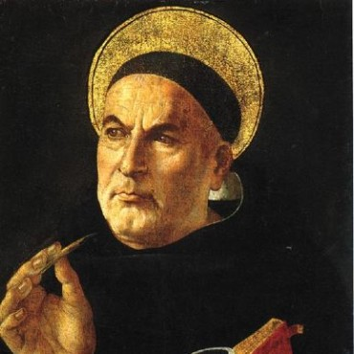
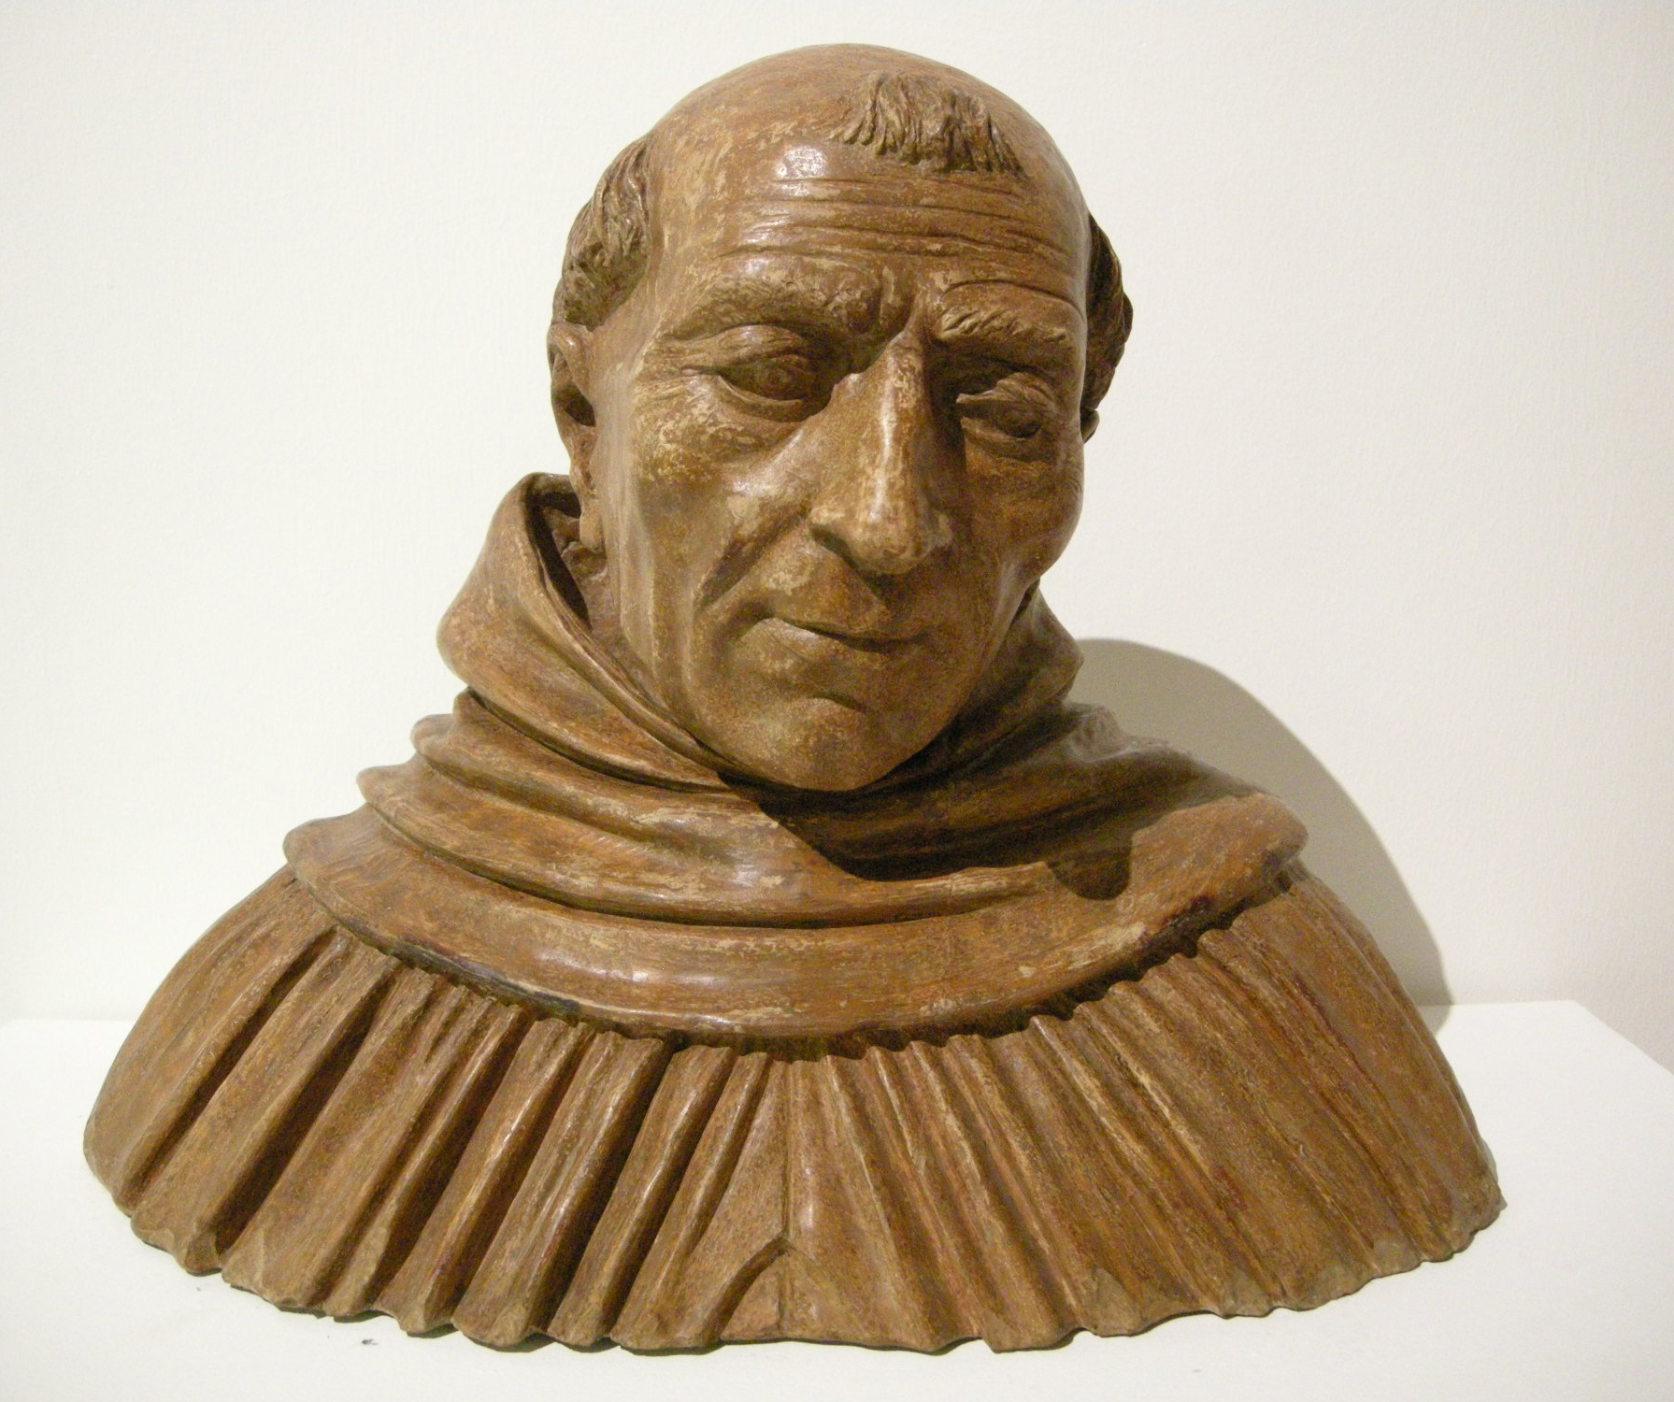
Problem: How to align the vice of curiosity with
interests in Aristotelian natural philosophy?
Thomas Aquinas (1225 – 1274), Dominican
friar and priest. He is was known for his attempt to
synthesize Aristotelian philosophy with the
principles of Christianity.
Albertus Magnus (before 1200 –1280), also
known as Albert the Great, was a Catholic bishop
and became a Catholic saint
First important commentaries on all of Aristotle’s writings.
‘…however, much it abounds, knowledge of the truth
is not bad, but good. The desire for good is not
wicked. Therefore no wrongful curiosity can attend
intellectual knowledge’
(Thomas Aquinas)

Slide 10
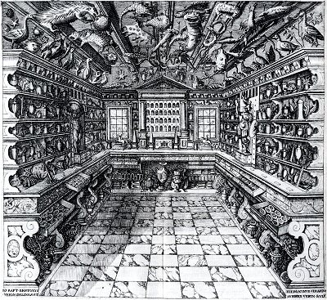
Cabinet of Curiosity/
Cabinets of wonder
Contained precious material,
exotica and antiques, specimens
of exquisite workmanship
(artificalia), and natural (naturalia).
The cabinets aimed at imitating
the interplay of the God-created
micro-macrocosm in order to
provoque wonder and marvel at
God’s creation in the dazzled on-
looker.

Slide 11
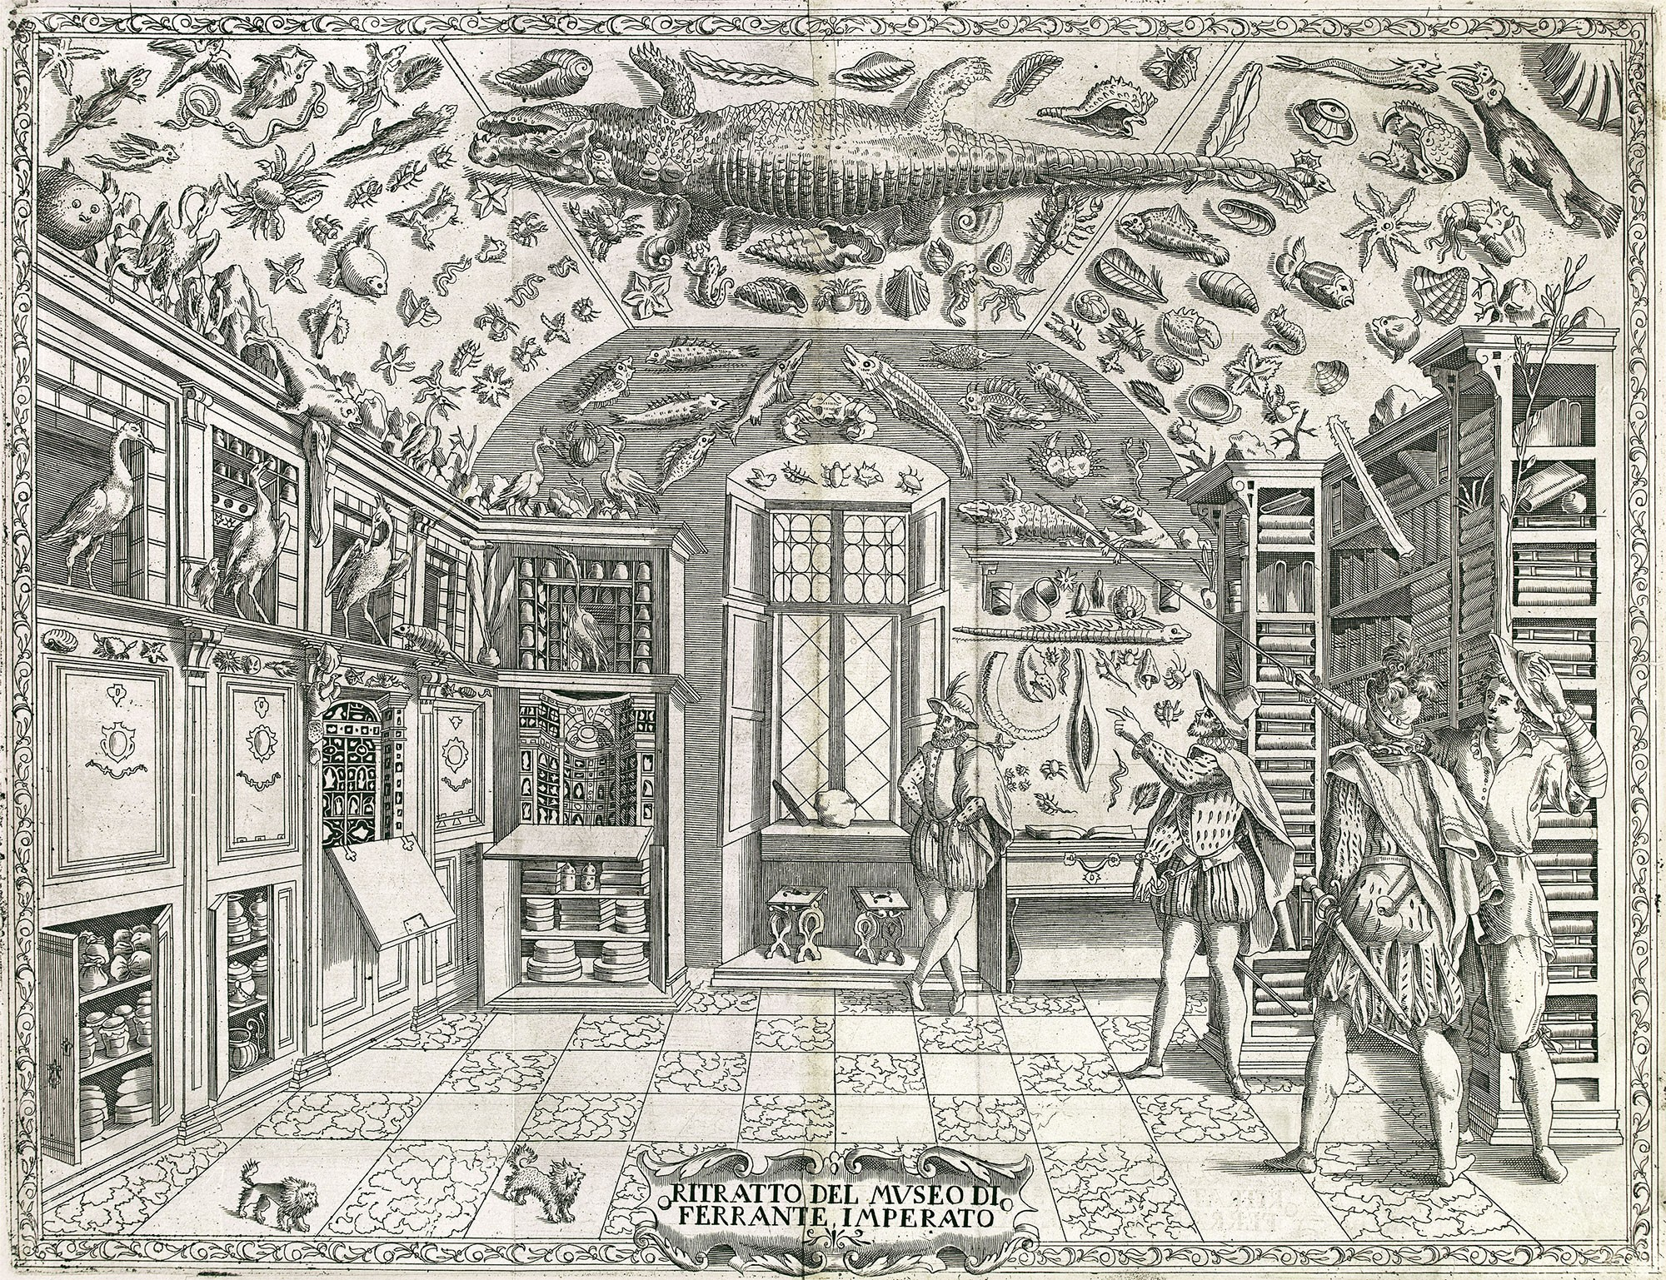

Slide 12
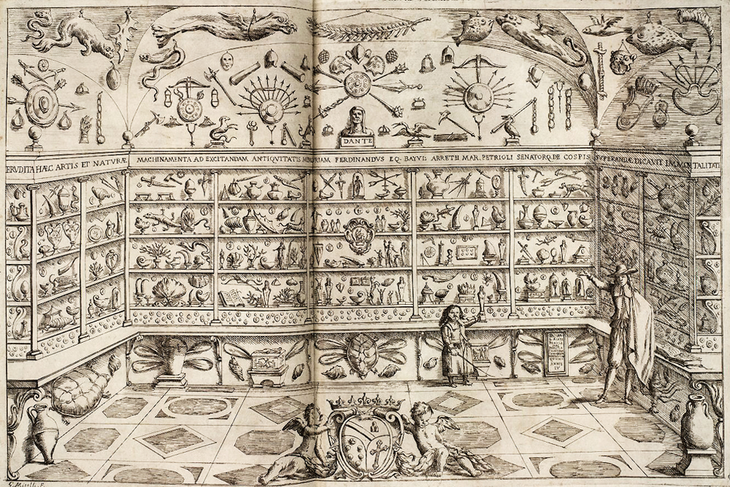

Slide 13
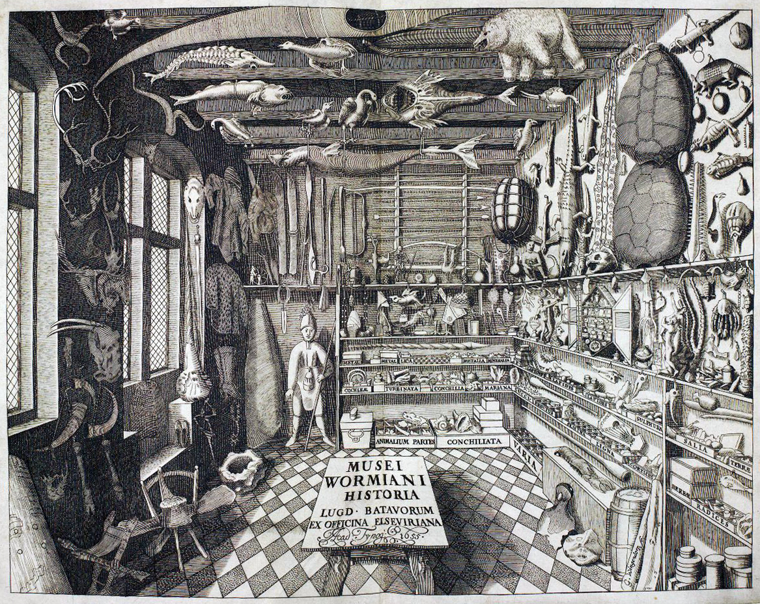

Slide 14
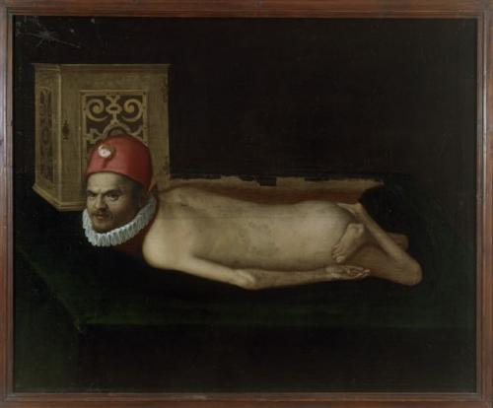
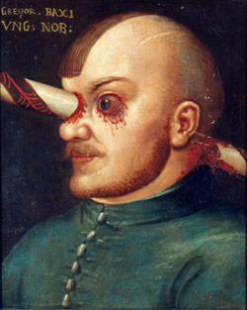
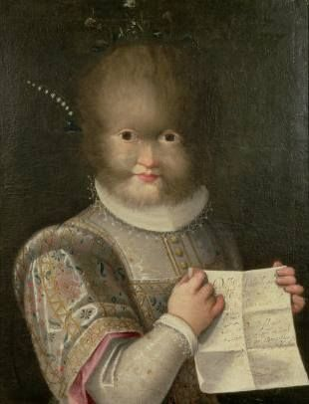
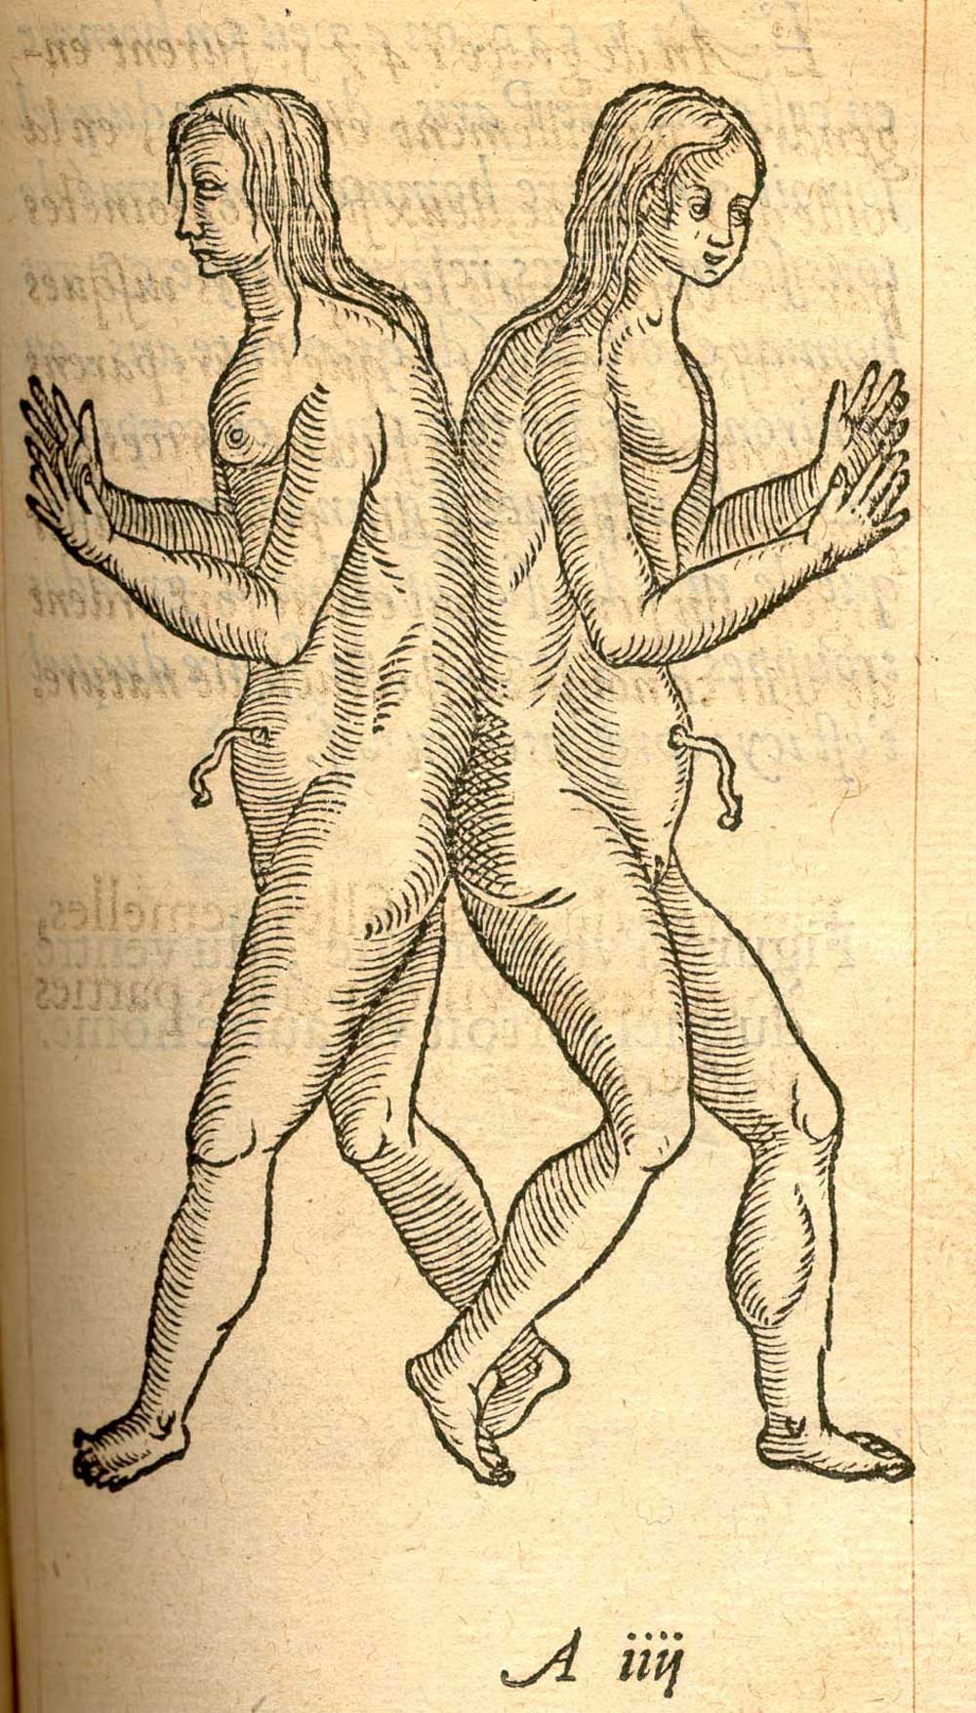
Paintings and drawings
are not yet held in
separate collections

Slide 15
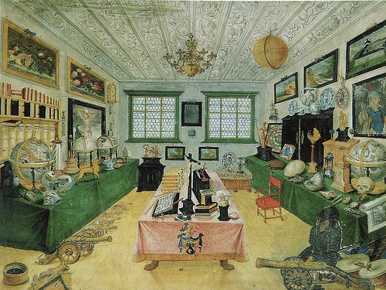
Cabinet of wonder of the Regensburg iron dealer and mining family Dimple (1608)

Slide 16
The new advancement of knowledge ‘movement’ had to meet two criteria in order to be accepted:
The natural philosopher was required to embody certain virtues, in particular humility and charity (not to appear ‘puffed up’ and self-obsessed)
The knowledge obtained could not be ‘vain’ or ‘unprofitable’. It had to be ‘useful’ for general mankind. Moreover, it could not venture into ‘forbidden’ domains (e.g. magic, witchcraft but also, if to a lesser extent, to astrology or alchemy)

Slide 17
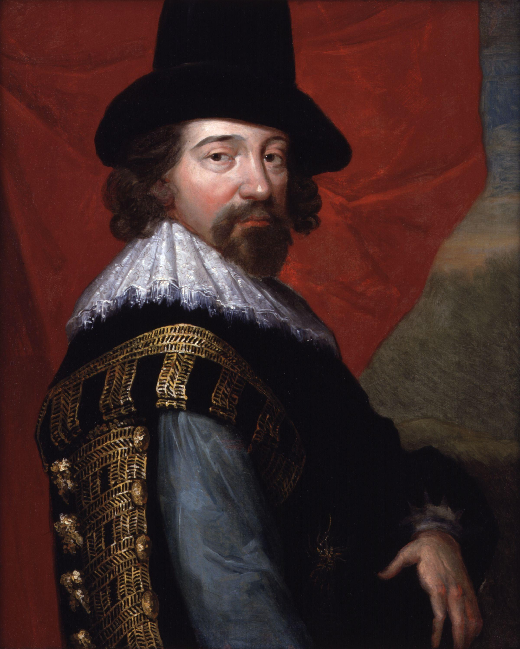
Francis Bacon, 1561 – 1626) Lord Chancellor. Allegedly he died due to his experimentation with a frozen chicken which he conducted in order to understand food preservation!
Empiricism: a philosophical stance that
holds that all knowledge is rooted in the
senses and the experience that they
provide
Bacon is celebrated as ‘the father’ of the
modern scientific method.
(we shall explore this in more detail
next week! So, no panic about it now!)

Slide 18
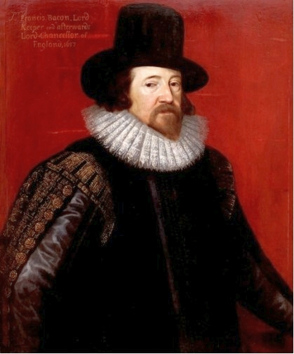
‘So as what so ever is not God but parcel of the world, he hath fitted it for the comprehension of man's mind, if man will open and dilate the powers of understanding as he may. But yet evermore it must be remembered that the least part of the knowledge passed to man by this so large a charter from God must be subject to that use for which God hath granted it; which is the benefit and relief of the state and society of man; for otherwise all manner of knowledge becometh malign and serpentine, and therefore as carrying the quality of the serpent's sting and malice it maketh the mind of man to swell; as the Scripture saith excellently: knowledge bloweth up, but charity buildeth up.’
Valerius Terminus: Of the Interpretation of Nature (1603), p.3.

Slide 19
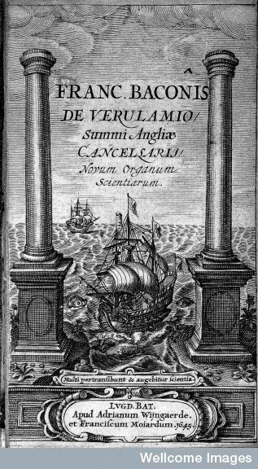
The Advancement of Learning (1605)
The Great Instauration (1620)
Novum Organum (1620)
New Atlantis (1627)
Sylva Sylvarum, or Natural History (1627)
Daniel 12:4, "Many shall go to and fro, and
knowledge shall be increased
(see title page of Novum Organum)

Slide 20
"that they consider what are the true ends of knowledge, and that they seek it not either for pleasure of the mind, or for contention or for superiority to others, or for profit, or fame, or power, or any of these inferior things; but for the benefit and use of life; and that they perfect and govern it in charity’

Slide 21
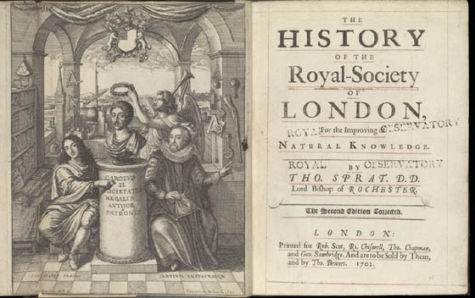
Royal Society, founded in 1660. Francis Bacon is on the right; Charles II
in the middle

