Slide 1
Mind, Body and Society
Lecture 9, term II, 2022/23
The History of the History of Medicine,
1960-today
Dr Claudia Stein

Slide 2
‘Historiography’ has two meanings:
A body of work written on a specific historical topic (i.e. the historiography of the history of anatomy)
the study of the theories and methodology used by historians and the development of history writing as an academic discipline.

Slide 3
Theory:
A theory is a system of assumptions, principles, and relationships posited to explain a specified set of phenomena. (For example, Michel Foucault’s theories of power/knowledge)
Methodology:
A methodology is often a whole set of methods developed according to a theory about how best to research and learn about natural or social phenomena.

Slide 4
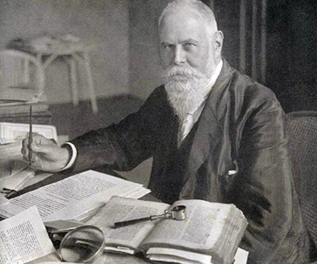
When does the history of medicine begin?
Sudhoff founded the first
Institute for the History of
Medicine in Leipzig in 1906
Karl Sudhoff, 1853-1938

Slide 5
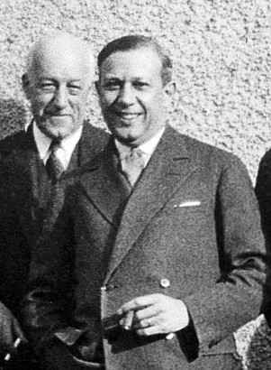
History of medicine goes to America..
Director at John Hopkins University
Institute for the History of Medicine,
1932-1937
He believes in ‘social medicine’ (i.e. medicine for all) and is fascinated by the medical system of the USSR
Henry E.Sigerist, 1891-1897

Slide 6
How was the History of Medicine before 1960s:
the analysis of text (very much focused on classical medicine; not material or visual objects)
on ‘thinking’ rather then medical ‘practice’
on ‘great men’, great doctors and the progressive development of the medical profession
In sum: a celebratory story of ‘progress’ and ‘discoveries’

Slide 7
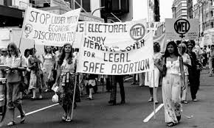
Everything changes in the 1960s and 70s……
Civil rights movement, women’s liberation movement. anti-war movements, anti-psychiatry movement...traditional authorities were challenged (including that of the
medical establishment)

Slide 8
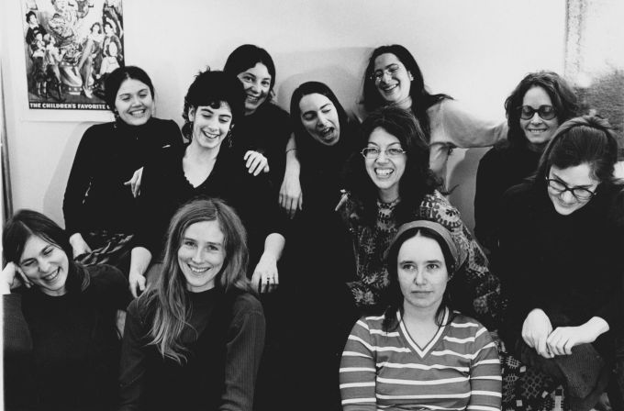
Founding members of ‘Our Bodies Ourselves’ of the Boston Women’s Collective

Slide 9
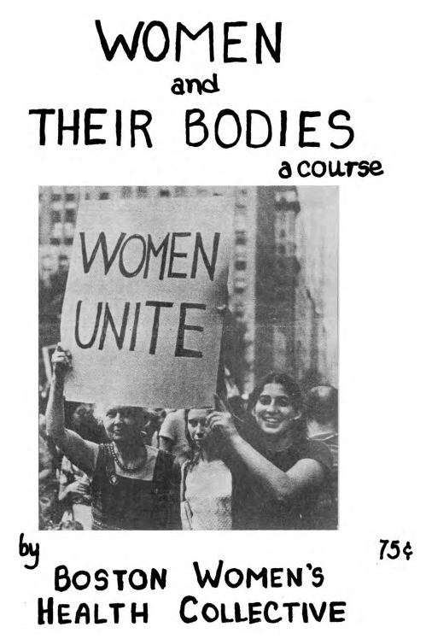

Slide 10
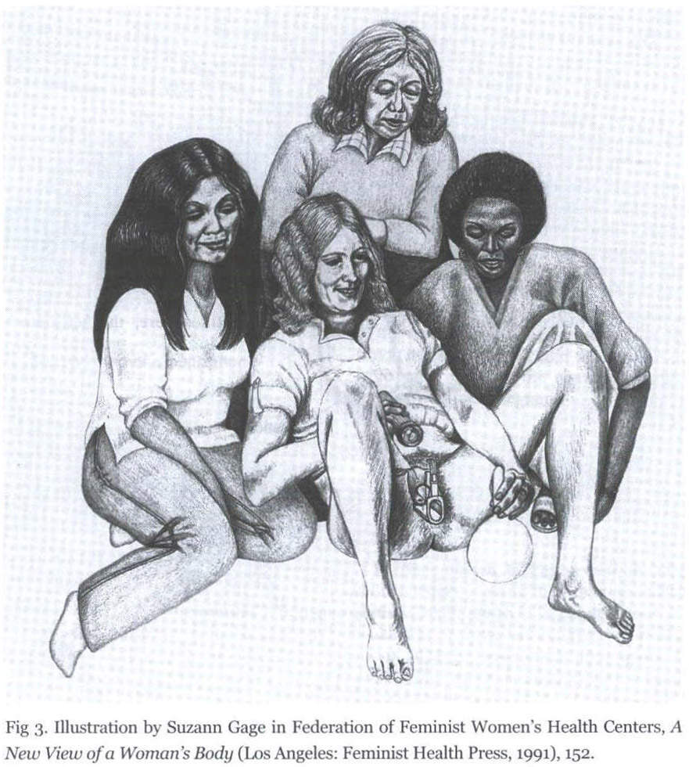
To know your body is to
have power!
Vaginal self-examination
groups as a way to explore the female body and defy male medical domination over it

Slide 11
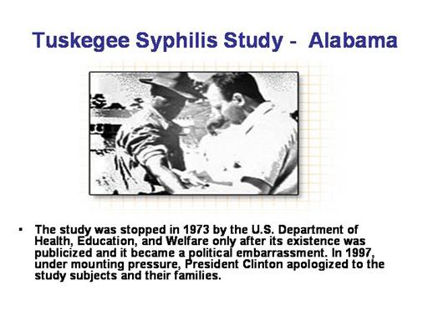
The authority of modern medicine is also shattered by various medical scandals…….

Slide 12
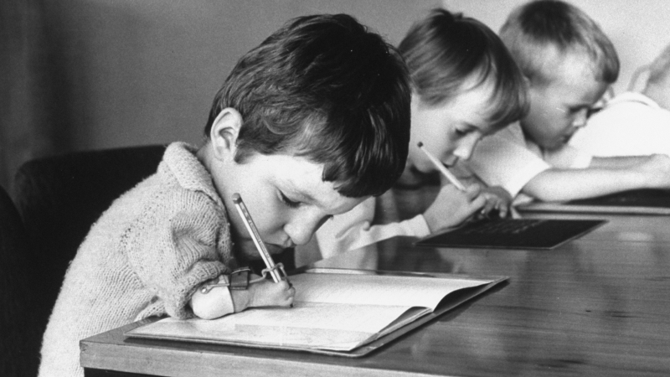
Thalidomide Scandal 1960s

Slide 13
This leads to an Increasing critique of the medical profession and a questioning of the ‘great heroes’ and progress stories
Niklas Jewson, ‘The Disappearance of the Sick Man from Medical Cosmology’, Sociology, 10 (1976), 225-44
Ivan Illich, Limits to Medicine (1976);
-- Medicial Nemesis: The Expropritation of Health (1974)
Influence of neo-Marxist understandings of power and historical development; everything is based on economic structures of a given society; suppression of the working classes (proletaria) (by the elites (bourgeoisie), doctors are part of the supressing system
This neo-Marxist view is reflected in the term: Medicalisation
def. the process by which nonmedical human conditions and problems (being gay, or having a liking for alcohol) come to be treated as a biological condition, and thus turned into subjects of medical study.

Slide 14
Characteristics of the ‘new’ social history of medical history in the 1960s:
Medical history as a way ‘to empower’ those who are suppressed (women, indigenous groups etc.)
On the political liberal left; neo-Marxist, this has effect on their understanding of how power works (from above, related to the productive forces; alienation from the ‘real’ medicine and the ‘real’ body through the professional establishment, patient voice is ‘silenced’ by profession)
A tendency to use sociology as an inspiration and method for work (quantitative data, sociological models and theories)

Slide 15
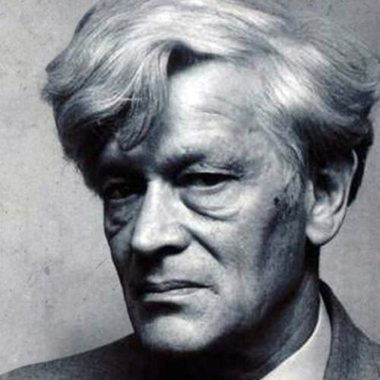
The ‘new’ social history of medicine is also shaped by developments in wider history writing in the 1960s and 1970s: the history ‘from below’
The Making of the English Working Class,
1963
Aimed at discovering the ‘experience’ of the poor and neglected in history
Re-discovery of historical narrative and a turn away from sociology
Historians turn to anthropology….
Edward Palmer Thompson, 1924-1993

Slide 16
‘Cultural Turn’ from the 1980: the Cultural History of Medicine
Anthropology
the study of humans, past and present. It aims to understand the complexity of cultures across all of human history and thus draws and builds upon knowledge from the social and biological sciences as well as the humanities and physical sciences.
Influential is the work of the American anthropologist:
Clifford Geertz,’ Thick Description: Towards an Interpretative Theory of Culture’, in ibid, The Interpretation of Culture: Selected Essays (1973)
Major impact on the history of medicine: Arthur Kleinmann, Patients and Healers in the Context of Culture (1980)

Slide 17
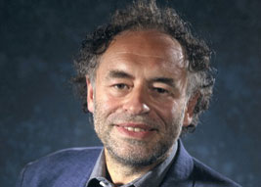
The ‘new’ cultural history
of medicine
Roy Porter, 1946-2002
‘The Patient’s View: A History from Below’ – excellent example to see how scholars moved
from the ‘new’ social history of medicine to the cultural history of medicine

Slide 18
Lingustic Turn:
Analytical turn upon, or problematisation of words/language used in a given field of study. Also used to refer to the ‘turn’ to linguistic philosophy in the late 20th century in the humanities and social sciences.

Slide 19
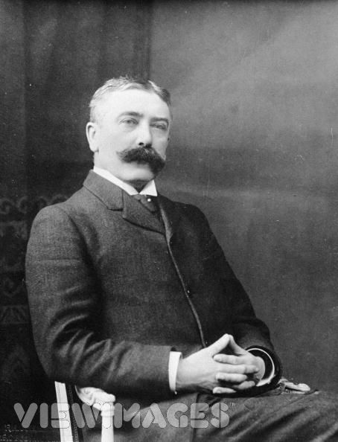
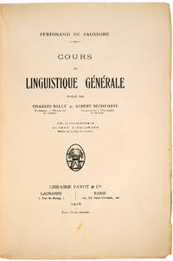
Cours de linguistique générale (1916)
Lingustics: scientific study of language in broadly three aspects: language form, language meaning, and language in context
Ferdinand de Saussure, 1857-1913

Slide 20
During the ‘lingustic turn’ Saussure’s ideas were applied to the understanding of wider human culture; central claims became :
Reality is unrepresentable in any form of human culture (whether written, spoken, visual or dramatic)
No authoritative account can exists of anything. Nobody can know everything, and there is never one authority on a given subject

Slide 21
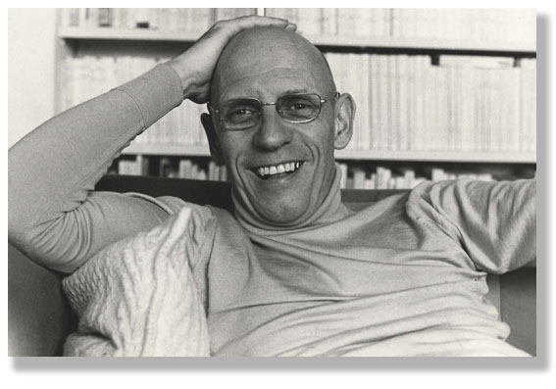
The most influential philosopher and historian inspired by the linguistic theories ...
Michel Foucault 1926-1984

Slide 22
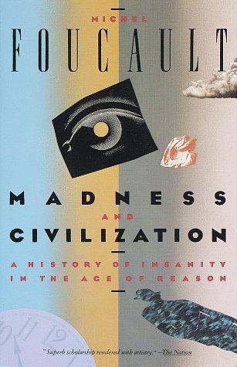
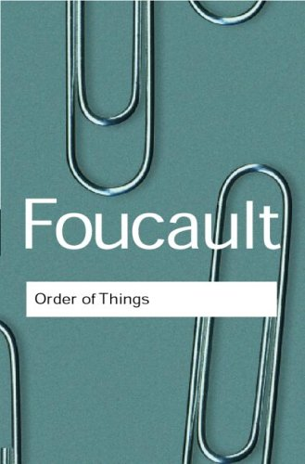
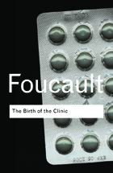
Foucault’s philosophical works are all ‘histories’ and most of the them deal with the medicine and the life sciences from the Middle Ages to the present (1980s)
Central Claims:
power is always directed at the human body
power aims to make it docile and obedient
Medicine/life sciences are central players in these games of power over the human body
Medical/life sciences knowledge is not ‘neutral’ or ‘objective’ but part of the complex nexus of ‘power/knowledge’
Scientific/medical knowledge is not universally true; knowledge is not ‘discovered’ but constructed in a specific society

Slide 23
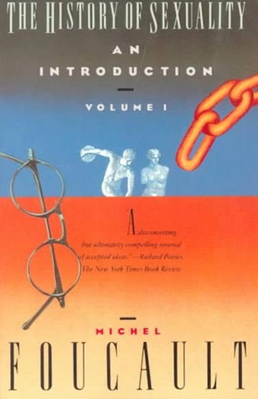
History writing as a ‘critique of the present’

Slide 24
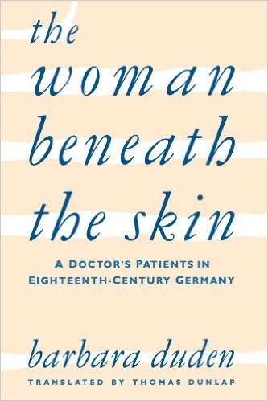
From these claims develop a new area
of study in the history of medicine:
The History of the Body

Slide 25
Where are we now?
Global approaches (global cultural history of medicine)
Medicine and health consumption/consumerism
Material and visual culture of medicine
Animals and the history of medicine
The history of emotion (developed out of the history of the body)

