Slide 1
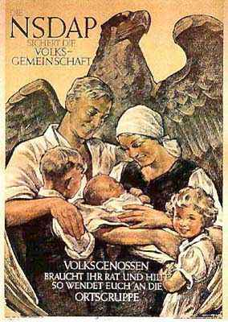
Nazi Germany: The ‘Folk Community’
HI290- History of Germany

Slide 2
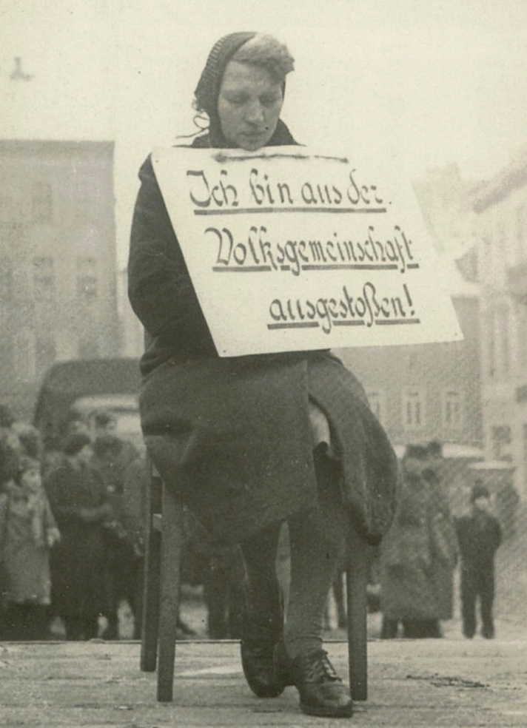
Volksgemeinschaft (Folk Community)
Idea of an equal community of racial comrades
Everyone’s participation
Equality defined racially and socially
Based on exclusion of those who did not fit in racially and biologically (“non-Aryans,” “asocials,” homosexuals, those sexually “deviant,” criminals, hereditary ill)
Eugenics
“I have been expelled from the folk community”

Slide 3
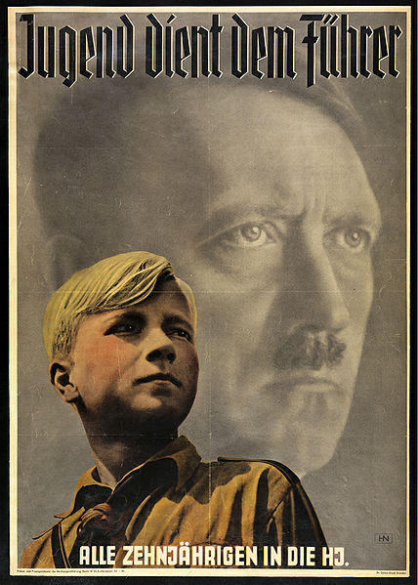
Education and Youth
‘Co-ordination’ of education system:
‘Politically unreliable’ teachers sacked.
Curriculum brought into line with Nazi ideology.
Youth Organizations:
Deutsches Jungvolk (German Young People, DJ) – Boys aged 10-14.
Hitler Jugend (Hitler Youth) – Boys aged 14-18.
Jungmädelbund (League of Young Girls) – Girls aged 10-14.
Bund Deutscher Mädel (League of German Girls, BDM) – Girls aged 14-18.

Slide 4
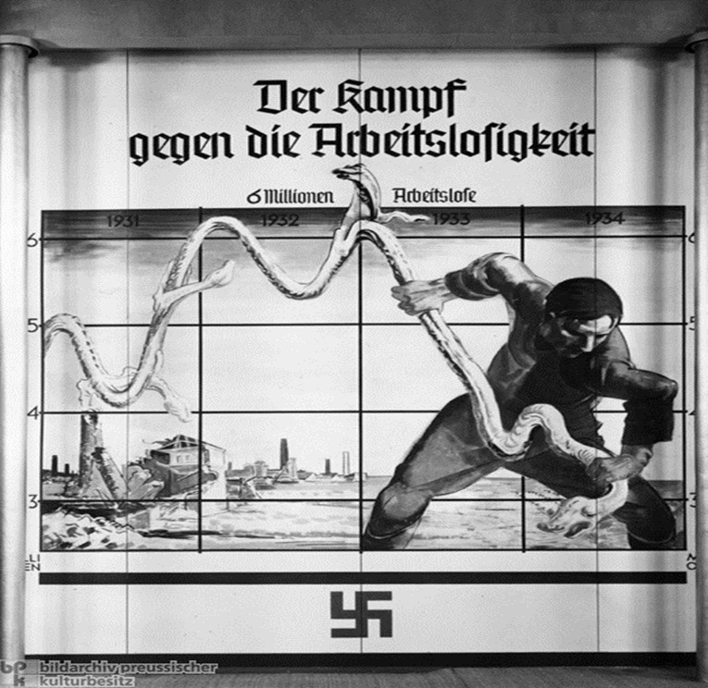
Economic Revival, 1933-36
Financier Hjalmar Schacht appointed President of the Reichsbank (1933-39) and Minister of Economics (1934-37) with virtual dictatorial powers over the economy – demonstrates the Nazis need to keep big business on side.
The priority to stimulate investment in the economy – this facilitated and led by state intervention: low interest rates, programme of public works.
1933-1936: public investment tripled and government expenditure increased by 70%
Sept. 1934: ‘New Plan’ introduces state control of trade & currency exchange. Bilateral trade agreements with South America and the Balkans.
By 1935 Germany had a trade surplus, unemployment was down to 1.7 million and industrial output had risen by 49.5%
‘The Fight Against Unemployment’: Graph
Presented by the Reich Ministry of Employment (1934)

Slide 5
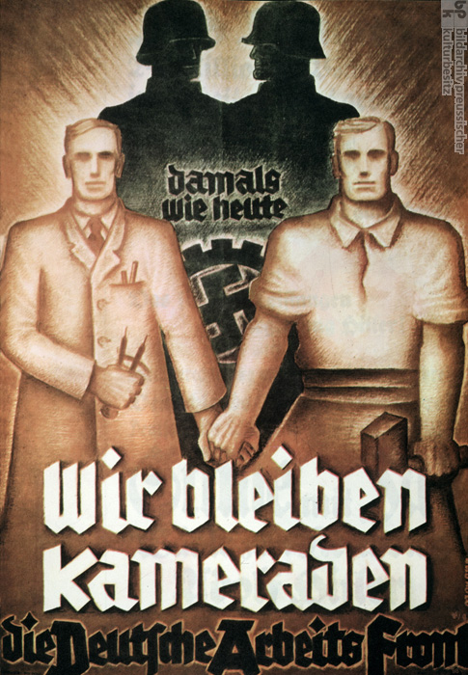
Labour: Peasants and Workers
Blut und Boden (Blood and Soil): the German peasantry were the ‘blood spring’ of the Volksgemeinschaft and farmers had a vital role to play in making the country self-sufficient. However, the Nazis unable to curb urbanisation.
The state-run trade union, the Deutsche Arbeitsfront (DAF), was the largest Nazi organization with a membership of 22 million by 1939.
It was responsible for setting wages and working hours, organizing training, dealing with strikes and absenteeism and supervising working conditions.
Kraft durch Freunde (KdF, Strength through Joy) provided opportunities for loyal workers to go on cheap holidays, participate in cultural visits or access sporting facilities.

Slide 6
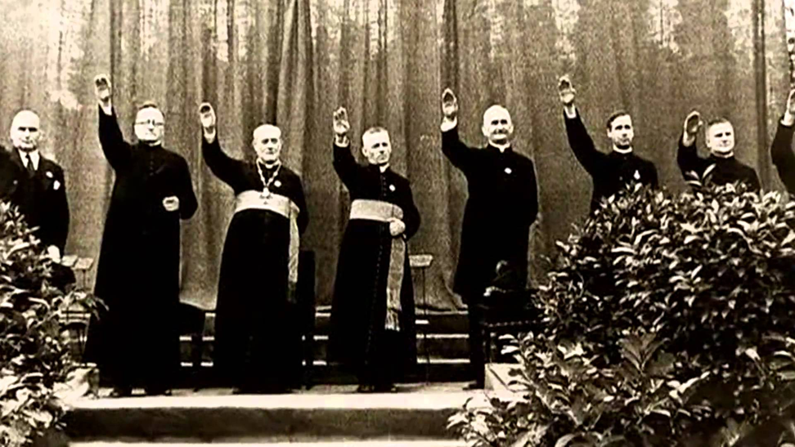
Religion
The German population 75% Protestant and 25% Catholic in the 1930s.
National Socialism fundamentally anti-Christian.
Some Nazis favoured a kind of völkisch neo-paganism, eg. the German Faith Movement.
Hitler recognized that, at least in the short-term, the established churches had to be conciliated.
July 1933: Concordat with the Vatican promises religious freedom for Catholics in exchange for a promise to keep out of politics.
Attempts to ‘co-ordinate’ the Protestant churches:
The German Christians sought to merge Protestantism with Nazi ideology.
July 1933: new church constitution introduced and Ludwig Müller appointed Reich Bishop.
The Nazis never fully succeeded in their aims, but while individual Christians were among the opposition to Hitler, the churches took a more pragmatic view.

Slide 7
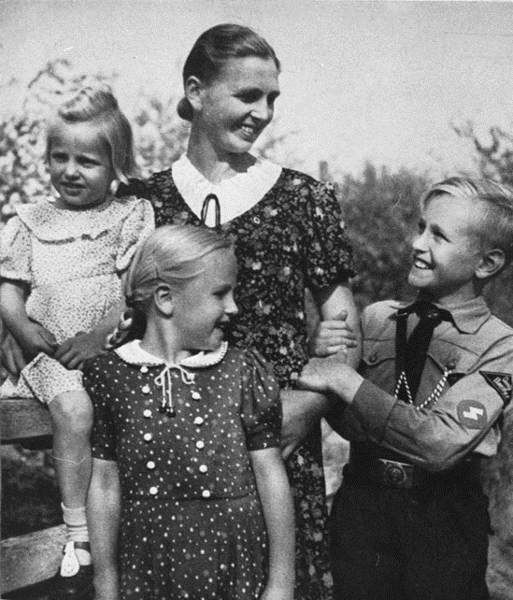
Women
National Socialist Women’s League (Nationalsozialistische Frauenschaft): founded Oct. 1931 through a merger of existing nationalist and right-wing women’s associations.
From 1934 led by Reich's Women's Leader (Reichsfrauenführerin) Gertrud Scholtz-Klink and published a monthly magazine, the NS-Frauen-Warte.
Designed to indoctrinrate women into the Nazi mindset, organised classes giving advice for newly married women and mothers on their duties within the Folk Community, gave domestic advice (eg. on the importance of using German-made products instead of imported ones), and during wartime mobilised women behind the war effort and allocated domestic servants from Eastern Europe to German families.
Had 2 million members, by 1938, the equivalent of 40% of total party membership.

Slide 8
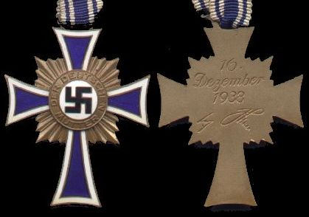
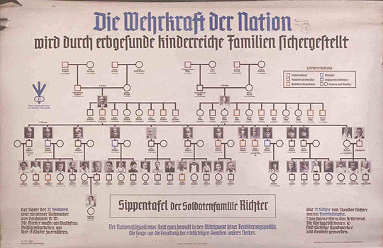
Pronatalism
The Great Depression discouraged large families; part of a wider trend of a falling birth-rate.
Positive eugenics: incentive schemes such as marriage loans, mothers’ crosses
Lebensborn (Well of Life): SS scheme to promote Aryan births out of wedlock
Anti-natalism (Gisela Bock): several hundred thousand women sterilised
Above: Mother’s Cross; below: ‘The nation’s military strength is safeguarded by hereditarily healthy, child-rich families’

Slide 9
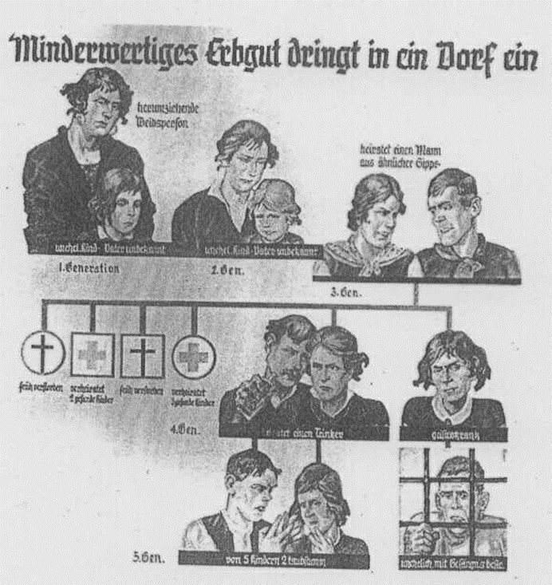
Eugenics
Eugenics = ‘good birth’; widespread in western societies from late 19thC (i.e. not German-specific)
‘Ideal’ racial stock often equated to middle-class
‘Dangerous’ classes of lumpenproletariat
Note cultural stereotypes rather than scientific criteria
Law for Prevention of Hereditarily Diseased Offspring (July 1933): approx. 2 million people sterilized
‘Inferior Hereditary Material Penetrates a Village’: lone mother, illegitimate children, drinking fathers, mental illness & prison

Slide 10
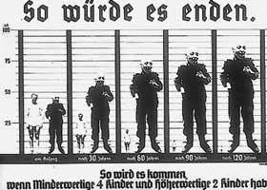
‘Asocials’
Racial theory of hereditary illnesses (criminality, alcoholism), rendering sufferers ‘unfit for community’
‘Workshy’ & prostitutes targeted from 1936 on, becoming significant proportion of concentration camp population
‘This is how it would end.’

Slide 11
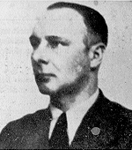
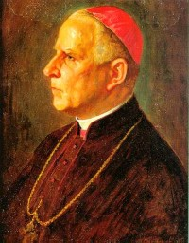
Euthanasia
Financial savings on mentally handicapped.
Killings in sanatoria. Around 360,000 people killed, many of them children, by 1939.
‘T4’ programme under Viktor Brack experiments with gas vans. As many as 93,000 killed by 1941.
Bishop Galen of Münster leads Catholic opposition (euthanasia becomes clandestine from 1941)
Key text: Michael Burleigh, Death and Deliverance
Victor Brack, architect of the ‘T4’ euthanasia programme
Bishop Galen of Muenster, outspoken critic of euthanasia

Slide 12
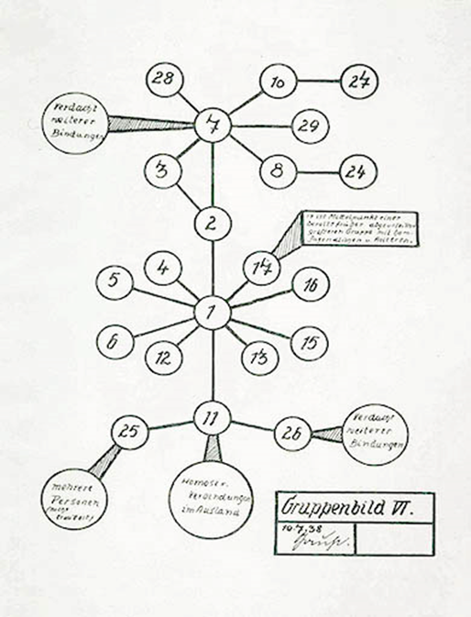
Homosexuals
Gay men targeted as “failing their reproductive duties”.
1936: penal code amended to make it easier to prosecute homosexuals.
4,000 arrests between 1933 and 1935; 22,000 between 1936 and 1938.
Homosexuals incarcerated in concentration camps with pink triangle.
50% of gay men in camps died.
Around 2,000 men castrated as a “cure” for homosexuality.
Nazi chart alleging that one homosexual man can ‘contaminate’ 28 others; note the pseudo-scientific diagram

Slide 13
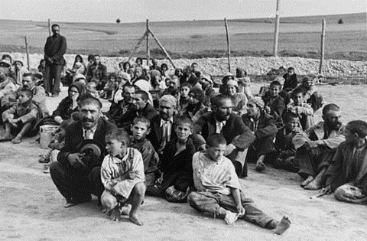
Roma and Sinti gypsies
Sinti & Roma labelled workshy.
Ethnographic studies of gypsies as Indo-European migrants.
From 1938 laws directly aimed at Gypsies similar to those aimed at Jews.
Proportionally as many gypsies died in Holocaust as Jews.
Gypsies await their fate at Belzec camp

Slide 14
Varieties of Antisemitism
Religious antisemitism, dating back to medieval period
Economic antisemitism: emancipation of Jewish Germans post-1871 coincided with economic depression
Biological antisemitism: Social Darwinism; organicist view of body politic; Jews as parasites ‘contaminating’ Aryan blood

Slide 15
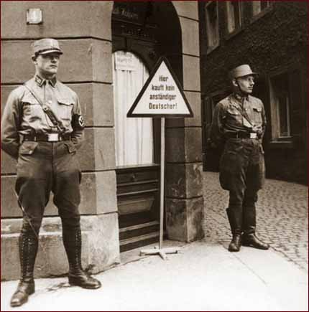
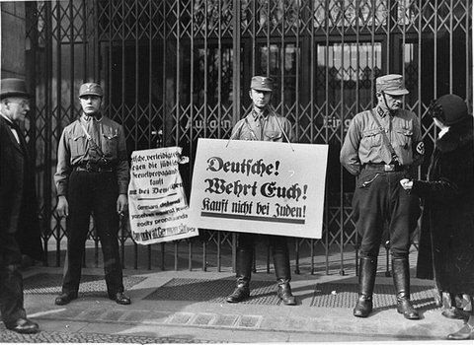
Assimilation Rejected
1933 April Boycott of Jewish Businesses

Slide 16
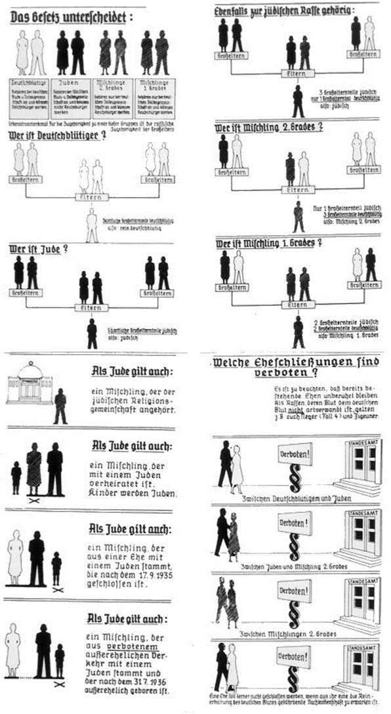
Nuremberg Race Laws
1933: Law for the Restoration of the Professional Civil Service.
1933: Law against the Overcrowding of German Schools.
1935: Reich Citizenship Act.
1935: Law for the Protection of German Blood and Honour.

Slide 17
Conclusion
The idea of a Volksgemeinschaft more a notion than a reality
Strong gender components; state interfering with family and private sphere → Totalitarian?
Based on exclusion of those who did not fit in racially and biologically (“non-Aryans,” “asocials,” homosexuals, those sexually “deviant,” criminals, hereditary ill)
Provided the basis for genocide

