Slide 1
Mass culture and popular pastimes
Week 7. Britain in the 20th century

Slide 2
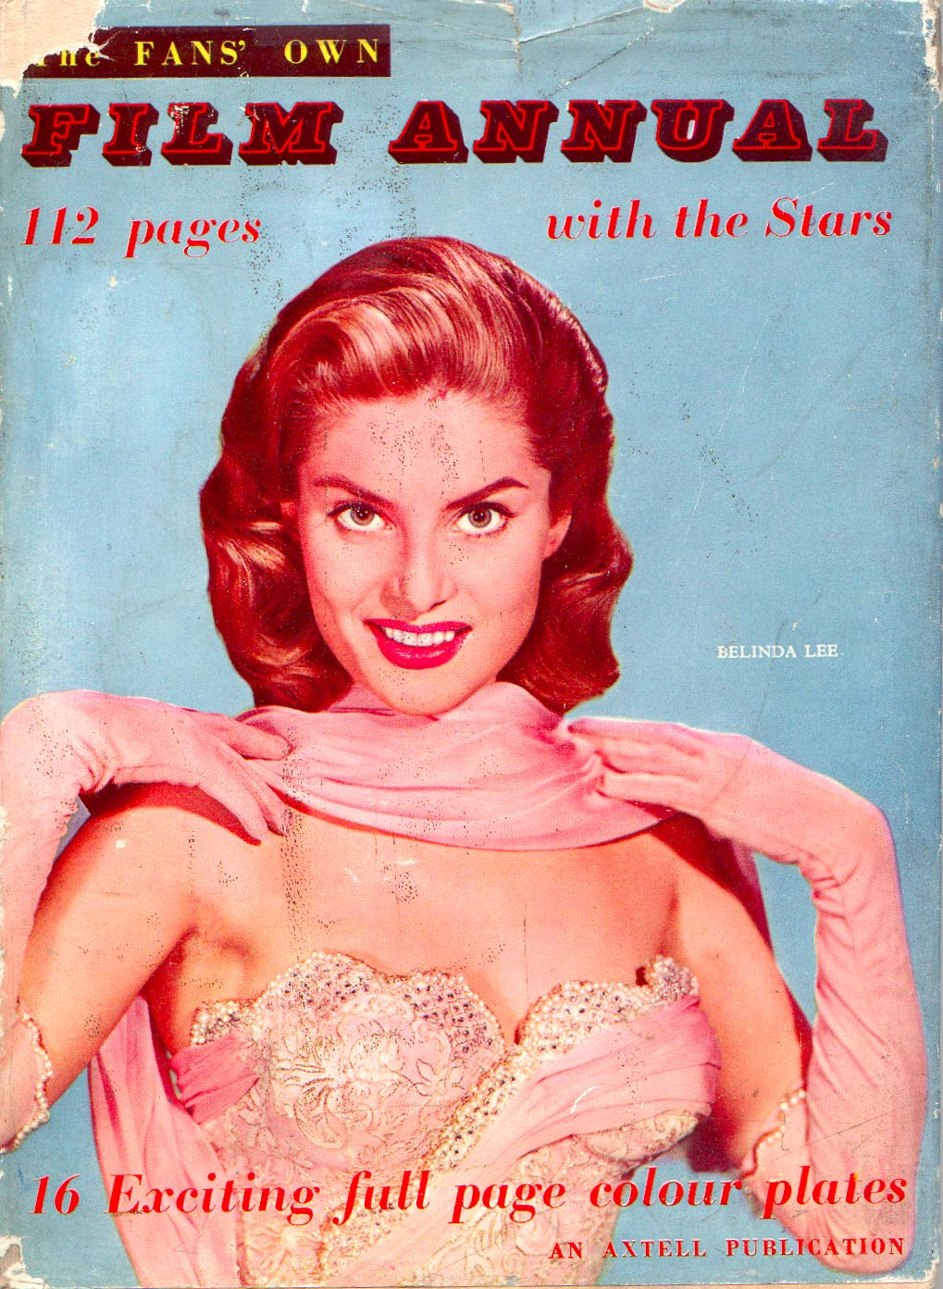
Cinema

Slide 3
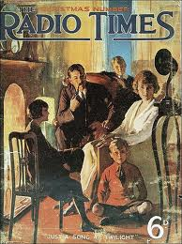
Radio

Slide 4
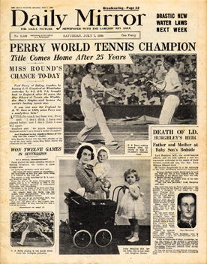
Press

Slide 5



Slide 6
"Let's dance: dancing in Britain 1920-1945”
BBC documentary
https://www.youtube.com/watch?v=owv9JmHOln0

Slide 7
‘The 1930s marked an important decade to the development of a common culture in Britain. This culture was “common, not because of its vulgarity or presumed inferiority; rather, it was widely shared by diverse groups within the entire community.’
LeMahieu, D.L. (1988), ‘Sight and Sound: Studies in Convergence’

Slide 8
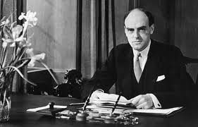
‘Give the public slightly better than it now thinks it likes’
John Reith, Director General of the BBC (1927-1939)

Slide 9
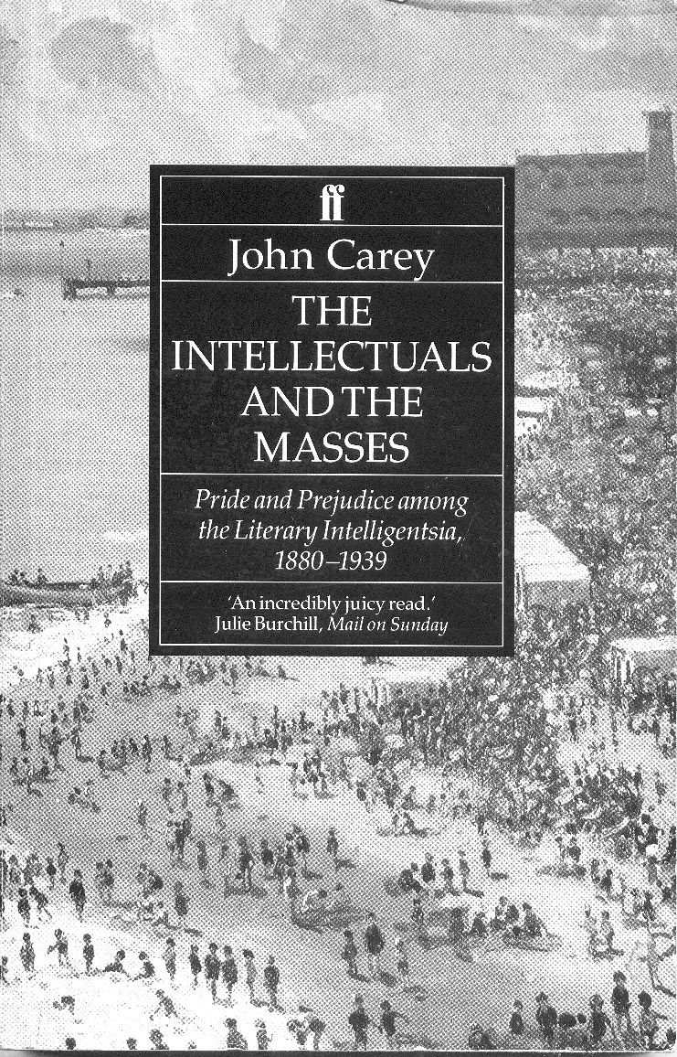

Slide 10
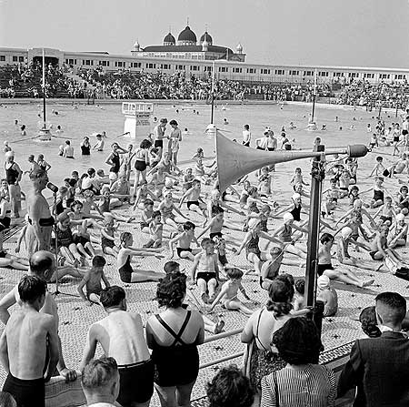
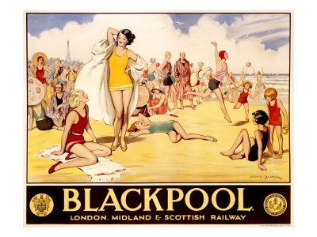

Slide 11
