Slide 1
The Break Up of Britain
Week 19. Britain in the 20th Century

Slide 2
‘The people of these islands have seldom been united politically or culturally. Efforts were made to unite them from the 12th century onwards, but they only came under the same monarch in 1603, and the complete political union, which was at last achieved in 1801, endured only till 1922. Since then the process has been reversed.’
Hugh Trevor Roper, The English World, 1982

Slide 3
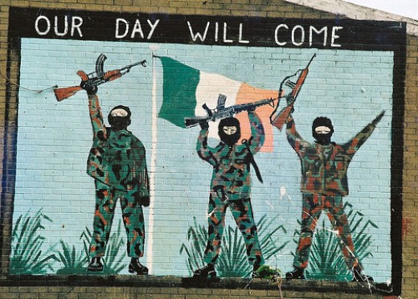
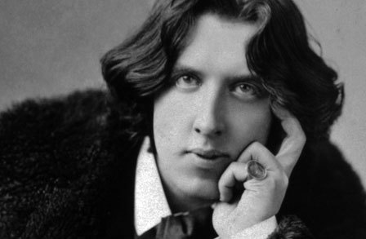

Slide 4



Slide 5
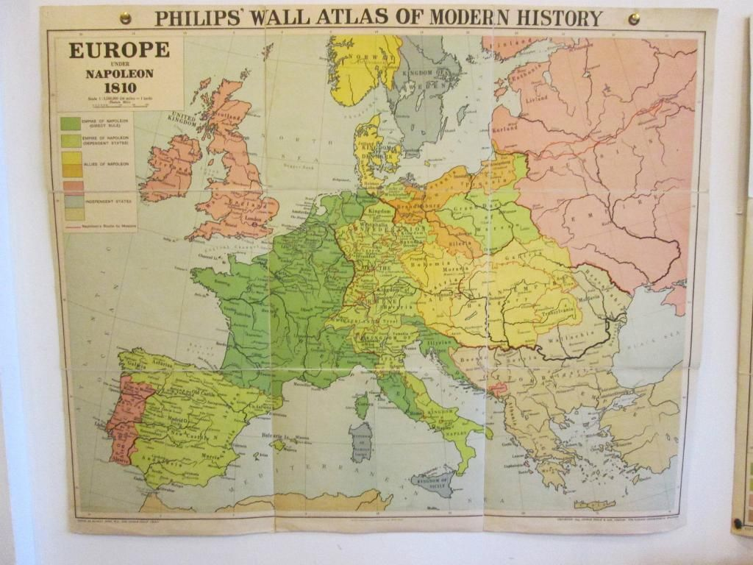

Slide 6


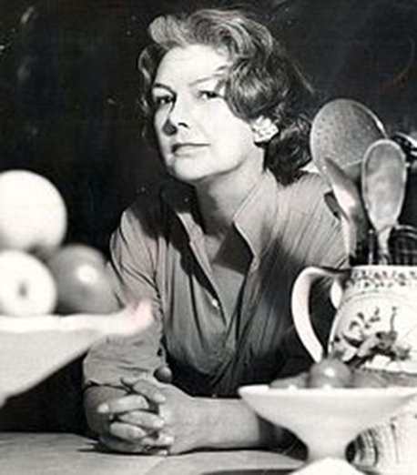

Slide 7
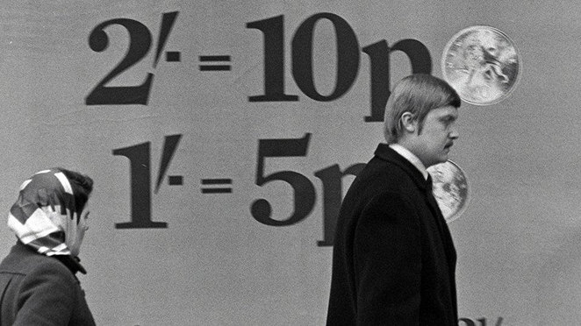

Slide 8
