Slide 1
Britain in the 20th Century Week 1. ‘The Problem with Britain’
Dr. Laura Schwartz

Slide 2
The four Nations model
J.G. A Pocock, 'The Limits and the Divisions of British History: In the Search of the Unknown Subject.' American Historical Review 87 (1982).
J. G. A. Pocock, 'British History: A Plea for a New Subject.' Journal of Modern History 4 (1975)

Slide 3
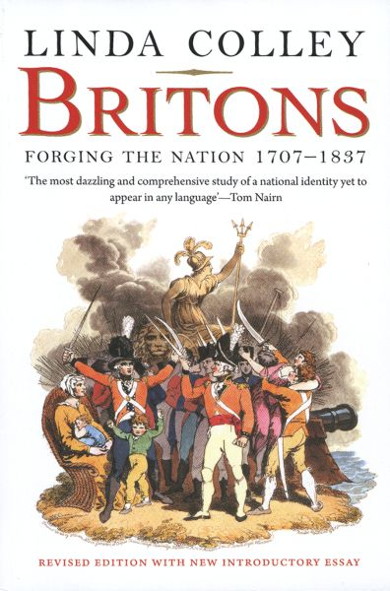
Britain and the ‘Other’

Slide 4

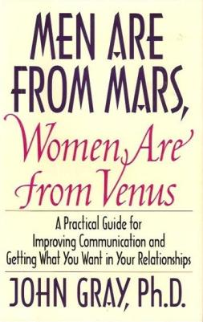
Othering and Binary Oppositions
A very good, serious book…
A pretty damn terrible book that sadly encapsulates prevalent assumptions

Slide 5


The "migrant" as the new "other"?

Slide 6
Nationalism
Emerges in the nineteenth century.
People united by ethnicity/culture/history, who demand to live with in a nation state which reflects that ethnicity/culture/history.
Often emerges as part of anticolonial struggles.
Constructed through culture, but also enforced via the state.
A set of ideas or ideology.

Slide 7
National Identity
A psychological/emotional/personal phenomena. A 'self-concept'.
Difficult to measure – a sense of belonging, loyalty, a sense of who you are.
The internalisation of nationalism? The internalisation of and ideology?

Slide 8
‘Modern history-writing … Has historically been a “narrative contract” with the territorially bounded nation-state.’
Antoinette Burton, ‘Who Needs the Nation’ (1997)

