Slide 1
The Affluent Society
Week 11.Britain in the 20th Century

Slide 2

1959 General Election:
Conservative party leader Harold Macmillan comes to power with the slogan 'you've never had it so good'

Slide 3
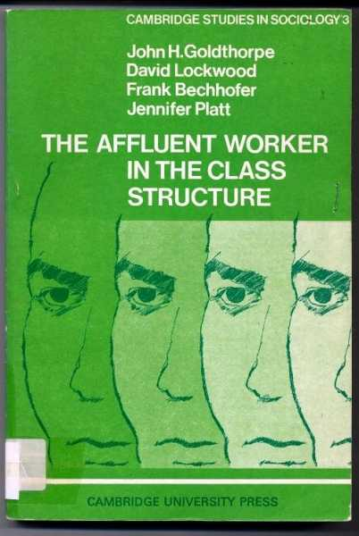
Sociological study of workers in Luton, published 1962.

Slide 4

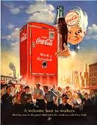

Slide 5
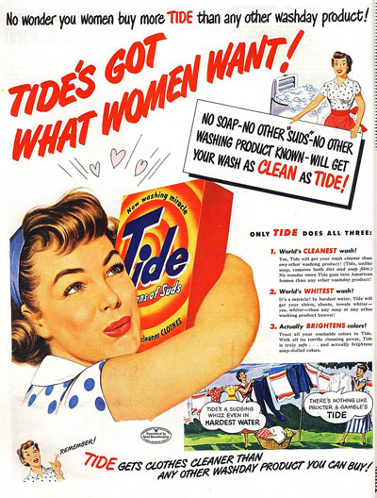
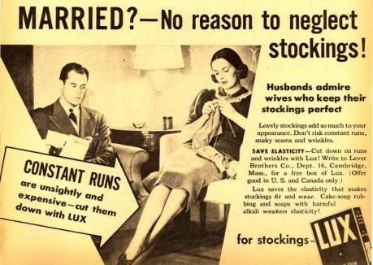

Slide 6
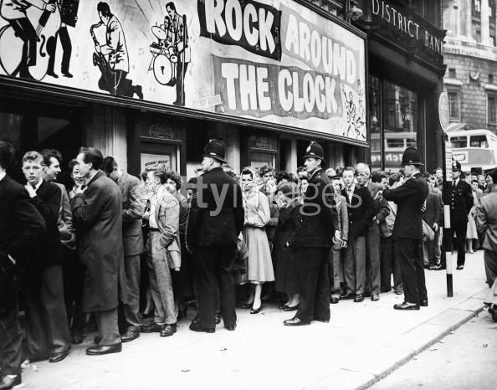
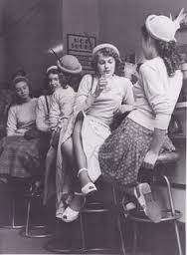
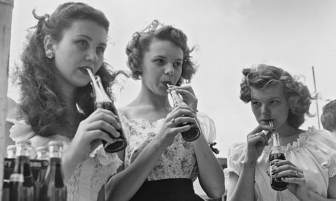
1950s teenagers

Slide 7


