Slide 1
The Permissive Society
Week 12.Britain in the 20th Century

Slide 2

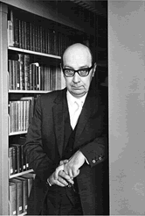
Phillip Larkin, ‘Annus Mirabilis’ (Published 1974)

Slide 3
Report of the Departmental Committee on Homosexual Offences and Prostitution (a.k.a. the Wolfenden Report) Published 1957

Slide 4
"The law's function is to preserve public order and decency, to protect the citizen from what is offensive or injurious, and to provide sufficient safeguards against exploitation and corruption of others... It is not, in our view, the function of the law to intervene in the private life of citizens, or to seek to enforce any particular pattern of behaviour."

Slide 5
‘permissive society… Signified a wide range of social and moral changes: loosening of traditional sexual and emotional restraint, rebellion against family responsibility, increasingly hedonistic expressions of consumer culture, as well as generational revolt. '
Frank Mort

Slide 6
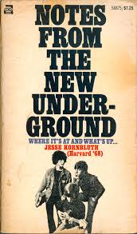
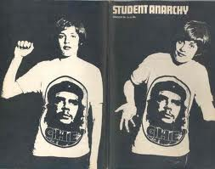
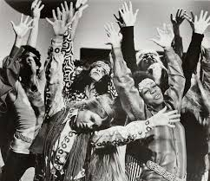
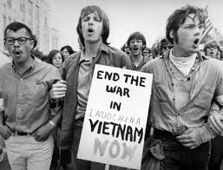

Slide 7
‘…people are only able to understand themselves in relation to meanings attributed to their behaviour, over which they have little control and which they inherit when they grow up in a particular culture. In other words, what it means to be a woman or a man, or gay or straight, is dictated to us, more discovered by us than created. Our experience is not outside society or pre-social, but given meaning through the language and vocabulary of our culture.'
H.G. Cocks and Matt Houlbrook, The Modern History of Sexuality (Basingstoke: Palgrave Macmillan, 2006)
(p.6)

