Slide 1
Race, Citizenship and Multiculturalism
Week 14. Britain in the 20th Century

Slide 2
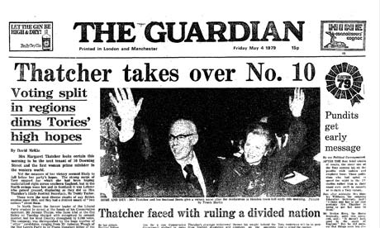
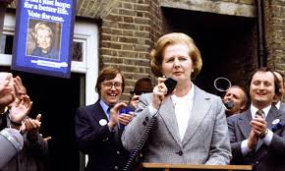
1979 General Election

Slide 3
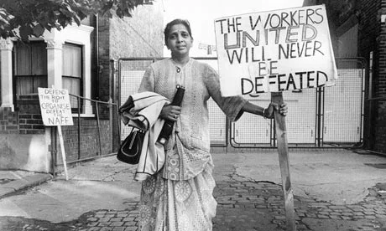
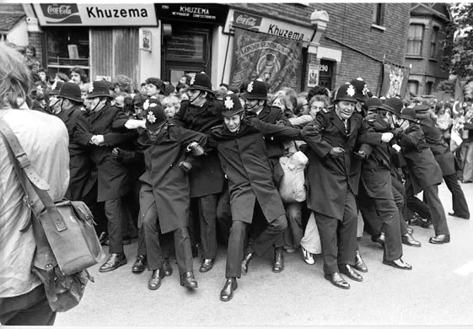
Grunwick Strike 1976-1977

Slide 4
‘official multiculturalism [shows]… an interest in magnifying racial, cultural and ethnic differences so that a special transgressive pleasure can be discovered in their spectacular overcoming… The widespread belief in their absolute nature may also be attractive because it absolves bona fide Brits and cultural insiders from the hard work involved in translation and cross cultural understanding.’
Paul Gilroy, There Ain’t No Black in the Union Jack

Slide 5
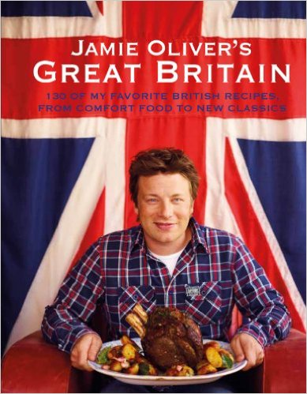

Slide 6
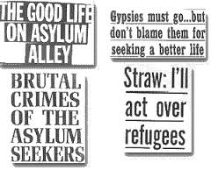
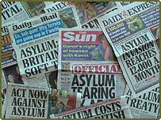
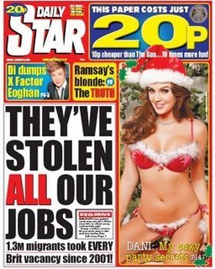

Slide 7
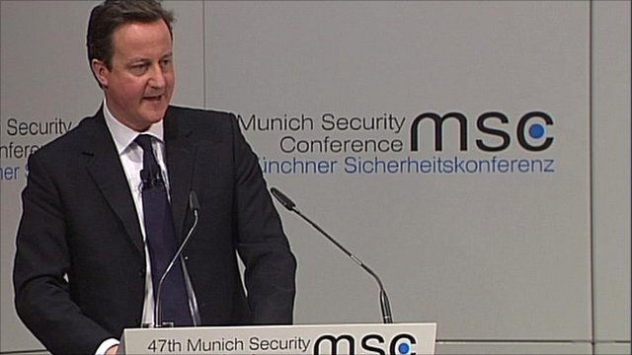
David Cameron, speech to the Munich Society Conference (2011)

Slide 8


