Slide 1
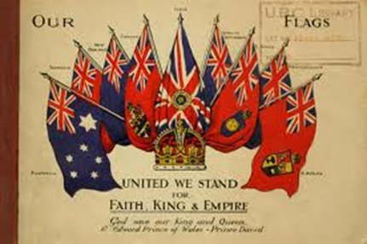
An Imperial People?
Britain in the Twentieth Century
Week 2

Slide 2
1815-1914: 10million square miles and 400m people added to Empire. Africa, India, Carribean.
1919 (via territorial gains from Germany in Africa) Empire reaches its greatest extent: ¼ of world population and land mass (‘sun never set’)

Slide 3
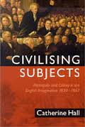
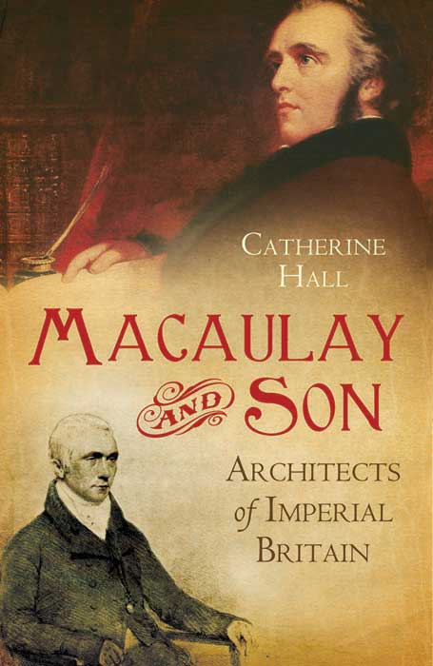

Slide 4
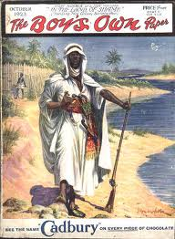
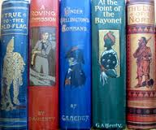

Slide 5
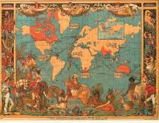

Slide 6
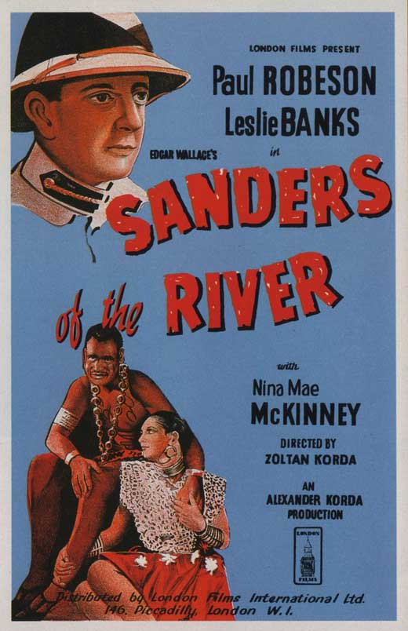
Film dedicated to "the handful of white men whose everyday work is an unsung saga of courage and efficiency".

Slide 7
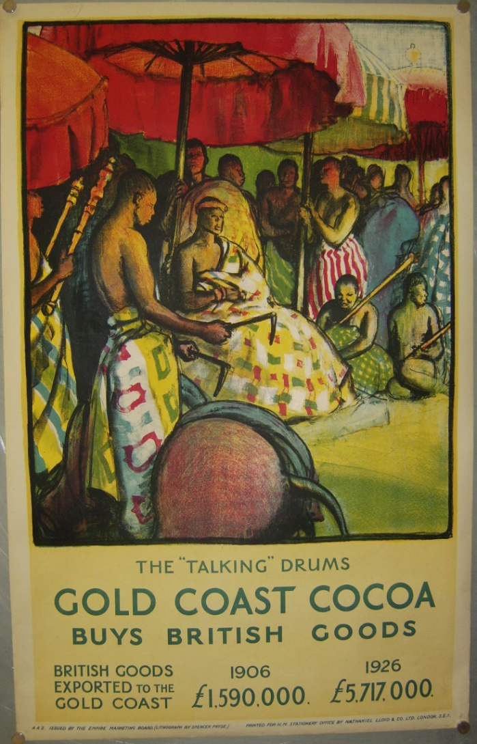

Slide 8
“Whatever else it may have been, the British Empire in the early and mid-19th century was not a “people’s” empire. Those who say it was, or that imperialism pervaded British culture and society generally during this period, are simply wrong… There is no direct evidence that the great majority of Britons supported the empire, took an interest in it, or were even aware of it for most of the century; whereas much circumstantial evidence points the other way.’ They were too busy and too poorly educated to care, while the middle class and upper class imperialists were happy to keep the empire to themselves.” (Bernard Porter, The Absent-Minded Imperialists)

Slide 9
