Slide 1
‘National Decline’, Reproduction and the state
Britain in the twentieth century

Slide 2
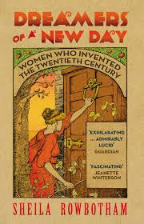
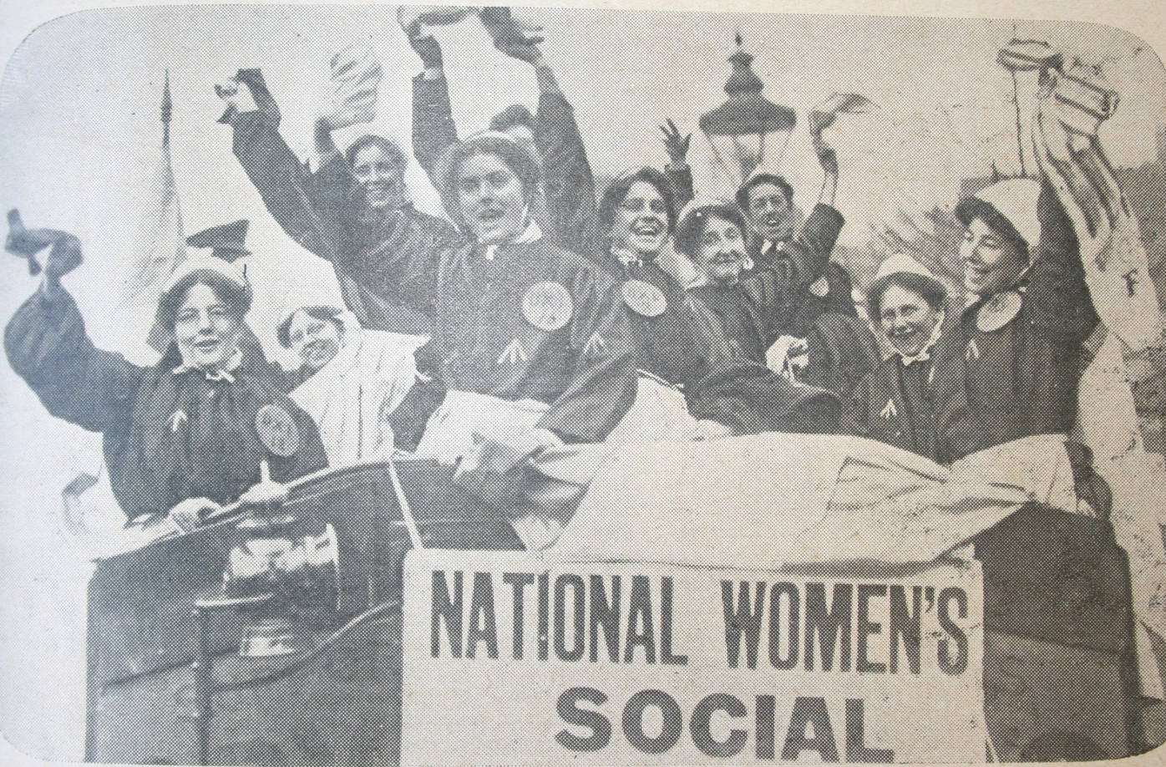

Slide 3


Slide 4
“The history of nations is determined not on the battlefield but in the nursery, and the battalions which give lasting victory are the battalions of babies.”
Dr. Caleb Saleeby, Parenthood and Race Culture (1909)

Slide 5
“Over production lessens, under-production enhances the value of commodities. Considering the life of an infant as a commodity its money value must be greater than 35 years ago. It is of concern to the nation that a sufficient number of children should annually be produced to more than make good the losses by death…”
Alexander Blyth, Medical Officer of Health for Marylebone (1907).

Slide 6
‘The district visitor excited their bitter hatred. She came in without so much as a “by your leave” or a “with your leave”… she poked her nose into corners, and if she didn’t say the place was dirty you could see she thought right enough, “an’ it’s all very well for them as ‘as servants, but I’d like to see what she’d make of ‘er room if she ‘as four children, and ‘ad to see to the cooking, and mend their clothes, an’ wash them.”’
Somerset Maugham, Of Human Bondage, drawn from his experience as a medical student in Lambeth doing midwifery practice in people’s homes in the 1890s.

Slide 7
