Slide 1
The Great War (1914-1918)
Britain in the 20th Century
Dr. Schwartz

Slide 2
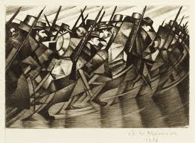
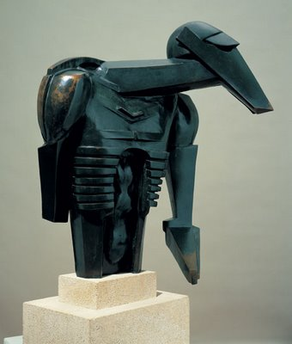
Nevinson
Epstein

Slide 3

Masculinity, militarism and patriotism

Slide 4
