Slide 1
Sources and Resources
Britain in the Twentieth Century

Slide 2
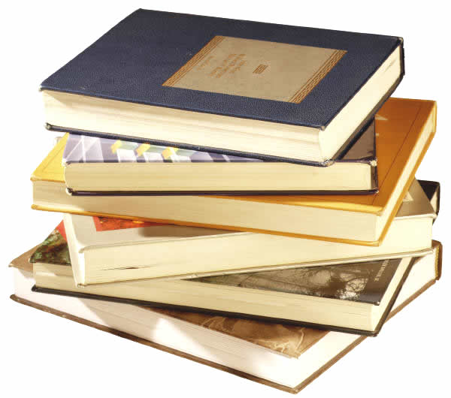
Bibliographic
Bibliography of British and Irish History
Lists most publications in field of British History
Includes books but also articles and chapters in books
Easily searchable
Available via Warwick Library Databases.

Slide 3
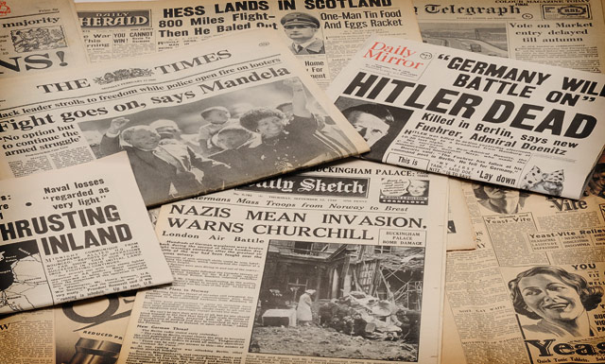
Newspapers
Times Digital Archive, also now Daily Mail and possibly Mirror available via Warwick Library.
Modernist Journals Project.
Easily searchable across whole period
Searching for needles in haystacks now possible
Searching via specific event
Patterns over time
Public opinion (letters; advertising)
Limitations

Slide 4
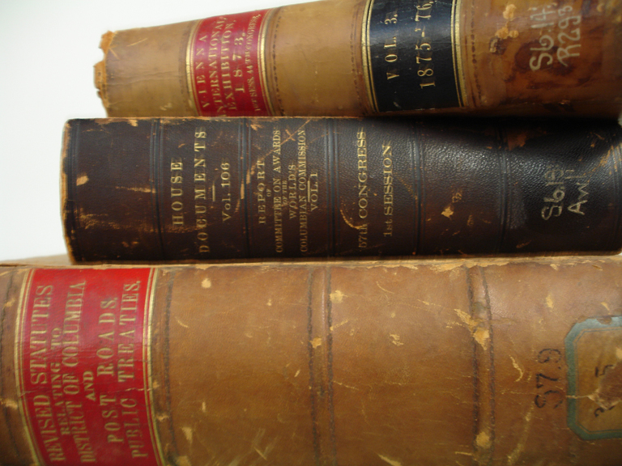
House of Commons Parliamentary Papers online
All government reports and house of commons debates
Available via Warwick Library Databases

Slide 5
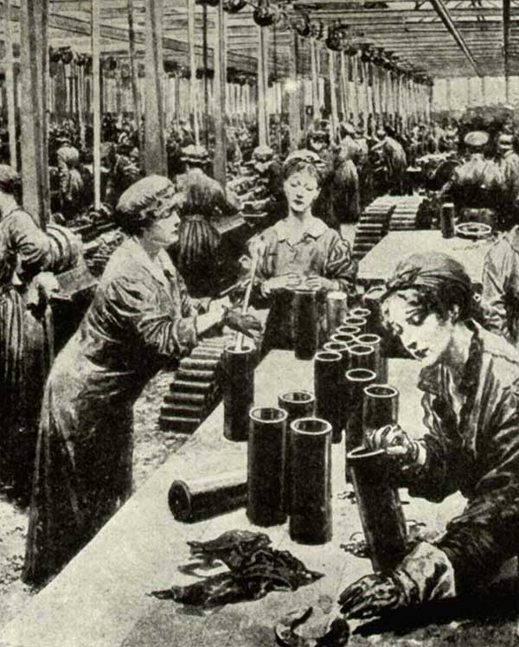
First World War
Women, War and Society, 1914-18. Available via Warwick Library Databases.
Articles and primary sources from the Imperial War Museum

Slide 6
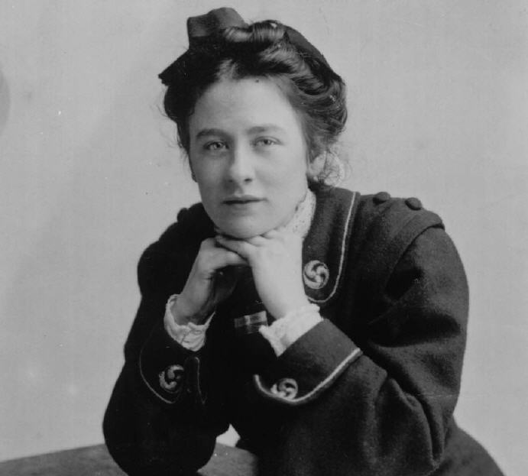
Women
Women in the National Archives: Available via Warwick Library Databases.
The Women’s Library @LSE
The Feminist Library, London
Votes for Women (digitised)

Slide 7
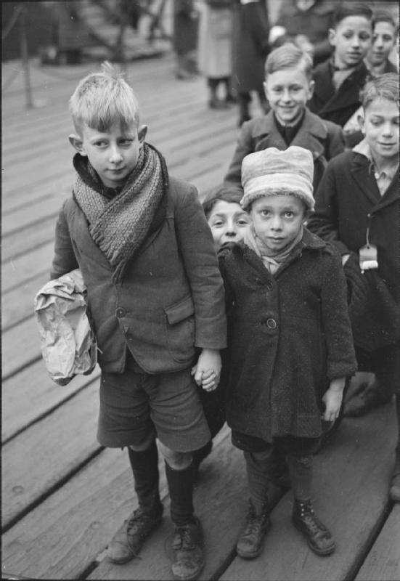
Second World War and Post-War Immigration
Post-War Europe: Refugees, Resettlement and Exile, 1945-50.
Available via Warwick Library Databases.
Oxford Great War Archive:

Slide 8
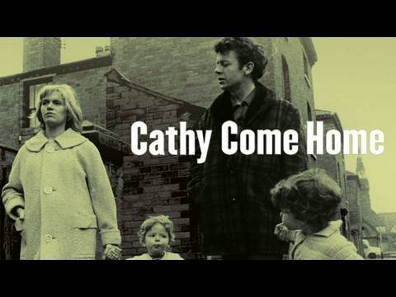
Film/Television
BBC Archive: http://www.bbc.co.uk/archive/
BFI Inview: http://www.bfi.org.uk/inview/
BFI Screenonline: http://www.screenonline.org.uk/
British pathe news: http://www.britishpathe.com/
Box of Braodcasting. Available via Warwick Library Databases.

Slide 9
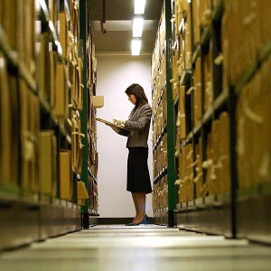
National Archives
http://www.nationalarchives.gov.uk/
Catalogue
Cabinet Papers online
Educational Resources

Slide 10
What to do with original sources?
Single document to open up fresh perspective: don’t be afraid to go into detail and consider issues of interpretation/context; analysis rather than just illustration
Consideration of a concentrated body of original sources to provide a case study to address broader question (and offer fresh insight)
Impressive to use material that demonstrates research skills in locating, identifying significance, and original interpretation

