Slide 1
'The People's War'?
Week 10.Britain in the 20th Century

Slide 2




Slide 3
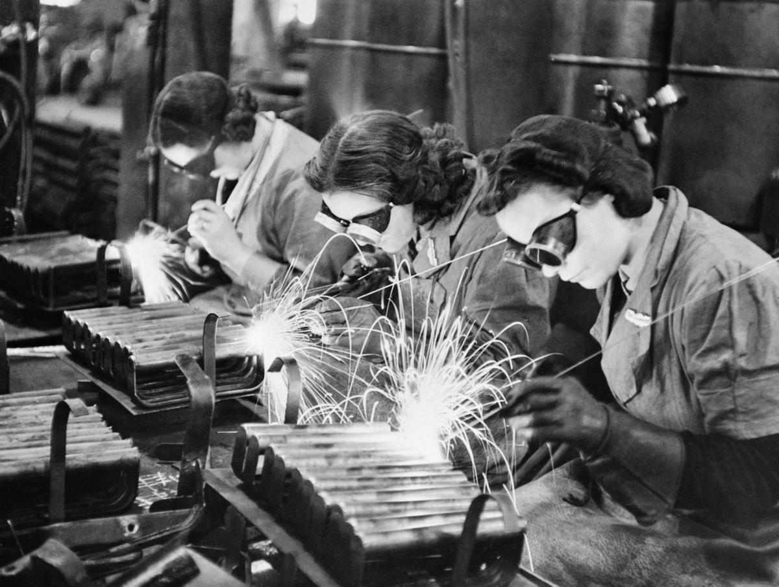
Women wore workers/ration books etc

Slide 4
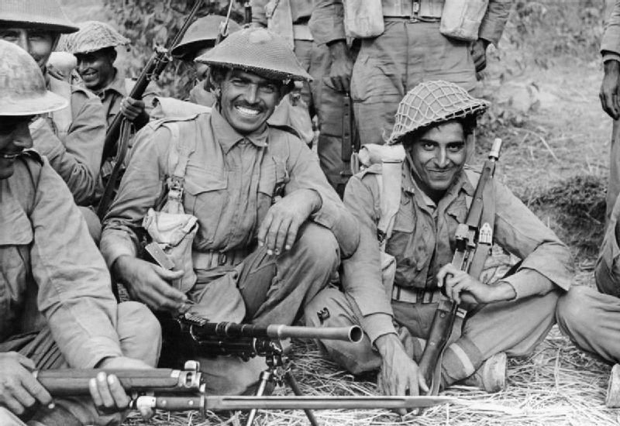
Indian soldiers

Slide 5
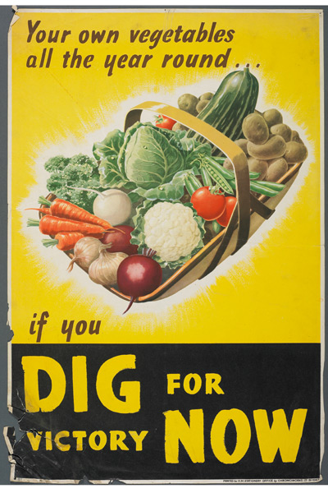
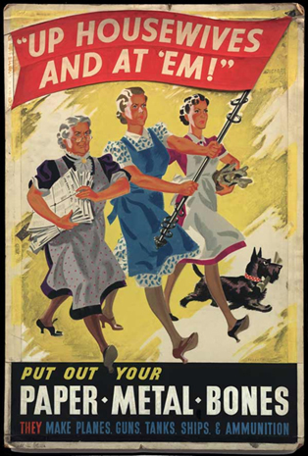

Slide 6
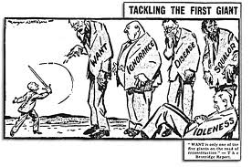
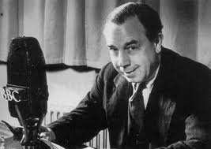
‘I will tell you what we did for [servicemen] and their young wives at the end of the last war. We did nothing …’ (J.B. Priestley, ‘Postscript’, 28 July 1940)

Slide 7
