Slide 1
Adam smith – the invention of economics?
Dr Imogen Peck
University of Warwick

Slide 2
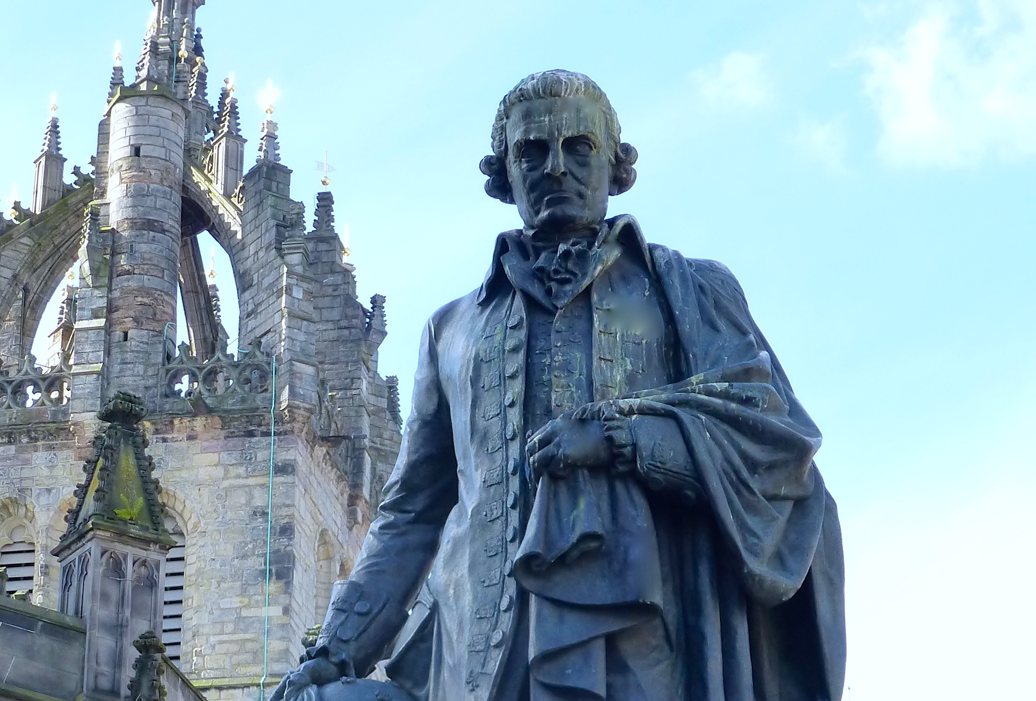
Adam Smith (1723-1790)
Theory of Moral Sentiments (1759)
Wealth of Nations (1776)
Book I: Of the Causes of Improvement in the Productive Powers of Labour
Book II: Of the Nature, Accumulation, and Employment of Stock
Book III: Of the different Progress of Opulence in different Nations
Book IV: Of System of Political Economy
Book V: Of the Revenue of the Sovereign or Commonwealth

Slide 3
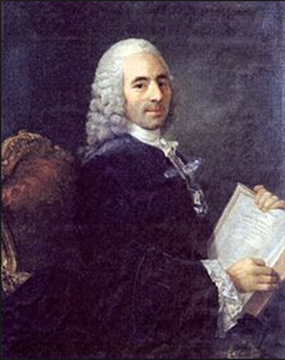
Francois Quesnay (1694-1774)
French economist and physiocrat.
Believed that the power of an economy derived from its agricultural sector.
Wanted Louis XV to deregulate agriculture and remove taxes, and to introduce ‘Laissez-faire’.
Attacked ‘mercantilism – advanced by Louis XV’s finance minister Jean Baptiste Colbert – which involved protectionism re: foreign trade, and tax farming.

Slide 4
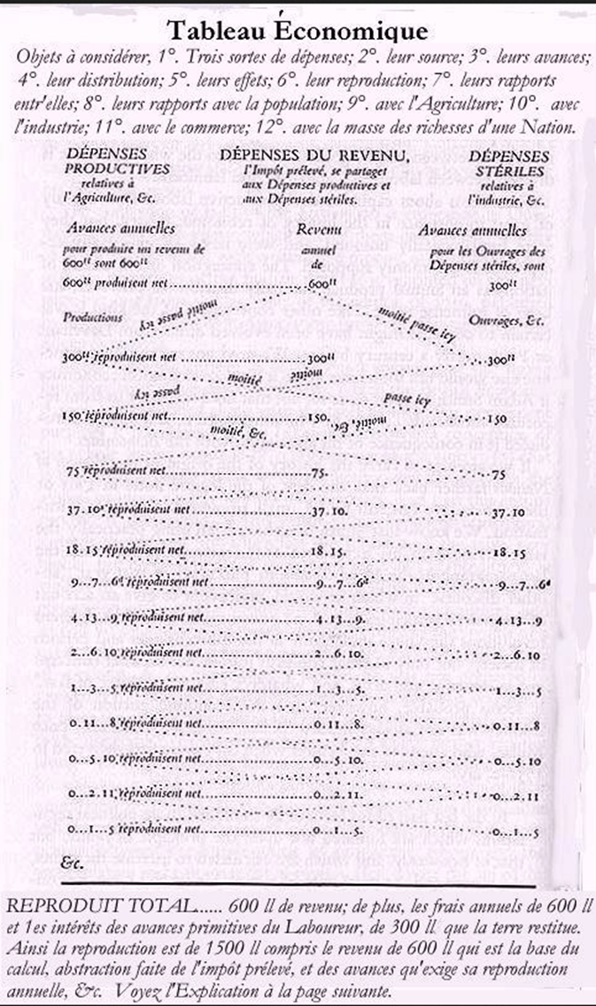
QUESNAY’S TABLEAU ECONOMIQUE
Sums up the way that Quesnay perceives the relationships between the different economic classes and sectors, producing a theory of economic equilibrium.
Begins to recognise a role of capital – i.e. a stock of wealth that you accumulate in advance of production.

Slide 5
Natural law AND THE SCIENCE OF THE LEGISLATOR
Wealth of Nations begins life as part of Smith’s lectures on jurisprudence, dealing with ‘police, revenue and arms’.
Economist tend to ignore this side of Smith - the unpublished, and destroyed notes on, ‘theory of history of law and government’ which drew heavily on natural jurisprudence – or natural law theory.
Science of legislator sits oddly with laissez-faire.
Responsibilities:
- To minimize injury
- Avoid favour
- To remove institutions and policies that hinder the public interest
- Dismantle unjust laws and institutions
- These are a central topic of Book V esp ch 1 (to read for the class)

Slide 6
PRODUCTIVITY
Productivity: the proportion between what is produced and the number who need to consume it.
Determinants of productivity: skill, energy, dexterity, with which labour is being applied, and the extent and the proportion of the population that is engaged in productive labour.
Distinction between productive and unproductive labour.

Slide 7
THE DIVISION OF LABOUR
Division of labour is the source of the greatest increase in the productive power of labour
Specialization of occupation and labour
Division of labour increases dexterity, reduces time wasting and is assisted by introduction of machines (but has an impact on the labourer)
‘
‘It is the necessary, though very slow and gradual consequence of a certain propensity in human nature which has in view no such extensive utility; the propensity to truck, barter , and exchange one thing for another’ I, ii
‘It is not from the benevolence of the butcher, the brewer, or the baker, that we expect our dinner, but from their regard for their self interest’. I.ii

Slide 8
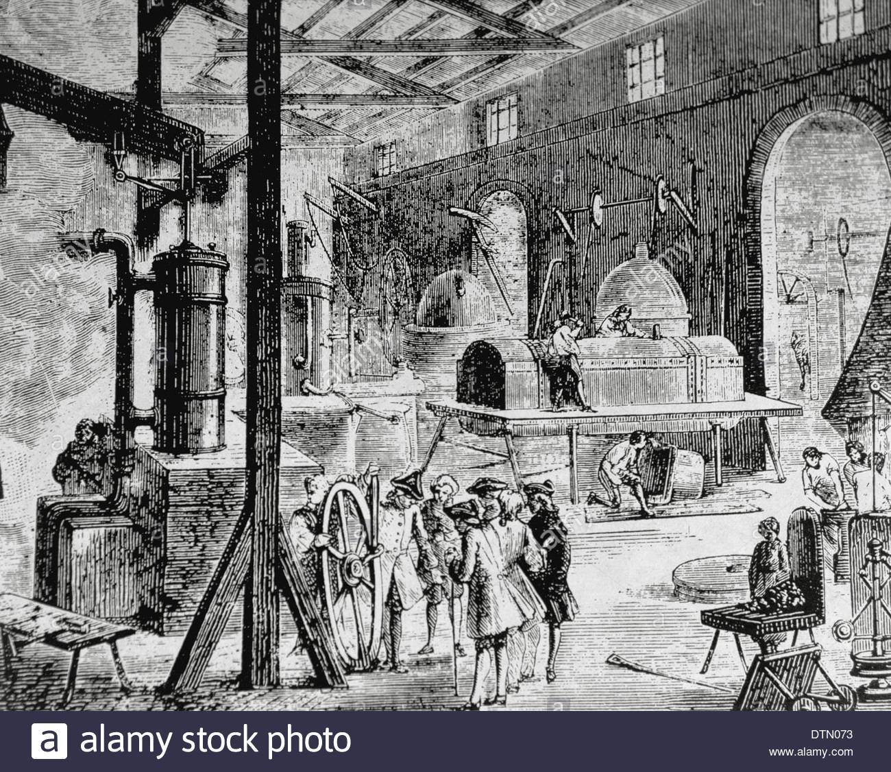
CONSEQUENCES OF DIVISION OF LABOUR
Division of labour is limited by the market: small markets do not allow much specialisation, large towns can.
Growing division = individuals capacity to satisfy all their own needs diminishes.
Invention of money = exchanges become more large scale.

Slide 9
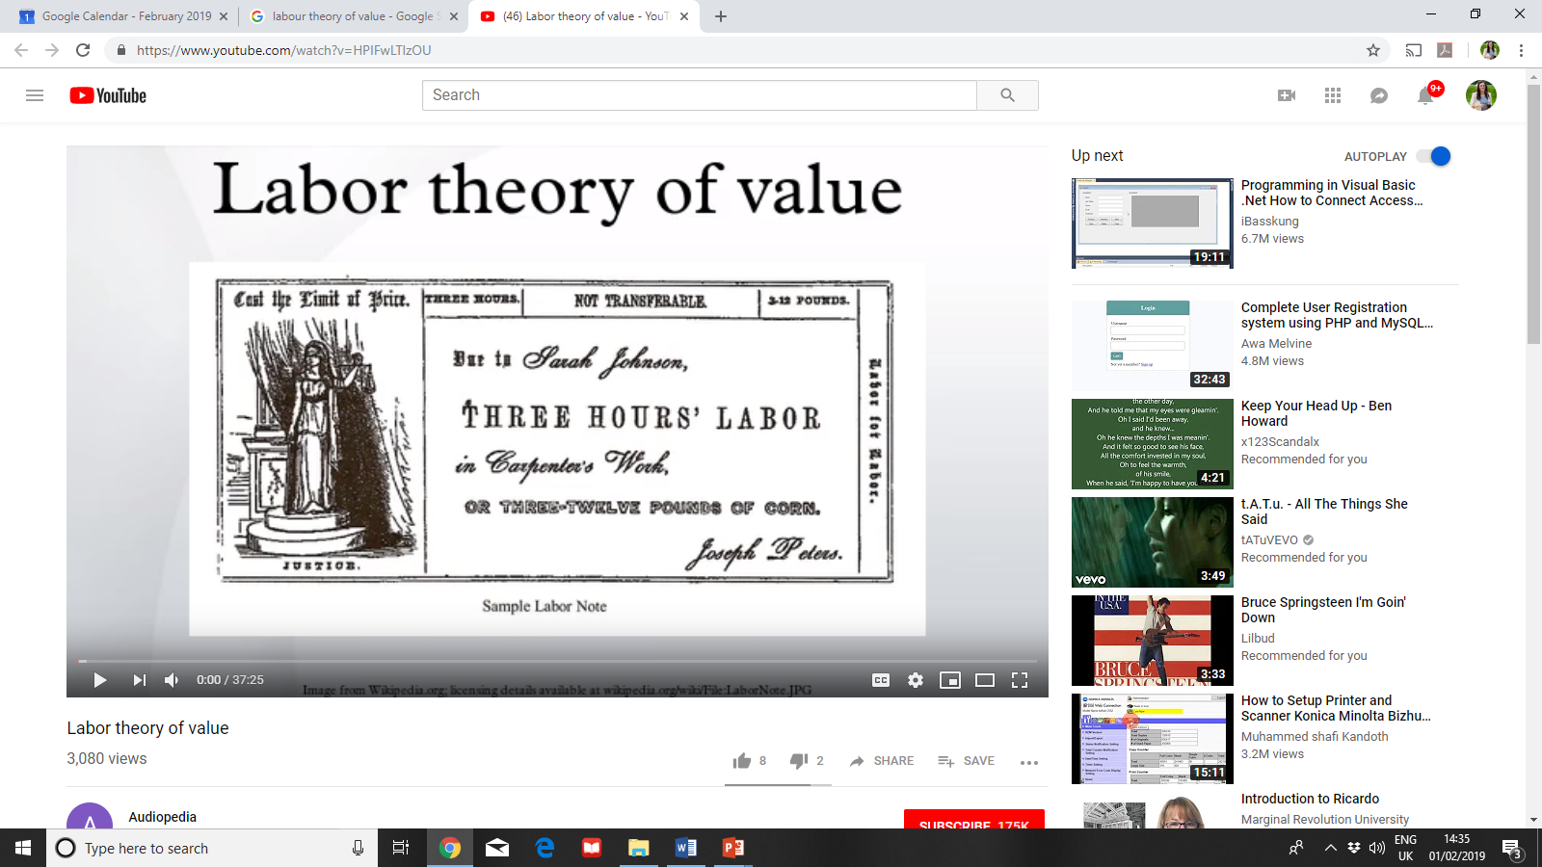
LABOUR THEORY OF VALUE
i.e. the value of any commodity tends to oscillate around the amount of labour time embodied in it.
‘the value of any commodity…to the person who means to exchange it for other commodities is equal to the quantity of labour which it enables him to purchase or command’. (I.v.1)
‘ The real price of everything …is the toil and trouble of acquiring it’.

Slide 10
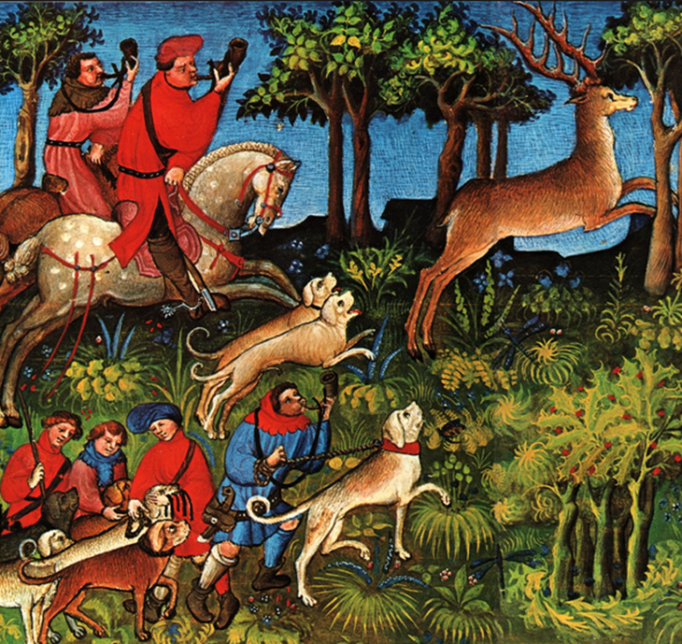
From hunting to industry
Where only labour is involved, goods exchange at their labour time value.
In more complex systems the real value of a commodity is a factor of the labour, stock and rent and as it is more manufactured, the proportion allocated to rent falls, and the profit owed to stock or capital increases.
And the proportion owing to labour falls in respect of the proportion owing to capital.
Capital/stock is Smith’s distinctive emphasis.

Slide 11
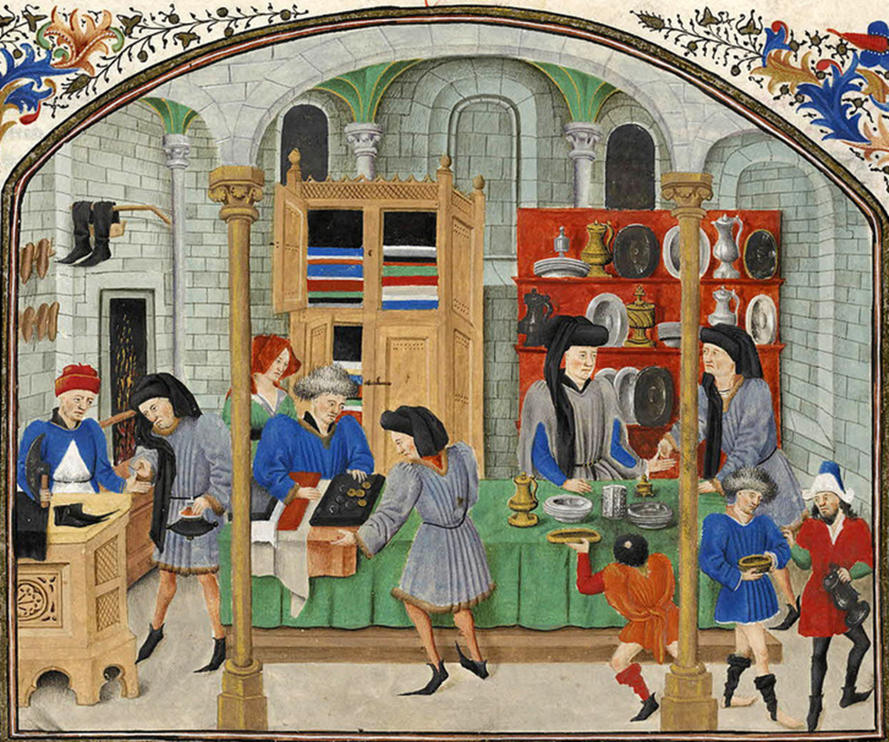
NATURAL PRICE VS MARKET PRICE
Natural price - what is sufficient to pay rent, labour and profit on stock
Market price - oscillates round this, depending on quantity of supply and demand.
The temporary fluctuations of price affect chiefly wages and profits.

Slide 12
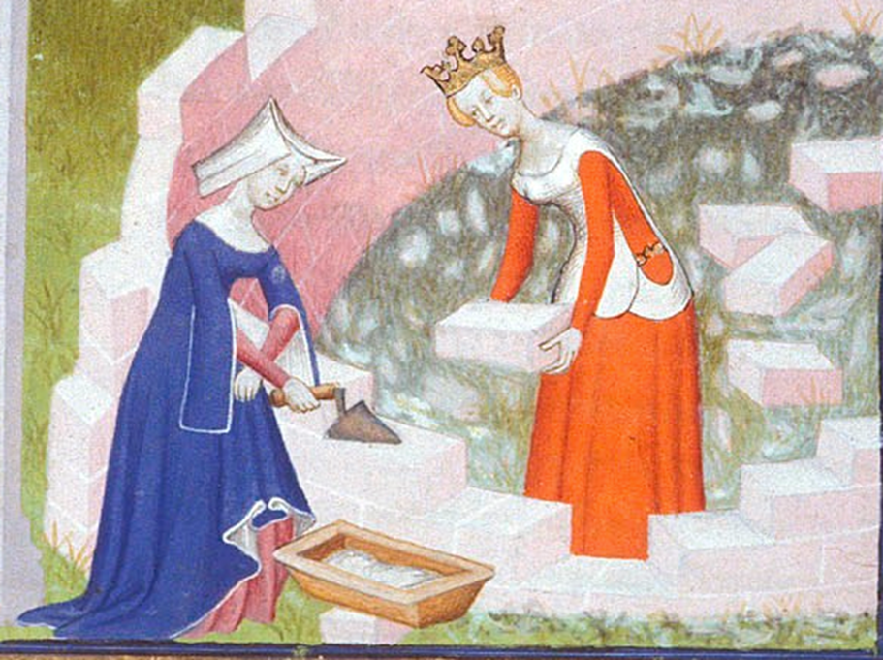
WAGES
Where the only factor is labour (no rent or stock) then wages would increase with productivity
Owners of land and stock are at an advantage in negotiating with labour:
- Fewer numbers, easy to combine
- No legislation against combination
- Each needs the other, but the worker’s need is more immediate
But: there is certain rate below which it seems impossible to reduce wages.

Slide 13

Factors influencing wages
Variability with ease/difficulty; cleanliness/dirtiness; honourableness/dishonourableness
Ease or cheapness of learning the trade
Constancy or inconstancy of employment
Degree of trust reposed in worker
Probability of success

Slide 14
ECONOMY MAKETH THE MAN…
Recognition of the impact of society on the formation of individuals and their aspirations.
Economic location frames a person’s experience and sense of self
‘where, as in Holland, there is a low rate of return on stock, each has to manage their own stock and engage in their own business It is there unfashionable not to be a man of business. Necessity makes it usual for almost every man to be so, and custom everywhere regulates fashion’. (I, ix)

Slide 15
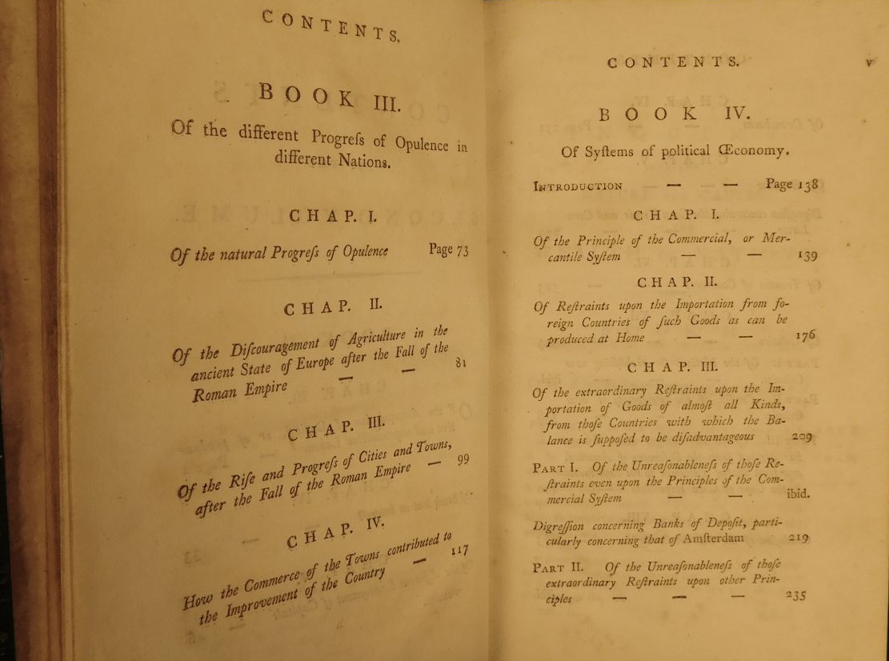
BOOK III: Of the Different Progress of Opulence in different Nations
A historical account of the rise of commercial societies.
‘The great commerce of every society is that carried on between the inhabitants of the town and those of the country’.

Slide 16
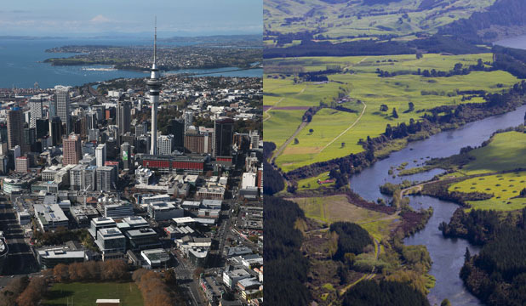
TOWN AND COUNTRY
Country
They purchase manufactured goods with less labour than they would employ in creating them.
Cultivation and improvement of country precedes that of the town.
Natural preference to invest in land and cultivation.
Dependent on artifice to effect their cultivation, smiths, carpenters, wheel-wrights, plough-wrights, masons, tanners, etc.
Town
Affords a market for surplus produce of country.
Depends on surplus of country – but subject to some variation.
Higher security from investment local manufacture, rather than foreign trade.
So agriculture-manufactures, commerce is the natural order.

Slide 17
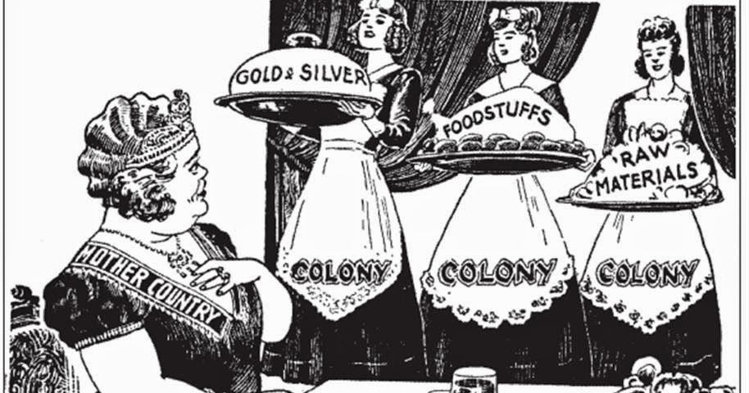
Book iv: of system of political economy
Critique of mercantilism
i.e. belief that domestic state gets wealthy by setting up protectionist barriers against other states and using its colonies to produce large amounts of goods that it can then incorporate into its domestic economy.

Slide 18
CLOSING REMARKS…
Micro and macro explanation
Modelling
Natural Jurisprudence

