Slide 1
Self-narration and silence by the ‘othered’
Dr Imogen Peck
University of Warwick

Slide 2
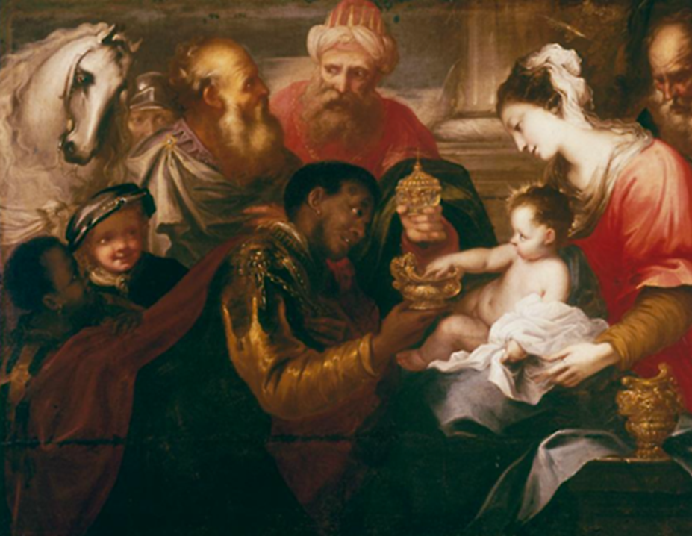
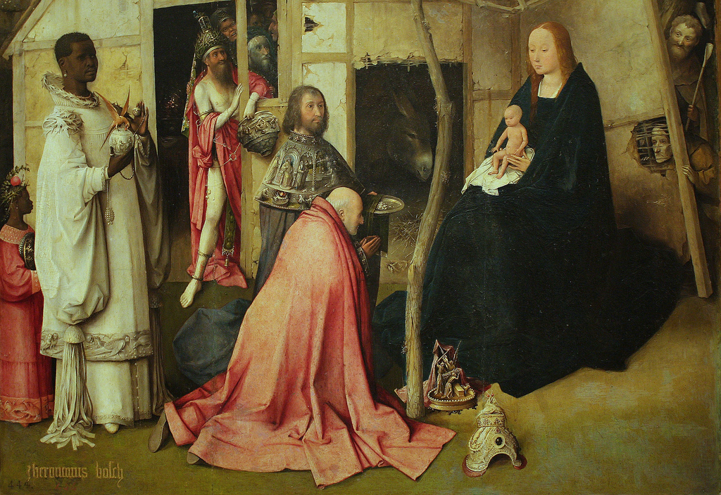
presence and absence in early modernity

Slide 3
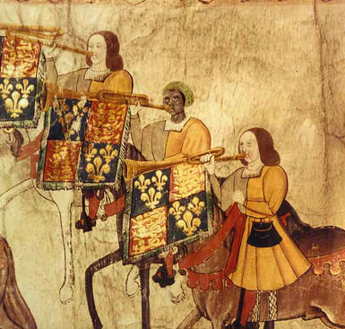
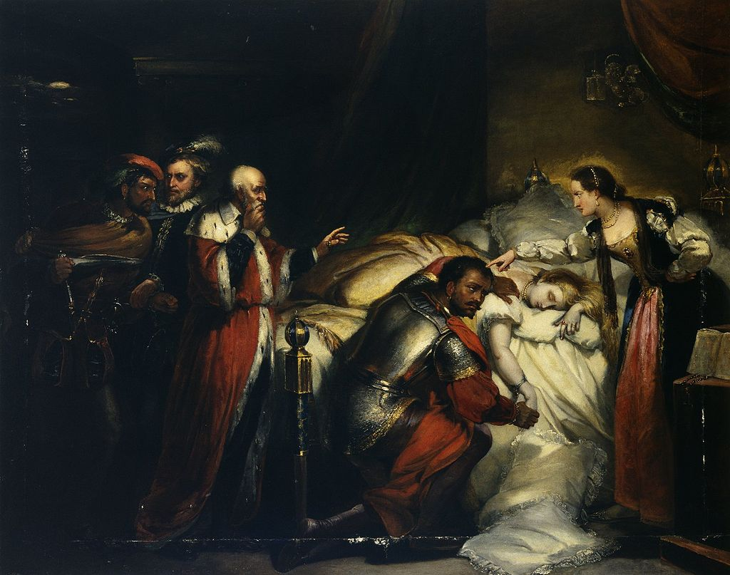
Black tudors
Westminster Tournament Roll (1511)
William Salter, ‘Othello weeping over Desdemona’ (1857)

Slide 4
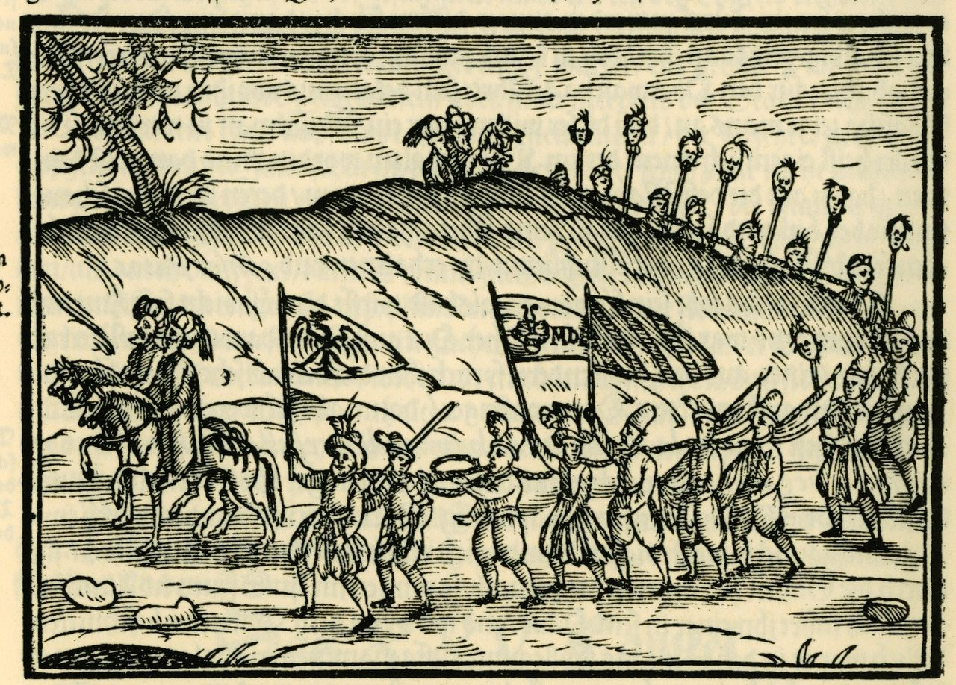
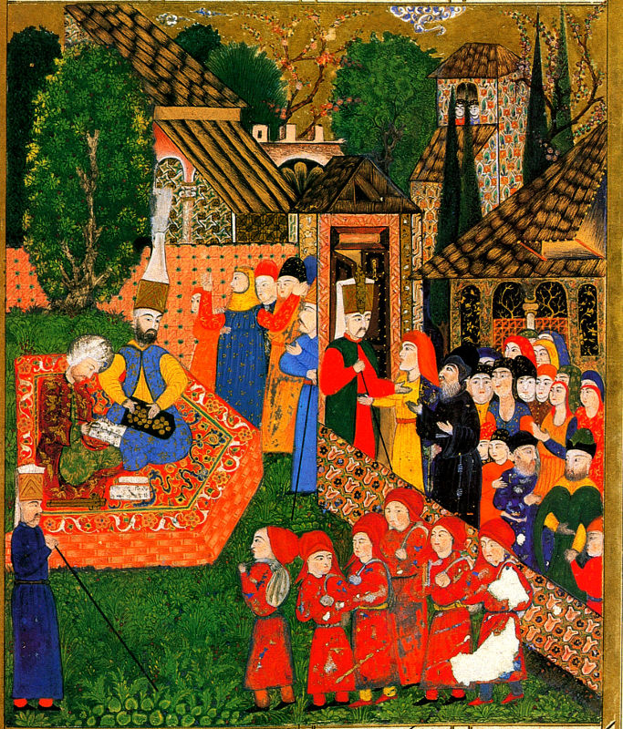
Varieties of slavery
Ottomans with Christian slaves depicted in an engraving (1608)
Ottoman painting of Balkan children taken as soldier slaves (1558)

Slide 5
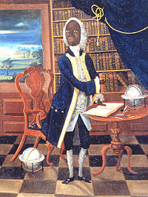
FRANCIS WILLIAMS
Know well, man dear to Mars, that this is not my rightful task. Minerva denies an African to celebrate the wars of military leaders. Were Buchanan to sing of you, in the assembly and in arms, he would write in his poem that you are equal to Achilles. That poet, the glory of his homeland, is more worthy to recount your deeds, and scarcely less accomplished than the sublime Virgil. We live under a sun that drives its own flame-bearing team. All eloquence is lacking in our hearts.
Francis Williams, Ode to George Haldane (1756)
Unknown artist, Portrait of Francis Williams (c. 1745)

Slide 6
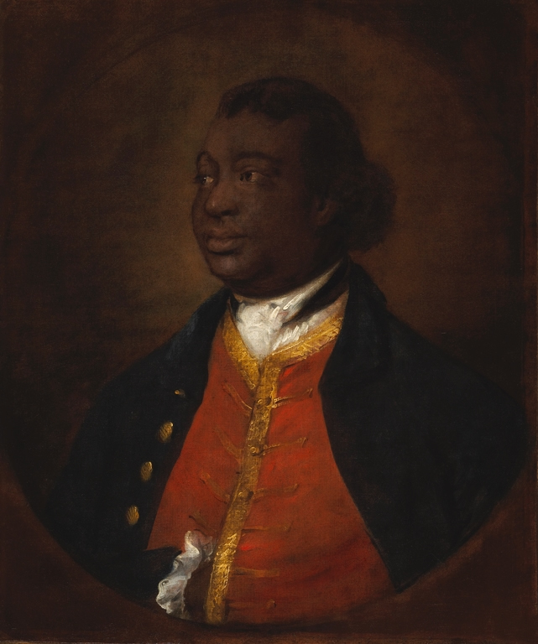
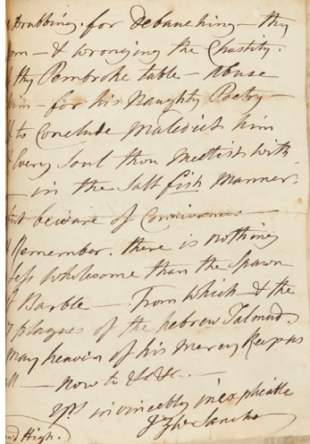
Ignatius sancho
A letter in Sancho’s hand
Thomas Gainsborough, ‘Portrait of Ignatius Sancho’ (1768)

Slide 7
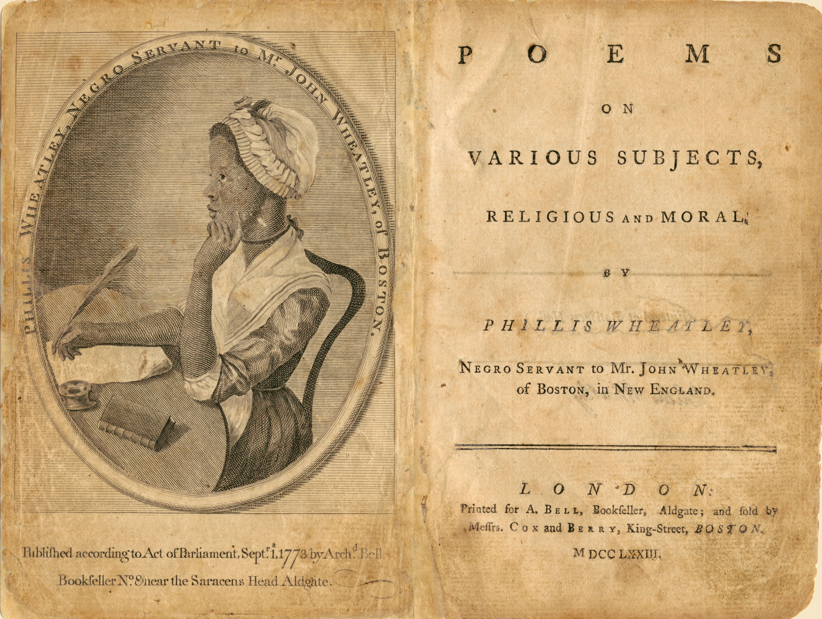
Phillis wheatley

Slide 8
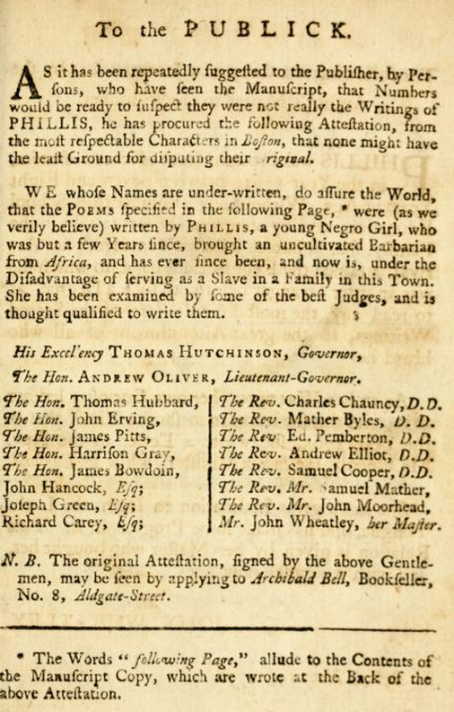
Authenticity and agency: the wheatley front material
‘As it has been repeatedly suggested to the Publisher, by Persons, who have seen the Manuscript, that Number would be ready to suspect that they were not really the Writings of PHILLIS, he has procured the following Attestation…
We whose Names are under-written, so assure the World, that the POEMS specified in the following page, were (as we verily believed) written by Phillis, a young Negro girl, who was but a few Years since, brought an uncultivated Barbarian from Africa…’

Slide 9
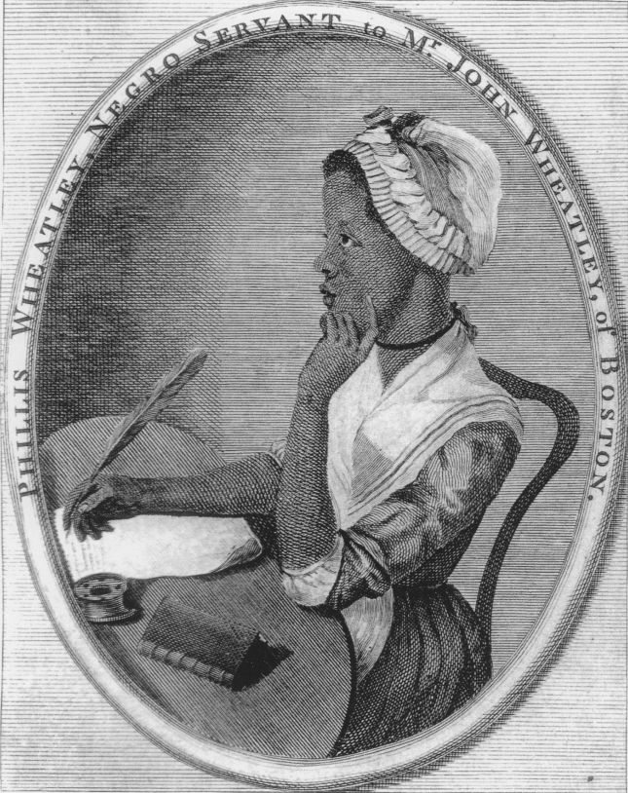
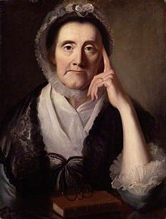
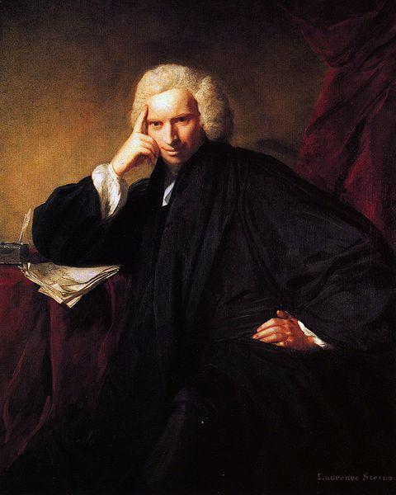
Phillis Wheatley (frontispiece)
Unknown artists, Portrait of Selina Hastings’ (c. 18thc)
Joshua Reynolds, ‘Portrait of Laurence Sterne’ (1760)

Slide 10
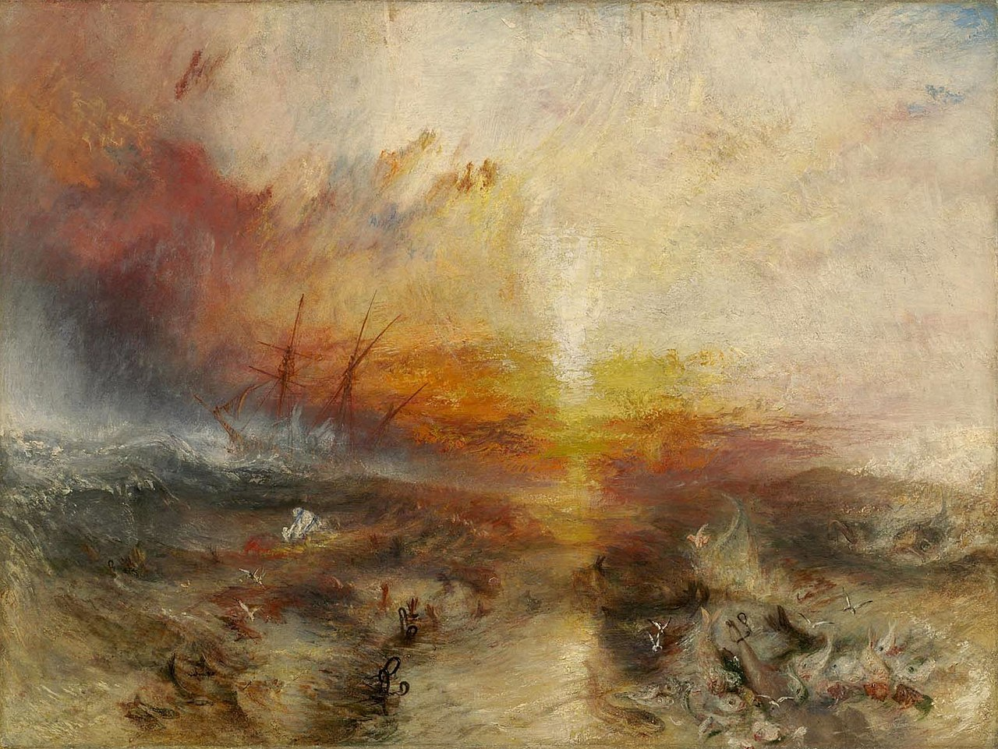
The Legal position of slaves
Somerset vs Stewart (1772)
Zong Case (1781)
The Slavery Abolition Act (1833)
https://www.ucl.ac.uk/lbs/project/

Slide 11
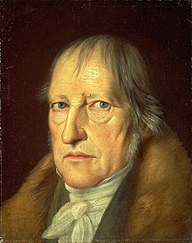
Hegel and The master/slave dialectic
Master (A) dominates the slave (B)
B recognises A, A does not have to recognise B
B has no recognition. But he contributes to the self-recognition of A.
But A’s self-recognition through the other is an illusion: he is dependent on B for material things; and becomes dependent on B’s recognition.
For B, it is his domination that leads to his own self-consciousness, which makes possible the transition to universal self-consciousness – the beginning of true human freedom.
Jakob Schlesinger, ‘Portrait of Hegel’ (1831)

Slide 12
How to write a ‘slave narrative’
The Plan:
A. An engraved portrait, signed by the narrator.
B. A title page that includes the claim, as an integral part of the title, "Written by Himself" (or some close variant: "Written from a statement of Facts Made by Himself; or "Written by a Friend, as Related to Him by Brother Jones"; etc.).
C. A handful of testimonials and/or one or more prefaces or introductions written either by a white abolitionist friend of the narrator or by a white amanuensis/editor/author actually responsible for the text, in the course of which preface the reader is told that the narrative is a "plain, unvarnished tale“ and that naught "has been set down in malice, nothing exaggerated, nothing drawn from the imagination"—indeed, the tale, it is claimed, understates the horrors of slavery.
D. A poetic epigraph, by preference from William Cowper.
E. The actual narrative
F. An appendix or appendices composed of documentary material bills of sale, details of purchase from slavery, newspaper items…
From James Olney, ch in Davis and Gates (eds.), The Slave’s Narrative (1985)

Slide 13
The Narrative:
1. a first sentence beginning, "I was born . . . ," then specifying a place but not a date of birth;
2. a sketchy account of parentage, often involving a white father;
3. description of a cruel master, mistress, or overseer, details of first observed whipping and numerous subsequent whippings, with women very frequently the victims;
4. an account of one extraordinarily strong, hardworking slave often "pure African"—who, because there is no reason for it, refuses to be whipped;
5. record of the barriers raised against slave literacy and the overwhelming difficulties encountered in learning to read and write;
6. description of a "Christian" slaveholder (often of one such dying in terror) and the accompanying claim that "Christian" slaveholders are invariably worse than those professing no religion;
7. description of the amounts and kinds of food and clothing given to slaves, the work required of them, the pattern of a day
8. account of a slave auction, of families being separated and destroyed, of distraught mothers clinging to their children…
9. description of patrols, of failed attempt(s) to escape, of pursuit by men and dogs;
10. description of successful attempt(s) to escape
11. taking of a new last name (frequently one suggested by a white abolitionist) to accord with new social identity as a free man, but retention of first name as a mark of continuity of individual identity;
12. reflections on slavery.

Slide 14
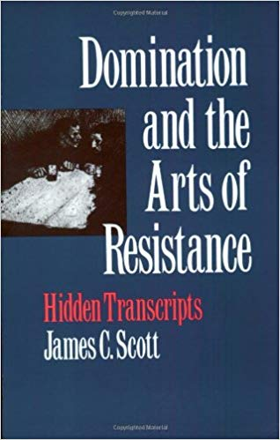
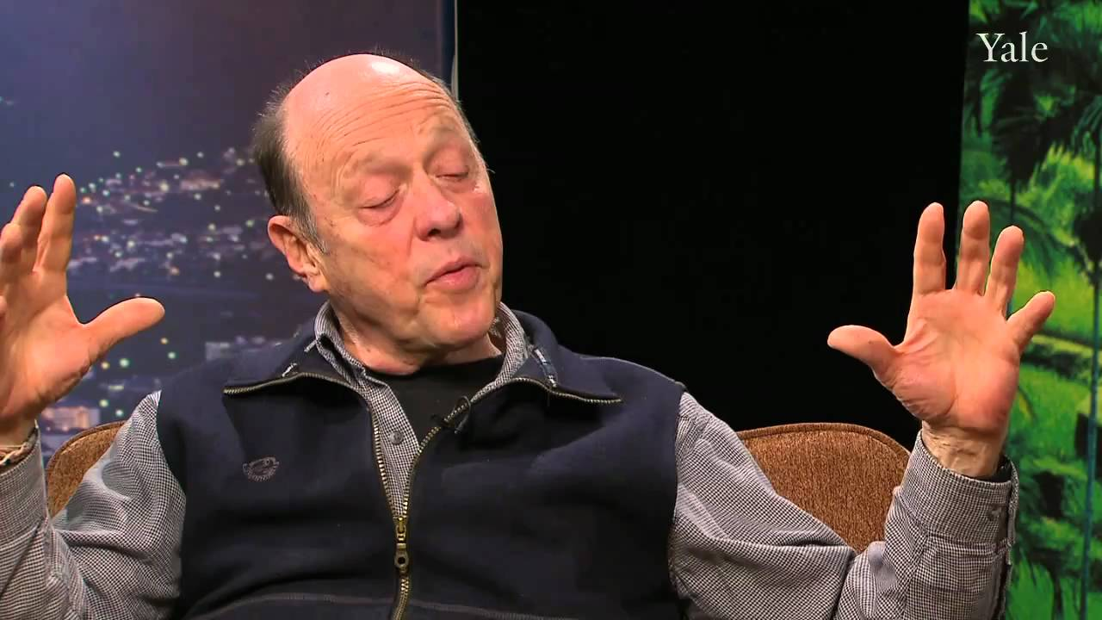
James C. Scott: Dominant and Hidden transcripts

Slide 15
Secondary bibliography
Astrid Franke, ‘Phillis Wheatley, Melancholy Muse’, The New England Quarterly 77.2 (2004), 224-251
James Olney, 'I Was Born': Slave Narratives, Their Status as Autobiography and as Literature’, in The Slave’s Narrative, (eds.) Davis and Gates (1985)
Vincent Carretta, ‘Who was Francis Williams?’, Early American Literature, 38.2 (2003), 213-237
Miranda Kaufmann, Black Tudors (2017)
James C. Scott, Domination and the Arts of Resistance (1990)

