Slide 1
Order and change
Dr Imogen Peck
University of Warwick

Slide 2
Lecture structure
Edmund Burke, Reflections on the Revolution in France (1790)
Critique and Rhetoric
Responses and Reaction
Subsequent influence
‘The Spirit of the Age’
IV. Hazlitt
V. J. S. Mill

Slide 3
I. CRITIQUE AND RHETORIC

Slide 4
1688 and all that
Richard Price, Discourse on the Love of our Country (1789)
Drew parallels between the revolutions of 1688 and 1789
3 key principles of 1688:
‘First; The right to liberty of conscience in religious matters.
Secondly; The right to resist power when abused.
And, Thirdly; The right to choose our own governors; to cashier them for misconduct; and to frame a government for ourselves’.

Slide 5
Burke on 1688 and 1789
Glorious Revolution an adjustment, and not an overthrow, of the English constitution.
English did not have the right to ‘choose our own governors; to cashier them for misconduct’; rather, they owed their allegiance to William and Mary, and their successors.
Virtues of the English constitution:
concern for continuity;
respect for traditional wisdom and usage;
acceptance of a hierarchy of rank and property;
role for honour and religion;
recognition of the imperfection of human contrivances.

Slide 6
THE limits OF REASON
‘Wisdom cannot create materials; they are the gifts of nature or of chance’.
‘Time is required to produce that union of minds which alone can produce all the good we aim at’.
‘That sort of reason which banishes the affections is incapable of filling their place’.

Slide 7
The rhetoric of reflections
‘Never, never more, shall we behold that generous loyalty to rank and sex, that proud submission, that dignified obedience, that subordination of the heart, which kept alive, even in servitude itself, the spirit of an exalted freedom. The unbought grace of life, the cheap defence of nations, the nurse of manly sentiment and heroic enterprize, is gone! It is gone, that sensibility of principle, that chastity of honour, which felt a stain like a wound, which inspired courage whilst it mitigated ferocity, which ennobled whatever it touched, and under which vice itself lost half its evil, by losing all its grossness’.

Slide 8
ii. response AND REACTION

Slide 9
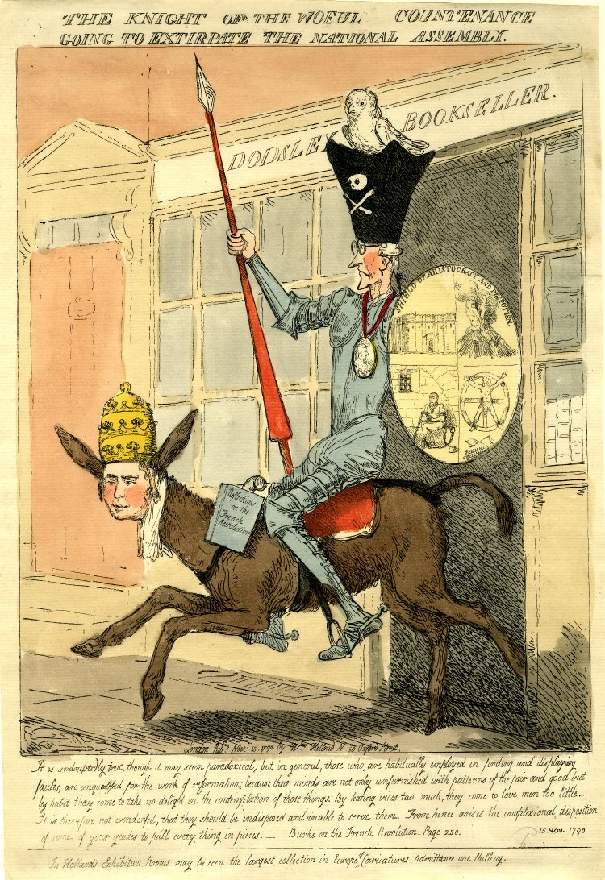
Caption (from Reflections): ‘It is undoubtedly true, though it may seem paradoxical; but in general, those who are habitually employed in finding and displaying faults, are unqualified for the work of reformation; because their minds are not only unfurnished with patterns of the fair and the good, but by habit they come to take no delight in the contemplation of those things. By hating vices too much, they come to love men too little. It is therefore not wonderful, that they should be indisposed and unable to serve them. From hence arises the complexional disposition of some of your guides to pull everything to pieces.’
‘The Knight of the Woful Countenance Going to Extirpate the National Assembly’ (1790)

Slide 10
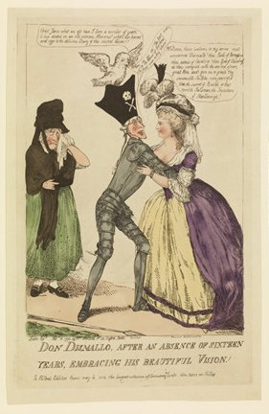
Christ, Jasus, what an ass I have been a number of years; to have doted on an old woman – Heavens ! What’s her bacon and eggs to the delicious Dairy of this celestial Vision
Welcome, thrice welcome to my arms, most renowned Dismalo, thou pink of Parnasus, thou Adonis of cavaliers! Thou God of Chivalry, do thou vanquish with the sacred spear, great Hero and give me to grasp thy invincible shillelee, more powerful than the sword of Rinaldo, or that terrible Talisman the Truncheon of Marlborogh
‘Don Dismallo, After an Absence of Sixteen Years, Embracing his Beautiful Vision’ (1790)

Slide 11
On Marie Antoinette
‘It is now sixteen or seventeen years since I saw the queen of France, then the dauphiness, at Versailles; and surely never lighted on this orb, which she hardly seemed to touch, a more delightful vision. I saw her just above the horizon, decorating and cheering the elevated sphere she just began to move in; glittering like the morning star, full of life, and splendor, and joy. Oh! what a revolution! and what an heart must I have, to contemplate without emotion that elevation and that fall! Little did I dream when she added titles of veneration to those of enthusiastic, distant, respectful love, that she should ever be obliged to carry the sharp antidote against disgrace concealed in that bosom; little did I dream that I should have lived to see such disasters fallen upon her in a nation of gallant men, in a nation of men of honour and of cavaliers. I thought ten thousand swords must have leaped from their scabbards to avenge even a look that threatened her with insult. But the age of chivalry is gone. That of sophisters, oeconomists, and calculators, has succeeded; and the glory of Europe is extinguished for ever’.

Slide 12
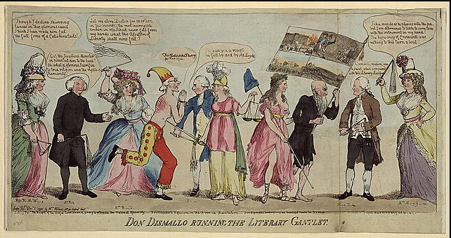
H M Williams; R Price; A L Barbauld; BURKE; Sheridan; BRITANNIA; GALLICA; Bastille prisoner; H Tooke; C Macaulay

Slide 13
‘Smelling out a rat; or the atheistical-revolutionist disturbed in his midnight "calculations” (1790)

Slide 14
Burke in caricature
Don Quixote
Tilting at Windmills
The Age of Chivalry is dead!
Enthusiasm
Apostacy

Slide 15
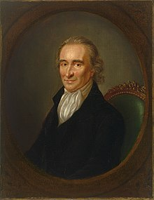
Paine’s response to reflections
‘As to the tragic paintings by which Mr Burke has outraged his own imagination […] He is not affected by the reality of distress touching his heart, but by the showy resemblance of it striking his imagination. He pities the plumage but forgets the dying bird. Accustomed to kiss the aristocratical hand that has purloined him from himself, he degenerates into a composition of art, and the genuine soul of nature forsakes him.’
Paine, Rights of Man (1791)

Slide 16
Iii. Subsequent influence
Very important in shaping a more complex view of society and government; and their connections
Forerunner to 19thc ‘conservatism’
Central to 1780s whiggism
Impact on radicals – e.g. Godwin

Slide 17
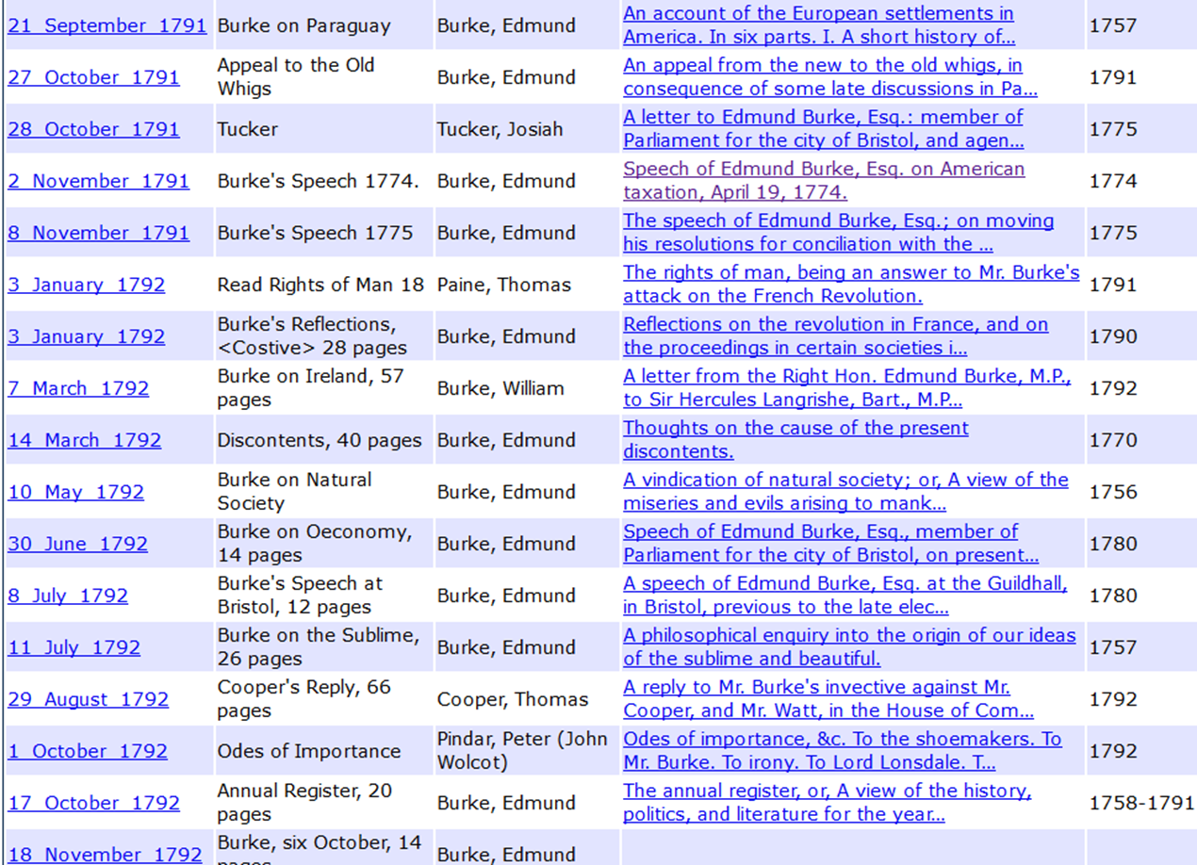

Slide 18
iv. William Hazlitt, spirit of the age (1825)
JEREMY BENTHAM
WILLIAM GODWIN
MR. COLERIDGE
REV. MR. IRVING
THE LATE MR. HORNE TOOKE
SIR WALTER SCOTT
LORD BYRON
MR. CAMPBELL—MR. CRABBE
SIR JAMES MACKINTOSH
MR. WORDSWORTH
MR. MALTHUS
MR. GIFFORD
MR. JEFFREY
MR. BROUGHAM—SIR F. BURDETT
LORD ELDON—MR. WILBERFORCE
MR. SOUTHEY
MR. T. MOORE
GEOFFREY CRAYON

Slide 19
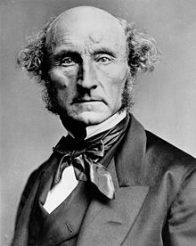
v. JOHN STUART MILL, THE SPIRIT OF THE AGE (1831)
‘The ‘SPIRIT OF THE AGE’ is in some measure a novel expression. I do not believe that it is to be met with in any work exceeding fifty years in antiquity. The idea of comparing one’s own age with former ages , or with our notion of those which are yet to come, had occurred to philosophers; but it never before was the dominant idea of any age. It is an idea essentially belonging to an age of change.’

Slide 20
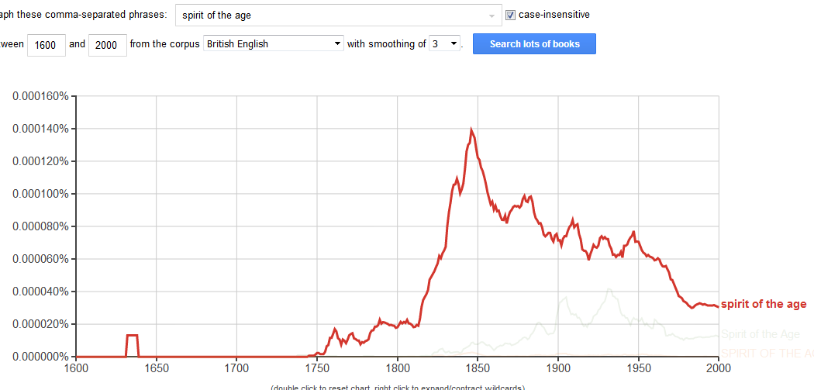

Slide 21
CHARACTERISTICS OF THE SPIRIT
It is an age of transition. Mankind have outgrown old institutions an old doctrines, and have not acquired new ones.
The grand achievement of this age is not a function of the growth of human understanding – but is ‘the diffusion of superficial knowledge’ and the renouncing of many opinions they once held.
No fixed opinions taken place of those abandoned: ‘Men may not reason better, concerning the great questions in which human nature is interested, but they reason more. […] Discussion has penetrated deeper into society; and if no greater numbers have attained he higher degrees of intelligence, fewer grovel in abject stupidity.’

Slide 22
AND ALSO…
‘The wisest men in every age generally surpass in wisdom he wisest of any preceding age […] But the multitude have the ideas of their own age, and no others [...] If they are nearer the truth than the multitude of another age, it is only in so far as they are guided by the wisest’.
Most of mankind take the far greater part of their opinions on all subjects upon the authority of those who have studied them – but they are less likely to in the age of transition.
But where is the authority which commands this confidence , or deserves it? Nowhere in an age of transition.

Slide 23
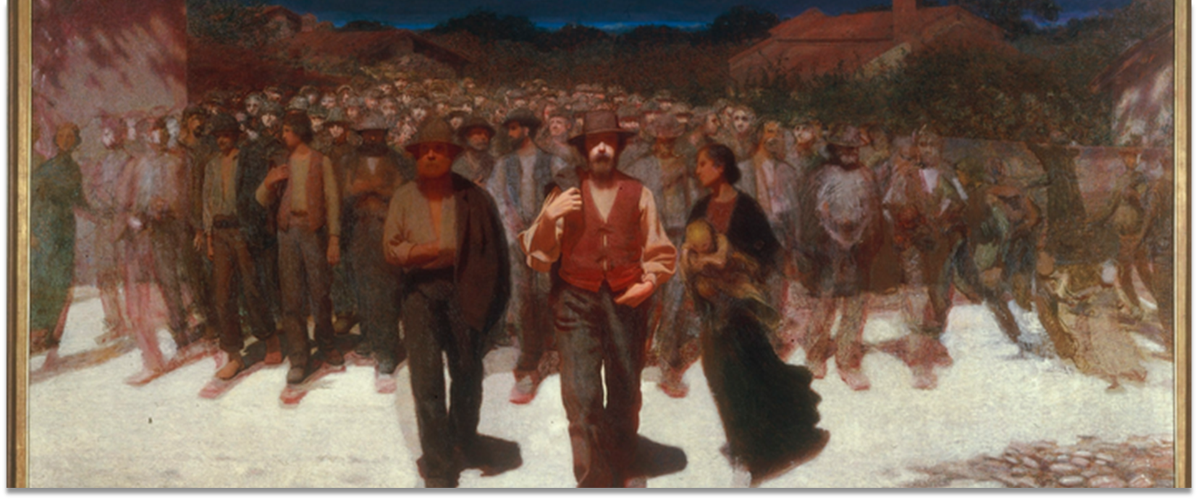
‘Worldly power must pass from the hands of the stationary part of mankind into those of the progressive part. There must be a moral and social revolution, which shall take no men’s lives or property, but which shall leave to no man one fraction of unearned distinction or unearned importance.’

Slide 24
TRANSITIONAL VS NATURAL STATES
Natural States
When worldly power is exercised by the fittest persons that the state of society affords
Transitional States
‘when society contains other persons fitter for world power and moral influence than those who have hitherto enjoyed them’

Slide 25
TRANSITIONAL STATES
Three sources of moral influence:
1. Eminent wisdom and virtue
2. The power of addressing mankind in the name of religion
3. Worldly power
conflict between young and old – the old have fixed principles, but the world has changed to make them less relevant
The young must prevail, though it were only by outliving their antagonists; but the most important of the qualifications or making good use of their success, are still to be acquired by them in the struggle.

Slide 26
Individual, polis, society
From…
Voluntarist account of the political order – contractualism, utilitarianism, institutional design, etc.,
In which the political order is a construct of individual and collective agency
And in which the individual – and his passions, interests and reason - is the originating source of exchange and contracts
To…
Political and social order become historicised and relativized, and in that process the individual becomes epiphenomenal to larger historical processes.
The social becomes more enveloping – rooted in language and culture, and particular history
As does the political order
In the process, the individual becomes caught in causal processes beyond his/her control
How to deal with that?!

