Slide 1
consumption
mp

Slide 2
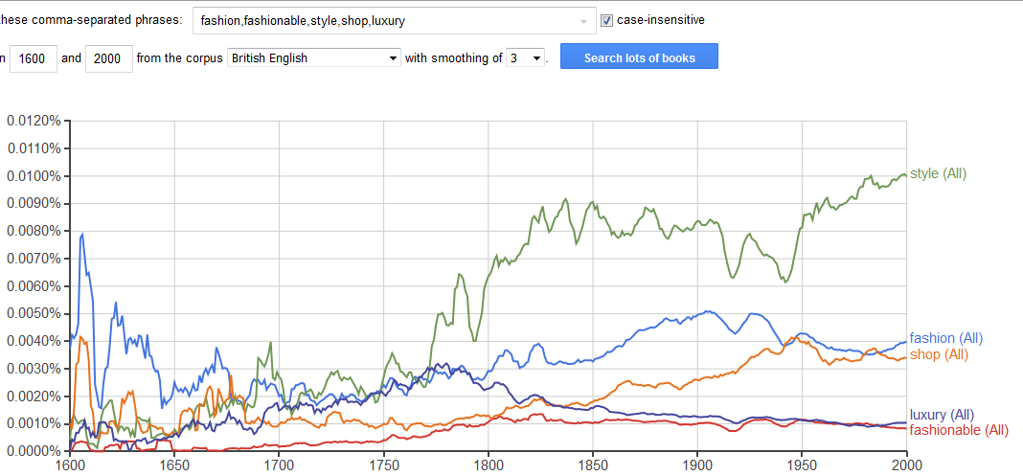

Slide 3
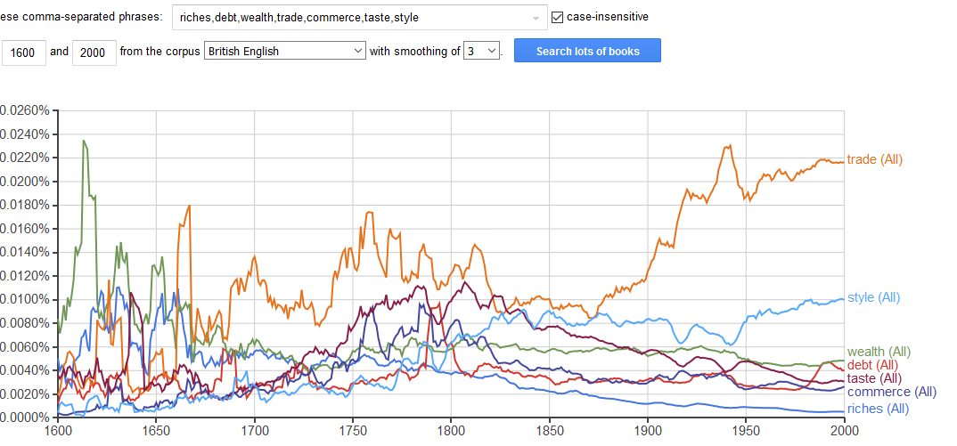

Slide 4
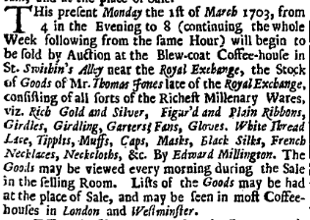
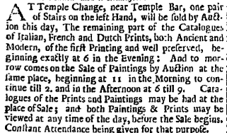
Advertising 1703

Slide 5
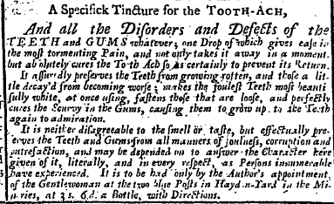
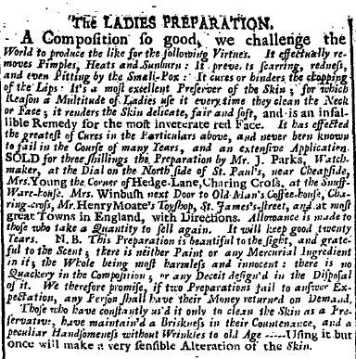
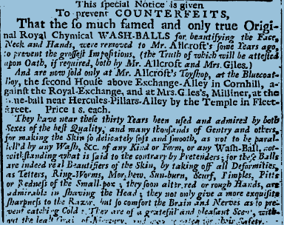
1728

Slide 6
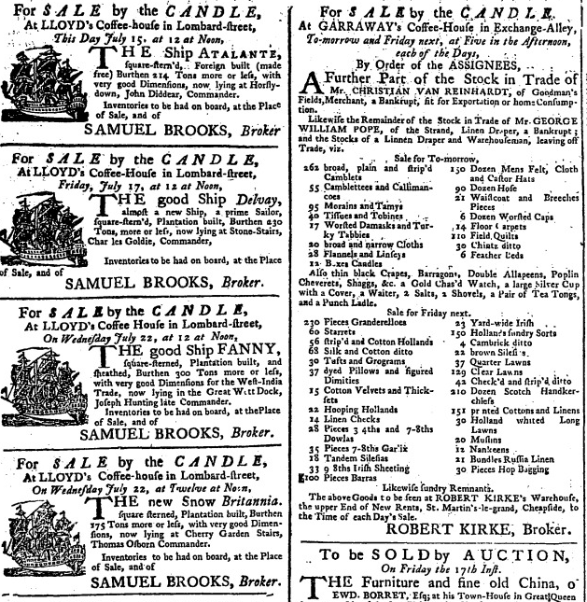
Sale by the candle (1740)
Auction in which the auction ends when the candle expires

Slide 7
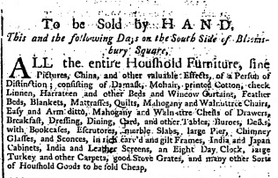
Sale by the hand
1766 W. Blackstone Comm. Laws Eng. II. xxx. 448 Antiently, among all the northern nations, shaking of hands was held necessary to bind the bargain; a custom which we still retain in many verbal contracts. A sale thus made was called handsale, ‘venditio per mutuam manuum complexionem’; till in process of time the same word was used to signify the price or earnest, which was given immediately after the shaking of hands, or instead thereof.

Slide 8
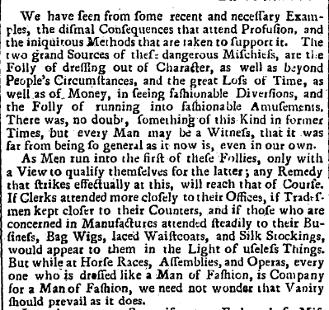
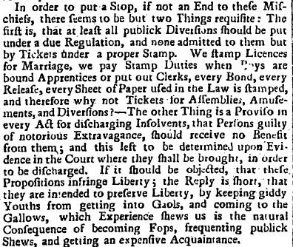
14 November 1761, London Evening Post

Slide 9
Novelty, luxury, utility: what drives consumption?
Novelty – central element to fashion – drive for constant change
M. Berg ‘ the energy behind fashion’s caprice and valorization of ephemerality.’ Stimulates the senses, alleviates the boredom that results from the body being satisfied.
But easier with clothes and knick-knacks than groceries – and there’s the problem of amalgamating the new
Kale!
Luxury – linked to pleasure and/or indulgence, arousal of the senses
Smith’s distinction between luxury that endures; and that which doesn’t – inc. switch from latter to former. But remains associated with elite consumption
New domestic material culture, linked to tea, and goods consumed in social settings (Jan De Vries) vs possets (a hot British drink made of milk curdled with wine or ale, often spiced, which was popular and used as a cold and flu remedy)
But also development of new baselines and standards for living

Slide 10
A Nation of Shopkeepers – or Shoppers
A Smith in WoN;
Napoleon ‘L’Angleterre est une nation de boutiquers.’
1688 King est. 50,000
1757 Postlethwayt est 1,000,000
1759, Massie est. 162,500
(pop’n rose c 20-25%; but also inc shift to towns)
Gradual eclipse of fairs by fixed shop trading – although pedlars survived
Development of the Shop
Site of display, leisure/browsing
Site of rapid cash exchange (resistance to credit)
Specialist town shops/generalist village shops
But also shift in sites of production (esp for groceries)
But had to make oneself known…

Slide 11
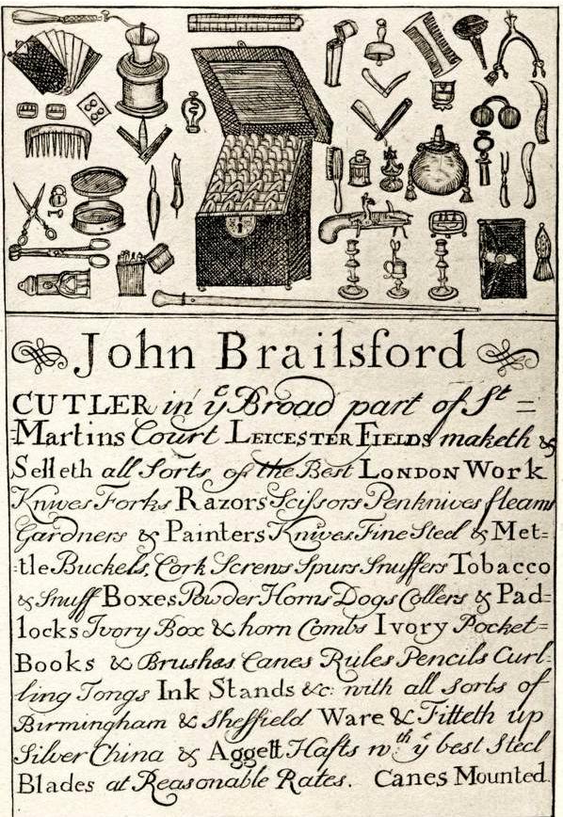
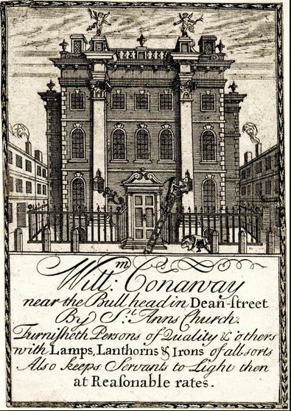
Trade Cards

Slide 12
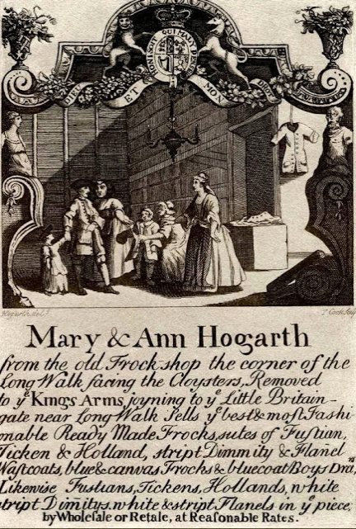
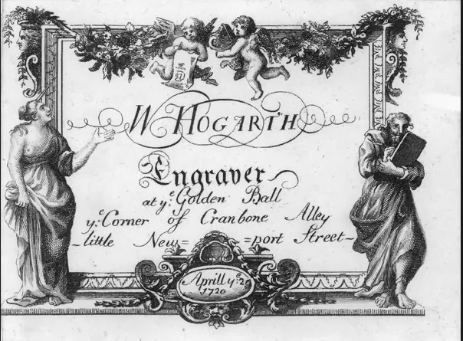
1730
Hogarth’s sisters

Slide 13
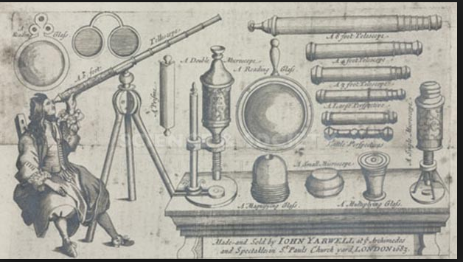

Slide 14
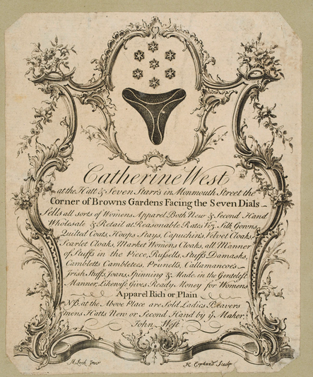

Slide 15
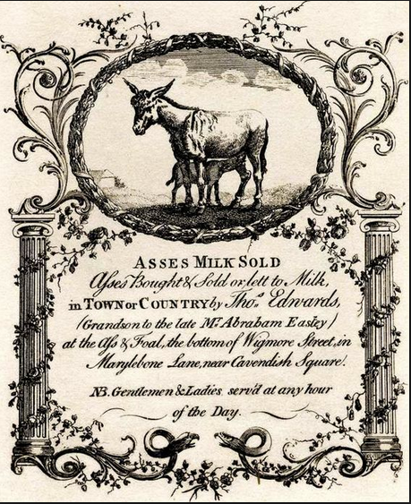

Slide 16
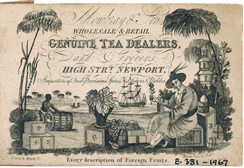
Notes:
1830

Slide 17
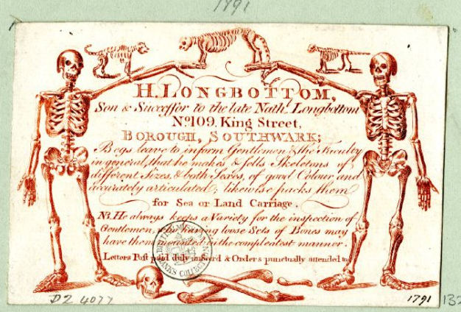

Slide 18
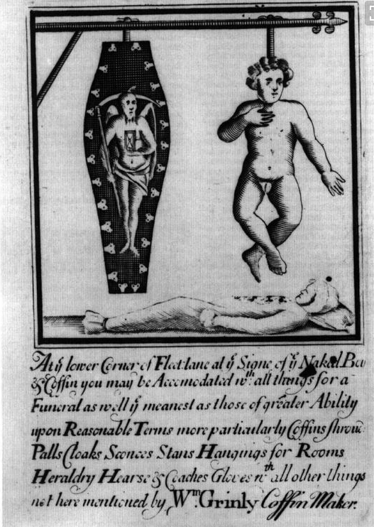

Slide 19
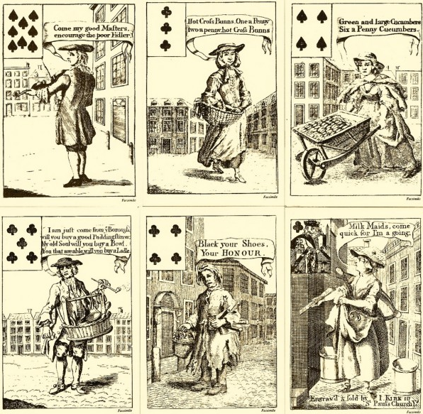

Slide 20
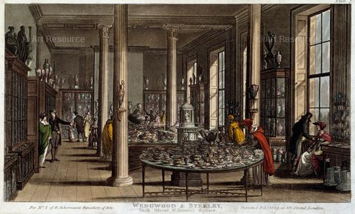

Slide 21
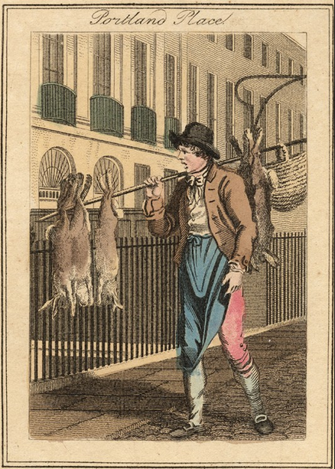
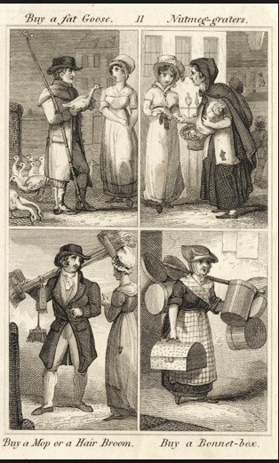

Slide 22
Defoe, The Complete English Tradesman 1726
Pray what would a bookseller make of his business at Billingsgate, or a mercer in Tower Street, or near the Custom-house, or a draper in Thames Street, or about Queen-hithe? Many trades have their peculiar streets, and proper places for the sale of their goods, where people expect to find such shops, and consequently, when they want such goods, they go thither for them; as the booksellers in St Paul's churchyard, about the Exchange, Temple, and the Strand, &c., the mercers on both sides Ludgate, in Round Court, and Grace-church and Lombard Streets; the shoemakers in St Martins le Grand, and Shoemaker Row; the coach-makers in Long-acre, Queen Street, and Bishopsgate; butchers in Eastcheap; and such like.
For a tradesman to open his shop in a place unresorted to, or in a place where his trade is not agreeable, and where it is not expected, it is no wonder if he has no trade. What retail trade would a milliner have among the fishmongers' shops on Fishstreet-hill, or a toyman about Queen-hithe? When a shop is ill chosen, the tradesman starves; he is out of the way, and business will not follow him that runs away from it: suppose a ship-chandler should set up in Holborn, or a block-maker in Whitecross Street, an anchor-smith at Moorgate, or a coachmaker in Redriff, and the like!

Slide 23
I have heard that some ladies, and those, too, persons of good note, have taken their coaches and spent a whole afternoon in Ludgate Street or Covent Garden, only to divert themselves in going from one mercer's shop to another, to look upon their fine silks, and to rattle and banter the journeymen and shopkeepers, and have not so much as the least occasion, much less intention, to buy any thing; nay, not so much as carrying any money out with them to buy anything if they fancied it: yet this the mercers who understand themselves know their business too well to resent; nor if they really knew it, would they take the least notice of it, but perhaps tell the ladies they were welcome to look upon their goods; that it was their business to show them; and that if they did not come to buy now, they might perhaps see they were furnished to please them when they might have occasion.
But let it be how and which way it will, whether mercer or draper, or what trade you please, the man that stands behind the counter must be all courtesy, civility, and good manners; he must not be affronted, or any way moved, by any manner of usage, whether owing to casualty or design; if he sees himself ill used, he must wink, and not see it—he must at least not appear to see it, nor any way show dislike or distaste; if he does, he reproaches not only himself but his shop, and puts an ill name upon the general usage of customers in it; and it is not to be imagined how, in this gossiping, tea-drinking age, the scandal will run, even among people who have had no knowledge of the person first complaining. 'Such a shop!' says a certain lady to a citizen's wife in conversation, as they were going to buy clothes; 'I am resolved I won't go to it; the fellow that keeps it is saucy and rude: if I lay out my money, I expect to be well used; if I don't lay it out, I expect to be well treated.'

Slide 24
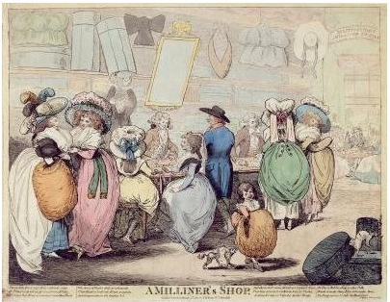

Slide 25
Credit
Credit is so much a tradesman's blessing that it is the choicest ware he deals in, and he cannot be too chary of it when he has it, or buy it too dear when he wants it; it is a stock to his warehouse, it is current money in his cash-chest, it accepts all his bills, for it is on the fund of his credit that he has any bills to accept; demands would else be made upon the spot, and he must pay for his goods before he has them—therefore, I say, it accepts all his bills, and oftentimes pays them too; in a word, it is the life and soul of his trade, and it requires his utmost vigilance to preserve it.
Credit: from Latin credo or belief
Revolving around reputation and trust
Buying and selling on credit – economy of obligation
A tradesman's credit and a virgin's virtue ought to be equally sacred from the tongues of men; and it is a very unhappy truth, that as times now go, they are neither of them regarded among us as they ought to be.

Slide 26
The credit of a tradesman respects two sorts of people, first, the merchants, or wholesale men, or makers, who sell him his goods, or the customers, who come to his shop to buy.
The first of these are so far from valuing him upon the gay appearance of his shop, that they are often the first that take an offence at it, and suspect his credit upon that account: their opinion upon a tradesman, and his credit with them, is raised quite another way, namely, by his current pay, diligent attendance, and honest figure; the gay shop does not help him at all there, but rather the contrary.
As to the latter, though some customers may at first be drawn by the gay appearance and fine gilding and painting of a shop, yet it is the well sorting a shop with goods, and the selling good pennyworths, that will bring trade, especially after the shop has been open some time: this, and this only, establishes the man and the credit of the shop.
the customers, who are the substantial dependence of a tradesman's shop, are such as are gained and preserved by good usage, good pennyworths, good wares, and good choice; and a shop that has the reputation of these four, like good wine that needs no bush, needs no painting and gilding, no carved works and ornaments;^{[31]} it requires only a diligent master and a faithful servant, and it will never want a trade.

Slide 27
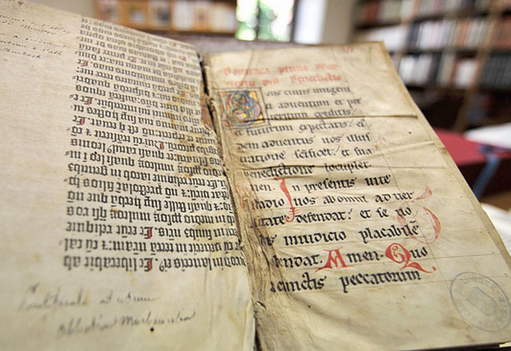
Authority of the object
The authority of the bible and the spread of publications

Slide 28
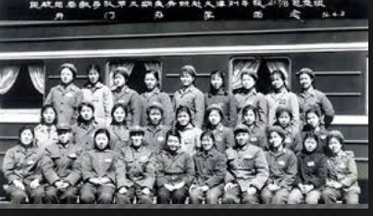
Uniformity

Slide 29
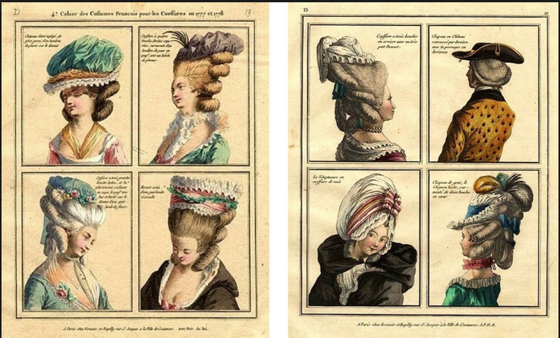
difference

Slide 30
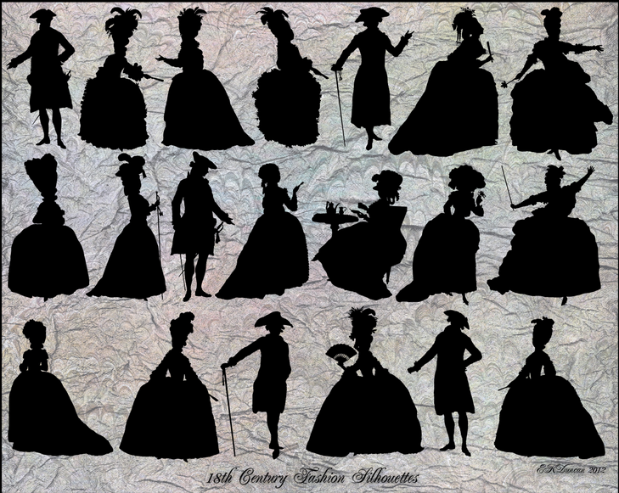

Slide 31
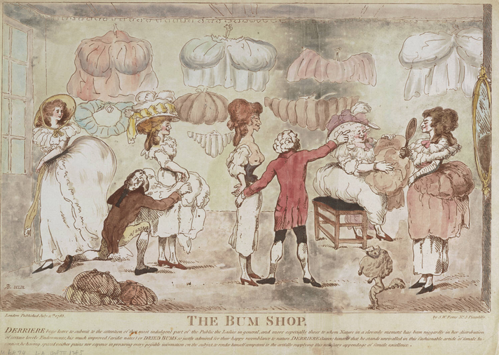
Dynamics of social placement
What do you wear?
To conform? To whose expectations?
To distinguish yourself? From whom/to whom
What about residence
Entertaining
Where you shop
To say something about your
    Style
    Money
    Position in society
    Patronage

Slide 32
Self-consciousness and society
Is this the emergence of a consumer, market society?
Or should we understand it as a hierarchical order that generates and structures its markets and exchange?
Craig Muldrew, The Economy of Obligation (1998)
And how did they understand it?
Respectability vs Vanity
Morality vs immorality
Standing vs dominance
Substance vs appearance
Honour vs reputation
Hierarchy vs equality
Independence vs dependence
Reference groups
passing

Slide 33
Philosophers and consumerism
Smith and Hegel
Recognition of market
And of its insufficiency – and its risks
Tendency to conspire
Need to provide public goods
Problem of indigent
Concern for character of morality
Second round of political economy
Malthus, James Mill, David Ricardo
J-B Say, Henri Saint-Simon, and St Simonians
French functional thinking vs English self-regulating system.
But also growing awareness of industry, diminishing importance of land, recognition of labour

