Slide 1
the contribution of labour: from liberal rights to socialism
Dr Imogen Peck
University of Warwick

Slide 2
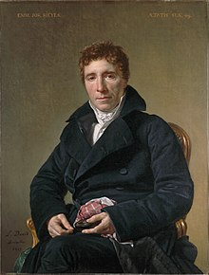
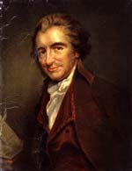
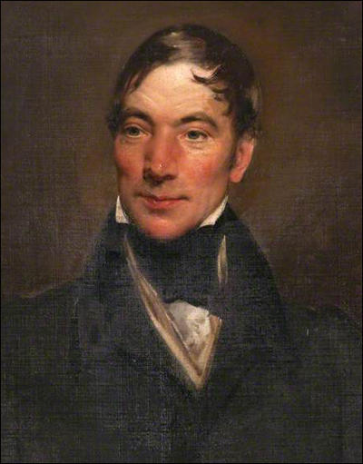
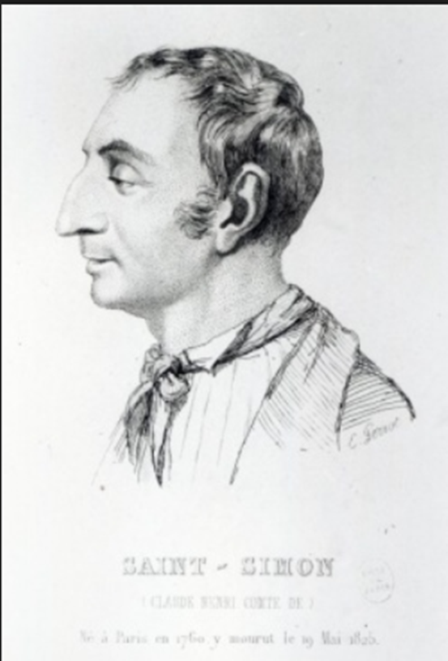
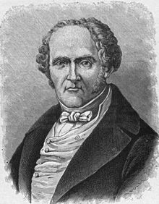
5 key figures
Emmanuel Joseph Sieyès (1748-1836)
Thomas Paine (1737-1809)
Robert Owen (1771-1858)
Henri Saint Simon (1760-1825)
François Marie Charles Fourier (1772-1837)

Slide 3
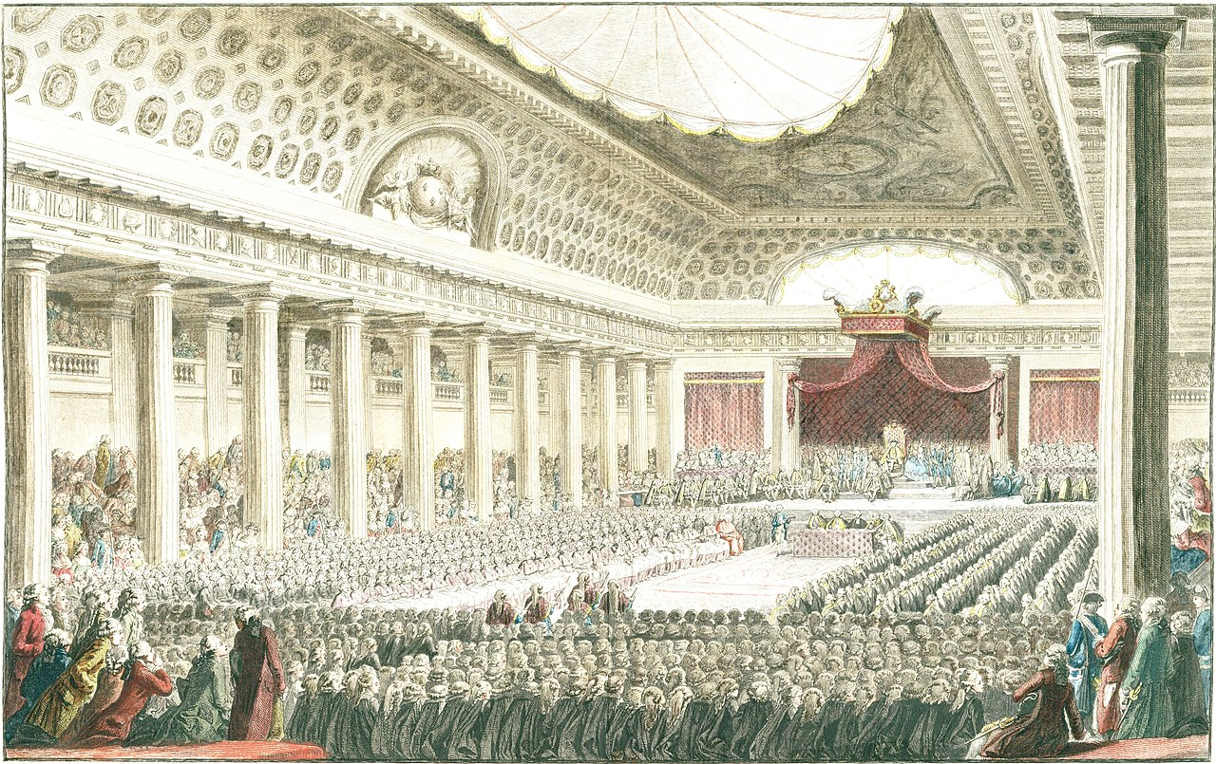
Emmanuel Joseph Sieyès (Abbé), What is the third estate? (1789)
1788 – Louis XVI recalled Estates General
Hadn’t sat since 1614
Estates General – consultative body made up of assemblies representing the three estates

Slide 4
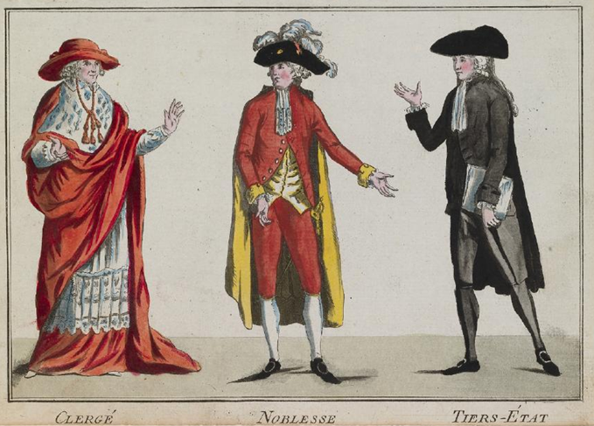
System of orders
1st Estate: Clergy (those who pray)
2nd Estate: Nobles (those who fight)
3rd Estate: Everyone else (those who work)

Slide 5
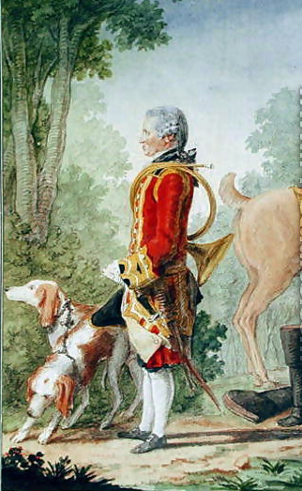
NOBLE PRIVILEGEs
Right to carry a sword
Trial by peers
Right to be beheaded (rather than hanged – and the right not to be tortured)
Right to hunt
Held the most eminent positions in the church, courts, and military
Louis de Carmontelle, ‘Monsieur de Bois-Massot, huntsman to the Duke of Orleans in hunting costume’ (1764)

Slide 6
An attack on noble privilege
‘ It suffices to have made the point that the so-called usefulness of a privileged order to the public service is a fallacy […] that without this order the higher posts could be infinitely better filled; that they ought to be the natural prize and reward of recognised ability and service; and that if the privileged have succeeded in usurping all well-paid and honorific posts, this is both a hateful iniquity towards the generality of citizens and an act of treason to the commonwealth’.
‘What is a nation? A body of associates living under common laws and represented by the same legislative assembly. Is it not obvious that the nobility possesses privileges and exemptions which it brazenly calls its rights and which stand distinct from the rights of the great body of citizens? Because of these special rights, the nobility does not belong to the common order’.
Excluding members of the third estate from positions of honour is damaging for the performance of these offices.
Nobles have privileges that exempt them from the law; therefore, they are not a true part of society.

Slide 7
THE THIRD ESTATE
Private labour
All families engaged in work on the land
All those engaged in the production of goods that adds value to them
Merchants and dealers who act to combine producers and consumers
Activities and personal services – liberal and scientific professions through to domestic servants
Public services
Army
Law
Church
Administration
‘It needs no detailed analysis to show that the Third Estate everywhere constitutes nineteen-twentieths of them [public services], except that it is loaded with all the really arduous work, all the tasks which the privileged order refuses to perform’.

Slide 8
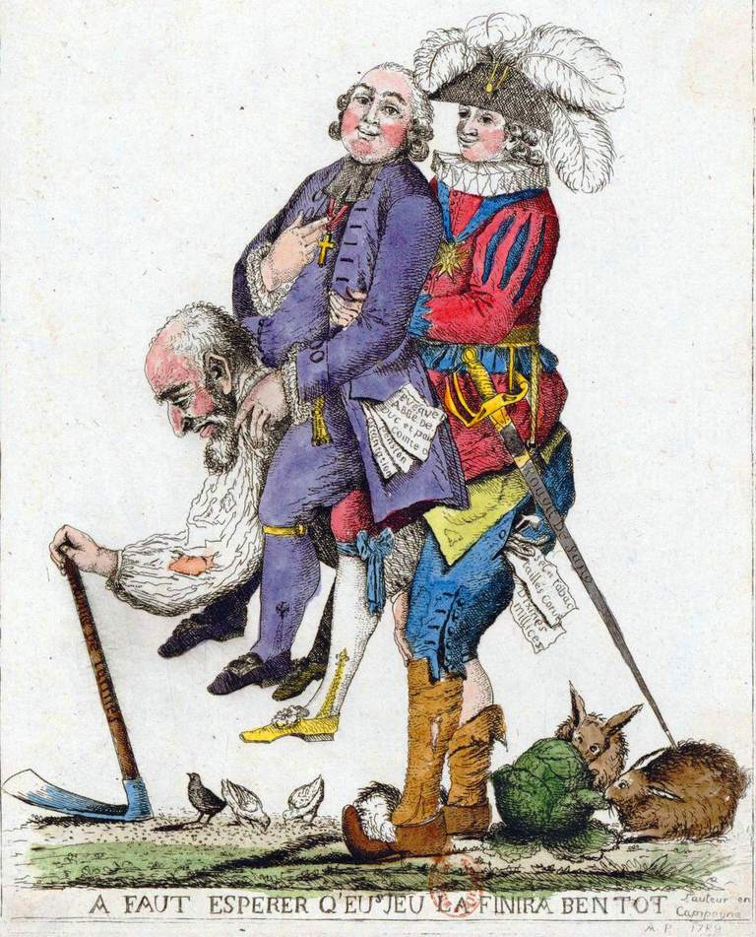
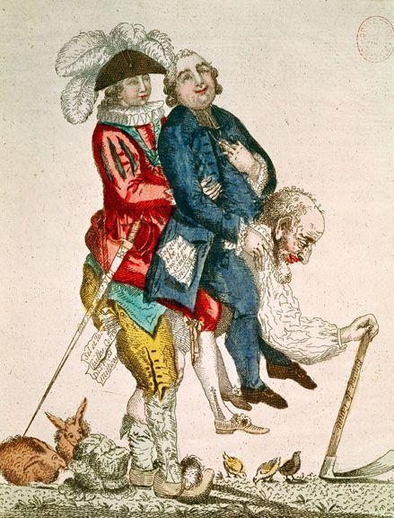
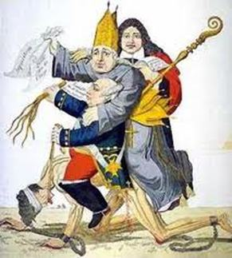

Slide 9
THE ESTATES GENERAL
‘Let them create as many noblemen as they like; it still remains certain that the moment any citizen is granted privileges against the common laws, he no longer forms part of the common order. His new interest is contrary to the general interest; he becomes incompetent to vote in the name of the People’.
The 3 claims of the third estate:
That the Representatives of the Third Estate Be Chosen Solely from among Citizens Who Really Belong to the Third Estates
That Its Deputies Be Equal in Number to Those of the Two Privileged Orders
That the States-General Vote, Not by Orders, but by Heads

Slide 10
Representation and election
Active and passive citizenship.
Division of political labour – increasing specialization reduces abuse.
Constitutional design ‘It would be a grave misjudgement of human nature to entrust the destiny of societies to the endeavours of virtue.’
‘The true object of the national assembly is to be concerned with the whole mass of citizens seen from the point of view of the common interest. The natural consequence of this proposition is that the right to be represented belongs to citizens only in respect to what they have in common and not to what serves to differentiate them. … It is not, therefore, because one is privileged but because one is a citizen that one has a right to elect deputies. … A privileged class is not something that can be represented. …anything that falls outside the common attributes of citizenship cannot give rise to an entitlement to political rights’.

Slide 11
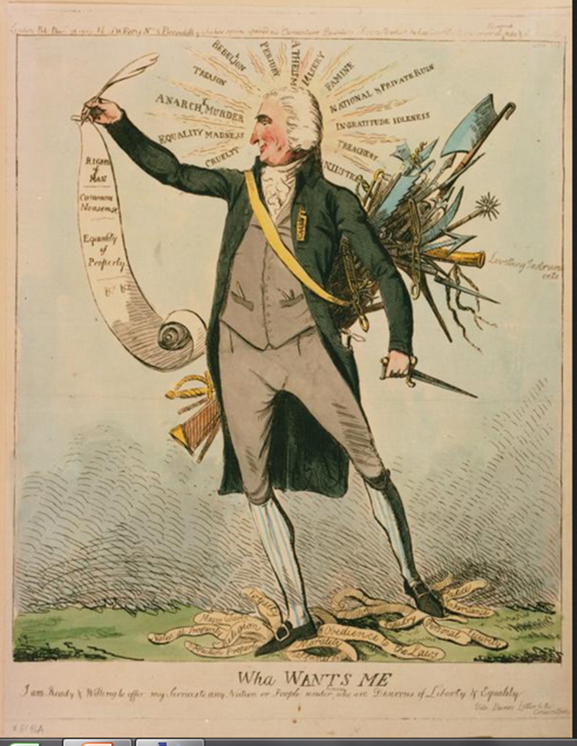
THOMAS PAINE, Agrarian justice (1797)
‘the earth, in its natural uncultivated state was, and ever would have continued to be, the common property of the human race’.
But as people take property into private ownership, this will inevitably leave some people worse off than they would have been in the state of nature, where everything was owned in common.
These people are therefore owed some form of compensation.

Slide 12
NATURAL RIGHT TO INHERITANCE
Difficulty of separating value of land and value of cultivation.
Value of cultivation must be respected.
But every proprietor of cultivated land owes the community a ground rent, for the land he holds.
Owed as a right not charity.
Fund giving each person £15 on reaching age of majority and a pension for all those over 50.
‘It is impossible to separate the improvement made by cultivation from the earth itself, upon which that improvement is made, the idea of landed property arose from that inseparable connection; but it is nevertheless true, that it is the value of the improvement only, and not the earth itself, that is individual property. Every proprietor, therefore, of cultivated land, owes to the community a groundrent […] for the land which he holds’

Slide 13
Claude-Henri Saint-simon 1760-1825
Aristocratic family
Enlisted in army at 17
Fought for France in the American Revolution
Arrested under Robespierre; released after July 1794
Lettres d'un habitant de Genève à ses contemporains (1803)
L'Industrie (1816-1817)
Le Politique (1819)
L'Organisateur (1819-1820)
Du système industriel (1822)
Catéchisme des industriels (1823-1824)
Nouveau Christianisme (1825).

Slide 14
Political order
Council of Newton, composed of 21 men of genius, for the governance of all mankind.
Below the grand council there would be four divisional councils representing the four divisions of humanity
Careers open to talents
1819 (in collaboration with Comte)
3 bodies:
chambre d’invention - 200 engineers and artists with the task of drawing up plans for public undertakings
chambre d’examination - 100 biologists and 100 physicists and mathematicians to scrutinise the plans
chambre d’execution - bankers and industrialists who would see to it that approved projects were expeditiously implemented.

Slide 15
Religion of newton
‘I propose to substitute the following principle for that of the Gospel: Man must work. The happiest man is the worker…The happiest nation is the one with fewest idlers. Any functionary, any person involved in the sciences, the fine arts, manufacturing or agricultural industry works as positively as the labourer digging the earth […] But a rentier, a property owner who has no profession and who does not direct the work necessary to render his property profitable, is a burden to society…’.

Slide 16
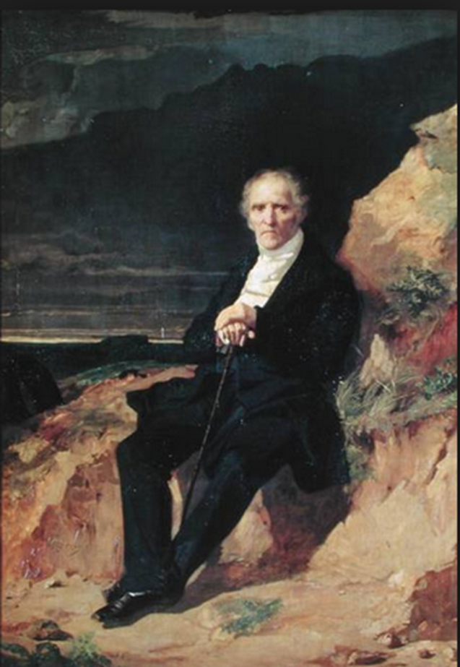
CHARLES FOURIER, Theory of the four movements and the general destinies (1808)
Critique of ‘free competition’
Anti-industrialist
Anti political- economy
Labour as a burden

Slide 17
CRITIQUE OF POLITICAL ECONOMY
‘It is obvious that the science called political economy, that of free competition, has duped society in every way through the intricacy of its deceit and through the complexity and cost of unproductive middlemen, misappropriated capital, and other losses and wastes which ultimately fall back on the consumer […] real economy consists in favouring the services of those who increase the production of goods, and in reducing those services which add to the production cost without augmenting production’.

Slide 18
THE PASSIONS AND THE phalanstery
810 Psychological types x 2 (men and women) = 1,620
a self-contained community housing 1,620 members with a myriad of subdivisions designed to encourage a dynamic interplay of various human passions.
twelve fundamental passions: five of the senses (touch, taste, hearing, sight and smell); four of the soul (friendship, love, ambition and parenthood); and three distributional:
la Papillone or the love of variety
la Cabaliste, concerning rivalry and conspiracy
la Composite, combination of two or more types of passion

Slide 19
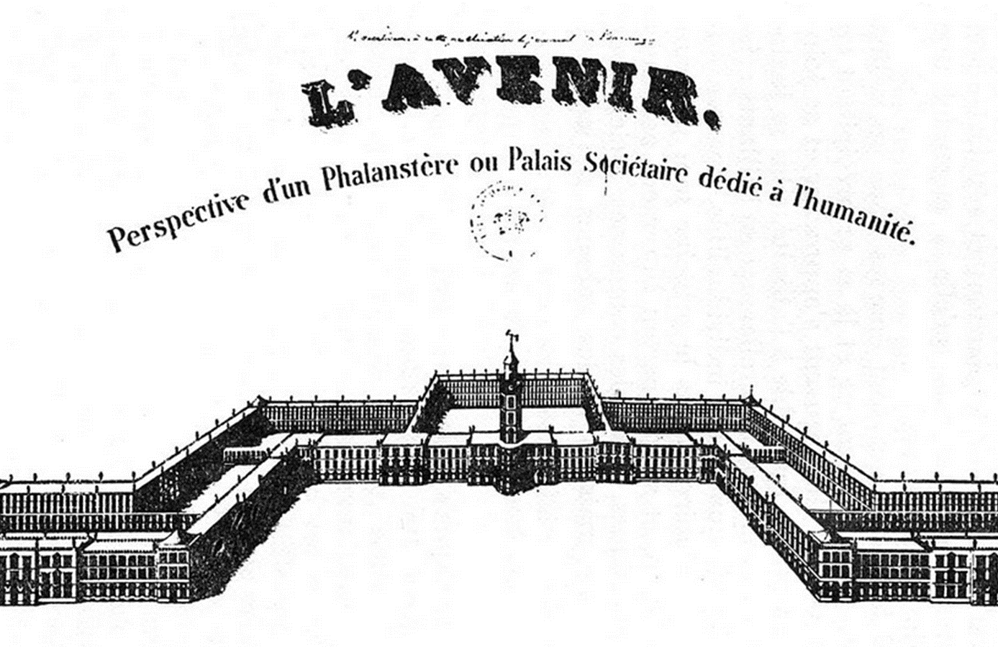

Slide 20
LIFE IN THE phalanstery
Social Minimum:
5 meals per day
Clothing
Lodging in a private room
Third class theatre and concert seats
Sexual minimum
Work will therefore become pleasurable, rather than an arduous, monotonous, but essential, activity.

