Slide 1
The critique of the social
Dr Imogen Peck
Department of History

Slide 2
The long essay
Due: 13th March (unless you are a visiting student, in which case you may have a different deadline - check your tabula!)
Length: 4,500 words (exc. references/bibliography)
Weighting: 50% of summative assessment
Extensions: Need to be approved via the administrative team. I cannot grant extensions, so make sure you apply in good time. The penalties for late submission without an approved extension are heavy (5 marks per day).
Scope: Essays may address a broad survey-type question concerning some of the themes of the course, or they may look at a small group of authors, or one author, in considerable depth and analyse the nature of the argument(s) that they are making.
Questions students have tackled in the past include:
Analyse the ways in which ideas about the polis changed over the course of the seventeenth and eighteenth centuries.
What connections are there between the political philosophy of J.G. Herder and the republican tradition?
How does the articulation of black identity by the African diaspora challenge white society?
‘While Marx believes fundamentally in the full and free development of the individual's powers, the individual is accorded little agency in his account of capitalism and its transition to communism.’ Discuss.
How compelling is Rousseau's understanding of the impact of society on the individual?
I STRONGLY suggest that you come and discuss your proposed question with me in office hours before you get started (11-12 on Mondays, 12-1 on Fridays, in H0.07).

Slide 3
criteria
Essays will be marked against the university marking scale (https://warwick.ac.uk/fac/arts/history/students/assessment/marking/)
They will therefore be marked for evidence of some of the following:
clarity and sophistication of argument and/or interpretation;
evidence of sound understanding of primary texts;
evidence of understanding those texts in their context;
and evidence of originality in thinking about the ideas and commitments of the authors studied.
Secondary texts may be used to support the arguments, but the main focus should be on the primary texts/sources.
Make sure that your bibliography and reference are in line with the department style guidelines. This is, essentially, MHRA (NOT Harvard). The MHRA guidelines are incredibly detailed, and cover almost every form of reference you can think of! You can find them online on this link: http://www.mhra.org.uk/pdf/MHRA-Style-Guide-3rd-Edn.pdf

Slide 4
overlap
The department guidelines state that essay and exam answers should not ‘include any significant amount of material already presented in ANY assessed work’.
However, you ARE allowed to build on one of your formative essays in the long, essay, if you would like to.
But do bear in mind that you will need to avoid replicating material from your long essay either in essays for other modules or the exam. You could write an essay and answer an exam question on the same writer, provided you address different aspects of their thought/different issues.
What counts as a ‘significant amount of material’ is clearly a judgement call. So use your common sense – the overlap rule is there simply in order to prevent people replicating the same essay/material over and over again in different assessments and modules!

Slide 5
A good essay question…

Slide 6
Is Well-defined and focused
i.e. enough scope for 4,500 words, but not SO broad that you can’t hope to manage adequate coverage in that word count.
So, ‘All Romantic writers engaged with the self through nature. Discuss’ isn’t great – because clearly you can’t hope to discuss ALL Romantic writers in 4,500 words! This could be nuanced to focus on specific writers, or a specific part of the Romantic movement (British, German etc.)

Slide 7
Enables you to show analytical and critical skills
i.e. is not just descriptive
So ‘How coherent and convincing is Rousseau’s claim that mankind must be ‘forced to be free’? is better than ‘What is Rousseau’s theory of freedom’?
The first allows you to analyse Rousseau’s arguments – are they coherent? Are they convincing? – the second just to describe what they are.

Slide 8
Is possible for you to answer
i.e. doesn’t rely on you making any claims that you can’t substantiate with evidence
So, ‘To what extent were William Godwin’s views the product of his non-conformism?’ is problematic, because you can’t really evidence what it was that motivated Godwin (you’re not his psychologist, after all!).

Slide 9
Is something you are interested in!
This is a great opportunity for you to focus on an particular text/author/theme that has really grabbed you during the course. It really is very open, so if there is a text/source we haven’t studied (but that is relevant to the scope of the module) then you are welcome to write on that.
It’s also good practice for dissertation writing, when you will be expected to define a research topic and title of your own.
And the first step away from always being reactive/responding to a question to setting the agenda for yourself.

Slide 10
Writing ‘historically’
This is really about reading the text, not in isolation, but in its historical context. Or, to put it another way, not just reading the words of the text, but reading them with an eye to how your interpretation is informed by knowing about when the text was written.
There are lots of different ways of doing this! The one you adopt will depend on your text, your question, and your interests.
Things to think about include: When was this text written? How does this affect the way you read/understand it? Which other texts/debates is it engaged with? How far is it similar (or different) to other sources being produced?
This needs to be integrated into your interpretation of the text, not a paragraph at the beginning of your essay that has no bearing on your interpretation of the material.

Slide 11
So for example...
NOT THIS:
I. Hobbes went to school in Malmesbury. He was tutor to William Cavendish’s son, also William. This is true, but it’s not really relevant to your interpretation of the text.
II. Hobbes was writing in the mid-17thc when people were concerned with theories of government’. Again, not untrue, but too general and vague to count as proper contextualisation.
THIS:
1. Hobbes’ idea of legitimate government is different from preceding theories. You can explain how it differs from earlier texts.
2. It is not a theory of divine right monarchy, but a social contract. You can explain how it differs from, and engages with, other contemporary theories.
3. Hobbes was writing in a time of Civil War. This significant because… You can show the RELEVANCE/INFLUENCE of historical context to your understanding of the text.

Slide 12
The critique of the social

Slide 13
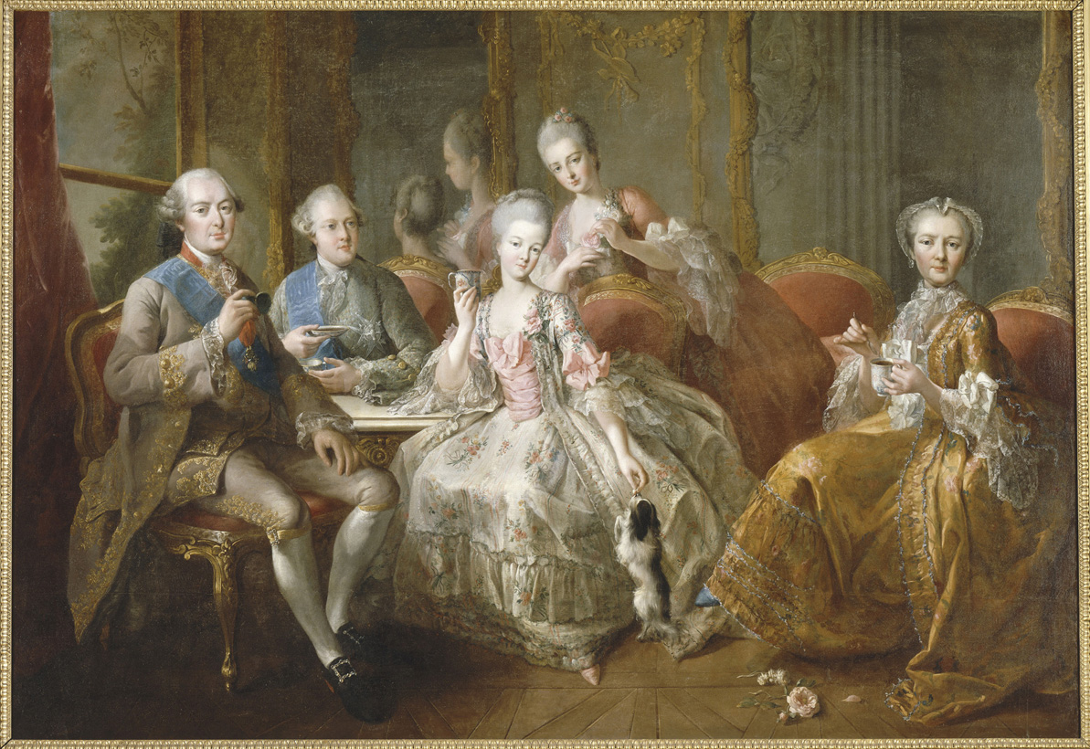
Which comes First: the social?
People responding to a change in patterns of:
Consumption and behaviour
Social spaces
Trade
Fashion
Drink
Gaming

Slide 14
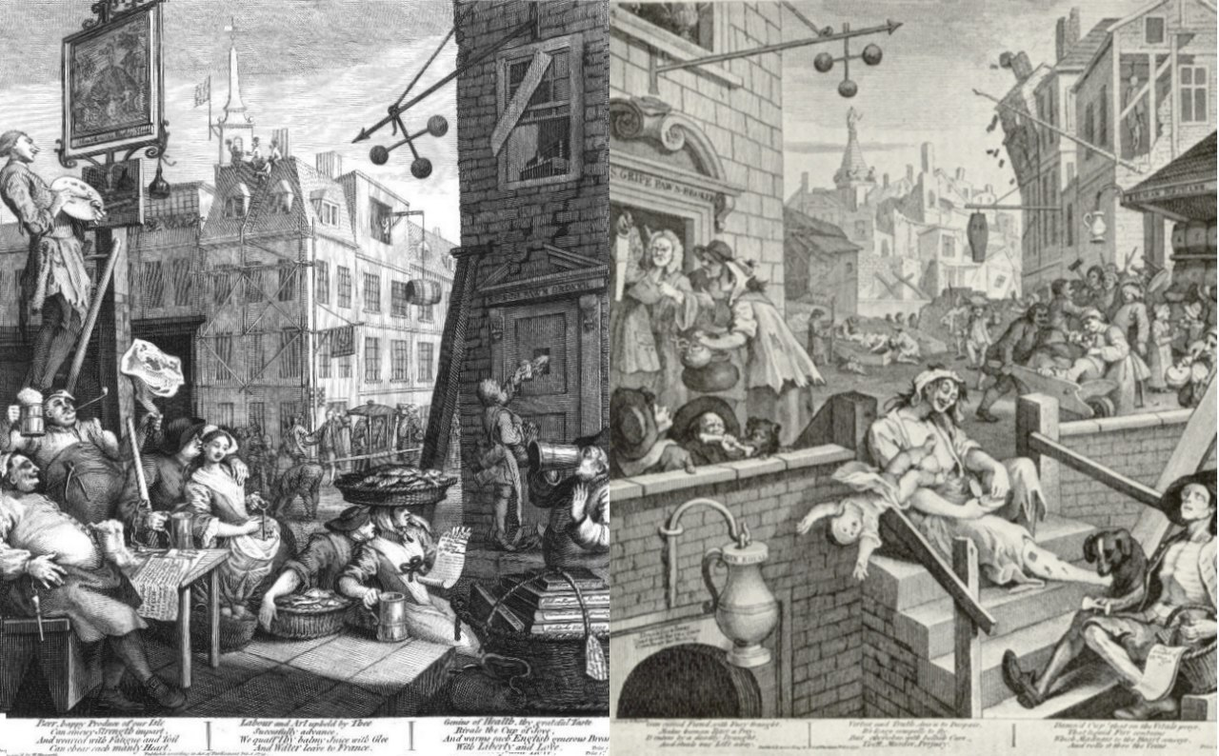
…Or the critique?
Anxieties about:
Moral corruption
Augustan age, and the collapse of Rome
Money, debt, and finance of government
Decline, transience, the eventual collapse of old orders and civilisations – so that signs of the new are also treated as signs of corruption and decay.

Slide 15
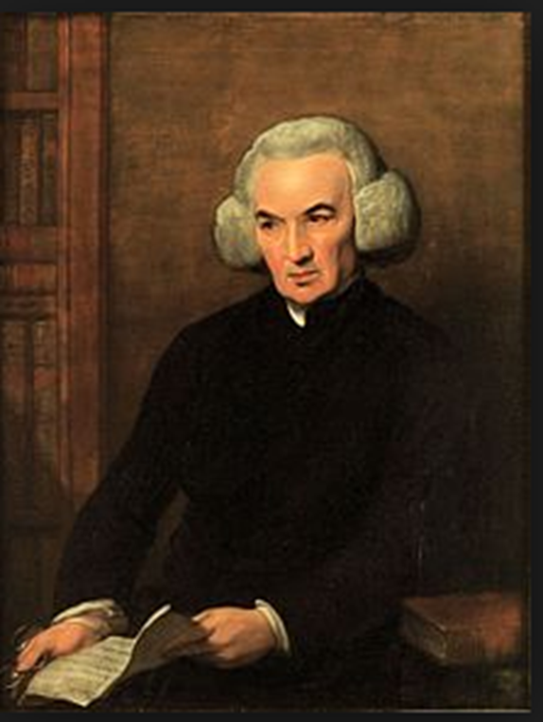
Enlightenment ‘optimism’
‘After sharing in the benefits of one Revolution, I have been spared to be a witness to two other Revolutions, both glorious. And now, methinks, I see the ardour for liberty catching and spreading, a general amendment beginning in human affairs, the dominion of kings changed for the dominion of laws, and the dominion of priests giving way to the dominion of reason and conscience. Be encouraged all ye friends of freedom and writers in its defence…Behold the light you have struck out, after setting America free, reflected to Franc and there kindled into a blaze that lays despotism in ashes and warms and illuminates Europe.’
Richard Price, 1789

Slide 16
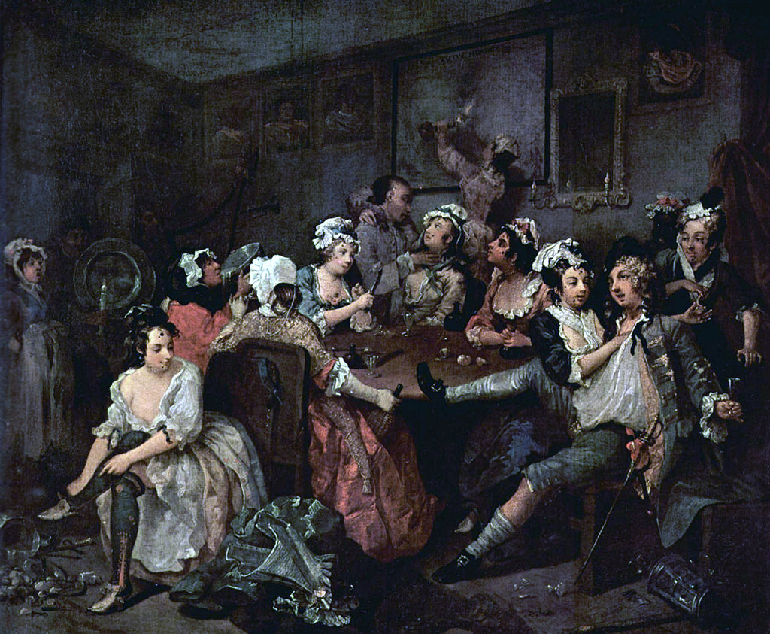
Enlightenment critiques
Partial critique of eighteenth century society…
Treatment of women
Treatment of slaves
Dangers of irreligion and popery
Dangers of the table
Dangers of the baize
Dangers of consumption
Risks to freedom
Threat of international order/disorder
Distance from nature
Yearning for simplicity

Slide 17
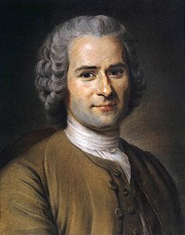
Rousseau and the three discourses
Discourse on the Moral Effects of the Arts and Sciences (1750)
Discourse on the Origin of Inequality Among Men (1754)
Discourse on Political Economy (1758)

Slide 18

The first discourse
Already concerns about corruption of morals – but much less about arts and sciences
Sees the arts as coming first and inspiring the sciences
‘So long as government and law provide for the security and well-being of men in their common life, the arts, literature, and the sciences, less despotic though perhaps more powerful, fling garlands of flowers over the chains which weigh them down. They stifle in men’s breasts that sense of original liberty, for which they seem to have been born; cause them to love their own slavery, and so make of them what is called a civilized people’.

Slide 19
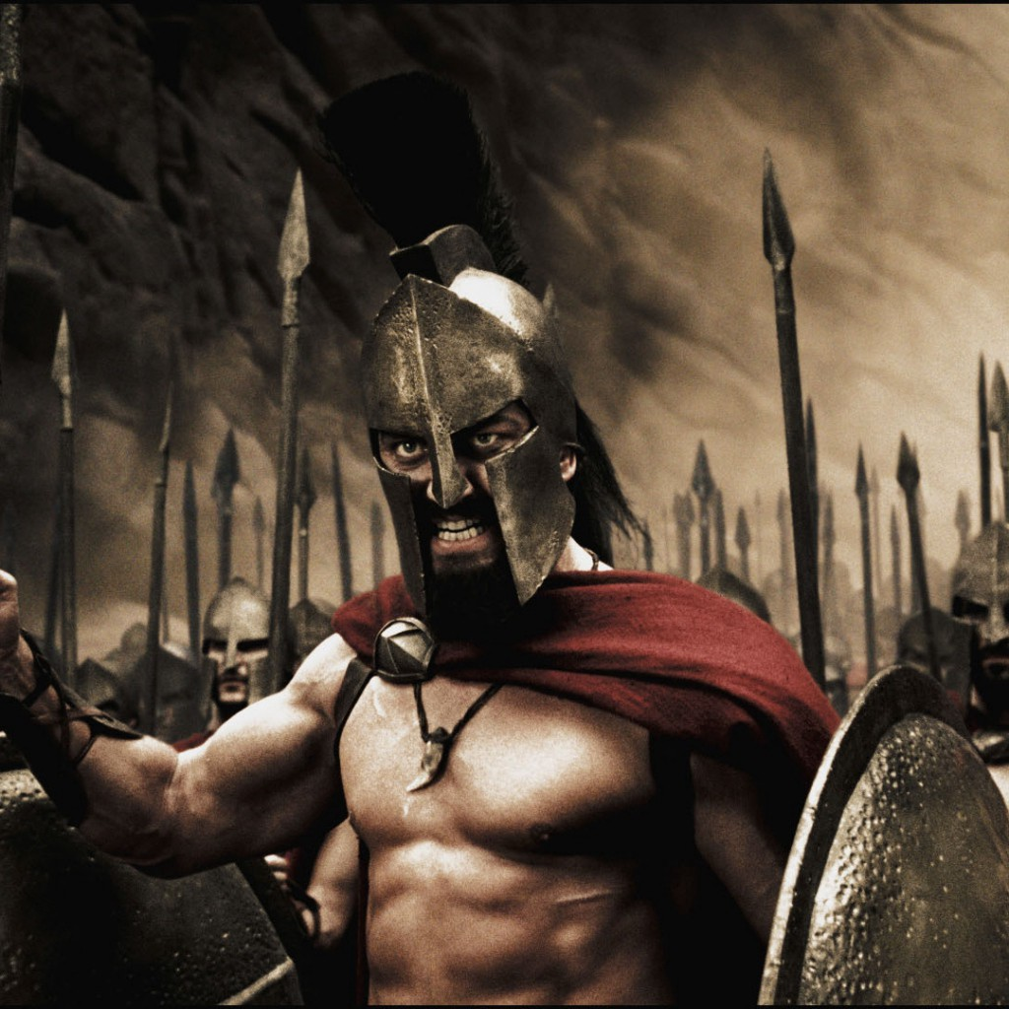
ARTS AND VIRTUES
‘Necessity raised up thrones; the arts and sciences have made them strong’.
‘Civilized peoples, cultivate such pursuits: to them, happy slaves, you owe that delicacy and exquisiteness of taste, which is so much your boast, that sweetness of disposition and urbanity of manners which make intercourse so easy and agreeable among you – in a word, the appearance of all the virtues, without being in possession of any one of them.’
‘Our minds have been corrupted in proportion as the arts and sciences have improved and twas ever thus’.

Slide 20
THE SECOND DISCOURSE
Amour de soi - 'is a natural sentiment which inclines every animal to attend to its self-preservation and which, guided in man by reason and modified by pity, produces humanity and virtue.’
Amour propre – ‘is only a relative sentiment, factious and born in society, which inclines every individual to set greater store by himself than by anyone else, inspires men with all the evils they do one another, and is the geuine source of honour. '
‘The question is no longer whether a man is honest, but whether he is clever. We do not ask if a book is useful, but whether it is well written. Rewards are lavished on wit and ingenuity, while virtue is left unhonoured. There are a thousand prizes for fine discourses, and none for good actions’.

Slide 21
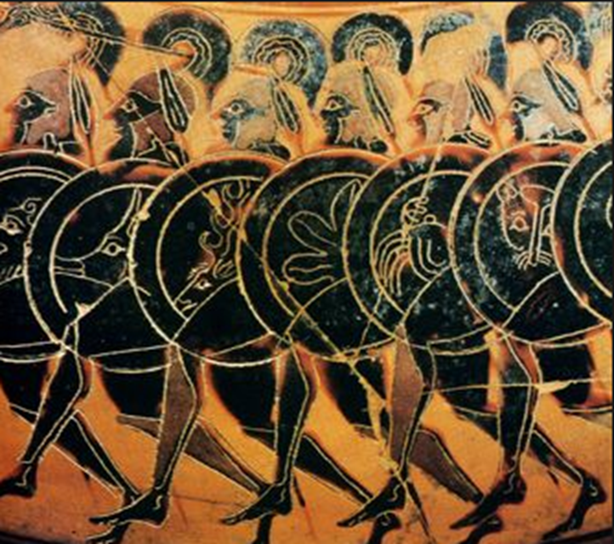
Natural vs Social – or competing social orders?
Simplicity of manners
Natural virtue
Probity and integrity
Courage and commitment to the common good

Slide 22
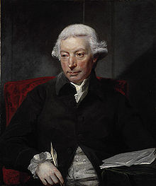
ADAM ferguson, Essay on the History of Civil Society (1767)
On the state of nature:
‘Among the various qualities which mankind possess, we select one or a few particulars on which to establish a theory, and in framing our account of what man was in some imaginary state of nature, we overlook what he has always appeared within the reach of our own observation, and in the records of history’.
‘the character of man, as he now exists, the laws of his animal and intellectual system, on which his happiness now depends, deserve our principal study; general principles relating to this or any other subject, are useful only so far as they are founded on just observation, and lead to the knowledge of important consequences…’.

Slide 23
Sociability and self-interest
‘If we admit that man is susceptible of improvement, and has in himself a principle of progression, and a desire of perfection, it appears improper to say, that he has quitted the state of his nature, when he has begun to proceed; or that he finds a station for which he was not intended, while, like other animals, he only follows the disposition, and employs the powers that nature has given’.

Slide 24
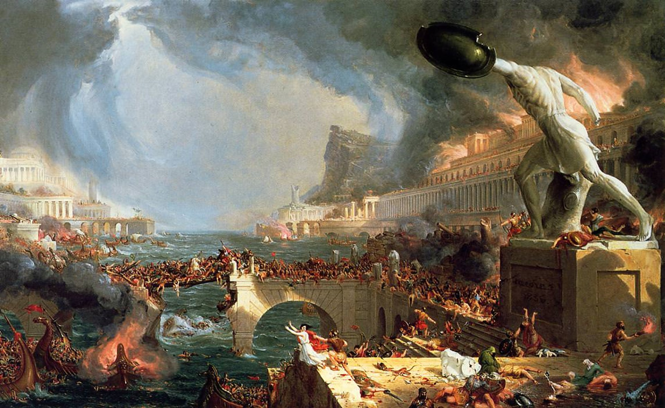
FERGUSON, CONJECTURAL HISTORY, AND THE EXAMPLE OF ROME
Endorses Montesquieu’s claim that the fall of Rome was traceable to the moral corruption engendered by the decline of Stoicism and the popularity of Epicureanism.
Argues that commercial ethic of 18thc runs the risk of obliterating the communal sentiments and virtues that are essential to a healthy state.
Fears that ‘polished’ society is going to lead to degeneration and decline.

Slide 25
Problems with ’polished’ societies
Specialism
Over-extension
Hedonism

Slide 26
specialisation
Narrows peoples’ sphere of identification: the ‘separation of professions […] breaks the bonds of society’.
Especially damaging is the specialisation, and professionalisation of political and martial functions: has a knock-on effect on civic virtue.
‘Every department of state is made the object of a separate profession, and every candidate for office must have passed through a regular education; and, as in the gradations of the university, must have obtained by his proficiency, or his standing, the degree to which he aspires […] With all these resources, and this learned preparation, which is made to turn these resources to use, the state is in reality weak; has repeatedly given the example which we seek to explain; and among the doctors of war or of policy, among the millions who are set apart for the military profession, can find none of its members who are fit to stand forth in the dangers of their country’.

Slide 27

overextension
A nation’s territory should be small enough to admit universal participation and hereby foster communal sentiment.
This isn’t possible in huge states, which then come to rely on over-bureaucratisation and over-centralisation.
In these circumstance, people become ‘disunited, and lose sight of their community’ and lapse into ‘a state of languor and obscurity’.
Where citizens play no part in the affairs of state there can be no civic virtue.

Slide 28

hedonism
Pursuit of luxury isn’t all bad – it’s had lots of positive effects.
But in ‘polished’ societies it’s at risk of becoming a vice because it is ‘unsupported by personal elevation and virtue’.
Wealth is not a key determinant of national happiness.
‘polished and commercial nations have more wealth, and practise a greater variety of arts, than the rude: But the happiness of men, in all cases alike, consists in the blessings of a candid, an active, and strenuous mind. And if we consider the state of society merely as that into which mankind are led by their propensities, as a state to be valued from its effect in preserving the species, in ripening their talents, and exciting their virtues, we need not enlarge our communities, in order to enjoy these advantages’.

Slide 29
THE PARADOX OF PROGRESS
On the one hand, commercial society is the result of the human desire for improvement and progress; but on the other hand, it is simultaneously undermining civilisation.
Progression or retrogression?

Slide 30
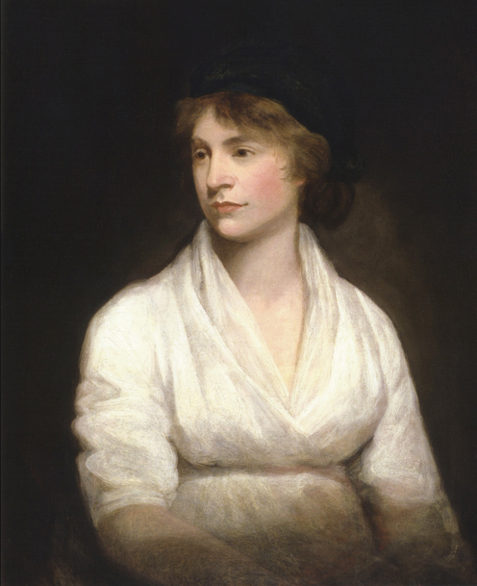
Mary Wollstonecraft: A vindication of the rights of woman (1792)
An argument for the rights of woman?
Or a contribution to the critique of society?

Slide 31
Critique of the social in wollstonecraft
‘It may be made a question, whether they (the bulk of the people in Europe) have acquired any virtues in exchange for innocence, equivalent to the misery produced by the vices that have been plastered over unsightly ignorance, and the freedom which has been bartered for splendid slavery’.
Critique of:
Kings (Oxford Wold Classics ed, p. 80)
Standing Armies and Sailors (p. 81)
Clergy (p. 82)
Every man is in some degree formed by his profession (p. 82)

Slide 32
ON SOCIAL CONSTRUCTION
‘Women in general, as well as the rich of both sexes, have acquired all the follies and vices of civilisation, and missed the useful fruit. Their senses are inflamed, and their understandings neglected, consequently they become the prey of their senses, delicately termed sensibility, and are blown about by every momentary gust of feeling’ (p. 131).

