Slide 1

Individual, Polis and Society
Mark Philp

Slide 2
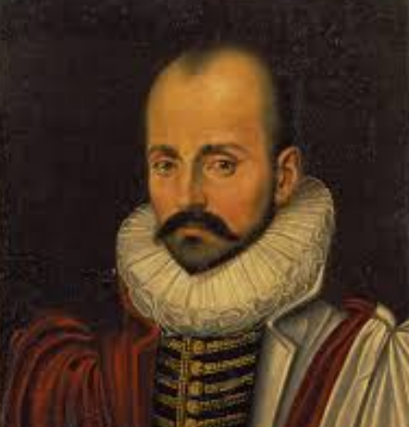
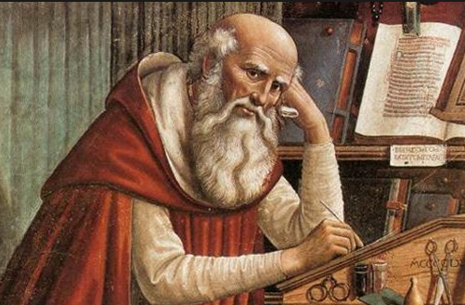
Autobiography/Diaris/Self-Reflection
Diaries and journals
Retrospective accounts
Private vs publication
Precursors

Slide 3

Augustine
But I still postponed my renunciation of the World’s joys, which would have left me free to look for that other happiness, the very search for which, let alone its discovery, I ought to have prized above the discovery of all human treasures and kingdoms or the ability to enjoy all the pleasures of the body at a mere nod of the head. As a youth I had been woefully at fault…I had prayed to you for chastity and said ‘Give me chastity and continence, but not yet.’
Plato – Republic IV, 440 Leontius and the bodies appetite/desire, spirit and reason

Slide 4

Montaigne
Of Practice (Book 1I, 6)
Of Experience (Book III, 13)
But is there anything so sweet as that sudden change, when from extreme pain, by the voiding of my stone, I come to recover as if by lightning the beautiful light of health, so free and so full, as happens in our sudden and sharpest attacks of colic? Is there anything in this pain we suffer that can be said to counterbalance the pleasure of such sudden improvement? How much more beautiful health seems to me after illness, when they are so near and contiguous that I can recognize them in each other’s presence in their proudest array, when they vie with each other, as if to oppose each other squarely!

Slide 5
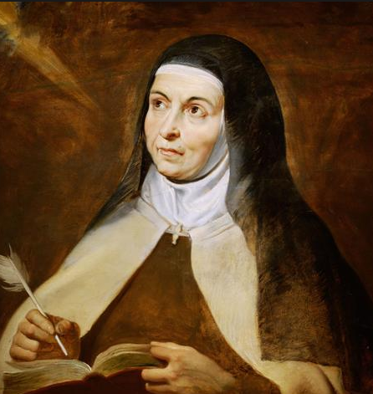
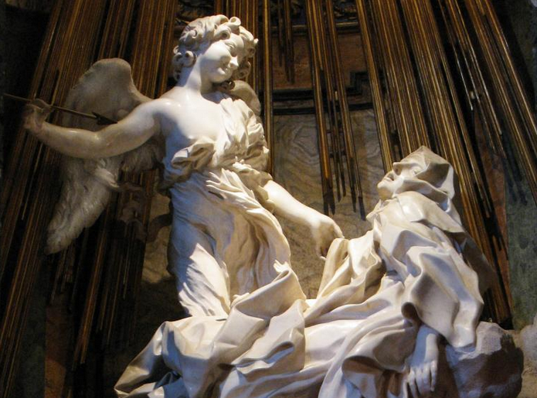
Women’s autobiography and diaries
Teresa of Avila
Bernini, St. Maria della Vittorio

Slide 6
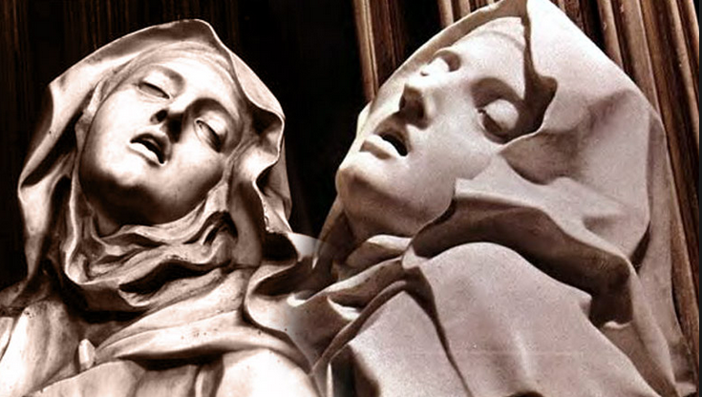
The four stages of the ascent of the soul:
1. mental prayer
2. devotion of peace – surrender to God
3. ecstatic state of absorption in God
4. Devotion to God – consciousness of body disappears

Slide 7
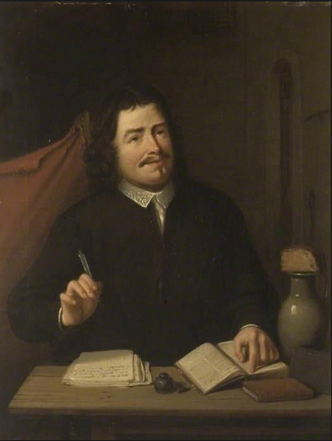
John Bunyan 1628-1688
As for my own natural life, for the time that I was without God in the world, it was indeed according to the course of this world, and “the spirit that now worketh in the children of disobedience” (Eph 2:2,3). It was my delight to be “taken captive by the devil at his will” (2 Tim 2:26). Being filled with all unrighteousness: the which did also so strongly work and put forth itself, both in my heart and life, and that from a child, that I had but few equals, especially considering my years, which were tender, being few, both for cursing, swearing, lying, and blaspheming the holy name of God.
Yea, so settled and rooted was I in these things, that they became as a second nature to me; the which, as I also have with soberness considered since, did so offend the Lord, that even in my childhood he did scare and affright me with fearful dreams, and did terrify me with dreadful visions; for often, after I had spent this and the other day in sin, I have in my bed been greatly afflicted, while asleep, with the apprehensions of devils and wicked spirits, who still, as I then thought, laboured to draw me away with them, of which I could never be rid.

Slide 8
Medieval autobiography as the search of the soul for sin
John Flemming:
‘…modern autobiography is grounded in subjectivity (the writer’s consciousness and individuality) and expression(the artistic presentation of subjectivity). …Early autobiography, on the other hand is generally grounded in exemplarity (a demonstration of the generalized meaning of a particular life in its illustration of a broad human or transcendental truths..’

