Slide 1
Individual, polis, and Society
Dr Imogen Peck
Department of History

Slide 2
Assessment
The assessment for this second-year module is as follows:
4,500 word essay (50%)
A two-hour exam (50%)
You are also expected to write two formative essays – these are a valuable chance to get feedback on your ideas and writing.
The deadlines are as follows:
Term 1 Monday week 7 – formative essay one (2,000 words, on diaries/autobiographies/life-writing)
Term 2 Monday week 1 – formative essay two (2,000 words, on politics)
As things stand, the summative essay is due term 2, week 10 (13 March)
The first formative piece will look at one of the diaries or autobiographies we have identified and discuss the way the work engages in a process of self-construction.
The second will involve an analysis of a particular text on political thought - to be negotiated.
The third will examine the ways in which we can use texts and other sources to understand the social experience of men and women in the late seventeenth/eighteenth century.

Slide 3
Deliberating the Self

Slide 4
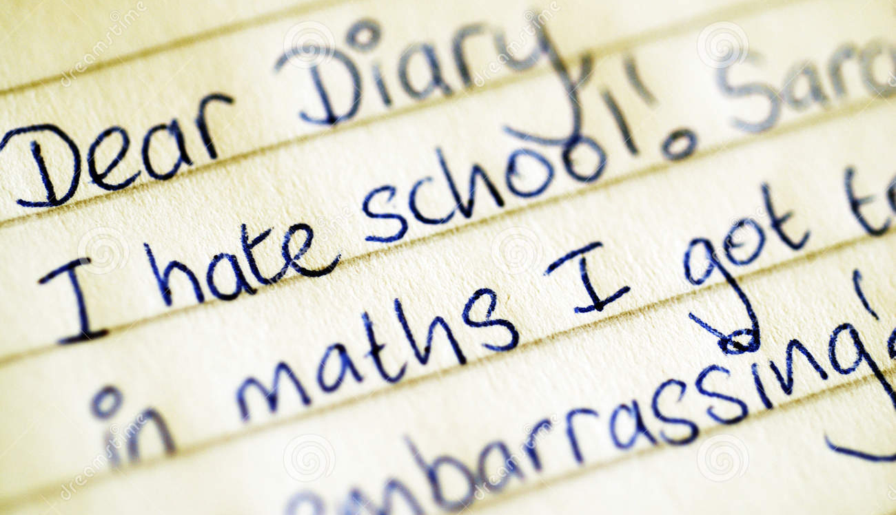
The practice of diary writing
What do you – or would you - write about?
Who are you writing for?
What do you consider the purpose of your diary to be?

Slide 5
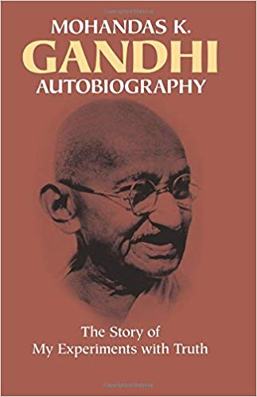
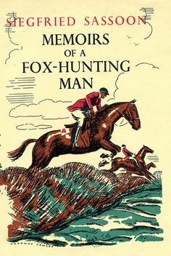
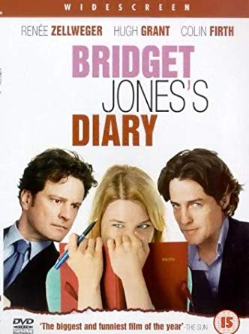
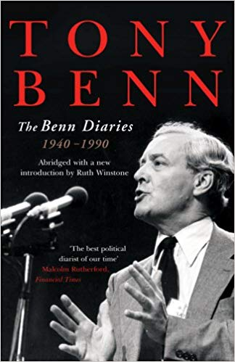

Forms of ‘life-writing’

Slide 6
Lecture overview
Spiritual autobiography
Family history
Almanac annotation
Diaries and journals (Josselin, Pepys, and Boswell)
Public Autobiography (Rousseau’s Confessions)

Slide 7
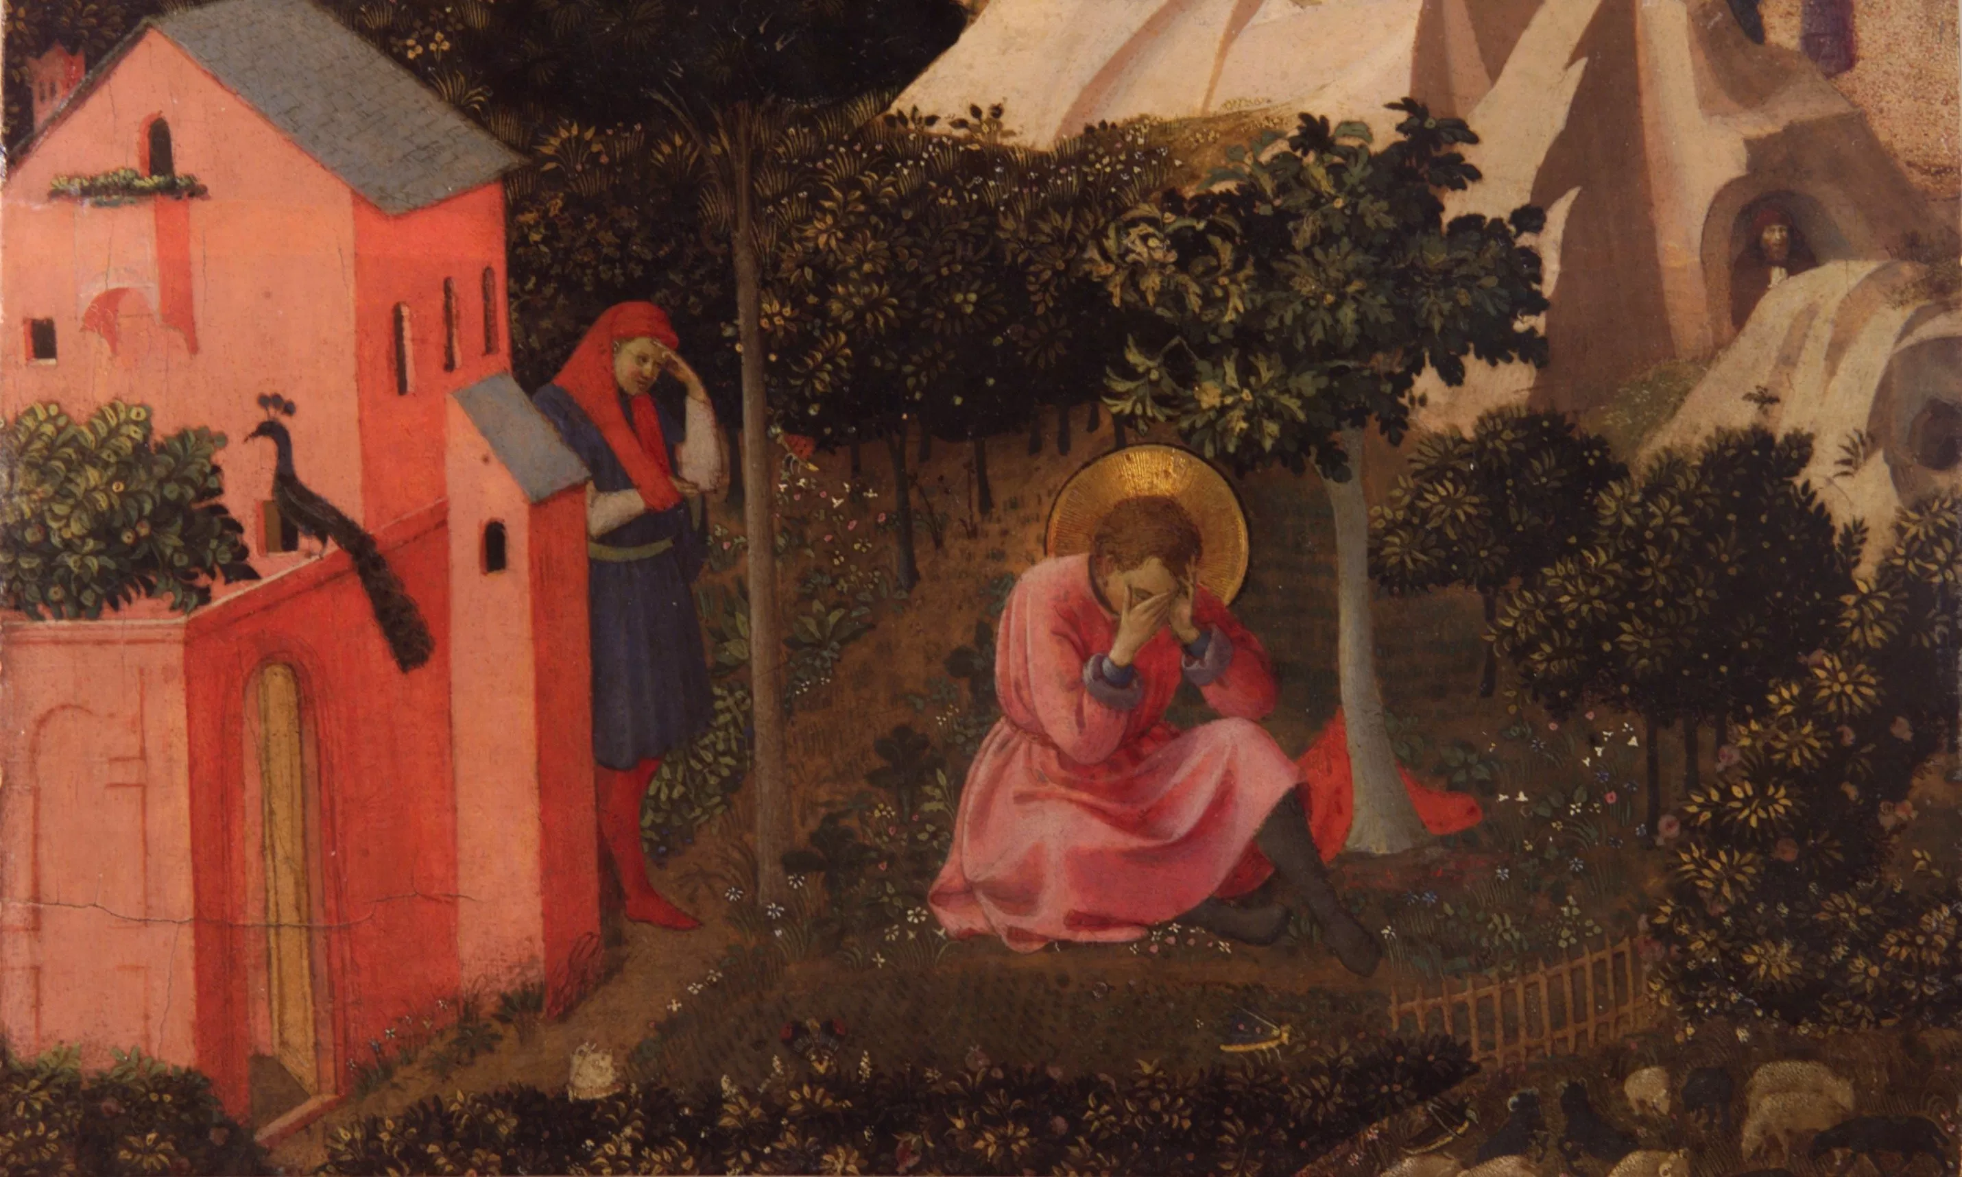
Spiritual Autobiography: Augustine’s Confessions and its legacy
‘…compelled by no hunger, nor poverty, but through a cloyedness of well-doing, and a pamperedness of iniquity. For I stole that, of which I had enough, and much better. Nor cared I to enjoy what I stole, but joyed in the theft and sin itself… O friendship too unfriendly! thou incomprehensible inveigler of the soul, thou greediness to do mischief out of mirth and wantonness, thou thirst of others' loss, without lust of my own gain or revenge: but when it is said, "Let's go, let's do it," we are ashamed not to be shameless’.
(Augustine, Confessions, Book II)

Slide 8
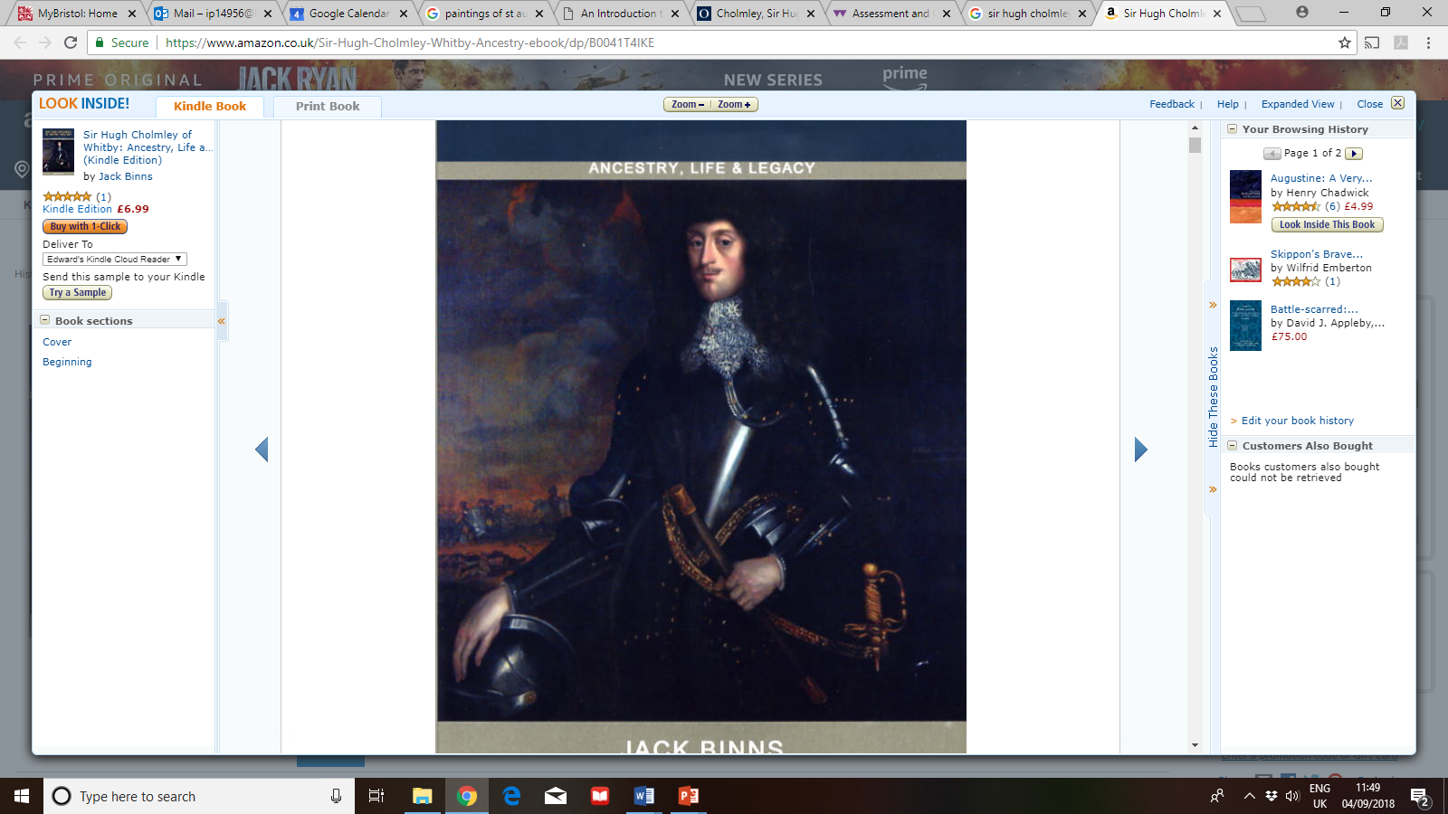
Family History: The memoirs of sir hugh cholmley (1600-1657)
‘Nor am I incensible with what difficulty and preiduice I undertake the worke, considering when I am to mentioned my owne blemishes and imperfections, the fralty of [humane] nature is such I shall scarsely discerne them, or rightly iudge of them, or if I doe, perhaps bee unwilling to have the world take notice, much lesse my selfe to bee the divoulger of them. And if I mention ought [that] may bee to my commendations or advantage, it will bee thought pride or vainglory’.
(Memoirs and Memorials of Sir Hugh Cholmley, pp. 79-80 ).

Slide 9
Sir Hugh as gentry ‘self-fashioning’?
‘Self-fashioning’ – Stephen Greenblatt, Renaissance Self-Fashioning (1980)
‘I did not forsake them Parlament till they did faile in performeing those perticulars they made the grounds of the warre when I was first ingaidged vidz. the preservation of Relegion protection of the Kings person and lyberties of the subject nor did I quit them then for any particular ends of my owne, but meerely to performe the duty and alleagence I owed to my Soveraigne.’
(Memoirs and Memorials of Sir Hugh Cholmley, p. 105)

Slide 10
Individual or exemplar?
‘modern autobiography is grounded in subjectivity (the writer’s consciousness and individuality) and expression (the artistic presentation of subjectivity). …Early autobiography, on the other hand is generally grounded in exemplarity (a demonstration of the generalized meaning of a particular life in its illustration of a broad human or transcendental truths…’.
John Fleming, ‘Early Medieval Autobiography’, in The Cambridge Companion to Autobiography, p. 35.

Slide 11
The rise of life-writing in the 16th century
The boom in print culture, sparked by the invention of the printing press
The rise in literacy rates
The capacity of readers to improvise with new textual forms
Protestantism’s emphasis on the individual’s relationship with God
(From Adam Smyth, Autobiography in Early Modern England, p. 13)

Slide 12
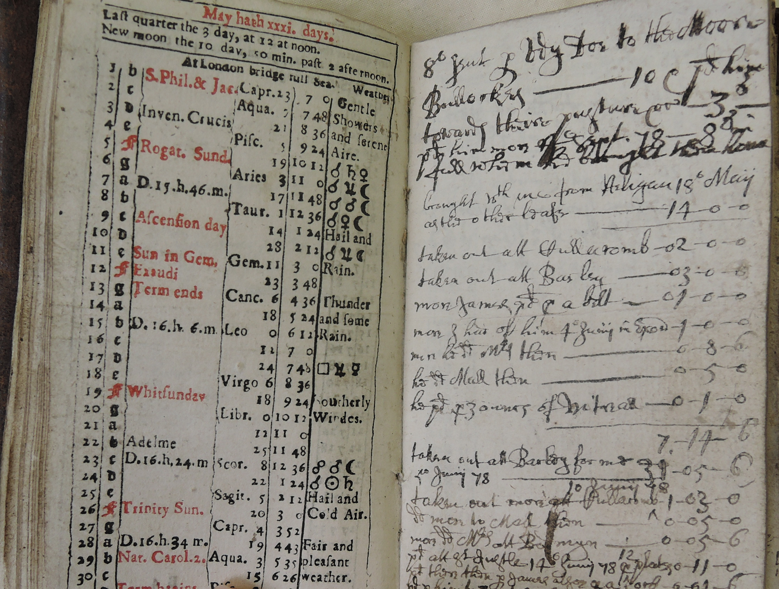
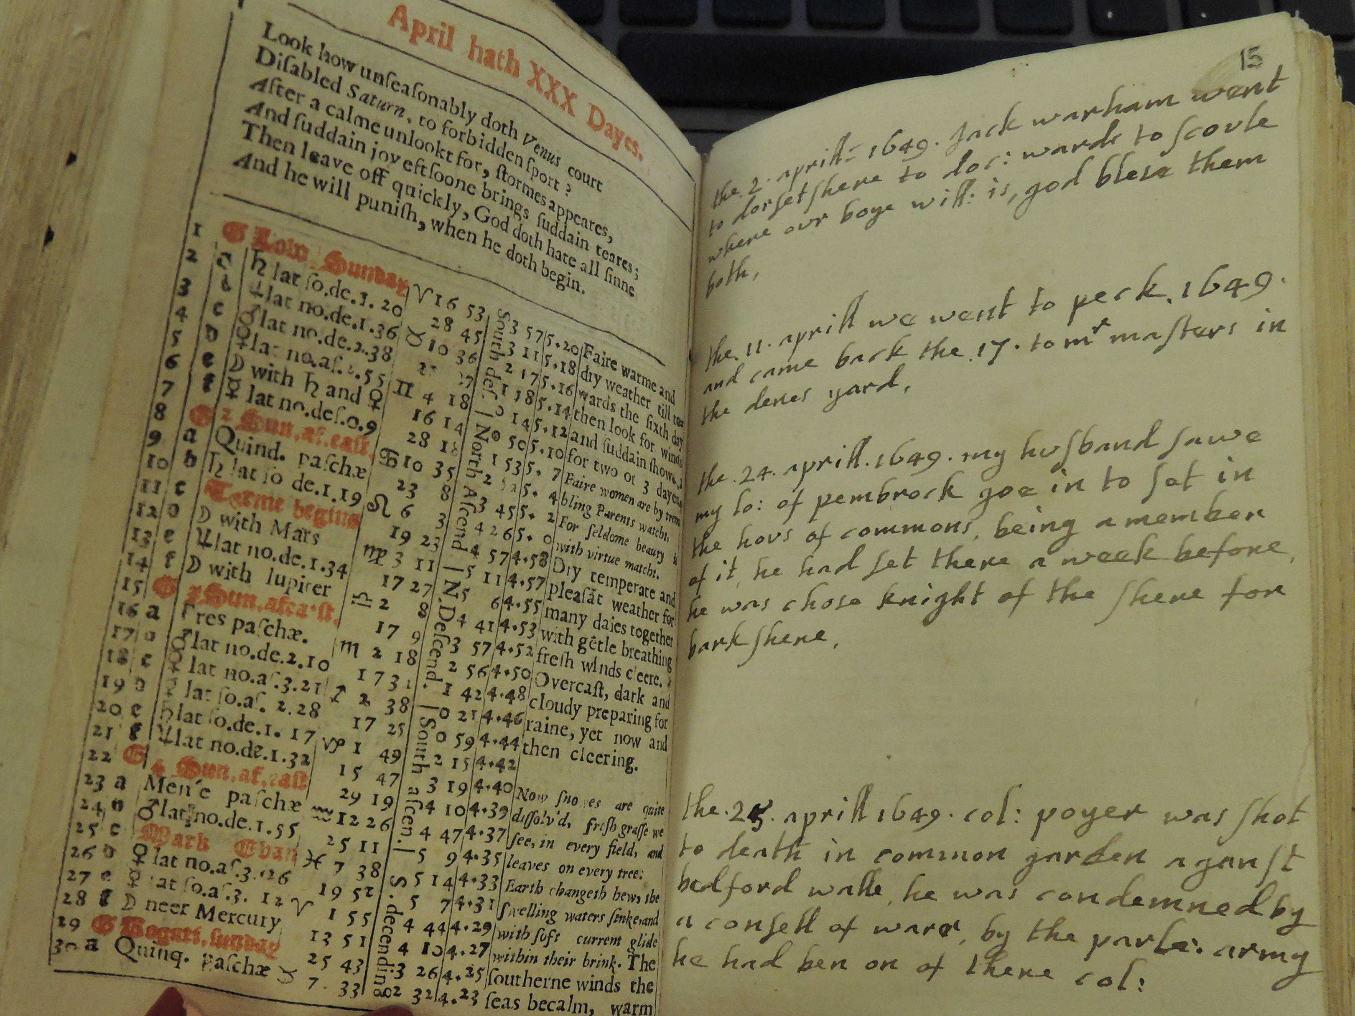
ALMANACS AND THEIR ANNOTATORS
Financial accounts in the almanacs of the Cornish man Lewis Tremayne (May 1678) Cornwall Record Office, T/1295
Isabella Twysden’s almanac journal (1649)
British Library, Add MS 34169-34172

Slide 13
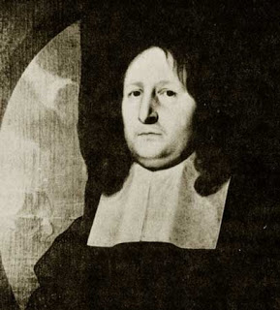
The puritan diary
25 January, 1677
‘this day I reflected on Gods providence in my estate, having one of my Welsh heifers three dead calves and but one living; Lord teach me humility, and submission, I am the greater sinner’.
Ralph Josselin (1617-1683)

Slide 14
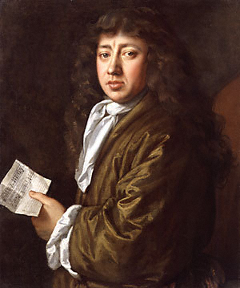
The diary of Samuel pepys

Slide 15
Two seventeenth century deaths
‘the lord had his hand then on my sister Anna. who was taken suddenly ill. dropsicall when with us, and went away cheerfull. a good woman and now happy. shee died Friday 26. god hath broken the brood there are now but three of us. shee was next above mee in age. lord fit me for my change’.
Diary of Ralph Josselin, 25 December 1673
‘The Doctors give him over and so do all that see him. He talks no sense two words together now. And I confess it made me weep to see that he should not be able when I asked him, to say who I was. I went to Mrs. Turners, and by her discourse with my brother's Doctor, Mr. Powell, I find that she is full now of the disease which my brother is troubled with, and talks of it mightily; which I am sorry for - there being other company; but methinks it should be for her honour to forbear talking of it. The shame of this very thing, I confess, troubles me as much as anything…’.
Diary of Samuel Pepys, 14 March 1664

Slide 16
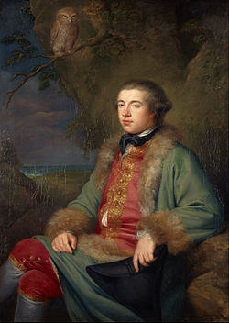
Secularised self-knowledge? james boswell
‘A man cannot know himself better than by attending to the feelings his heart and to his external actions, from which he may with tolerable certainty judge “what manner of person he is”’.
James Boswell, London Journal, p. 39.
just as ‘a lady adjusts her dress before a mirror, a man adjusts his character by looking at his journal’.
James Boswell, Life of Samuel Johnson, iii, p. 228.

Slide 17
‘to form yourself into a man’: Manliness and masculinity in james boswell
‘I was not inspired by Venus. I felt rather a delicate inclination of love than a violent amorous inclination […] I thought myself feeble as a gallant’.
‘This conquest was completed to my highest satisfaction […] I really conducted this affair with a manliness and prudence that pleased me very much. The whole expense was just eighteen shillings’.

Slide 18
Boswell’s ‘inviolable plan’
Attain the habits of study, so that you may have continued entertainment by yourself
Avoid affection
Elevate your soul by prayers and by contemplation
Never talk of your self
Be firm, and persist like a philosopher

Slide 19
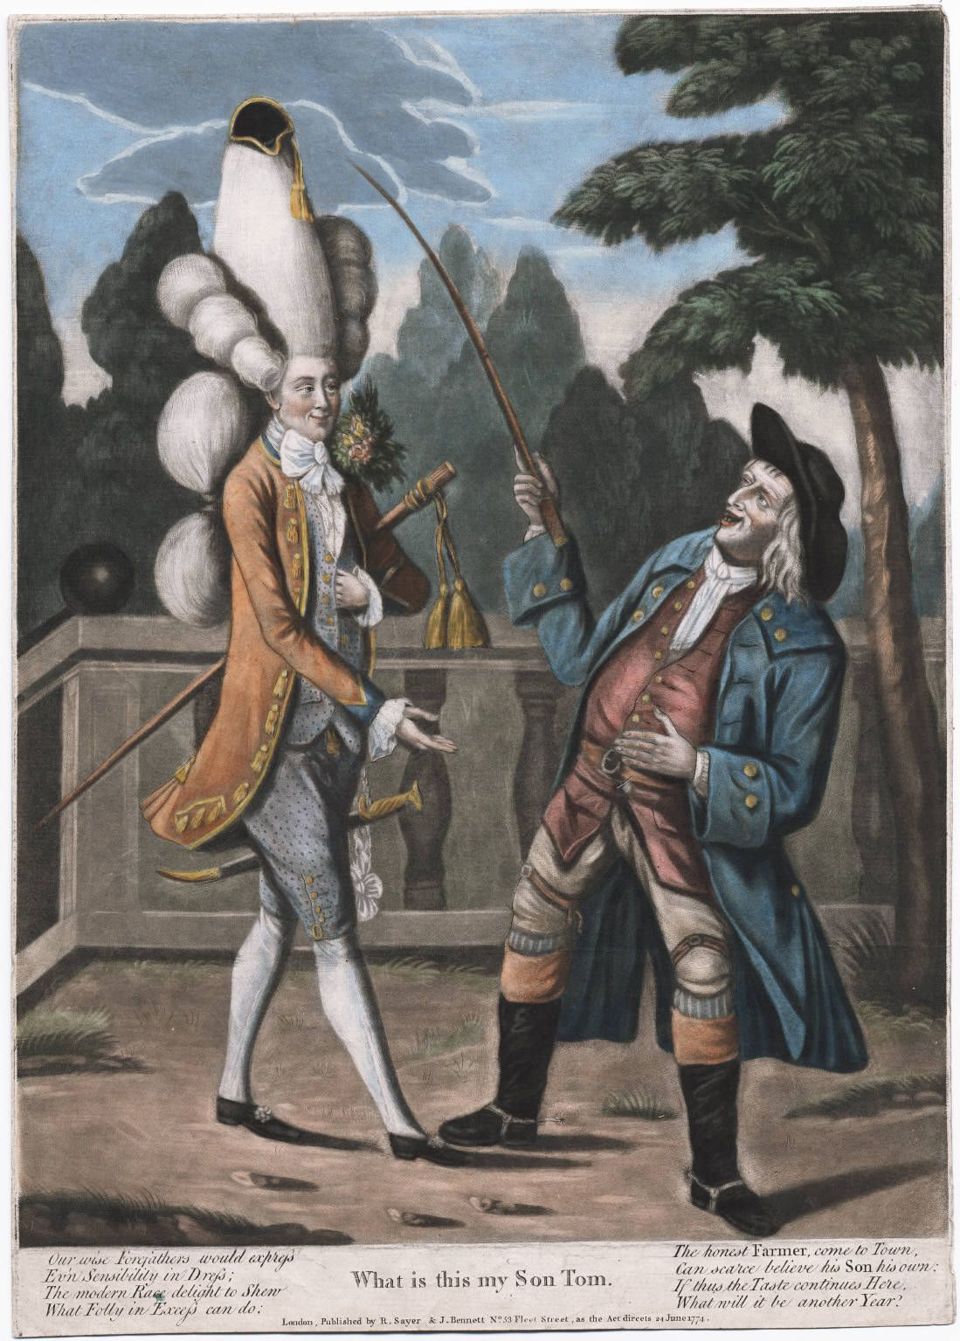
Our wise forefathers would express
Ev’n sensibility in dress
The modern race delight to shew
What folly in excess can do
(‘What is this my son Tom’, 1774)

Slide 20
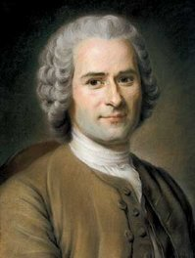
Public autobiography: rousseau’s Confessions
‘My purpose is to display to my kind a portrait in every way true to nature, and the man I shall portray will be myself’.
Jean Jacques Rousseau, Confessions, Book One.

Slide 21
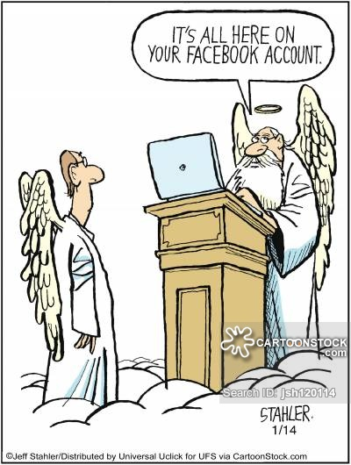
Summary

Slide 22
bibliography
SECONDARY READING
Stephen Greenblatt, Renaissance Self-Fashioning: From More to Shakespeare (1980)
John Fleming, ‘Early Medieval Autobiography’, in The Cambridge Companion to Autobiography (2014)
Adam Smyth, Autobiography in Early Modern England (2010)
Mark Dawson, ‘Histories and Texts: Refiguring the Diary of Samuel Pepys’, The Historical Journal (2000)
John Brewer, The Pleasures of the Imagination: English Culture in the Eighteenth Century (1997)
Philip Carter, ‘Boswell’s Manliness’, in English Masculinities, 1660-1800 (1999)
Robert Zaretsky, Boswell’s Enlightenment (2015)
PRIMARY TEXTS
The Confessions of St Augustine (trans. E. B. Pusey, online, project Gutenberg: https://www.gutenberg.org/files/3296/3296-h/3296-h.htm)
Guibert of Nogent, Autobiography (online: https://sourcebooks.fordham.edu/basis/guibert-vita.asp)
Jack Binns (ed.), The Memoirs and Memorials of Sir Hugh Cholmley of Whitby, 1600-1657 (2000)
Ralph Macfarlane, The Diary of Ralph Josselin, 1616-1683 (1991)

