Slide 1
Consumption in the 18thc

Slide 2
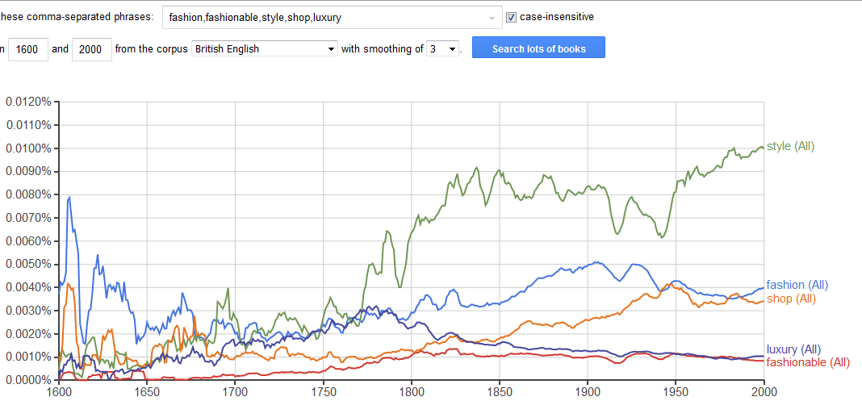
Books that reference these terms, 1600-2000, courtesy of the google books corpus

Slide 3
Lecture structure
Advertising
Utility, Novelty, and Luxury
Shops and Shopping

Slide 4
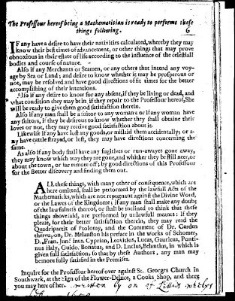
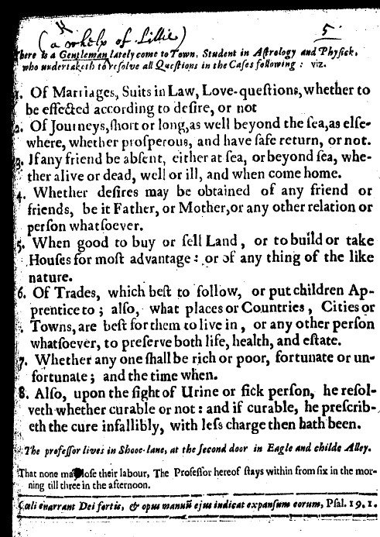
I. ADVERTISING

Slide 5
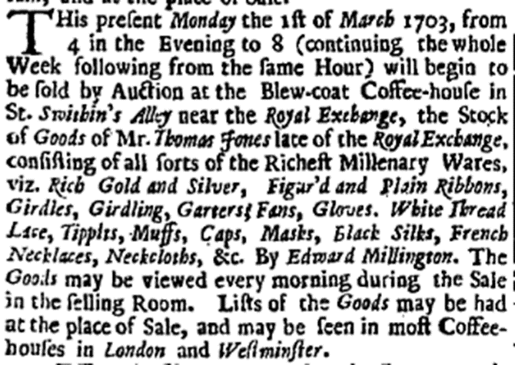
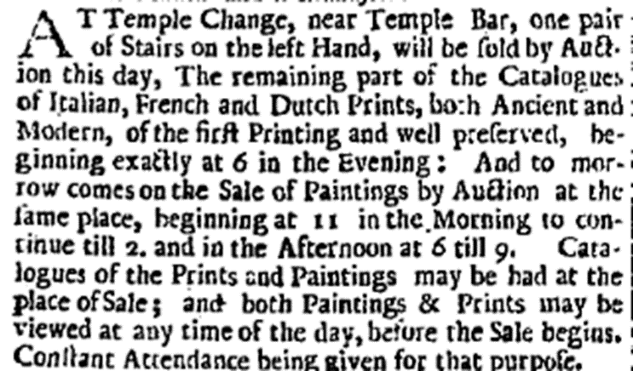
ADVERTISMENTS FOR PLACES OF SALE
(Both 1703)

Slide 7
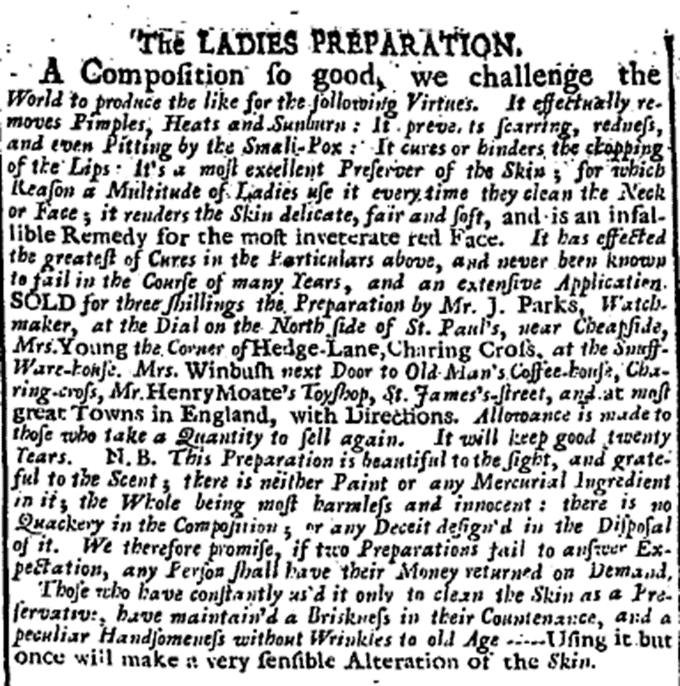
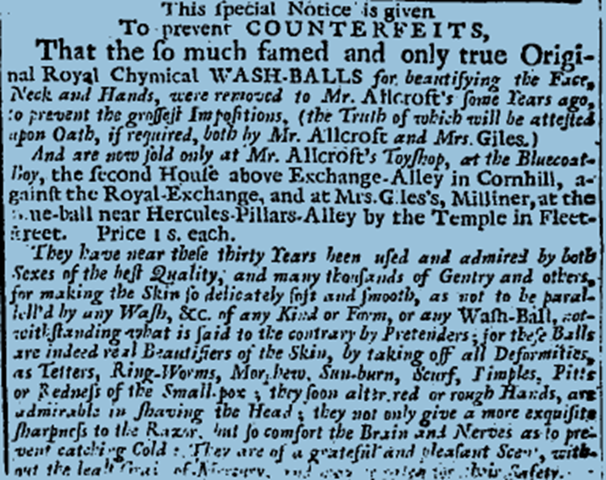
ADVERTISMENTS FOR PRODUCTS

Slide 8
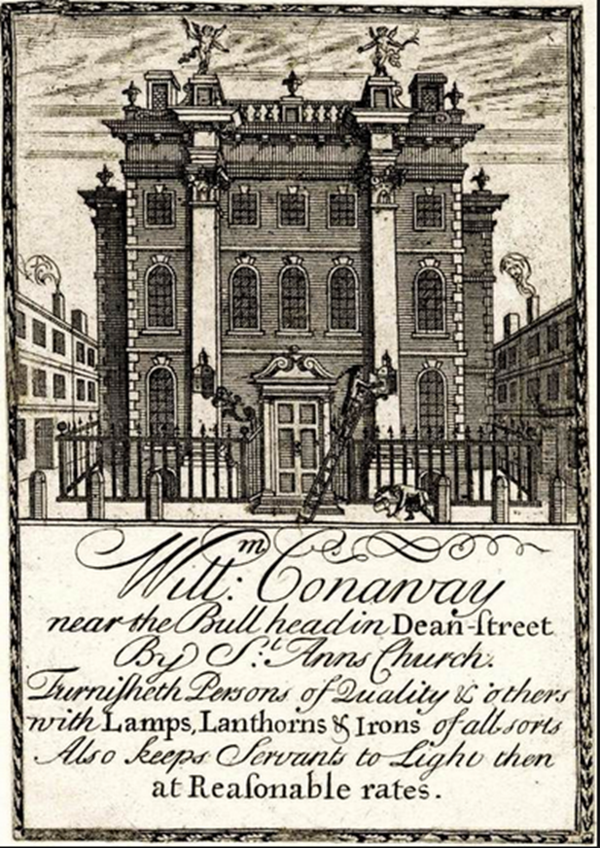
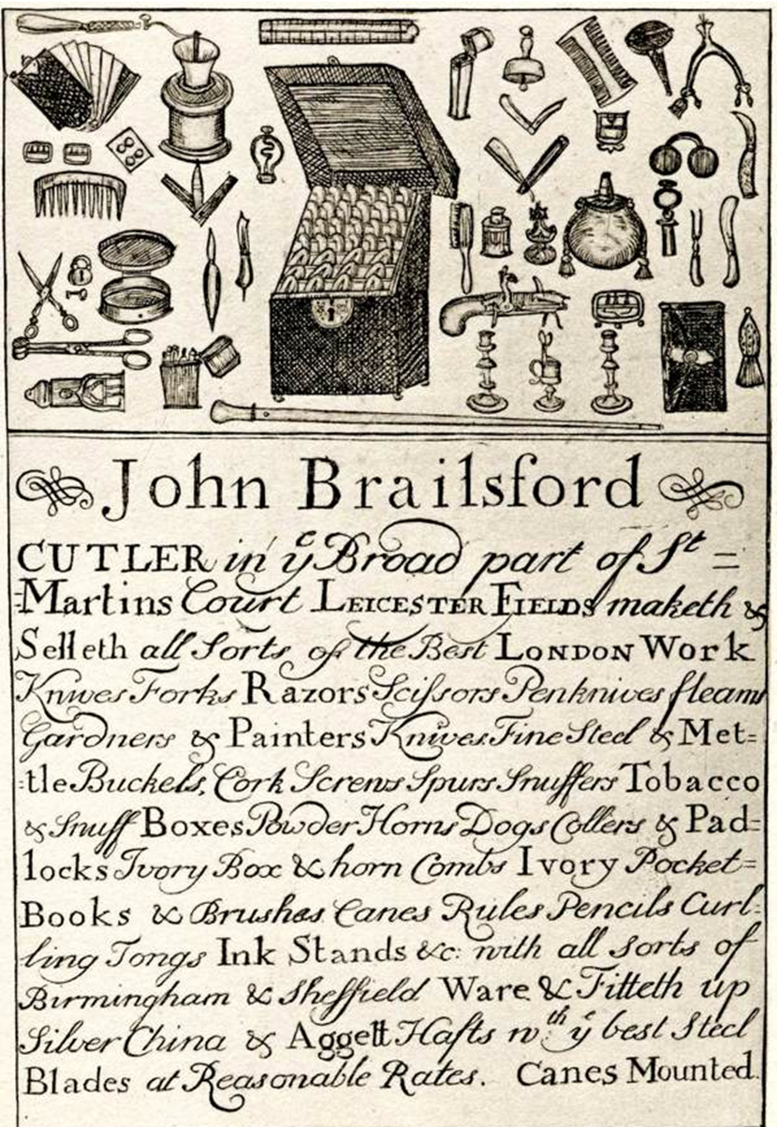
TRADE CARDS

Slide 9
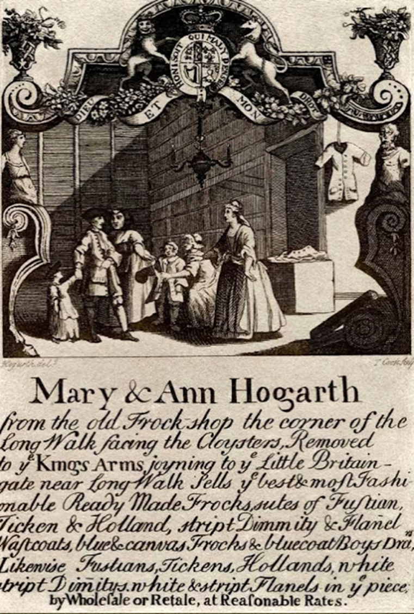
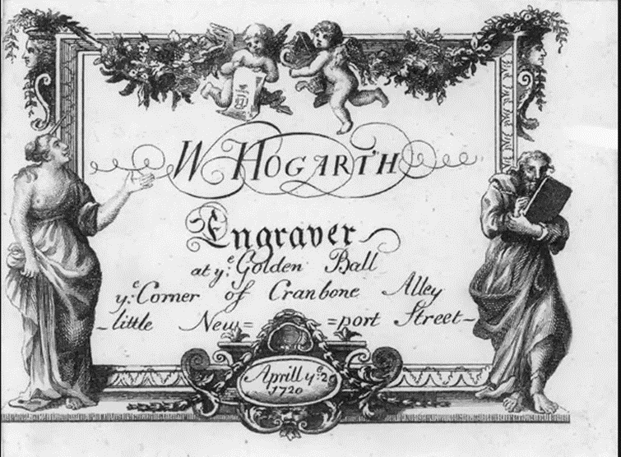
Trade cards taught ‘consumers about new goods, how to use them and desire them. It transmit[ed] skills in identifying networks of goods and the lifestyles that frame them’.
Maxine Berg and Helen Clifford, ‘Selling Consumption in the 18thc’ (2007)

Slide 10
ii. UTILITY NOVELTY, LUXURY: what drives consumption?
Luxury
Linked to pleasure and/or indulgence, arousal of the senses.
‘The wants of the Mind are infinite, Man naturally Aspires, and as his Mind is elevated, his Senses grow more refined, and more capable of Delight; his Desires are enlarged, and his Wants increase with his wishes, which is for everything that is rare, can gratifie his Senses, adorn his Body, and promote the Ease, Pleasure, and Pomp of Life’. [Nicholas Barbon, A Discourse on Trade (1690)]
Novelty
Central element to fashion – drive for constant change.
Maxine Berg - ‘ the energy behind fashion’s caprice and valorization of ephemerality.’
Stimulates the senses, alleviates the boredom that results from the body being satisfied.

Slide 11
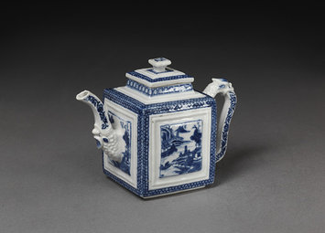
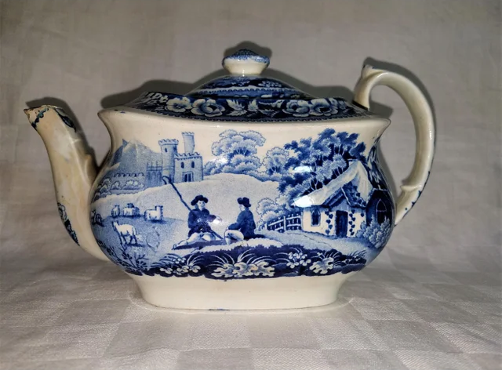
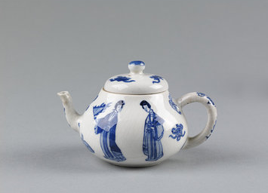
LUXURY AS ‘FOREIGN’

Slide 12
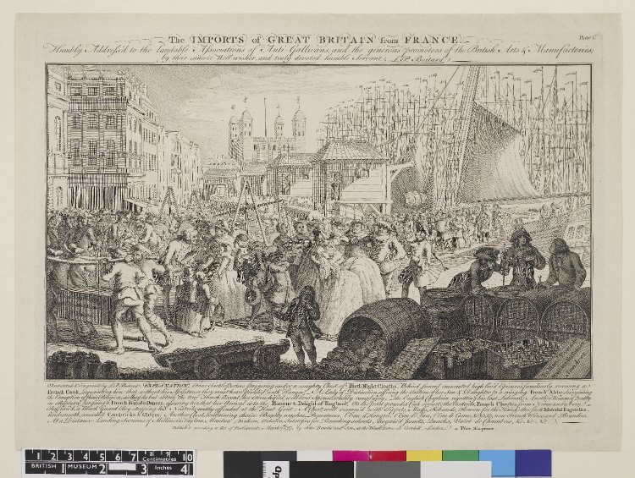

Slide 13
DEFINING ‘LUXURY’
Hume – luxury as a word of ‘uncertain significance’.
Diderot – ‘what is this luxury that we so infallibly attribute to so many objects?’
Galiana - ‘no one knows or dare say what luxury might properly be. This sphere, as it must be called, wanders among us, never seen in its true light, or recognised for its efficiacy’.
Shift in contemporary perceptions of luxury during the 18thc from an emphasis on luxuries that endure to luxuries that don’t.
Adam Smith - makes a distinction between luxury that endures and that which doesn’t.

Slide 14
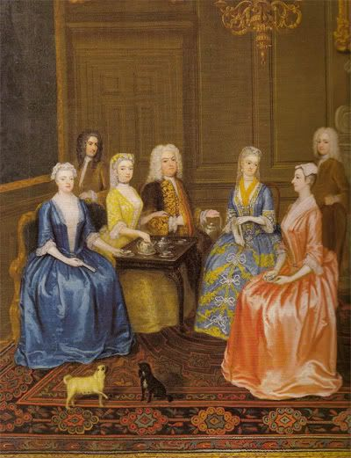
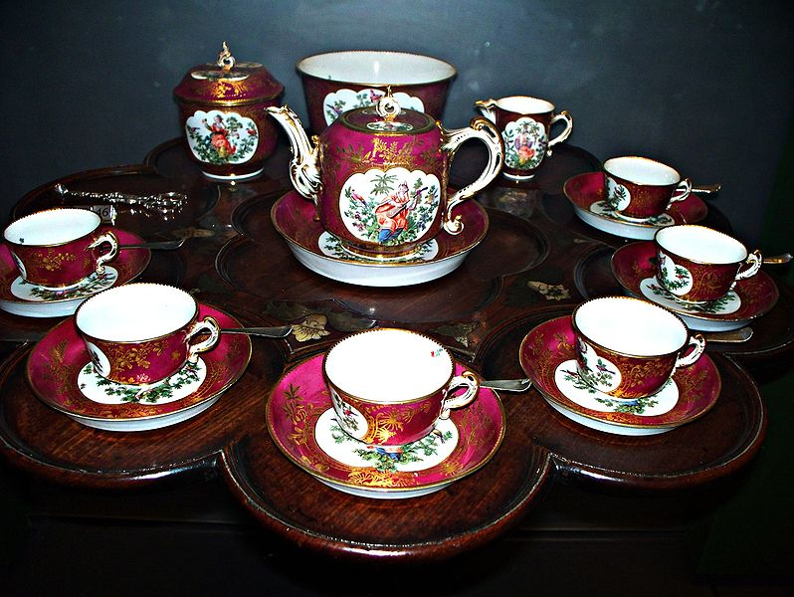
DOMESTIC CULTURE AND CONSUMPTION
(Above) 18thc tea service
(Left) Detail of a tea party by C. Phillips (1730)

Slide 15
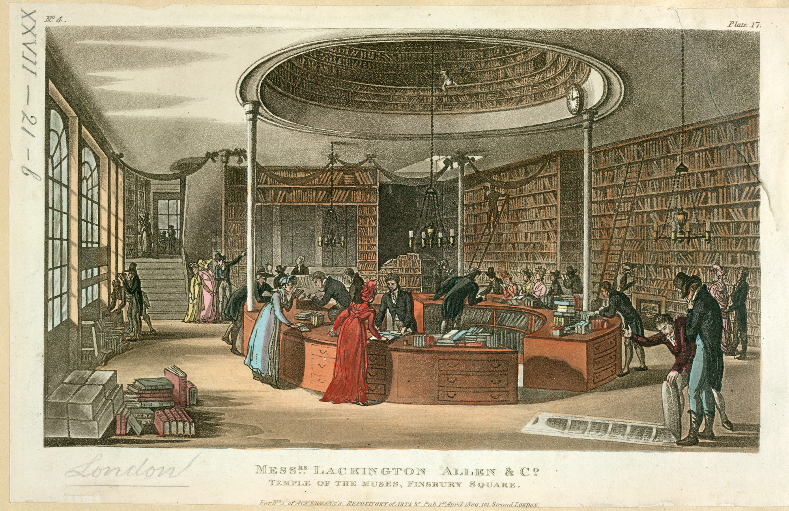
iii. Shops and shopping
‘A Nation of Shopkeepers’
1688 - King est. 50,000
1757 - Postlethwayt est. 1,000,000

Slide 16
DANIEL DEFOE, THE complete ENGLISH TRADESMAN (1726)
‘I have heard that some ladies and those, too, persons of good note, have taken their coaches and spent a whole afternoon in Ludgate Street or Covent Garden, only to divert themselves in going from one mercer's shop to another, to look upon their fine silks, and to rattle and banter the journeymen and shopkeepers, and have not so much as the least occasion, much less intention, to buy anything; nay, not so much as carrying any money out with them to buy anything if they fancied it: yet this the mercers who understand themselves know their business too well to resent’.
‘But let it be how and which way it will, whether mercer or draper, or what trade you please, the man that stands behind the counter must be all courtesy, civility, and good manners; he must not be affronted, or any way moved, by any manner of usage, whether owing to casualty or design; if he sees himself ill used, he must wink, and not see it—he must at least not appear to see it, nor any way show dislike or distaste; if he does, he reproaches not only himself but his shop, and puts an ill name upon the general usage of customers in it…’.

Slide 17
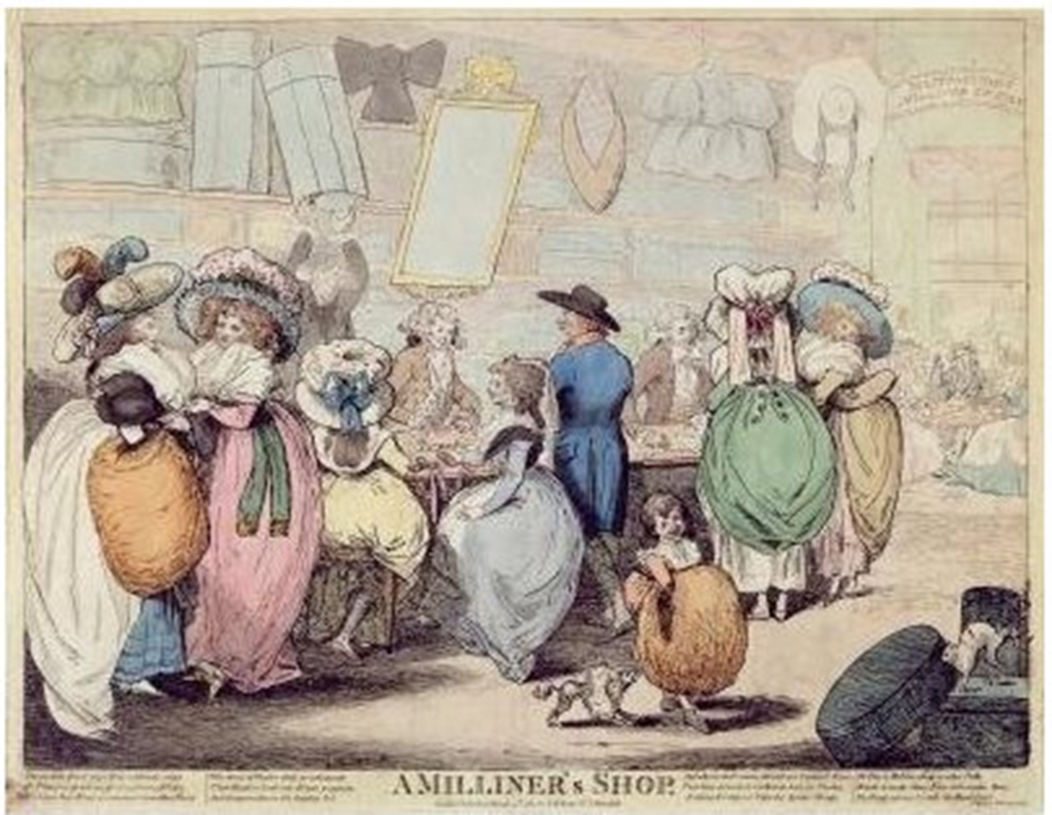
CREDIT
‘Credit is so much a tradesman's blessing that it is the choicest ware he deals in, and he cannot be too chary of it when he has it, or buy it too dear when he wants it; it is a stock to his warehouse, it is current money in his cash-chest, it accepts all his bills, for it is on the fund of his credit that he has any bills to accept; demands would else be made upon the spot, and he must pay for his goods before he has them—therefore, I say, it accepts all his bills, and oftentimes pays them too; in a word, it is the life and soul of his trade, and it requires his utmost vigilance to preserve it’.
‘A tradesman's credit and a virgin's virtue ought to be equally sacred from the tongues of men’.
(Defoe, The Complete English Tradesman)

Slide 18
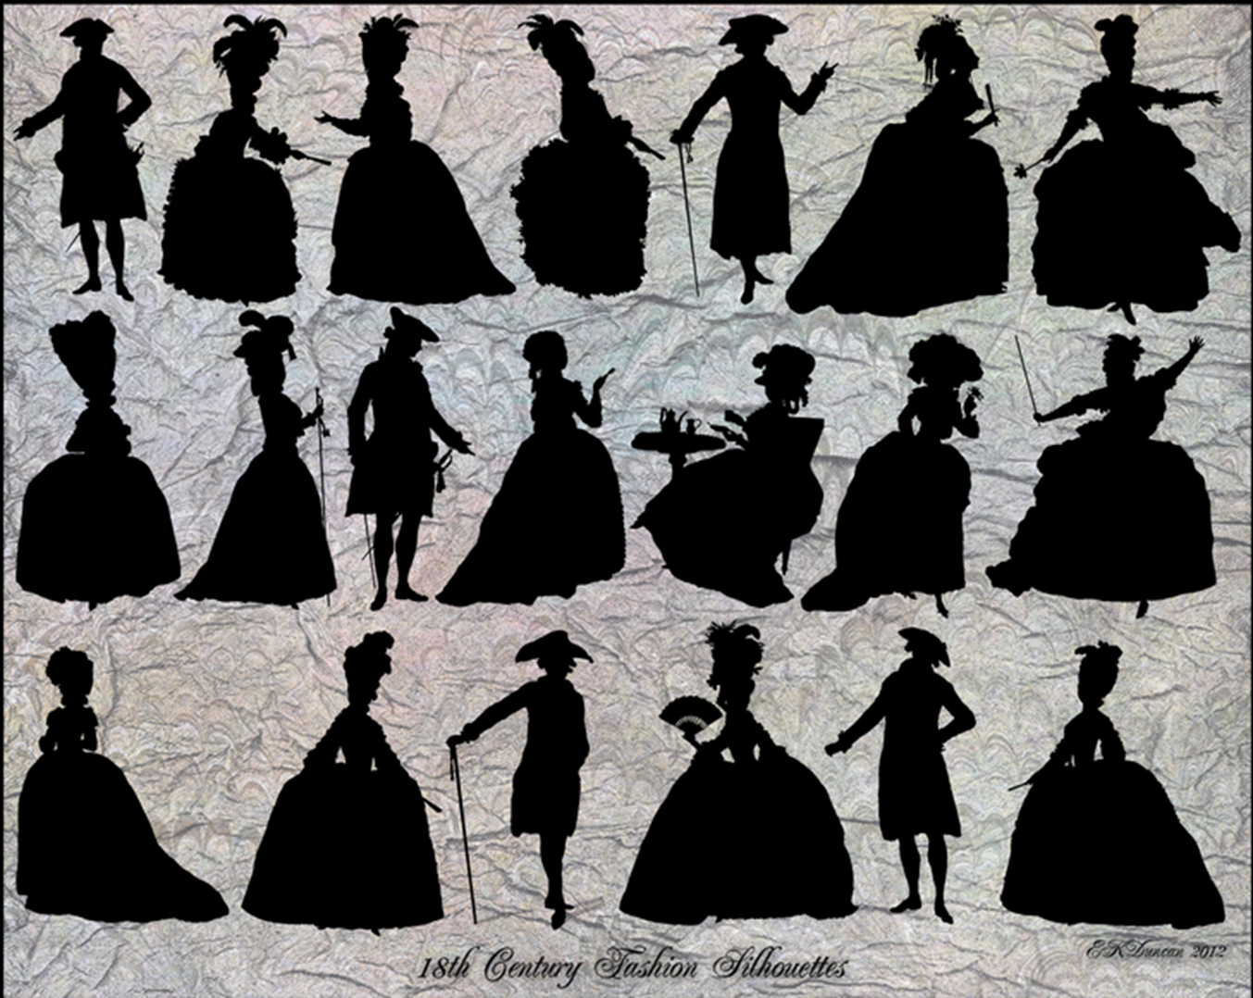
CONSUMPTION AND THE INDIVIDUAL

Slide 19
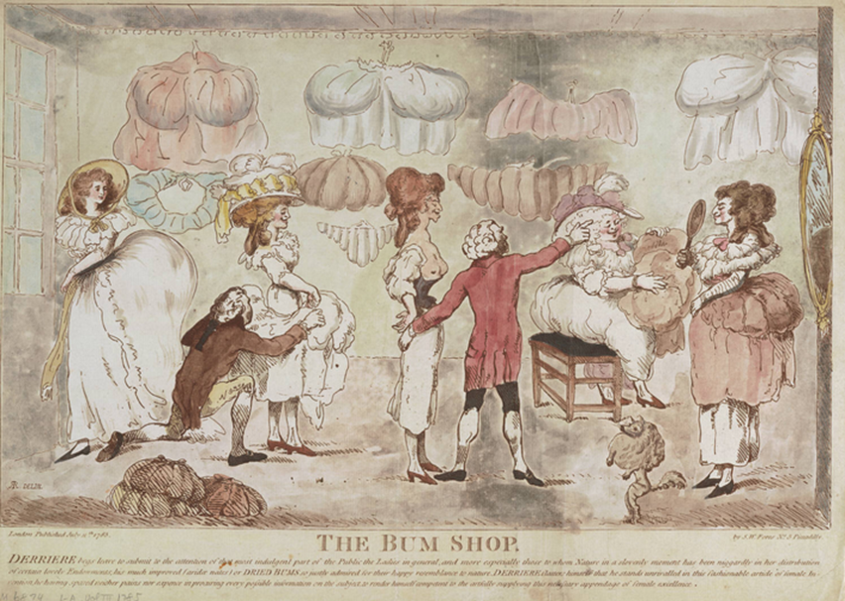
DYNAMICS OF SOCIAL PLACEMENT
What do you wear?
To conform? To whose expectations?
To distinguish yourself? From whom/to whom
What about residence?
Entertaining?
Where you shop?
To say something about your:-
Style
Money
Position in society
Patronage

Slide 20
THE EMERGENCE OF CONSUMER SOCIETY?
Is this the emergence of a consumer, market society?
Or should we understand it as a hierarchical order that generates and structures its markets and exchange?
Craig Muldrew, The Economy of Obligation (1998) - not until very late on the 18thc that the free market economy began to develop; we should recognise the extent to which 18thc sellers and buyers were linked together by a whole series of networks beyond cash (credit etc).

