Slide 1
Sense or sensibility?: Constructions of women in the eighteenth century
Dr Imogen Peck
University of Warwick

Slide 2
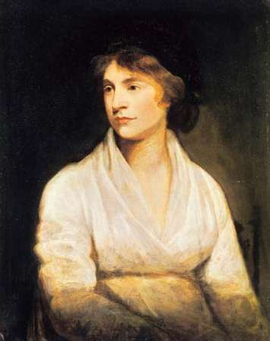
‘[Women’s] senses are inflamed, and their understandings neglected, consequently they become the prey of their sense, delicately termed sensibility, and are blown about by every momentary gust of feeling. […] Ever restless and anxious, their overexcited sensibility not only renders them uncomfortable themselves, but troublesome, to use a soft phrase, to others’.
John Opie, Mary Wollstonecraft (c. 1797)
Mary Wollstonecraft, The Vindication of the Rights of Woman (1792), book v, pp. 130-1 (Oxford World Classics edition)

Slide 3
Lecture structure
(i) Science and sensation
(ii) Virtue and the cult of sensibility
(iii) Theories of education
(iv) Sensibility and virtue in Wollstonecraft

Slide 4
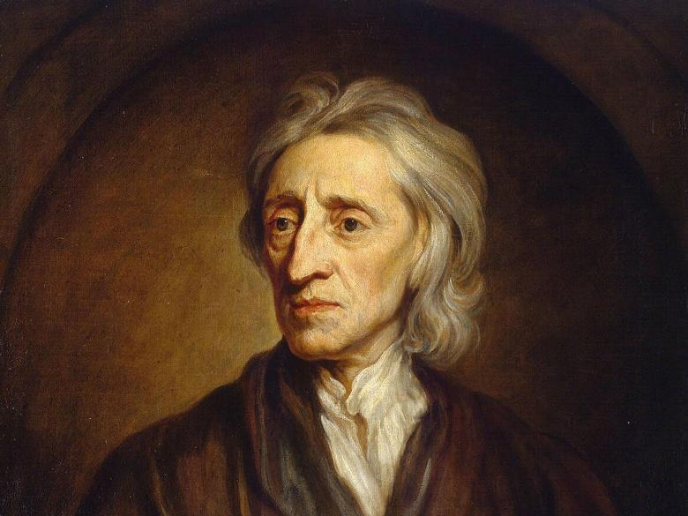
Sensationalism: Locke and the tabula rasa
‘Let us then suppose the mind to be, as we say, white paper void of all characters, without any ideas. How comes it to be furnished? Whence comes it by that vast store which the busy and boundless fancy of man has painted on it with an almost endless variety? Whence has it all the materials of reason and knowledge? To this I answer, in one word, from EXPERIENCE.’
John Locke, Essay Concerning Human Understanding (1689)

Slide 5
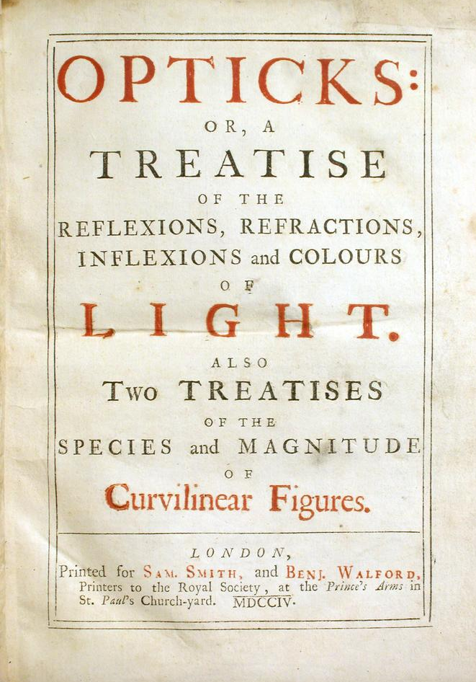
nerves and sensation
‘the Intelligent Principle, or Soul resides somewhere in the Brain, where all the Nerves, or instruments of sensation terminate, like a Musician in a finely fram’d and well-time’d Organ – Case; these nerves are like Keys which, being struck on or touch’d convey the Sound and Harmony to this Sentiment Principle, or Musician’.
George Cheyne, The English Malady (1733) p. 49.
Isaac Newton, Opticks (1704)

Slide 6
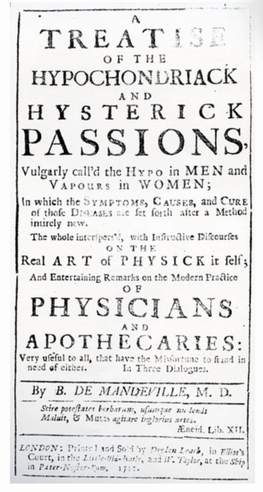
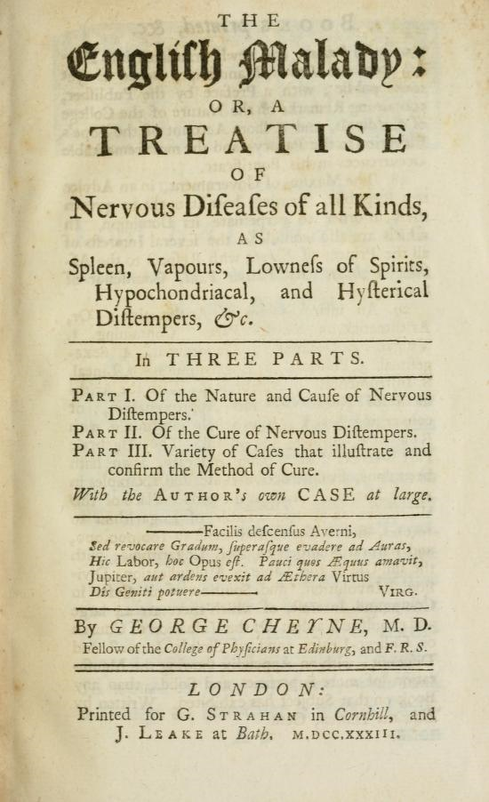
gendering NERVES
Women ‘are cast in too soft a mould, and made of too fine, too delicate composure to endure the severity of study, the drudgery of contemplation, the fatigue of profound speculation’.
The British Apollo (1708)
Bernard De Mandeville, The Treatise of the Hypochondriack and Hysterick Passions (1711) and George Cheyne, The English Malady (1733).

Slide 7
Sensibility and virtue
‘fine-wrought spirit feels acute pains:
Where glow exalted sense, and taste refin’d
…Sweet Sensibility! thou keen delight!
Thou hasty moral! sudden sense of right!
Thou untaught goodnesse! Virtue’s precious seed!’
Hannah More, ‘Sensibility: a Poem’ in Sacred Dramas (1782)

Slide 8
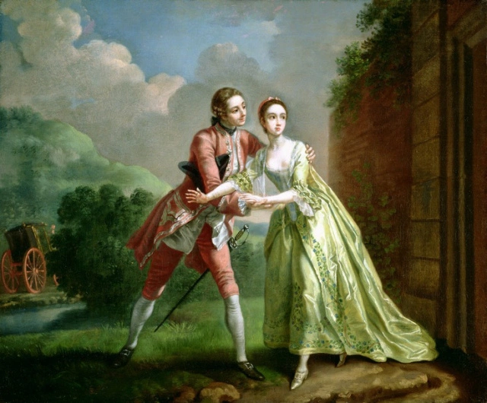
The cult of sensibility
‘the latter [i.e. Orville] has such gentleness of manners, such delicacy of conduct, and an air so respectful that, when he flatters most, he never distresses, and when he most confers humour, appears to receive it! The former [i.e. Willoughby] obtrudes his attention, and forces mine; it is so pointed that it always confuses me, and so public that it attracts general notice’.
Fanny Burney, Evelina: Or, The History of a Young Lady's Entrance Into the World (1778)
Francis Hayman, ‘Robert Lovelace preparing to abduct Clarissa’ (1753)

Slide 9
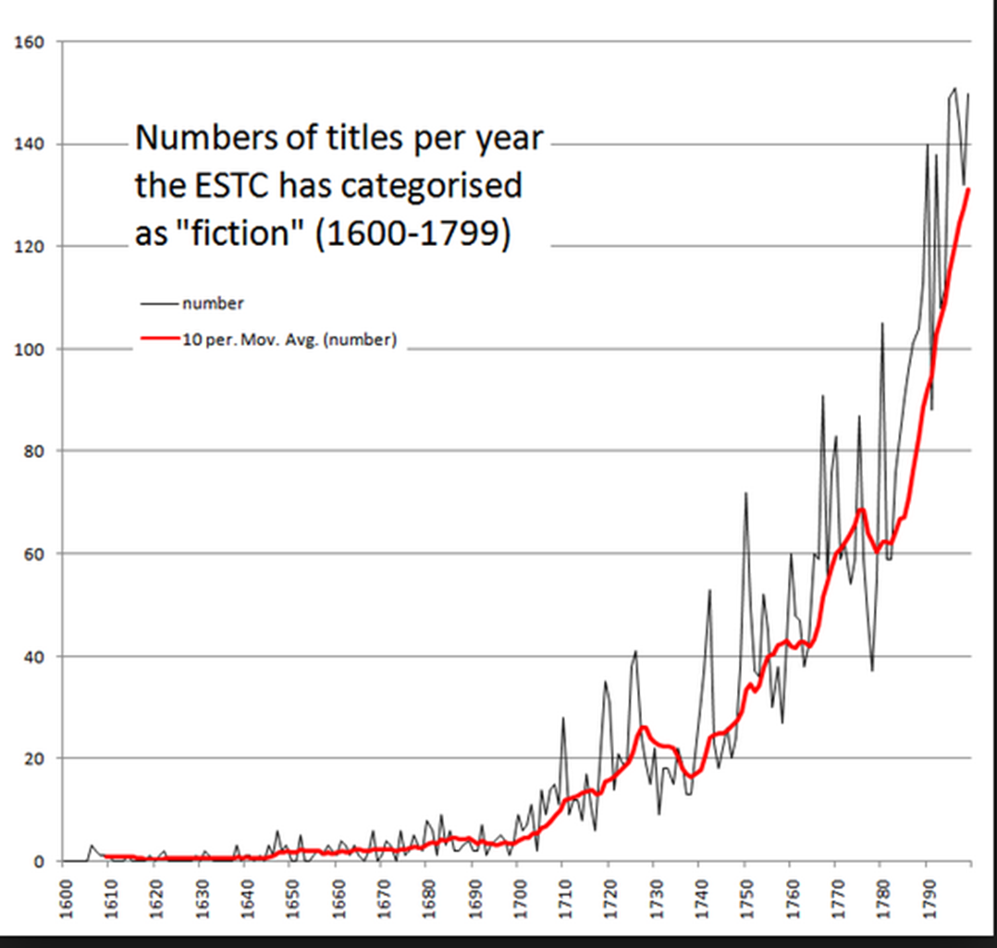
ESTC = English Short Title Catalogue (catalogue of works published between 1473 and 1800 in Britain and its former colonies, especially North America).

Slide 10
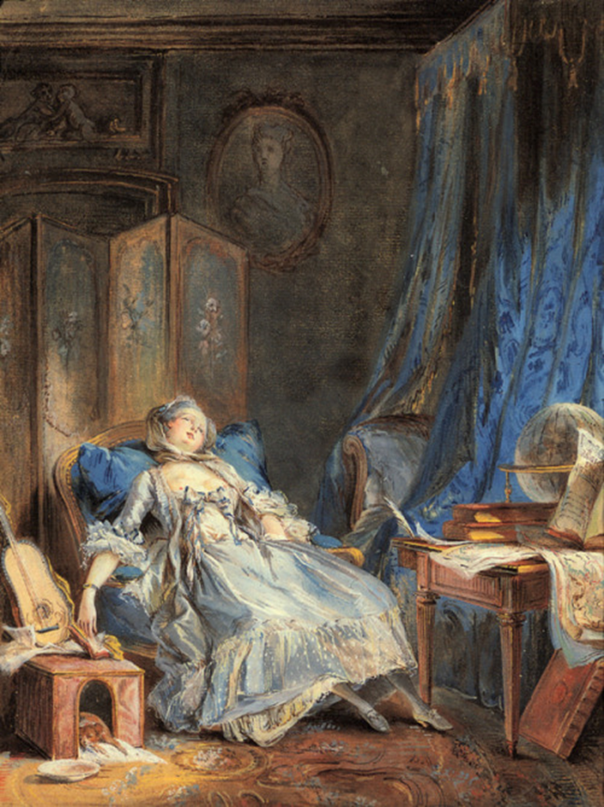
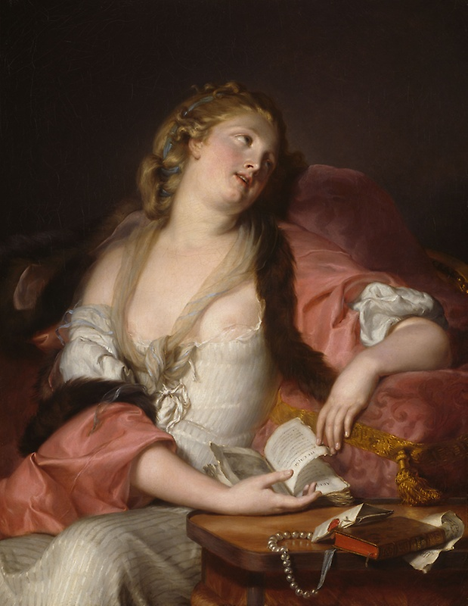
Auguste Bernard d'Agesci, ‘Lady Reading the Letters of Heloise and Abelard’ (c.1780)
Pierre-Antoine Baudoin, ‘La Lecture’ (c.1760).

Slide 11
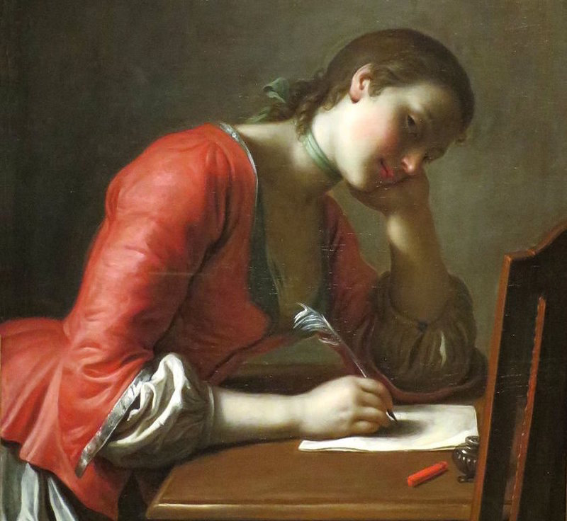
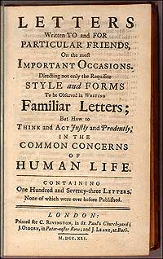
Letter writing
Samuel Richardson, Letters Written To and For Particular Friends (1741)
Its 173 sample letters include:
‘From a respectful Lover to his Mistress’
‘From a Father to a Daughter against a frothy, French Lover’
‘To a young Man too soon keeping a Horse’
Pietro Antonio Rotari, ‘Young girl writing a love letter’ (1755)

Slide 12
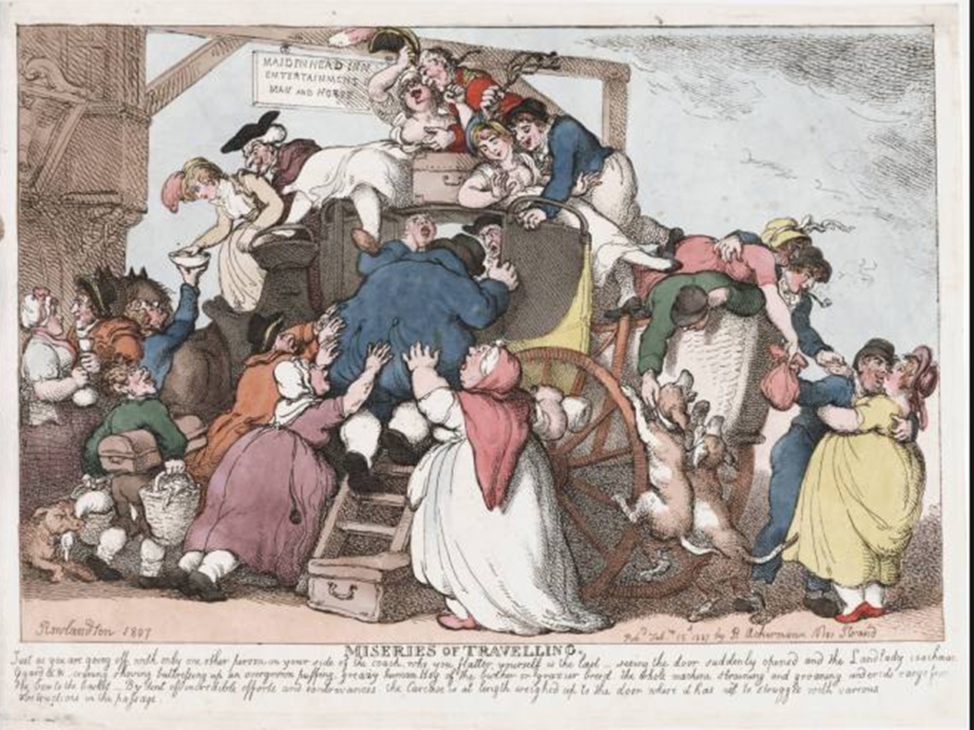
Theory and practice
‘I placed myself beside her and we soon became quite familiar. If there was nothing striking either in her exterior or her manners, still she proved a pleasant companion – and enliven the tedium of riding – we were full of our jokes – and when we parted from each other at Wheatley – she made me promise to call upon her at her return to London – I did so – willingly, but as yet, I have thought nothing more on the subject.’
William Upcott (1807)
Thomas Rowlandson, ‘Miseries of Travelling’ (1807)

Slide 13
Rousseau’s women: Julie and Sophie
‘It does not suit an educated man to take a wife with no education. But I would prefer a simple and uneducated girl a hundred times over a woman with intellectual and literary pretensions […] Une femme bel-esprit is the scourge of her husband, of her children […] of everyone. From the sublime elevation of her genius, she disdains all her womanly duties and soon transforms herself into a man’.
Emile, book IV
‘She serves as the means of connection with their father: it is she who makes him love them, gives him confidence to call them his own. What tenderness and solicitude ought she not to be possessed of, in order to maintain the peace and unity of the whole family’.
Emile, book IV.

Slide 14
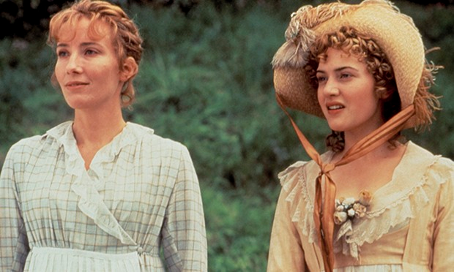
Sensibility in Wollstonecraft’s vindication
‘Novels, music, poetry and gallantry, all tend to make women the creatures of sensation, and their character is thus formed during the time they are acquiring accomplishments, the only improvement they are excited, by their station in society, to acquire. This overstretched sensibility naturally relaxes the other powers of the mind, and prevents intellect from attaining that sovereignty which it ought to attain, to render a rational creature useful to others, and content with its own station; for the exercise of the understanding, as life advances, is the only method pointed out by nature to calm the passions’.
Wollstonecraft, The Vindication of the Rights of Women, ch 4.

Slide 15
Bibliography
PRIMARY TEXTS
John Locke, Essay Concerning Human Understanding (1689)
George Cheyne, The English Malady (1733)
Bernard De Mandeville, The Treatise of the Hypochondriack and Hysterick Passions (1711)
Hannah More, ‘Sensibility: a Poem’ in Sacred Dramas (1782)
Fanny Burney, Evelina: Or, The History of a Young Lady's Entrance Into the World (1778)
Samuel Richardson, Letters Written To and For Particular Friends (1741)
Samuel Richardson, Clarissa: or the History of a Young Lady (1748)
Jean Jacques Rousseau, Julie, or the new Heloise (1760)
Jean Jacques Rousseau, Emile, or on Education (1762)
Mary Wollstonecraft, A Vindication of the Rights of Woman (1792)
Mary Wollstonecraft, Maria; or the Wrongs of Woman (1798)
SECONDARY READING
G. J. Barker-Benfield, The Culture of Sensibility: Sex and Society in Eighteenth-Century Britain (1992)
Paul Langford, A Polite and Commercial People: England 1727-83 (1998)
Mary Trouille, ‘The Failings of Rousseau's Ideals of Domesticity and Sensibility’, Eighteenth-Century Studies, 24.4 (1991), 451-483
Mary Trouille, Sexual Politics in the Enlightenment: Women Writers Read Rousseau (1997)
‘The Education of Rousseau’s Natural Woman’ in Eduardo Velásquez (ed.), Nature, Woman, and the Art of Politics (2000)
Janet Todd, ‘Reason and Sensibility in Mary Wollstonecraft’s The Wrongs of Woman’, Frontiers: A Journal of Women Studies, 5.3 (1980), 17-20
Mary Shanley, ‘Mary Wollstonecraft on sensibility, women's rights, and patriarchal power’, in Hilda Smith (ed.), Women's Political and Philosophical Writings, 1690–1800, ii (1998)

