Slide 1
Godwin and Malthus
Mark Philp

Slide 2
Rousseau/Federalists Godwin/Malthus
The limits and possibilities of morality/politics
Human design vs nature
Causality vs agency

Slide 3
1789
Wordsworth: Bliss was it in that dawn to be alive; But to be young was very heaven..
Charles James Fox: ‘How much the greatest event that has happened in the history of the world, and how much the best.’
Richard Price ‘…methinks I see the ardour for liberty catching and spreading ; a general amendment beginning in human affairs; the dominion of kings changed for the dominion of laws, and the dominion of priests giving way to the dominion of reason and conscience.’

Slide 4
1790s
1789 April Estates General; May Tennis Court Oath; 14 July Storming of the Bastille
November 1789 Richard Price’s Discourse on the Love of Our Country
November 1790 Edmund Burke’s Reflections on the Revolution in France
December 1790 Wollstonecraft Vindication of the rights of Men
March 1791 Paine’s Rights of Man Pt 1 (pt 2 March 1792)
May 1792 Royal Proclamation against seditious writings
May Prosecution of Paine
August, Paine leaves for France
September 1792 September Massacres
January 1793, execution of Louis XVI. Britain declares war on France.

Slide 5
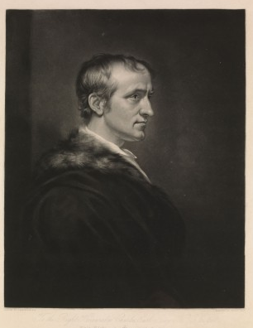
William Godwin 1756-1836

Slide 6
Godwin Diary Project
http://godwindiary.bodleian.ox.ac.uk

Slide 7
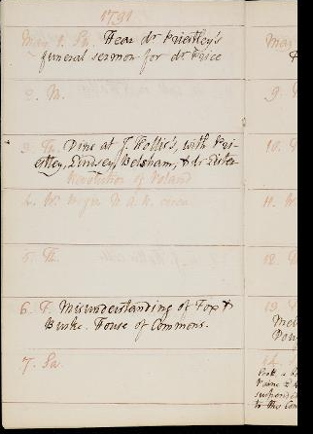
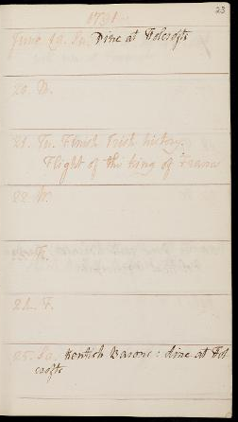
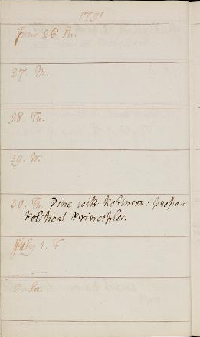
May – July 1791

Slide 8
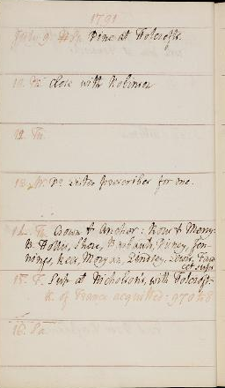
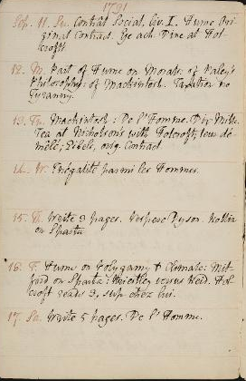
July 1791 September 1791

Slide 9
Enquiry Concerning Political Justice
Principles of society:
  Chap 2 Of Justice:
    Fenelon
    Reciprocity of rights and duties
    Duty is a term …to describe the mode in which any being may best be employed for the general good.
    I have no right to omit what my duty prescribes - it inevitably follows that men have no rights (understood as discretionary)

Slide 10
Enquiry….(2)
II (6) On the exercise of Private Judgment
To a rational being there can be but one rule of conduct, justice, and one mode of ascertaining that rule, the exercise of his understanding.
In contrast to force and fraud, and in contrast to fear of punishment or hope of reward.
Relationship to consequentialism

Slide 11
Enquiry (3)
Each individual is included in the calculation of justice, but each needs to judge impartially his or her own claims.
Positive institution furnishes additional motives to the mind and thereby corrupts the judgment of the agent. Have to respond to intrinsic properties of a case, and be moved by intrinsic merits.
Every man is bound to the exertion of his faculties in the discovery of right, and to carrying into effect all the right with which he is acquainted.

Slide 12
Godwin on Marriage
‘The habit is, for a thoughtless and romantic youth of each sex to come together, to see each other a few times and under circumstances full of delusion, and then to avow to each other eternal attachment. In almost every instance the find themselves deceived.’
VIII, vi
‘The institution of marriage is a system of fraud…add to this, that marriage is a system of property, and the worst of all properties … so long as I engross one woman to myself, and to prohibit my neighbour from proving his superior desert and reaping the fruits of it, I am guilty of the most odious of all monopolies.’ VIII, vi.

Slide 13
Marriage, Property, and Population
Principle of private judgment
Reason and motive – utility as criteria
All coercion is a violation of judgment
Final speculative Book VIII
property – marriage as a form of property
Impact on population –
rational versus sensual pleasure
judgment of utility
immortality

Slide 14
Rational relations
The men therefore who exist when the earth shall refuse itself to a more extended population, will cease to propagate, for they will no longer have any motive, either of error or duty, to induce them. In addition to this they will perhaps be immortal. The whole will be a people of men, and not of children. Generation will not succeed generation, nor truth have in a certain degree to recommence her career at the end of every thirty years. There will be no war, no crimes, no administration of justice as it is called, and no government. These latter articles are at no great distance; and it is not impossible that some of the present race of men may live to see them in part accomplished. But beside this, there will be no disease, no anguish, no melancholy and no resentment. Every man will seek with ineffable ardour the good of all. Mind will be active and eager, yet never disappointed. Men will see the progressive advancement of virtue and good, and feel that, if things occasionally happen contrary to their hopes, the miscarriage itself was a necessary part of that progress. They will know, that they are members of the chain, that each has his several utility, and they will not feel indifferent to that utility. They will be eager to enquire into the good that already exists, the means by which it was produced, and the greater good that is yet in store. They will never want motives for exertion; for that benefit which a man thoroughly understands and earnestly loves, he cannot refrain from endeavouring to promote.

Slide 15
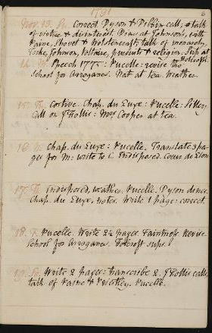
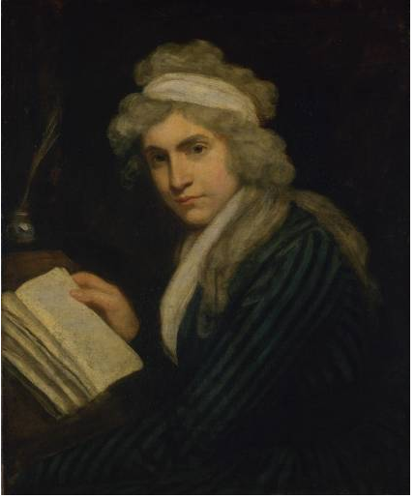
Mary
Wollstonecraft
(1759-1797)

Slide 16
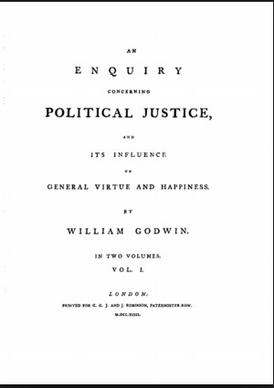
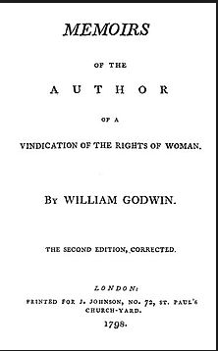
Theory and Practice

Slide 17
Memoirs (1798)
‘It was friendship melting into love. Previously to our mutual declaration, each felt half assured, yet each felt a certain trembling anxiety to have assurance complete. Mary rested her head on the shoulder of her lover, hoping to find a heart with which she might safely treasure her world of affection. … I had never loved til now; or, at least, had never nourished a passion to the same growth, or met with an object so consummately worthy. We did not marry.’
Memoirs 153

Slide 18
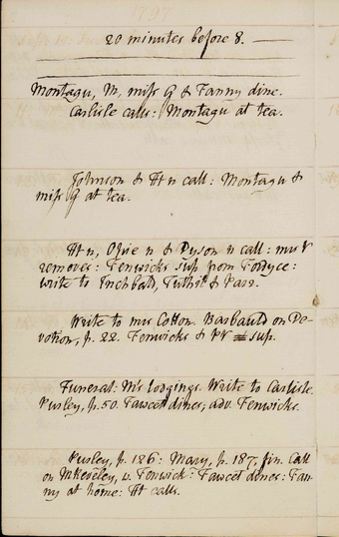
Godwin’s relationships
Godwin meets MW in November 1791
1793-6 Friendships with Maria Reveley, Amelia Alderson, Elizabeth Inchbald, Mary Hays and Sarah Parr
Godwin and Wollstonecraft re-introduced in January 1796 by Mary Hays
Begin their affair August 1796
She becomes pregnant c December 1796
They marry March 1797
She dies in September 10 days after the birth of her daughter Mary.
Memoirs – Southey ‘he stripped his dead wife naked’
Godwin proposes to Harriet Lee, A Bath schoolmistress in 1798
Godwin proposes to Maria Reveley after the death of her husband in August 1799
He meets Mary Jane Clairmont in May 1801 and they marry in December 1801

Slide 19
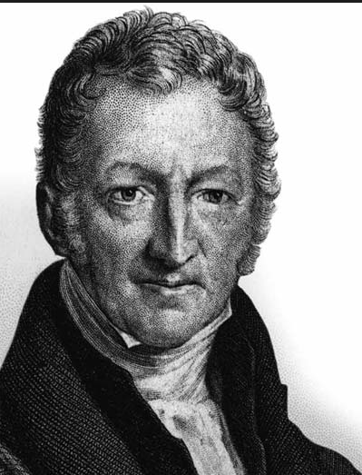
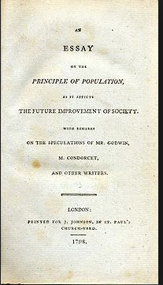
Robert Malthus 1766-1834

Slide 20
T. R. Malthus1766-1834
Cambridge Graduate (i.e., orthodox churchman)
Takes a living as a church of England clergyman
An Essay on the Principle of Population (1798)
Development of Political Economy

Slide 21
Syllogism of poverty
That food is necessary and the passions between the sexes is necessary and will remain nearly in the present state (no evidence that there has been any alteration in them)
Population, when unchecked, progresses in geometric ratio – subsistence in arithmetic. That is, where means of subsistence are abundant then there is no check on providing for a family, people marry earlier and keep producing children. When unchecked Malthus calculates the population doubles every 25 years (assuming, implicitly, each woman producing about 8 children).
In contrast, agricultural expansion is limited and grows by arithmetic ration (moreover, as more land taken into cultivation the output falls, because the land is less productive).
The effects of these two unequal powers must be kept equal – which implies a constant and strong operating check on population from the difficulty of subsistence.
The ‘passion between the sexes’ is a constant (31) but the foresight of the difficulties of rearing a family act as a preventative check; and the actual distresses of some of the lower classes acts as a positive check to the natural increase in population.
Positive checks = one that represses an increase already begun mortality, want and distress
Necessity is the great restrictive law: the two great constraints are misery and vice. Misery is absolutely necessary consequence; vice is less necessary – it is the ordeal of virtue to resist all temptation to evil.
‘The mighty law of self-preservation expels all the softer and more exalted passions of the soul. The temptations to evil are too strong for human nature to resist… benevolence…makes some faint expiring struggles, til at length self-love resumes his wonted empire and lords it triumphant over the world.’

Slide 22
mortality and procreation
..in all old states the marriages and births depend principally upon the deaths…to act consistently we should facilitate this mortality
We should reprobate specific remedies for ravaging diseases
If by these and similar means, the annual mortality were increased from 1 in 36 or40, to 1 in 18 or 20, we might probably every one of us marry at the age of puberty, and yet few be absolutely starved (1803, IV,v)

Slide 23
1803 edition of Malthus’s Essay
‘if a child is born into a world already possessed, if he cannot get subsistence from his parents, on whom he has a just demand, and if the society do not want his labour, he has no claim of right to the smallest portion of food, and in fact no business to be where he is. At nature’s feast there is no vacant cover for him; she tells him to be gone, and will quickly execute her orders, if he do not work on the compassion of some of her guests; if these guests get up and make room for him, other intruders immediately appear, demanding the same favour.

Slide 24
Reformation of manners
Shift in attitudes to sex and marriage, closely linked to political conflicts.
1790s reformers and aristocratic moeurs
Hannah More and cheap repository tracts
Reaction to Godwin’s Memoirs incl. Malthus
Paris and London radical circles at the end of 1790s
Francis Place and eradication of customary practice and pleasures

Slide 25
Middle classes
The middle regions of society seem to be best suited to intellectual improvement, but it is contrary to the analogy of all nature to expect that the whole of society can be a middle region. The temperate zones of the earth seem to be the most favourable to the mentaland corporeal energies of man; but all cannot be temperate zones. 1798 ch. xviii

Slide 26
Godwin and Malthus
Necessity vs determinism
Individual agency and virtue vs Malthus’s laws of nature
Godwin’s moralism vs Malthus’s laws of society
Judgment vs incentives and disincentives (preventive checks)
Dissent vs anglicanism

Slide 27
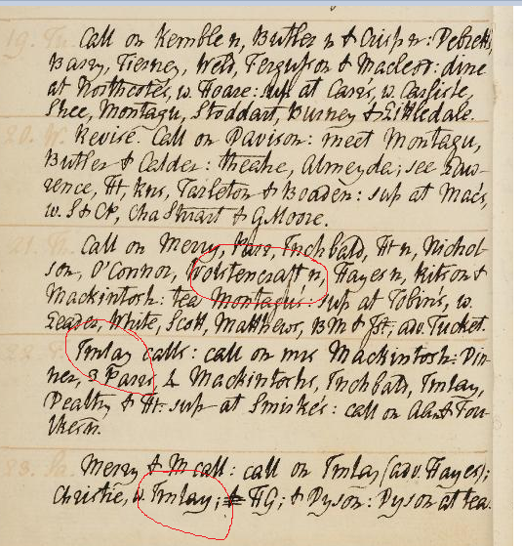
1796-04-22
22. F. Imlay calls : call on mrs Mackintosh : Dinner, 3 Parrs , 4 Mackintoshs , Inchbald , Imlay , Dealtry & Ht : sup at Smirke's : call on A A n & Foulkes n .
1796-04-23
23. Sa. Merry & M call : call on Imlay ( adv. Hayes ) ; Christie , w. Imlay ; & H G ; & Dyson : Dyson at tea .

Slide 28
Harriet G qua Lydia 1804
21. Tu.Camilla, revise. Write to Harris & Kemble. M dines; adv. Jo G. E M.
22. W.Write to Philips, on Perrault. C^{t} Pool & miss Walsh call: Truchsess Gallery, w. Loffts & M J^{e}: call on Foulkes & Kemble: sup at Jo G's, w. M. meet H Rowan & Castle Brown.
23. Th.Coach, Golden Cross, C C, w. Jo G: breakfast at Godstone: dine at Lewes, Bear: call on West^{n}: Coffee house; note to West: write to M J: sleep.[Not in London]
24. F.Barracks, Malling Hill, & Castle: enquiries, Post Office, &c^{e}: call on West^{n}: note from dº: write to dº, & M J.[Not in London]
25. Sa.Call on Smith, Neale (Dallas, alias Dallison: write to Harriet) & Hooper: walk to Brighton; dine at White Horse; adv. Spiring: Neale calls: sleep at Lewes. Letter from West.[Not in London]
Feb. 26. Su.Call on Langridge: letter to Ht, sent delivered by the maid: Steel, baker, calls: call on Steel & mrs Neal: Langridge writes to West: write to M J. Letter from West.[Not in London]
27. M.Call on mrs Steel, Alfeck^{na}, Neal, Langridge (adv. Kell), Wolger, constable, col. Wall & lord Craven; adv. West: adieux, Neal & Langridge: dine at White Horse, Brighton; adv. Spiring: write to M J & Steel.[Not in London]
28. Tu.Coach, w. rev. Hudson, Tomlins & Day: breakfast at Cuckfield: dine at Somers Town; adv. M: call on Wordsworth, w. Jo G
29. W.Call on R Wordsworth, R Taylor^{n} & Lofft^{n}: meet Damiani: affidavit, bef. judge Grose^{e}: call, w. M J, on L Ht & E Fk
………
3. Sa.Write to Kemble & Dallas. Letters (to Jo G) fm West & Harriet^{e}. Jo G & Smith call: call on Wordsworth, & Goodyer, sexton, Chelsea: dine at H Rowan's: call on Carlisle^{n}. Letters fm Kemble & Coleridge.
Mar. 4. Su.Letter from Dallas. Smith dines; adv. miss Walsh & Rawlins. Cherche mon Pere^{e}.
5. M.Write to Dallas & Kemble. Petite Ville, & Udolphe. H Rowan calls. Harriet in town

Slide 29
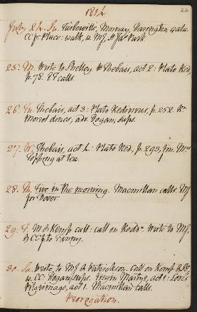
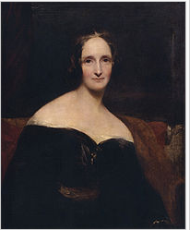
Mary Wollstonecraft Shelley (1797-1851)

Slide 30
