Slide 1
Improvement and its critics:
William Godwin and Thomas Malthus
Dr Imogen Peck
University of Warwick

Slide 2
1789
‘Bliss was it in that dawn to be alive; But to be young was very heaven…’ (William Wordsworth)
‘methinks I see the ardour for liberty catching and spreading ; a general amendment beginning in human affairs; the dominion of kings changed for the dominion of laws, and the dominion of priests giving way to the dominion of reason and conscience’. (Richard Price)
‘How much the greatest event that has happened in the history of the world, and how much the best’. (Charles James Fox)

Slide 3
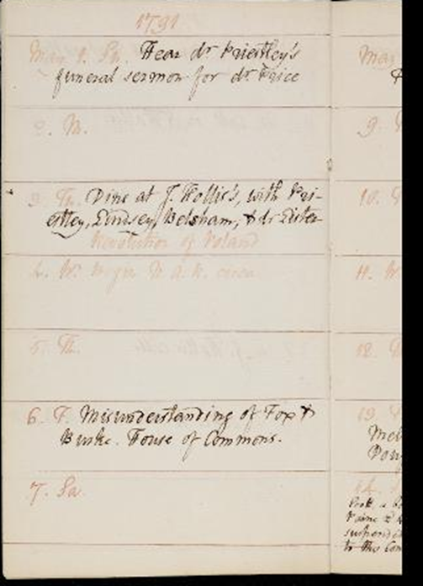
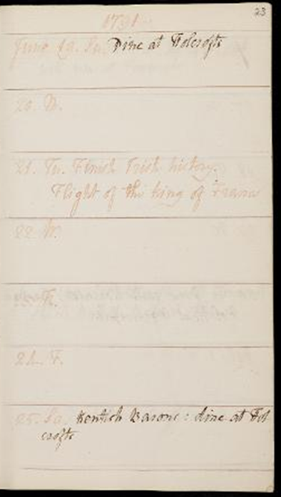
William godwin: an enquiry concerning political justice (1793)
Godwin’s diaries May-June 1791.
They are available online at:
godwindiary.bodleian.ox.ac.uk

Slide 4
3 tenets of Political justice
That there are objective standards of truth and right action.
That persons are capable of grasping these truths through public discussion and the exercise of private judgement.
People are obliged and motivated to act in accordance with these truths.

Slide 5
On truth
‘Truth is in reality single and uniform. There must be in the nature of things one best form of government, which all intellects, sufficiently roused from the slumber of savage ignorance, will be irresistibly incited to approve’.
(PJ, Book III)
Humans, through the exercise of their own judgement, will be able to work out what these truths are, and they will be things that tend to the well-being of humanity.

Slide 6
On welfare
‘What is that society bound to do for its members? Everything that can contribute to their welfare. But the nature of their welfare is defined by the nature of the mind. That which will most contribute to it, which enlarges the understanding, supplies incitements to virtue, fills us with generous consciousness of our independence, and carefully removes whatever can impede our exertions.’
(PJ, Book II, ch 2)

Slide 7
ON JUSTICE
‘To a rational being there can be but one rule of conduct, justice, and one mode of ascertaining that rule, the exercise of understanding’
(PJ, Book II, ch 6)

Slide 8
On duty
    Duty is a term to describe the mode in which any being may best be employed for the general good.
    I have no right to omit what my duty prescribes; it inevitably follows that men have no rights (these are understood as discretionary).

Slide 9
Condorcet and progress
‘As the number of facts known increases, man learns to classify them, to reduce them to more general terms; because the instruments and the methods of observation and exact measurement are at the same time reaching a new precision; the truths whose discovery has cost the most effort, which at first could be grasped only by men capable of profound thought, are soon carried further and proved by methods that are no longer beyond the reach of ordinary intelligence. If the methods that lead to new combinations are exhausted, if their application to problems not yet solved requires labours that exceed the time or the capacity of scholars, soon more general methods, simpler means, come to open a new avenue for genius’.
(The Future Progress of the Human Mind)

Slide 10
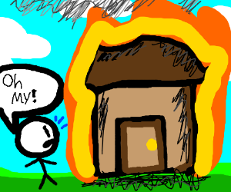
Godwin and the burning building
Situation 1 – Fenelon and the maid
Situation II – Fenelon and the maid, but the maid is your mother
Situation III – Fenelon and you

Slide 11
First-order impartiality
Our decisions should be impartial to our own preferences.
Instead, they should be guided in all matters by judgments about which acts will produce the greatest value or benefits for society.
‘In saving the life of Fenelon, suppose at the moment when he was conceiving the project of his immortal Telemachus, I should be promoting the benefit of thousands, who have been cured by the perusal of it some error, vice and consequent unhappiness. Nay, my benefit would extend father than this, for every individual thus cured has become a better member of society, and has contributed in turn to the happiness, the information, and the improvement of others’.
(PJ, Book II, ch 2)

Slide 12
Godwin and utilitarianism
‘actions are right in proportion as they tend to promote happiness, wrong as they tend to promote the reverse of happiness. By happiness is intended pleasure, and the absence of pain; by unhappiness pain and the privation of pleasure’.
(J.S. Mill, Utilitarianism)
‘The nature of happiness and misery, pleasure and pain, is independent of all positive institution: that is, it is immutably true that whatever tends to procure a balance of the former is to be desires, and whatever tends to procure a balance of the latter is to be rejected. In like manner the promulgation of virtue, truth and political justice must always be right. There is perhaps no action of a rational being that has not some tendency to promote these objects, and consequently that has not a moral character founded in the abstract nature of things’. (PJ, Book II, ch 6)
VS

Slide 13
Implications For government and law
On Law:
‘If I yield my opinion to his dictum [ie the dictum of government, the law], my action becomes modified, and my character too. An influence like this is inconsistent with all generous magnanimity of spirit, all ardent impartiality in the discovery of truth, and all inflexible perseverance of assertion’.
(PJ, Book II, ch 6)
On Justice:
‘Strictly speaking no two men were ever guilty of the same crime but here come the positive law with its Proscrutes’ bed, and levels all characters , and tramples upon all distinctions’.
(PJ, Book II, ch 6)
On Government: ‘private judgement and public deliberation are not themselves the standard of right and wrong; they are only the means of discovering right and wrong, and of comparing particular propositions with the standard of eternal truth’.
(PJ, Book III, ch 4)

Slide 14
On population
As reason expands and develops luxury will disappear.
Progress will mean that here will be adequate resources available for minimal labour and no man will withhold from another what is necessary to his need.
As a result, a dramatically more egalitarian order will ensue.
One objection: that in these conditions, the human population would expand, eventually reintroducing want as pressure on resources superseded what was available.
Godwin’s response: men will ‘cease to propagate, for they will no longer have any motive, either of error or duty, to induce them’. (PJ, Book VIII, ch 7).

Slide 15
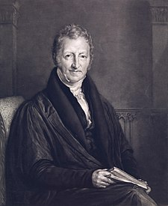
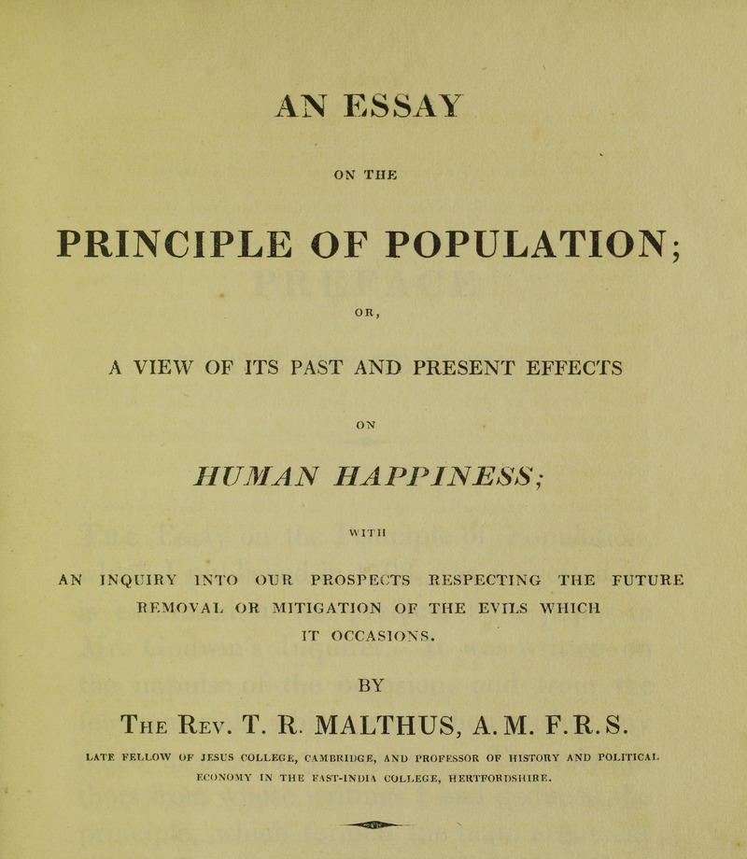
Thomas malthus (1766-1834)

Slide 16
Against improvement
‘It has been said that the great question is now at issue, whether man shall henceforth start forwards with accelerated velocity towards illimitable, and hitherto unconceived improvement; or be condemned to a perpetual oscillation between happiness and misery […]
I have read some of the speculations on the perfectibility of man and of society with great pleasure. I have been warmed and delighted with the enchanting picture which they hold forth. I ardently wish for such improvements. But I see great and, to my understanding, unconquerable difficulties in the way to them’.
(An Essay on the Principle of Population, ch 1)

Slide 17

Malthus’ two postulata
‘First, That food is necessary to the existence of man.
Second, That the passion between the sexes is necessary, and will remain nearly in its present state.
These two laws ever since we have had any knowledge of mankind, appear to have been fixed laws of our nature; and, as we have not hitherto seen any alterations in them, we have no right to conclude that they will ever cease to be what they now are…’.
(Essay, ch 1)

Slide 18
On population and production
Population, when unchecked, progresses in a geometric ratio. But subsistence, resources, increase only by an arithmetic ratio.
So, where the means of subsistent are abundant and there is no check on providing for a family, people marry earlier and keep producing children.
When unchecked, Malthus calculates that the population will double every 25 years. Agriculture, meanwhile, has a limited expansion and will grow more slowly.
The effects of these two unequal powers – population and production - must be kept equal. This will require a constant and strong operating check on population.

Slide 19
Malthus’ checks on population
‘there is a principle in human society, by which population is perpetually kept down at the means of subsistence […] a degree of misery, the necessary and inevitable result of the laws of nature, which human institutions, so far from aggravating, have tended considerably to mitigate, though they can never remove’. (Essay, ch 10)
Two checks that act on population are:
Preventative check – the difficulties people perceive at raising a family they can’t afford to feed.
Positive check - the actual distresses of some of the lower classes acts as a check to the natural increase in population.

Slide 20

1804 edition of malthus’ essay
‘if a child is born into a world already possessed, if he cannot get subsistence from his parents, on whom he has a just demand, and if the society do not want his labour, he has no claim of right to the smallest portion of food, and in fact no business to be where he is. At nature’s feast there is no vacant cover for him; she tells him to be gone, and will quickly execute her orders, if he do not work on the compassion of some of her guests; if these guests get up and make room for him, other intruders immediately appear, demanding the same favour’.

Slide 21
Godwin and malthus
Individual agency and virtue vs laws of nature.
Judgement vs incentives and disincentives.
Dissent vs Anglicanism?

Slide 22
bibliography
Robert Mayhew, Malthus: The Life and Legacies of an Untimely Prophet (2014)
Mark Philp, Godwin’s Political Justice (1986)
Alison Bashford and Joyce Chaplin, The New World of Thomas Robert Malthus (2016)
William Pickering (Ed.), The Political and Philosophical Writings of William Godwin (1993)
Peter Marshall, William Godwin (1984)

